Slide 1
ECLABYAA
EleCtronics LABoratory for
You
Anytime Anywhere
By
Subhayan Nath , Alisha Parvez
Under guidance of
Nagesh Patle & Prof. Bibhudatta Sahoo

Slide 2
Table of contents
ECLABYAA in pandemic situation
Objective
01
02
Functionalities and components provided
Schematics and Layout
03
04
Our primary goal to make this
How it can help to enrich our practical knowledge in this pandemic.
Why it can substitute an Electronics LAB for UG students
Design of the board in altium designer

Slide 3
Table of contents
05
Images of the front end GUI
06
Improvements that will be done in next version of ECLABYAA
03
Estimated cost of ECLABYAA for this version
04
Estimated cost for next version

Slide 4
Objective
01
To produce a low cost solution to the problem of using a physical analog and digital electronics laboratory for the undergraduate students who are opting for a degree in ‘Electronics engineering’.

Slide 5
01
02
03
In the pandemic situation it is really hard for the students to attend the labs offline.
But as we all know engineering is primarily about practical knowledge and that is where “ECLABYAA” comes into the the picture.
“ECLABYAA” is a low cost solution which can provide necessary functionalities which an undergraduate student of electronics engineering needs in laboratory to conduct analog and digital experiments.
A student only need a breadboard and few IC s (which they need to conduct the required experiment) along with “ECLABYAA” to conduct an experiment.

Slide 6
Functionalities
Signal Generator
Oscilloscope
Voltage
Generator
Voltmeter
A two channel signal generator which can generate Rectangular ,Triangular and Sine wave of upto 2 MHz with a lowest 1 Hz resolution.
Two channel Oscilloscope (currently can sense upto 5 KHz)
Four voltage generators to generate voltages between 1V and 4.6V.
.
A four channel voltmeter

Slide 7
Components of the Product
A GUI ,which is to be installed in a laptop.
(MATLAB APP Designer is used to make the GUI)
The circuit board “ECLABYAA” consisting of several chips to fulfill our requirement.
1
3
The main hardware needs to be controlled by a microprocessor (Arduino Nano is used here)
2

Slide 8
Schematic

Slide 9
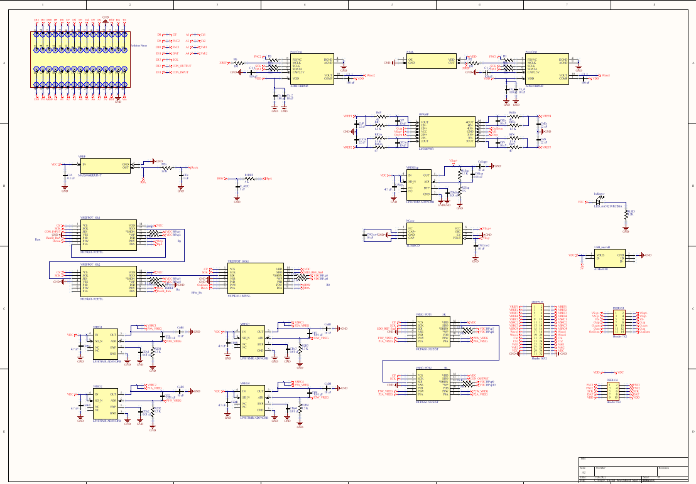

Slide 10
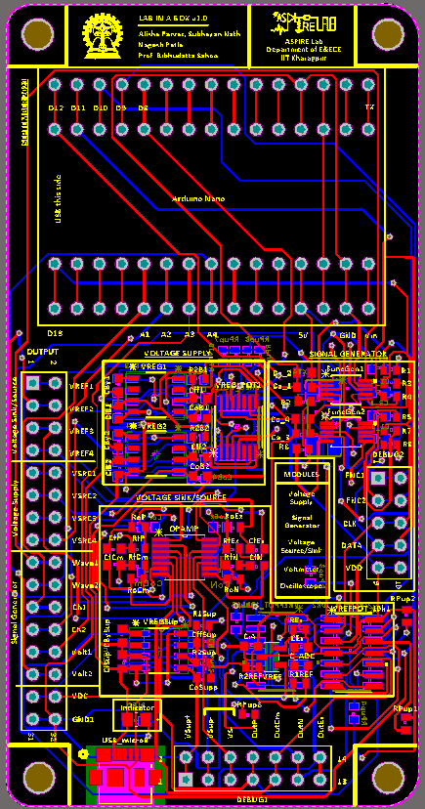
2D Layout of the Board
Made using Altium

Slide 11
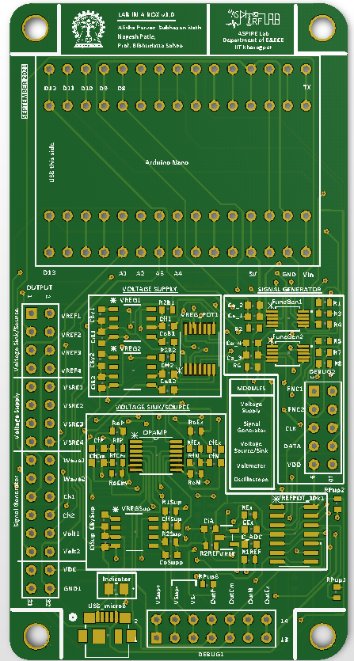
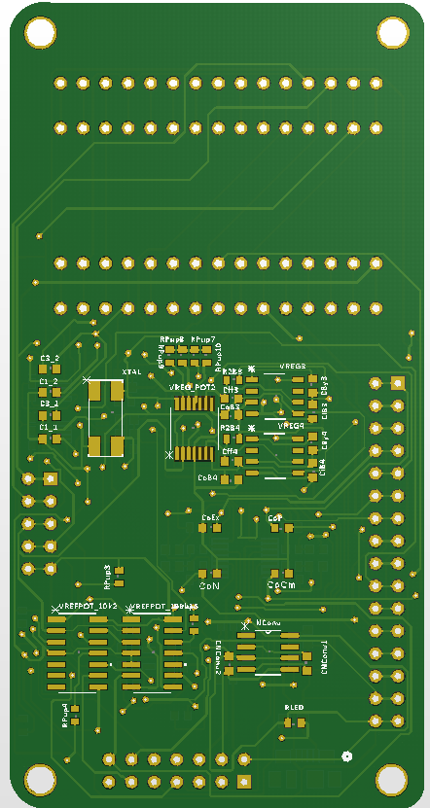
3D Layout of the PCB

Slide 12
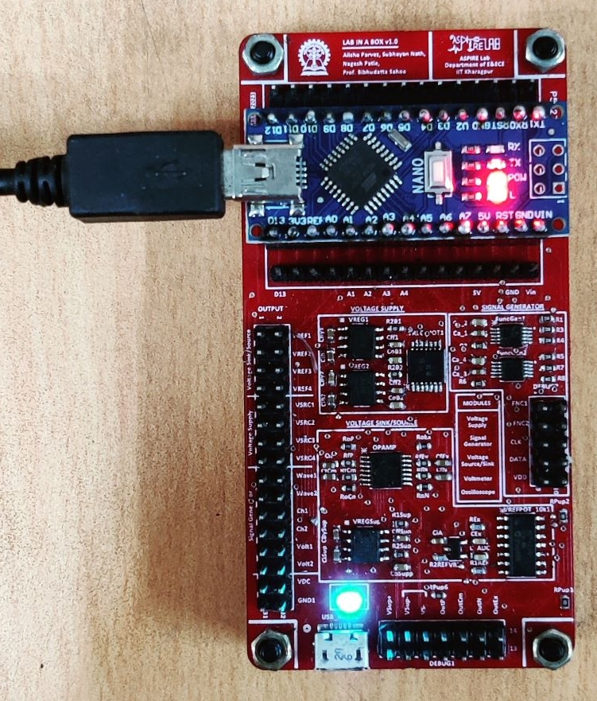
The Final Board
ECLABYAA in action at the lab

Slide 13
Outline of The GUI

Slide 14
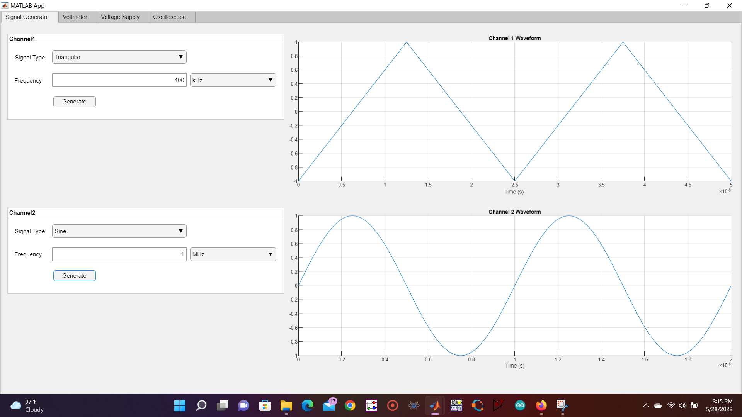
Signal Generator

Slide 15
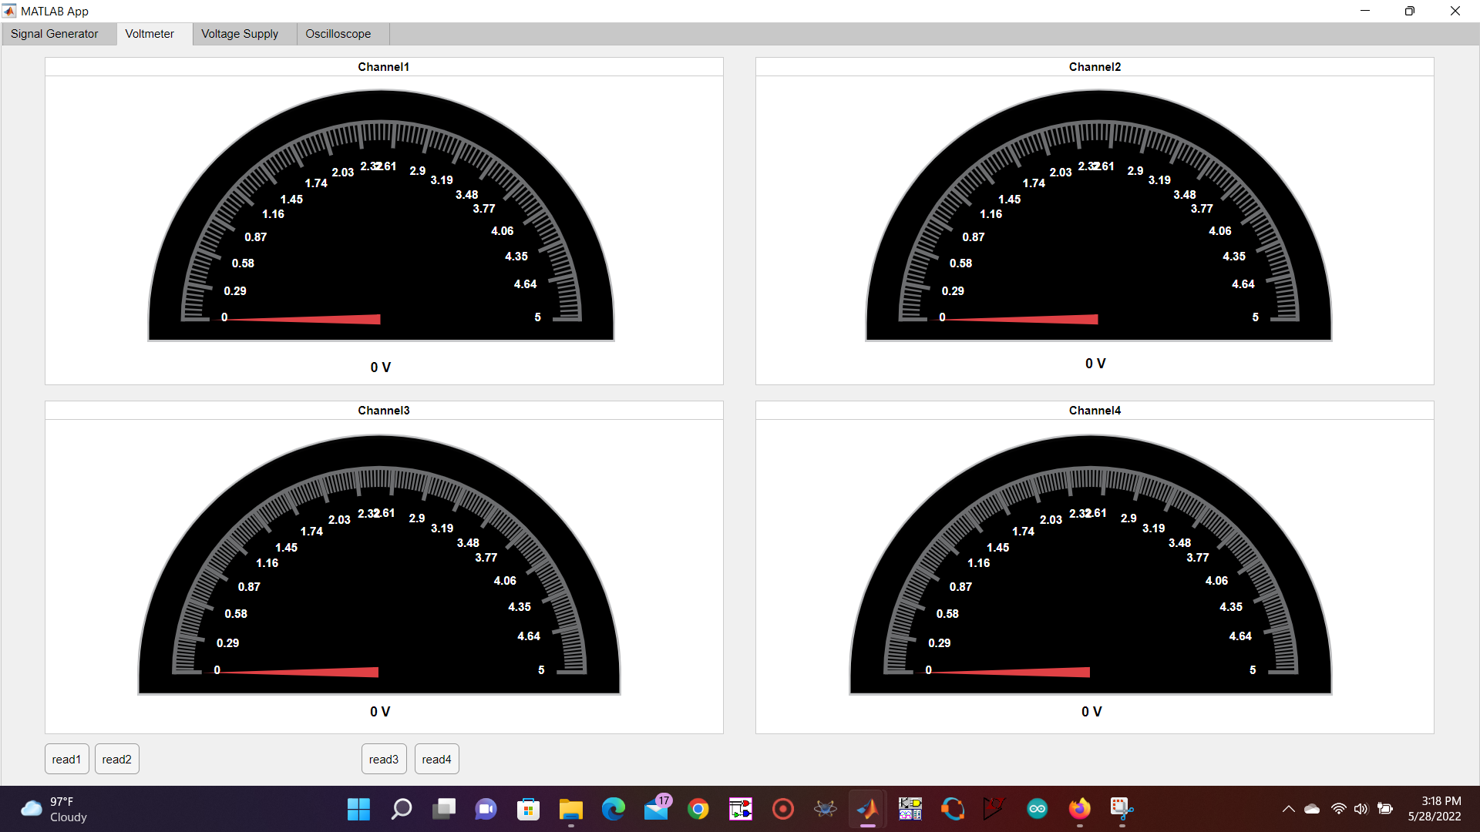
Voltmeter

Slide 16
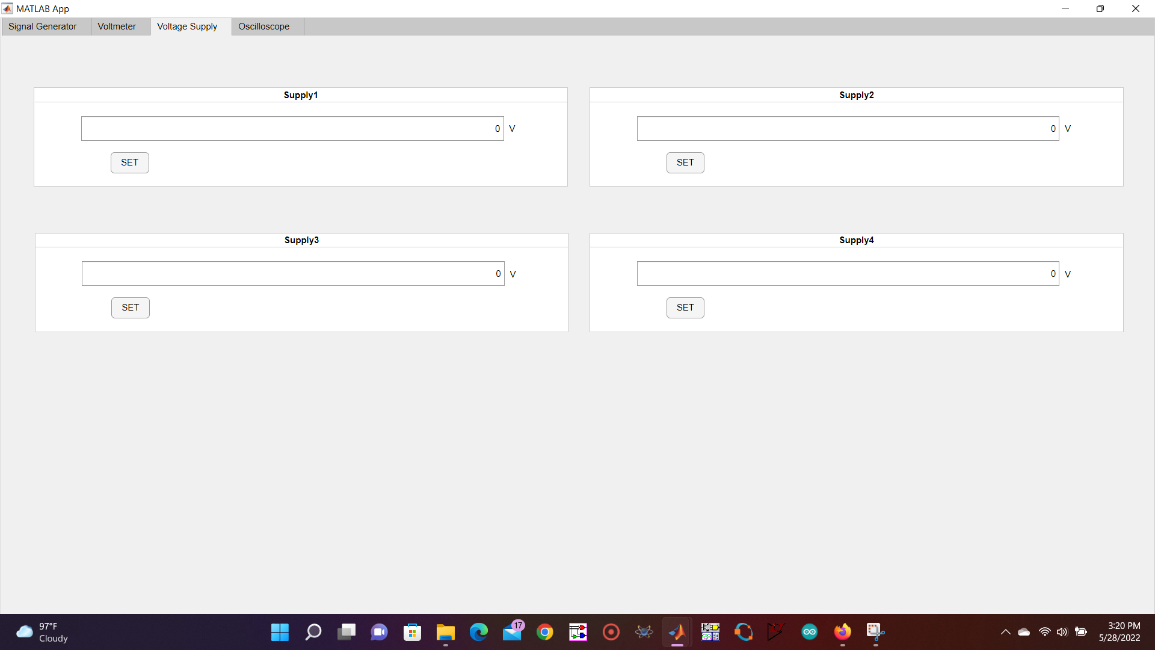
Voltage Supply

Slide 17
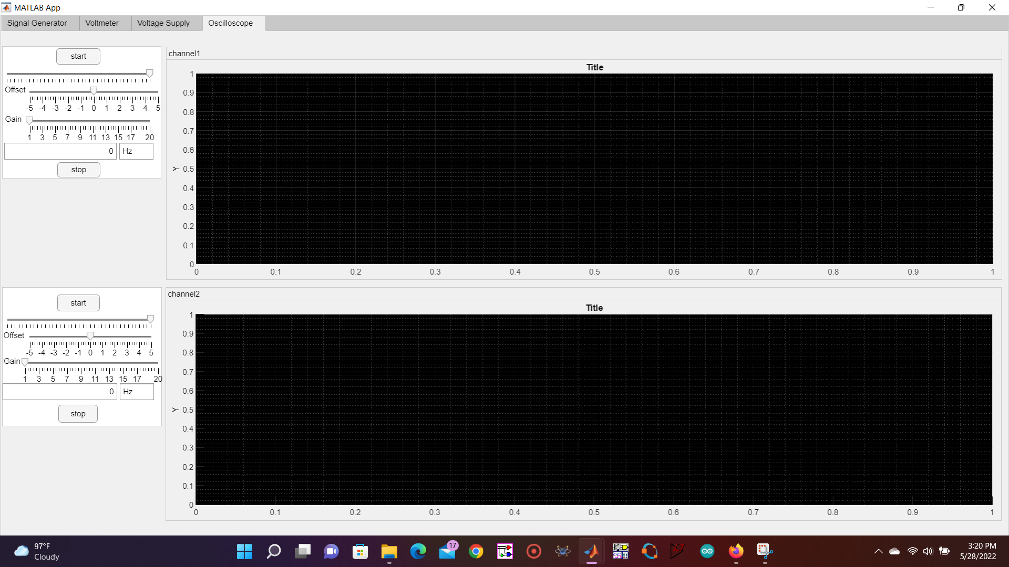
Oscilloscope

Slide 18
Improvements in the next version
Gain or Offset improvements for Signal Generator
Low frequency limit improvement for Oscilloscope
IC improvements for voltage generator
There is no ‘Gain’ and ‘Offset’ circuitry for the ‘Signal Generator’ part hence user can’t generate signal of arbitrary amplitude and offset level .The DDS signal generator chip AD9833 can generate a square wave of swing 0 to 5 V, a triangular wave of swing 0 to 600 mV and a sine wave of swing 0 to 600 mV by default.
To change this an op-Amp based ‘Gain’ and ‘Offset’ circuit will be included in next version of ‘ECLABYAA’
Currently the in built ADC of arduino Nano is being used to serve the purpose of an Oscilloscope but it has a very low sampling speed for which signals more than 5 KHz cannot be detected and analyzed properly in the current version of Oscilloscope in ‘ECLABYAA’.
To overcome that ,an external 2 channel high-speed 8-bit ADC (around 20 MSPS) will be used along with a serializer to enhance the sampling rate such that signals of high frequencies can also be analyzed in the Oscilloscope .
MCP42010 digital potentiometer IC with LM …. (voltage regulator) is used as voltage generator in this current version .But MCP42010 is too slow to be used with arduino in an ‘SPI connection’ which leads to some undesirable result sometimes.
To solve that MCP42010 digital potentiometer IC s will be replaced with appropriate IC s which will solve the speed mismatch issue .

Slide 19
Cost calculation for ECLABYAA

Slide 20
Components used | Cost w.r.t element14
AD9833 function generator (2) | 873.1*2 = 1746.2
100nF Capacitor (6) | 2.16*6=12.96
10uF Capacitor (13) | 4.17*13 = 54.21
0.01uF Capacitor (10) | 10.76*10 = 107.6
0.1 uF (1) | 3.13
4.7 uF (5) | 1.85*5 = 9.25
22 uF (4) | 8.92*4 = 35.68
1uF (2) | 0.928*2 = 1.856
LED_AA3021VRCBSA (1) | 5.00
Voltage inverter - TL7660CD (1) | 153.65
Quad OP-Amp - LM324PWR (1) | 26.76
5 KΩ Resistor (2) | 0.22*2 = 0.44

Slide 21
Components used | Cost w.r.t element14
1 KΩ Resistor (1) | 2.18
22 KΩ Resistor (1) | 0.22
1.5 KΩ Resistor (20) | 1.98*20 = 39.6
47Ω Resistor (4) | 5.41*4= 21.64
100Ω Resistor (8) | 2.18*8 = 17.44
USB_microB Port | 77.00
Voltage Regulator - LP3878MR-ADJ/NOPB (5) | 193.00*5 = 965.00
Voltage Reference - MAX6066BEUR+T (1) | 297.34
25 MHz crystal (1) | 61.64
Arduino Nano board (from local market) | 700.00
10KΩ dual digital potentiometer - MCP42010 (4) | 234.45*4 = 937.8
100KΩ dual digital potentiometer - MCP42100 (1) | 234.45
PCB making cost | 450.00

Slide 22
Total cost = 5961.46/-
(Excluding Soldering cost)

Slide 23
Thank You

