Slide 1
Computational analysis of single-cell RNA-seq data: Challenges and opportunities

Slide 2
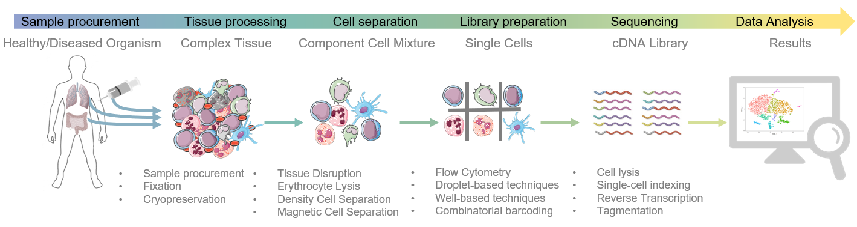
Single-cell RNA-seq experiments are highly complex

Slide 3
3’ vs full length libraries
mRNA
polyA tail
Cell-specific barcode
Transcript-specific barcode (UMI)
polyT primer
cDNA sequence
3’-targeted library
Full length library
e.g. DropSeq, SeqWell, 10x
Less sensitive (more dropouts)
Higher throughput
Allows more accurate quantification of transcript numbers
e.g. smartSeq2
More sensitive
Less throughput
Allows for isoform detection

Slide 4
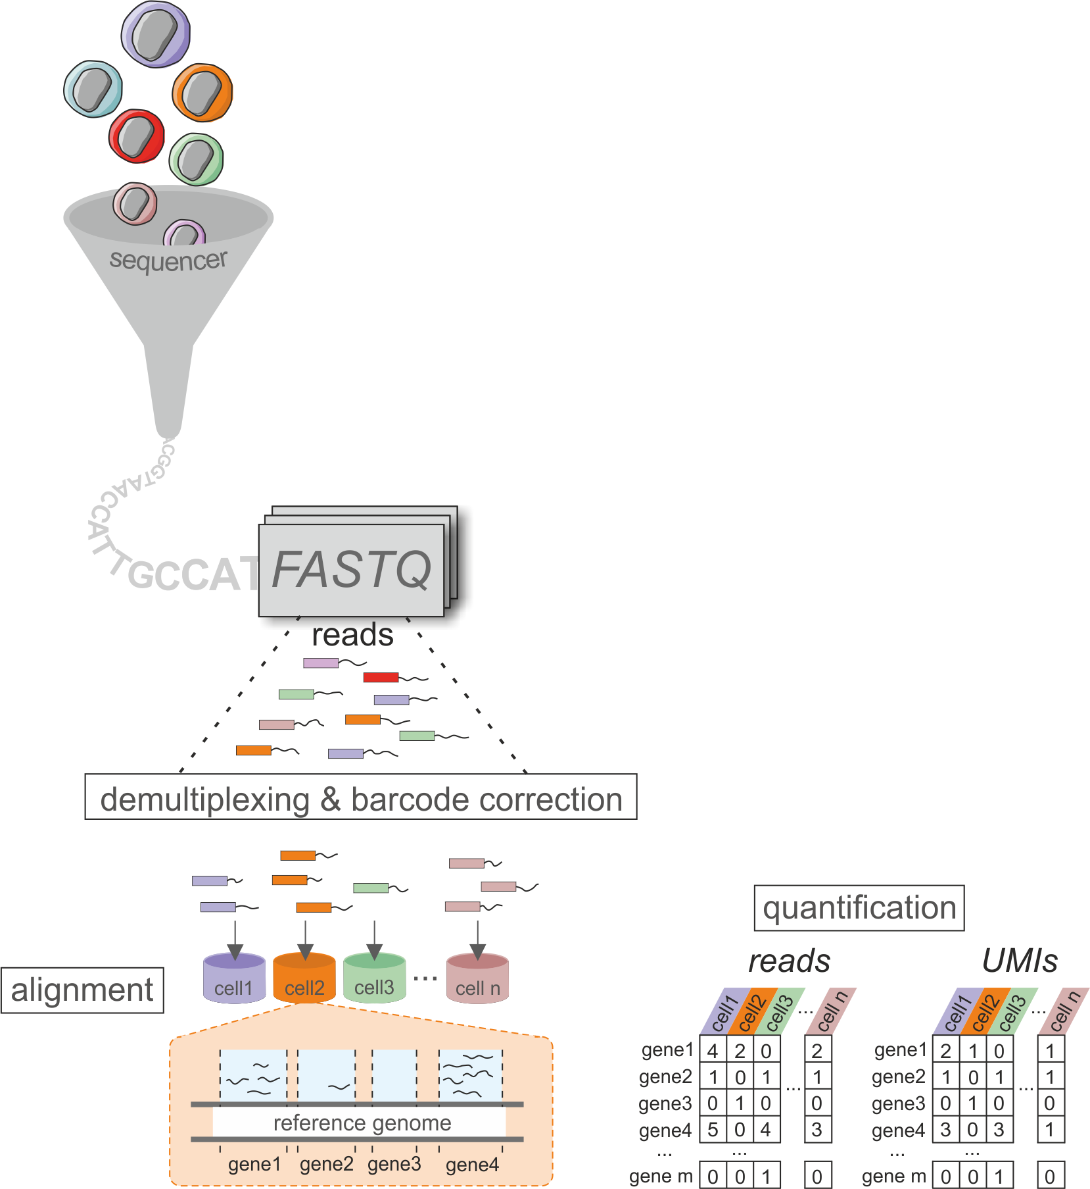
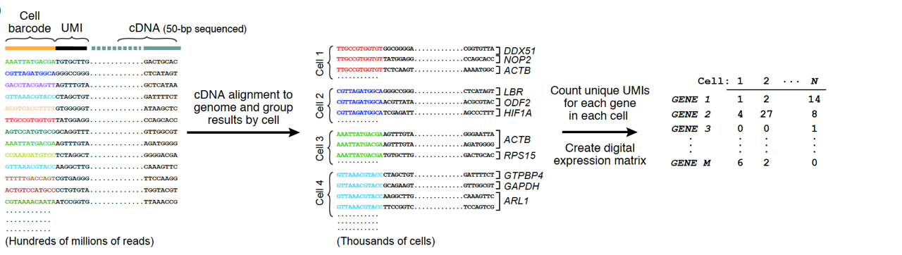
Standard data processing workflow
Complete pre-processing workflows, such as Cellranger (10X) or
dropseq tools (http://mccarrolllab.org/dropseq/) perform:
Bcl2 to FASTQ conversion including library demultiplexing
In e.g. SS2 each library corresponds to a single cell
FASTQ Quality Control (!)
For 3’ techniques: Read Demultiplexing for single cells
FASTQ files of read2 (cDNA reads) are converted to BAM
Cell and UMI Tags from read1 are stored as Tags in read2 BAM file
BAM file is converted back to fastq
Barcode Correction
Alignment
Quantification
STAR
http://mccarrolllab.org/wp-content/uploads/2015/05/figure-2D.png
A bioinformatic toolkit for single-cell mRNA analysis
Kevin Baßler, Patrick Günther, Jonas Schulte-Schrepping, Matthias Becker, Pawel Biernat
2019, Single Cell Methods, Springer Protocols

Slide 5
What are the challenges in scRNA-seq data analysis?
Generating a cDNA library from a single cell is tough:
High dropout rates, i.e. molecule is present but not captured
Variable capture rates across cells
Low quality cells where mRNA is not captured or lost
Duplicated reads from PCR duplication
What is genuine biology? What is technical noise?

Slide 6
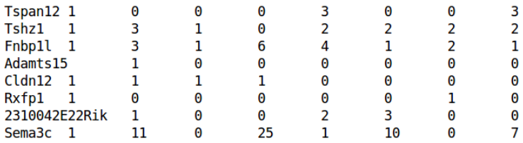
What does scRNA-seq data look like?
In its rawest form, FASTQ files after Illumina sequencing.
Align to reference genome
Count number of reads per gene
Output is a count matrix with genes as rows and cells as columns
~100-10^6 cells
~10000-40000 genes
Lots of zeros due to dropout or no expression
Variable total counts across cells – cell specific bias
Variable counts per gene – part biological, part technical
Slide adapted from Single-cell Analysis Workshop by Aaron Lin, CRUK Cambridge Institute

Slide 7
Performing a basic analysis of scRNA-seq data
Starting from a count matrix:
Quality control on the cells
Normalization and modeling of technical noise
Identification of variable genes
Dimensionality reduction and clustering
Biological interpretation
Slide adapted from Single-cell Analysis Workshop by Aaron Lin, CRUK Cambridge Institute

Slide 8
1. Quality control on the cells
Low quality cells generated by:
Insufficient sequencing
Failed reverse transcription
Damaged and apoptotic cells
We use the following metrics to identify and remove low quality cells:
Total number of expressed genes or UMI per cell
Percentage of reads mapped to mitochondrial genes
Slide adapted from Single-cell Analysis Workshop by Aaron Lin, CRUK Cambridge Institute

Slide 9
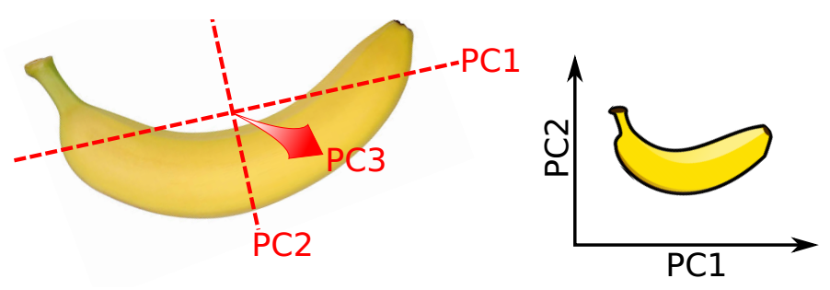
Dimensionality reduction with PCA
Identifies axes of maximal variance in high-dimensional data
Each subsequent principle component explains less variance
Use the first few PCs as a “summary” of the relevant variance in the data
Speed up downstream analyses by reducing dimensionality
Focus on biology, remove random noise in later PCs
Slide adapted from Single-cell Analysis Workshop by Aaron Lin, CRUK Cambridge Institute

Slide 10
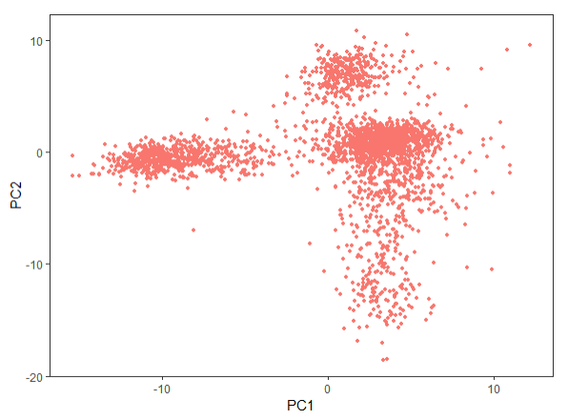
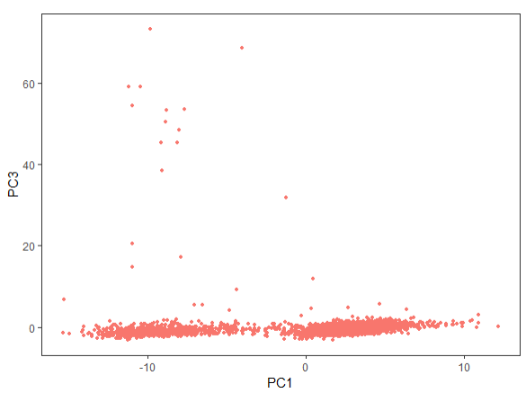
Visualization with PCA
The first 2-3 PCs can be directly used for visualization:
Simple and efficient, but limited resolution of complex structure!
Slide adapted from Single-cell Analysis Workshop by Aaron Lin, CRUK Cambridge Institute

Slide 11
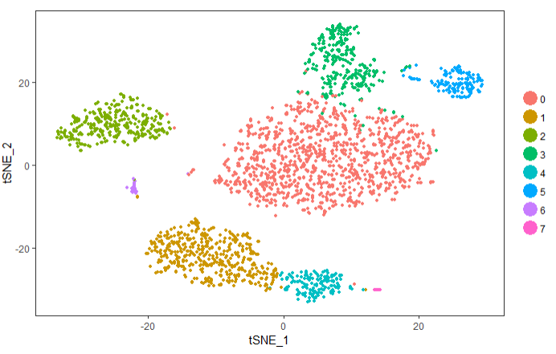
Visualization with t-SNE
T-distributed Stochastic Neighbor Embedding (t-SNE) is a machine learning algorithm for visualization. It is a nonlinear dimensionality reduction technique well-suited for embedding high-dimensional data for visualization in a low-dimensional space of two or three dimensions. Specifically, it models each high-dimensional object by a two- or three-dimensional point in such a way that similar objects are modeled by nearby points and dissimilar objects are modeled by distant points with high probability.
Finds a low-dimensional representation of high-dimensional data
Preserves distances to neighbouring cells
Non-linear: not-limited to straight axes
Slide adapted from Single-cell Analysis Workshop by Aaron Lin, CRUK Cambridge Institute

Slide 12
Why single-cell analyses?
What if a disease is caused by the local infiltration or loss of a specific cell type or a specific alteration of a cellular subset?
Bulk RNA-seq
Identification on single-cell level
allows targeted evaluation in bulk
Averaging the expression over a highly heterogeneous cell population leads to a loss of cell-type specific information and can masks specific alterations.
Preserving cell-type identity allows assessment of cellular heterogeneity and the identification of cell-type specific alterations of gene expression.

Slide 13
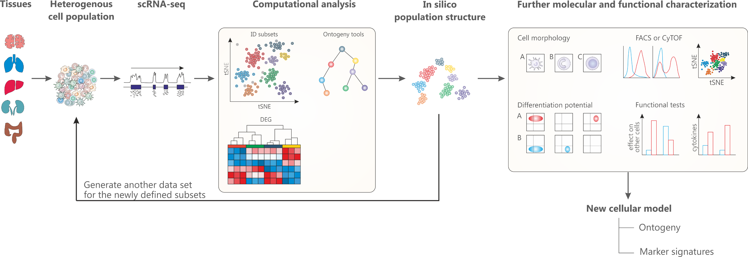
The power of single-cell RNA-seq
Schultze & Aschenbrenner, Sem Cell Dev Biol, 2018
Ginhoux*, Schultze*, et al. Nature Immunology, 2016
Single-cell RNA sequencing can reveal complex and rare cell populations, uncover regulatory relationships between genes, and track the trajectories of distinct cell lineages in development.

Slide 14
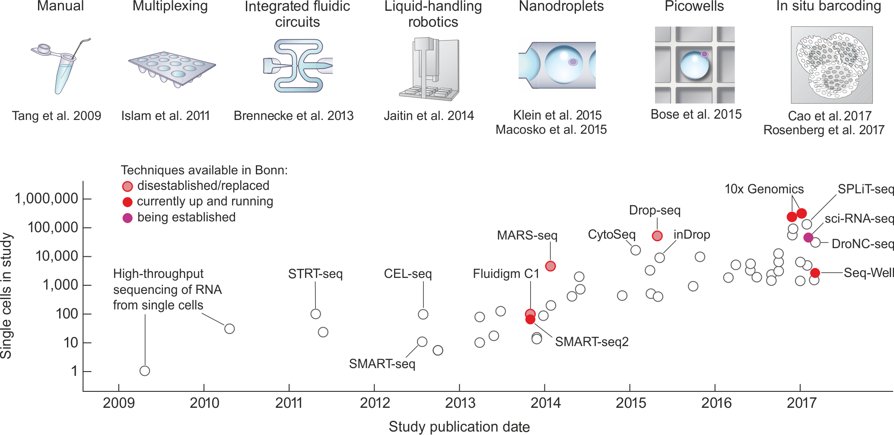
Evolution of single-cell RNA-seq methods
Modified from Exponential scaling of single-cell RNA-seq in the last decade, Svennson et al. 2017 arXiv

Slide 15
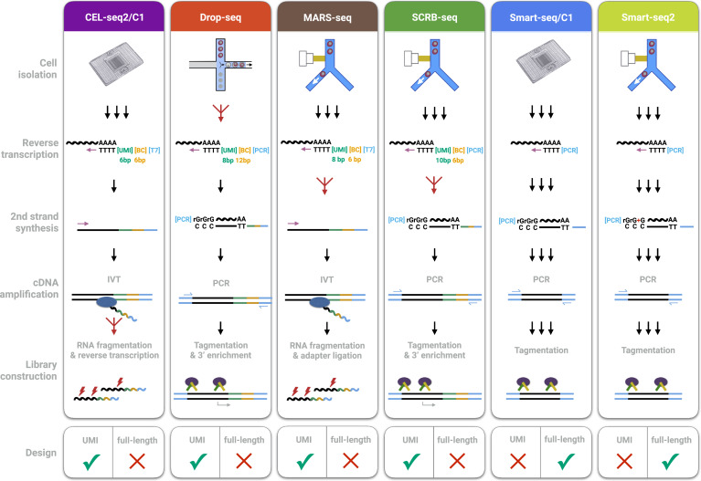
3’ vs full length libraries
Comparative Analysis of Single-Cell RNA Sequencing Methods, Ziegenhain et al., Molecular Cell 2017

