Slide 1
GPGPU Background
Hyesoon Kim

Slide 2
CPU pipeline
CPU pipeline
Increasing the performance in the execution units
Increase the issue width (superscalar)
Multi-threading
Front-end
Decode
Rename
Schedule
Execution
Write-back
Memory
F
D
S
E
W
F
D
S
E
W
F
D
S
E
W
F
D
S
E
W
F
D
S
E
W
F
D
S
E
W
F
D
S
E
W
F
D
S
E
W
F
D
S
E
W
F
D
S
E
W
F
D
S
E
W
F
D
S
E
W
F
D
S
E
W
F
D
S
E
W
F
D
S
E
W
F
D
S
E
W
5-stage pipeline
F
D
S
E
W
F
D
S
E
W
F
D
S
E
W
F
D
S
E
W
Multi-threading
Superscalar

Slide 3
GPU pipeline
Warp/Wave-front execution model
SPMD programming model (Single Program Multiple Data)
…
Tn
T4
Inst 1
T
T
T
T
T
T
T
T
T
T
T
T
T
T
T
T3
T
T1
T2
Inst 2
Inst 3
One warp
One warp
Inst 1
Inst 2
Inst 3
Fetch 1 instruction and each instruction has multiple threads are associated.
The group of instruction is called warp/wave-front
All threads have the same program

Slide 4
GPGPU Programming
Become popular with CUDA (Compute Unified Device Architecture)
CUDA (Based on Nvidia architectures)
Portland Group Compiler supports CUDA → x86
OpenCL

Slide 5
Quick Summary of CUDA Programming Model
SIMD or SIMT
Single instruction multiple data or single instruction multiple thread
Unified Memory space (global memory space)
Program hierarchy
Thread, block, kernel

Slide 6
Execution Model
Thread & Block
Block
Block
Inst 1
T
T
T
T
T
T
T
T
T
T
T
T
T
T
T
T
T
T
T
T
T
T
T
T
Inst 2
Inst 3
warp
warp
warp
warp
warp
warp
SM
SM
Kernel
Shared Memory
Shared Memory
SP
SP
SP
SP
SP
SP
SP
SP
Sing instruction multiple thread
Block = a group of thread which share “the shared memory space”
Warp
[the slide is from Hong&Kim ISCA’09]

Slide 7
Memory Data Indexing
SIMT-execution model
Use thread id and block id to index data
Let’s assume N=16, blockDim=4 → 4 blocks
0
1
2
3
4
5
6
7
8
9
10
11
12
13
14
15
+
0
1
2
3
4
5
6
7
8
9
10
11
12
13
14
15
+
+
+
+
blockIdx.x = 0
blockDim.x = 4
threadIdx.x = 0,1,2,3
Idx= 0,1,2,3
blockIdx.x = 1
blockDim.x = 4
threadIdx.x = 0,1,2,3
Idx= 4,5,6,7
blockIdx.x = 2
blockDim.x = 4
threadIdx.x = 0,1,2,3
Idx= 8,9,10,11
blockIdx.x = 3
blockDim.x = 4
threadIdx.x = 0,1,2,3
Idx= 12,13,14,15

Slide 8
1D, 2D, 3D data structures
A kernel is executed as a grid of thread blocks
Threads and blocks have IDs
So each thread can decide what data to work on
Block ID: 1D or 2D
Thread ID: 1D, 2D, or 3D
Loop index in sequential loop
Use thread ids, block ids
1D array index= c1*threadId.x + c2*block Id.x
2D array index = c1*threadId.x+c2*blockId.x+c3*threadId.y+c4*blockId.y
CPU code
for (ii = 0; ii < 100; ++ii) {
C[ii] = A[ii] + B[ii];
}
CUDA code
// there are 100 threads
__global__ void KernelFunction(…) {
int tid = blockDim.x * blockIdx.x + threadIdx.x;
int varA = aa[tid];
int varB = bb[tid];
C[tid] = varA + varB;
}

Slide 9
Memory Space
Thread, block, and kernel have different memory spaces
 | Space | ~= CPU
Local Memory | Within Threads | Stack
Shared Memory | Within Blocks | Distributed memory space
Global Memory | All | Centralized storage
Constant Memory | All | Centralized read-only storage (very small)
Texture Memory | All | Centralized read-only storage (medium size, 2D- cache)

Slide 10
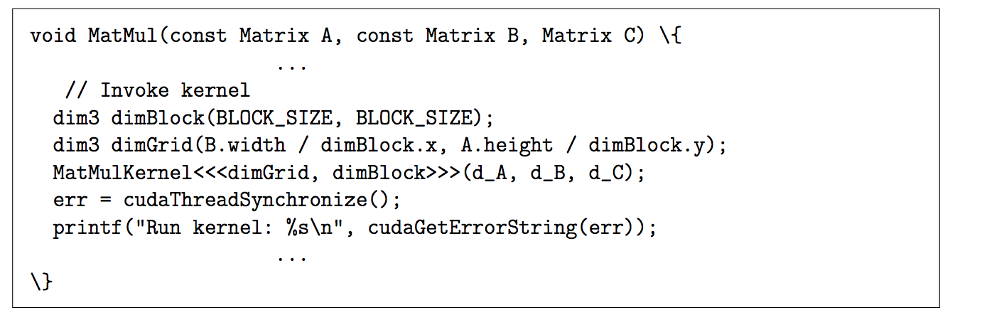
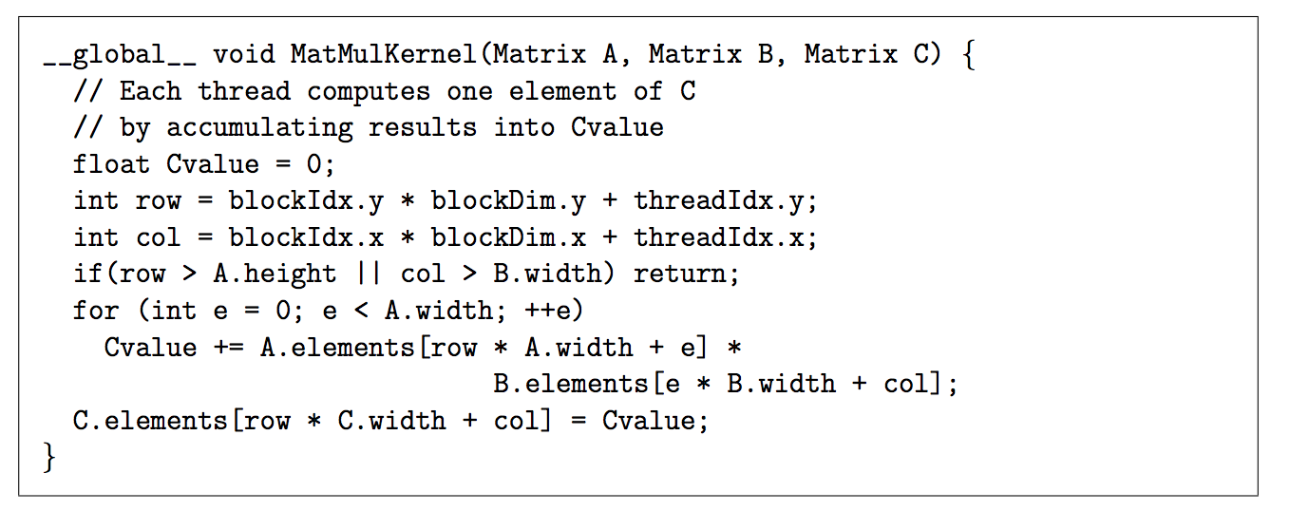
CUDA Program Example

Slide 11
Number of Threads Per CUDA Block
Host sets the number of threads per CUDA block. E.g., threadsPerBlock
Set up at the kernel launch time
# of registers per CUDA block
Compiler sets how many architecture registers are needed for each CUDA block (Will be covered later part of the course)
Typical CPU ISAs, # of registers per thread is fixed (e.g., 32), but in CUDA, this is flexible
Shared memory size is determined from the code
E.g., __shared__ int sharedMemory[1000]; → 4B*1000 = 4000B
kernelName<<<numBlocks, threadsPerBlock>>>(arguments);
Notes:
Host sets the number of threads per CUDA block. E.g., threadsPerBlock when it launches the kernel.
# of registers per CUDA block can be varied.
Why?
Because the compiler sets how many architecture registers are needed for each CUDA block
(This Will be covered later part of the course)
Typical CPU ISAs, # of registers per thread is fixed (e.g. 32) but in CUDA, this is flexible
Shared memory size is also determined from the code
E.g., __shared__ int sharedMemory[1000]; → 4B*1000 = 4000B
So the occupancy is determined by these factors.

Slide 12
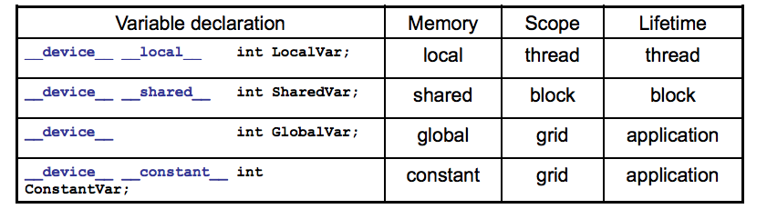
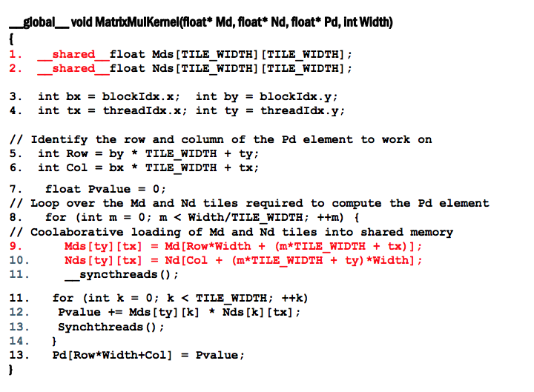
Shared Memory
From: http://accel.cs.vt.edu/files/lecture10.pdf

Slide 13
Synchronization Model
Bulk-Synchronous Parallel (BSP) program (Valiant [90])
Synchronization within blocks using explicit barrier
Implicit barrier across kernels
Kernel 1 → Kernel 2
C.f.) Cuda 3.x
Kernel1
Block
Block
barrier
barrier
Block
barrier
barrier
Barrier
Kernel2
Block
Block
barrier
barrier

Slide 14
OpenCL vs. CUDA
 | OpenCL | CUDA
Execution Model | Work-groups/work-items | Block/Thread
Memory model | Global/constant/local/private | Global/constant/shared/local + Texture
Memory consistency | Weak consistency | Weak consistency
Synchronization | Synchronization using a work-group barrier (between work-items) | Using synch_threads Between threads

Slide 15
GPU Pipeline
Scheduler
Active bit mask vectors/
score boarding
Fetch
One instruction for each warp
Multiple PC registers exist to support multi-threaded architecture
Round-robin scheduler
Wide execution width
I-cache
Fetch unit
Decoder
Register
Scheduler (Score boarding)
Lane 0
Lane 1
. . . . . .
Lane N-1
Memory
Memory access unit
Lane 0
Lane 1
. . . . . .
Lane N-1
Writeback

Slide 16
GPU Register Files
To accommodate a large number of active threads, a large number of register files are essential.
e.g.) 128 threads, 64 registers = 128X64 = 8KB
NVIDIA G80 architecture: 64KB registers (16KB cache)
Vortex: 32x # of threads per warp x # of warps x # or cores
Register read BW
1Tflop/s peak performance (2 read, 1 write)
-2T * 32B/s = 64TB/s register read BW
Highly banked register files

Slide 17
Register File Structures: Multiple Banks
Th 0
…
Th N-1
Warp 0’s reg file
. . . . . .
Warp ID.Reg ID
. . . . . .
. . .
Register files
Warp M-1’s reg file
. . . . . .
Lane 0
Lane 1
. . . . . .
Lane N-1
Writeback
All threads in a warp read the register values in parallel.
Register is indexed with register ID, warp ID
Multiple banks (Narasiman’s figure)

Slide 18
Handling Branch Instructions
A reduction example
What about other threads?
What about different paths?
0
1
2
3
4
5
6
7
If (threadId.x%==2)
0
2
4
6
If (threadId.x%==4)
0
4
If (threadId.x%==8)
0
A
If (threadid.x>2) {
do work B}
else {
do work C
}
B
C
Divergent branch!
D
From Fung et al. MICRO ‘07

Slide 19
Split/Join
Compiler inserts split/join
Split:
Put tmask in the ipdom stack (do work c part}
Put next PC in the stack (not-taken path. // do work c part )
Join
Pop from a stack
If (threadid.x>2)
// split
{
do work B
}
else {
// join
do work C
}

Slide 20
How Many CUDA Blocks on One Stream Multiprocessor?
Occupancy
3 to 1?
2 to 1?
Grid 0
SM
SM
SM
SM
Block (0,0)
Block (1,0)
Block (2,0)
SM
SM
SM
SM
Block (0,1)
Block (1,1)
Block (2,1)
Cache
SM
SM
SM
SM
SM
SM
SM
SM
How many CUDA blocks can run on one streaming multiprocessor?
Multiple blocks per SM

Slide 21
Occupancy
How many CUDA blocks can be executed on one SM is decided by following parameters
# of registers, shared memory, # of threads
Exact H/W configurations are varied by GPU microarchitecture
E.g., HW: each SM can execute 256 threads, 64K registers, 32 KB shared memory
SW: one CUDA block: 32 threads and 2KB shared memory and each thread has 64 registers
Constrain by running threads: 256/32 = 8 CUDA blocks
Constrain by register size = 64*1024/(64*32) = 32 CUDA blocks
Constrain by shared memory = 32KB/2KB = 16 CUDA blocks
Final answer: 8 CUDA blocks per SM
Notes:
How many CUDA blocks can be executed on one SM can be decided by following: # of registers, shared memory, # of threads
Exact HW configuration are varied by GPU microarchitecture and different by each generation.
Let’s take a closer look at one example. We'll explore the example with 2 hundred 56 threads, 64KB of register files, and 32KB of shared memory.
In the software side, Each CUDA block has 32 threads and 2KB shared memory and each thread has 64 registers.
If the occupancy is constrained by running number threads, the total number of CUDA blocks per SM would be 256/32 = 8 CUDA blocks
If the occupancy is constrained by registers it will be 64*1024/(64*32) = 32 CUDA blocks
If the occupancy is constrained by shared memory it will be 32KB/2KB = 16 CUDA blocks
The final answer is the minimum of all constrains so the final answer is 8 CUDA blocks per SM

Slide 22
Why Do We Care about Occupancy?
Higher Occupancy means more parallelism.
Utilization: Utilizing more hardware resources generally leads to better performance.
Exceptional cases will be studied in later lectures.
Block
Block
Block
Block
Block
Block
Block
Block
Block
Block
Block
Block
SM
SM
SM
SM
SM
SM
SM
SM
Case (b): Each SM runs two CUDA block (4 threads per block)
Case (a): Each SM runs one CUDA block (6 threads per block)
Notes:
Why Does Occupancy Matter?
This is because higher occupancy means more parallelism.
Utilizing more hardware resources generally leads to better performance. <click>
In case (a) only one CUDA block runs on each SM and each CUDA block has 6 threads . <click>
In case (b) each SM can execute two blocks but each block has only 4 threads so total 8 threads per block which actually runs more threads than case (a)

Slide 23

GPU Pipeline (1)
add r1, r1, 1
12
I-cache
13
Front-end
Decode
RF
schedule
Execution
Write-back
14
add r1, r1, 1
add r1, r1, 1
add r1, r1, 1
Memory
15
 | PC value
#1 (b:1, T1-T4) | 0x8000
#2 (b:1, T5-T8) | 0x8004
#3 (b:2, T1-T4) | 0x8000
#4 (b:2, T5-T8) | 0x800A
Shared Memory
add r1, r1, 1
 | Src 1 |  | Src 2
W1 | v | r | v | r
W2 | v | r | v | r
W3 | v | r | v | r
W4 | v | r | v | r
 | Src 1 |  | Src 2
W1 | v | r | v | r
W2 | v | r | v | r
W3 | v | r | v | r
W4 | v | r | v | r
 | Src 1 |  | Src 2
W1 | v | r | v | r
W2 | v | r | v | r
W3 | v | r | v | r
W4 | v | r | v | r
 | Src 1 |  | Src 2
W1 | v | r | v | r
W2 | v | r | v | r
W3 | v | r | v | r
W4 | v | r | v | r
 | Th1 | Th2 | Th3 | Th4
R1 | 11 | 12 | 13 | 14
R2 | 2 | 2 | 2 | 2
R3 | 3 | 4 | 13 | 15
R4 | 23 | 24 | 32 | 33
11
1
12
1
13
1
14
1
add r1, r1, 1
0x8000 | add r1, r1, 1
0x8004 | sub r2, r,2,1
0x8008 | mov r1, tid.x
0x800A | mov r2, ctaid.x
0x8010 | ld.shared r1 [A]
tid.x: special register to store thread ID within a block
ctaid.x: special register to store block ID within a grid
Notes:
Here is a GPU pipeline
<click>
And here it shows PC values for each warp. In this example, there are 4 warps and the first warp should fetch from PC value 0x8000. and the first warp is from Block 1 and thread 1 to 4. The second warp is from block 1 as well and thread 5 to 8.
The 3rd warp is from block 2 and thread 1 to 4 and 4th warp is block 2 thread 5 to 8.
<click>
Here it shows register values for block 1
<click>
Here it shows an I-cache memory address and the instructions. <click>
You see tid.x at 0x8008. tid.x is special register to store thread ID within a block .
And an instruction at 0x800A has ctaid, which is another special register to store block ID within the grid
<click> Here is a scoreboard.
<click> The front-end fetches an instruction from 0x8000
<click>
Only one instruction for the entire warp.
<click>
And this one instruction is decoded in the decode stage.
<click>
Since the instruction has a constant value #1, the value is sent to all threads within a warp.
<click>
In the next stage, the processor access the register file and it reads r1 value form threads 1 to 4.
<click>
All source operands are ready <click>
So the scheduler selects warp 1 and then it will be executed <click>
The results will be written back <click> at the write back stage.

Slide 24
GPU Pipeline (2)
sub r2, r2, 1
1
I-cache
1
Front-end
Decode
RF
schedule
Execution
Write-back
1
sub r2, r2, 1
sub r2, r2, 1
sub r2, r2, 1
Memory
1
 | PC value
#1 (b:1, T1-T4) | 0x8000
#2 (b:1, T5-T8) | 0x8004
#3 (b:2, T1-T4) | 0x8000
#4 (b:2, T5-T8) | 0x800A
Shared Memory
sub r2, r2, 1
One lane is not shown
 | Src 1 |  | Src 2
W1 | v | r | v | r
W2 | v | r | v | r
W3 | v | r | v | r
W4 | v | r | v | r
 | Src 1 |  | Src 2
W1 | v | r | v | r
W2 | v | r | v | r
W3 | v | r | v | r
W4 | v | r | v | r
 | Src 1 |  | Src 2
W1 | v | r | v | r
W2 | v | r | v | r
W3 | v | r | v | r
W4 | v | r | v | r
 | Th1 | Th2 | Th3 | Th4 | Th5 | Th6 | Th7 | Th8
R1 | 12 | 13 | 14 | 15 | 16 | 17 | 18 | 19
R2 | 3 | 3 | 3 | 3 | 2 | 2 | 2 | 2
R3 | 3 | 4 | 13 | 15 | 23 | 32 | 37 | 23
R4 | 23 | 24 | 32 | 33 | 11 | 7 | 8 | 5
2
1
2
1
2
1
0x8000 | add r1, r1, 1
0x8004 | sub r2, r,2,1
0x8008 | mov r1, tid.x
0x800A | mov r2, ctaid.x
0x8010 | ld.shared r1 [A]
tid.x: special register to store thread ID within a block
ctaid.x: special register to store block ID within a grid
Notes:
Now, let’s look at the 2nd warp.
It fetches an instruction from warp #2 which is block 1 and threads 5 to 8. <click>
Again the instruction is decoded. The constant value #1 is broad casted to all source operand buffers. <click> Here we omitted values for one execution unit due to the space limitation.
<click>
In the next stage, the processor access the register file and it reads r2 value form threads 5 to 8.
<click>
In this example all source values are all 2.
All source operands are ready <click>
So the scheduler selects warp 2 and then it will be executed Even those they are all operating the same values, the hardware performs the same work for all threads in a warp<click>
The results will be written back <click> at the write back stage just like the previous example.

Slide 25
GPU Pipeline (3)
mov r2, ctaid.x
2
I-cache
2
Front-end
Decode
RF
schedule
Execution
Write-back
2
Memory
2
 | PC value
#1 (b:1, T1-T4) | 0x8000
#2 (b:1, T5-T8) | 0x8004
#3 (b:2, T1-T4) | 0x8000
#4 (b:2, T5-T8) | 0x800A
Shared Memory
One lane is not shown
 | Src 1 |  | Src 2
W1 | v | r | v | r
W2 | v | r | v | r
W3 | v | r | v | r
W4 | v | r | v | r
 | Src 1 |  | Src 2
W1 | v | r | v | r
W2 | v | r | v | r
W3 | v | r | v | r
W4 | v | r | v | r
 | Src 1 |  | Src 2
W1 | v | r | v | r
W2 | v | r | v | r
W3 | v | r | v | r
W4 | v | r | v | r
 | Th1 | Th2 | Th3 | Th4 | Th5 | Th6 | Th7 | Th8
R1
R2
R3
R4
Block 2 register file
2
2
2
0x8000 | add r1, r1, 1
0x8004 | sub r2, r,2,1
0x8008 | mov r1, tid.x
0x800A | mov r2, ctaid.x
0x8010 | ld.shared r1 [A]
tid.x: special register to store thread ID within a block
ctaid.x: special register to store block ID within a grid
Notes:
Now let’s assume the processor fetches from warp 4.
The PC address is 0x800A, which moves ctaid.x to r2.
The warp 4’s block id is 2, so ctaid.x value is also 2.
<click>
Ctaid.x value is read and stored inside the scoreboard.
<click> These values will be stored to R2 at the write back stage as shown in this animation.

Slide 26
GPU Pipeline (4)
mov r2, ctaid.x
5
I-cache
6
Front-end
Decode
RF
schedule
Execution
Write-back
7
Memory
8
 | PC value
#1 (b:1, T1-T4) | 0x8000
#2 (b:1, T5-T8) | 0x8004
#3 (b:2, T1-T4) | 0x8000
#4 (b:2, T5-T8) | 0x8008
Shared Memory
One lane is not shown
 | Src 1 |  | Src 2
W1 | v | r | v | r
W2 | v | r | v | r
W3 | v | r | v | r
W4 | v | r | v | r
 | Src 1 |  | Src 2
W1 | v | r | v | r
W2 | v | r | v | r
W3 | v | r | v | r
W4 | v | r | v | r
 | Src 1 |  | Src 2
W1 | v | r | v | r
W2 | v | r | v | r
W3 | v | r | v | r
W4 | v | r | v | r
 | Th1 | Th2 | Th3 | Th4 | Th5 | Th6 | Th7 | Th8
R1
R2
R3
R4
Block 2 register file
6
7
8
0x8000 | add r1, r1, 1
0x8004 | sub r2, r,2,1
0x8008 | mov r1, tid.x
0x800A | mov r2, ctaid.x
0x8010 | ld.shared r1 [A]
tid.x: special register to store thread ID within a block
ctaid.x: special register to store block ID within a grid
Notes:
Now, let’s assume that instead of 0x800A, the processor fetches from 0x8008 for warp 4.
The instruction has tid.x since this is for threads 5 to 8, tid.x value will be 4,5,6,8,
The tid.x values will be read and stored in the score board.
<click> In the write-back stage, all these values will be written back to R1 as shown in this animation. <click>

Slide 27
Mask Bits
id | Mask bit
w1 | 1111
w2 | 1110
w3 | 0111
w4 | 1111
w5 | 1111
What if we do not need to execute all 4 threads?
Mask bits tell which threads are active.
 | Src 1 |  | Src 2
w1 | v | r | v | r
w2 | v | r | v | r
w3 | v | r | v | r
w4 | v | r | v | r
w5 | v | r | v | r
 | Src 1 |  | Src 2
w1 | v | r | v | r
w2 | v | r | v | r
w3 | v | r | v | r
w4 | v | r | v | r
w5 | v | r | v | r
 | Src 1 |  | Src 2
w1 | v | r | v | r
w2 | v | r | v | r
w3 | v | r | v | r
w4 | v | r | v | r
w5 | v | r | v | r
 | Src 1 |  | Src 2
w1 | v | r | v | r
w2 | v | r | v | r
w3 | v | r | v | r
w4 | v | r | v | r
w5 | v | r | v | r
V
V
V
V
V
V
V
V
V
V
V
V
V
V
V
V
V
V
Notes:
What if we do not need to execute all 4 threads?
GPU stores information tells which thread or lane is active.
<click> one ALU execution path is called lane.
Active thread performs actual computation and inactive threads will not do any work.
Mask bits tell which threads are active or not. <click>
Here scoreboard shows register values and ready bits.
Warp 1 has 1111 in the mask bits, <click> which means all threads in the warp1 will actually perform the work. <click>
warp1 is selected and <click> is executed.
In the warp 2 case, the mask bit is 1110 <click>. So only the first 3 lanes (or threads) will do the work. <click> <click>

Slide 28
Summary
GPUs execute many threads as a group (warp/wave front)
GPU provides features to handle multiple threads concurrently and also time multiplexing
Massive thread level parallelism → massive memory level parallelsim

