Slide 1
Vortex Code Structure
Blaise Tine

Slide 2
Agenda
Source Tree
Documentation
Hardware
Synthesis
Simulation
Runtime
Kernel
Testing and Integration
Configuration
Coding Convention
Debugging Vortex
Multi-threading

Slide 3
Source Tree
Reference: /vortex
/ci: Continuous integration
/doc Documentation
/hw Hardware
/runtime GPU runtime
/kernel Kernel library
/sim Simulation
/tests Testing

Slide 4
Documentation
Reference: /vortex/doc
Vortex.md
Codebase Layout
Microarchitecture
Cache Subsystem
Software
Simulation
FPGA Setup Guide
Debugging

Slide 5
Hardware
Reference: /vortex/hw
/dpi Verilog DPI library
/scripts Scripting tools
/syn Synthesis tree
/unit_tests Hardware unit tests

Slide 6
Hardware - RTL
Reference: /vortex/rtl
/afu Command processor
/core Core components
/cache Cache source tree
/fpu Floating-point cores
/mem Memory system
/interfaces Module interfaces
/libs Library modules

Slide 7
Hardware – Processor Dependency Tree
scheduler
sharedmem
fetch
ibuffer
decode
core
scoreboad
issue
operands
socket
socket
core
execute
alu_unit
Vortex
cluster
socket
core
lsu_unit
commit
socket
socket
fpu_unit
icache
sfu_unit
Mem_unit
dcache
L2 cache

Slide 8
Hardware – AFU
Reference: /vortex/rtl/afu
opae: Intel OPAE
xrt: Xilinx XRT
vortex
vx_to_mem
OPAE
cci_to_mem
avs_wrapper
AFU
XRT
vortex
afu_ctrl
Notes:
Xilinx Chipscope

Slide 9
Hardware – Cache
Reference: /vortex/rtl/cache
nc_bypass: cache bypassing
flush_ctrl: flushing
bank_sel: bank select
rsp_merge: response merge
nc_bypass
flush_ctrl
tag_access
bank_sel
data_access
cache
bank
mshr
rsp_merge

Slide 10
Synthesis
Reference: /vortex/hw/syn
/altera Altera FPGA synthesis
/xilinx Xilinx FPGA synthesis
/yosys Yosys synthesis
/synopsys Synopsys
/modelsim Modelsim

Slide 11
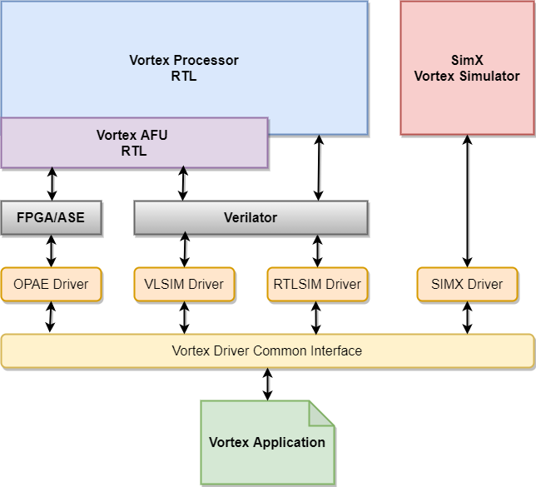
Simulation
Reference: /vortex/sim
rtlsim: Processor RTL
vlsim: AFU RTL
simX: cycle-level

Slide 12
Kernel
Reference: /vortex/kernel
/linker Loader scripts
/src Kernel API sources
start.* Startup routine
print.* Standard out print
spawn.* Tasks scheduler
perf.* Performance counter logger
syscalls.* System calls handling

Slide 13
Runtime
Reference: /vortex/runtime
/stub Stub library for linking
/opae OPAE FPGA runtime
/xrt XRT simulation runtime
/rtlsim RTL Simulation runtime
/simx SimX runtime

Slide 14
Testing - Coverage
Reference: /vortex/tests
/kernel kernel tests
/regression C++ applications tests
/opencl OpenCL benchmarks
/riscv RISC-V conformance tests

Slide 15
Testing - Integration
Reference: /vortex/ci
blackbox.sh Apps runner driver
regression.sh CI regression suite
Test_compiler.sh CI compiler suite
prebuild.sh Build prebuilt binaries
toolchain_install.sh Install prebuild binaries
Usage: <tool> --help

Slide 16
Configuration - VX_config.vh
Reference: /vortex/hw/rtl/VX_config.vh
Contains all HW configuration parameters
e.g. NUM_CORES, NUM_THREADS, L2_ENABLE
Autogen C++ header: VX_config.h
$ make –s

Slide 17
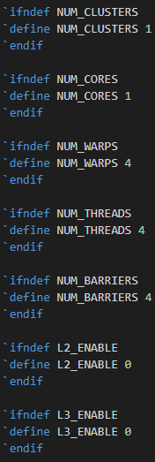
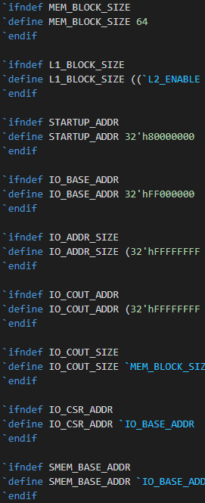
Configuration – VX_config.vh (2)
Startup
Memory
IO
COUT
SMEM
Caches
Enable/disable

Slide 18
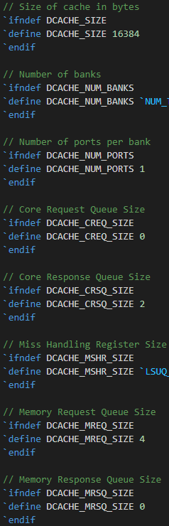
Configuration – VX_config.vh (3)
Cache config
Banks
MSHR size
Queues sizes

Slide 19
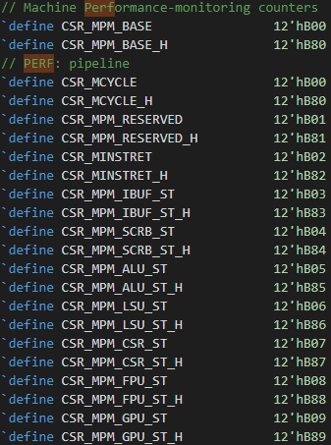
Configuration – VX_types.vh
CSRs
Control status regs
Performance counters
DCRs
Device config regs
Perf monitor class
Startup location

Slide 20
Configuration - Simulation
Reference: /vortex/hw/VX_config.h
Auto-generated
Consumed by all SW components
Vortex kernel library
Vortex runtime
All simulators
Blackbox examples:
./ci/blackbox.sh --cores=2 --warps=2 –app=vecadd
CONFIGS=“-DNUM_CORES=2 -DNUM_WARPS=2“ ./ci/blackbox.sh --app=vecadd
CONFIGS="-DMEM_LATENCY=100“ ./ci/blackbox.sh --app=vecadd

Slide 21
Configuration - Synthesis
Reference: /vortex/hw/syn/opae
FPGA build scripts allows customization
Use parameters from VX_config.vh
FPGA synthesis examples:
CONFIGS="-DNUM_THREADS=4“ make fpga
CONFIGS="-DNUM_WARPS=4“ make fpga
CONFIGS=“-DPERF_ENABLE=4“ make fpga

Slide 22
Coding Convention – Naming
Benefits of coding standard
Self-documentation
Refactoring
Extensibility
Module files: VX_<module>.sv
Interfaces: VX_<interface>_if.sv
Header: VX_<name>.vh
Data Types: VX_<name>_types.vh

Slide 23
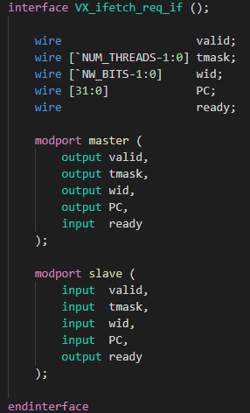
Coding Convention - Interfaces
Reference: /vortex/hw/rtl/interfaces
Grouping of related signals
Master/slave interconnect
Master: outgoing
Slave: incoming

Slide 24
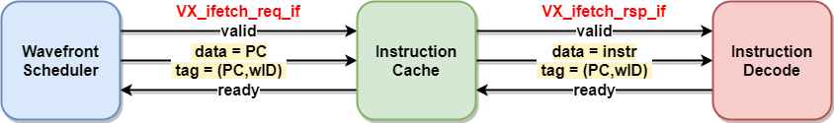
Coding Convention – Handshaking
Elastic Pipeline Pattern
valid/ready interfaces
out: data Data to transfer
out: valid Producer has valid data to transfer
in: ready Consumer is ready to accept data
fire => valid && ready;

Slide 25
Debugging Vortex - Modes
Three debugging modes
Cycle-Level Debugging
Using Simx simulator
RTL Debugging
Using RTLsim or OpaeSim simulators
FPGA Debugging
Proprietary scope analyzer (Altera)
Xilinx ChipScope (Xilinx)

Slide 26
Debugging Vortex - SimX
When to use this mode?
User application debugging
Vortex S/W stack debugging
New SimX extension
Example: debug levels=3
$ blackbox.sh --driver=simx --app=demo –debug=3

Slide 27
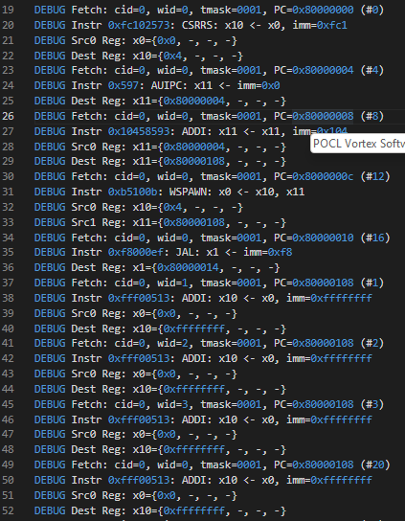
Debugging Vortex – SimX (2)
Generated output: run.log
Instructions trace
Fetched instruction
Source operands
Destination result
Memory trace
Stalls with info

Slide 28
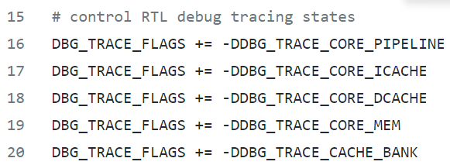
Debugging Vortex - RTL
When to use this mode?
RTL code debugging
Command lines
$ blackbox.sh --driver=rtlsim --app=demo –debug=1
Controlling debug trace via Makefile
vortex/sim/rtlsim/Makefile

Slide 29
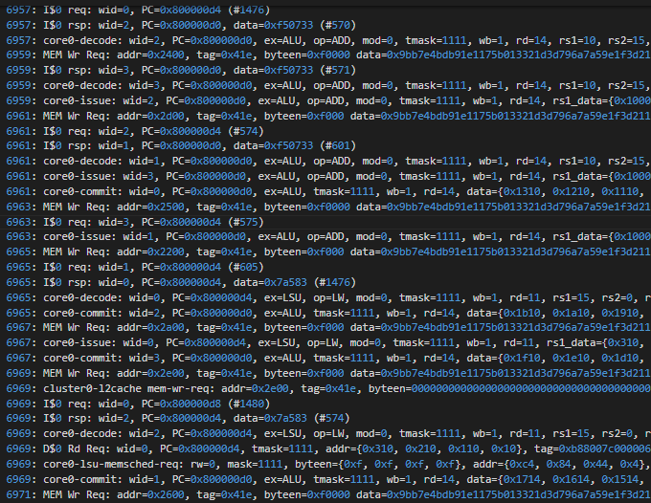
Debugging Vortex – RTL (2)
Generated output: run.log
Instructions trace
Fetched instruction
Source operands
Destination result
Memory trace
Stalls with info
Waveform: trace.vcd
Detail is controllable
Using Verilator annotation
vortex/sim/rtlsim/Makefile

Slide 30
Debugging Vortex - FPGA
When to use this mode?
FPGA debugging
The EDA tool lacks a logic analyzer
Synthesis
$ CONFIGS=-DSCOPE=1 make fpga-4c
Runtime
$ blackbox.sh --driver=fpga --app=demo –scope
Generated Output: trace.vcd

Slide 31
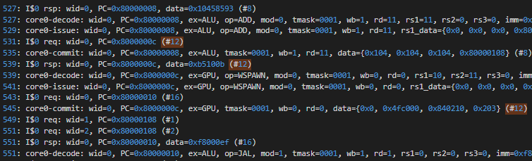
Debugging Vortex - UUID
Universal Unique Identifier
Static number across runs
Track instruction life cycle
From fetch to commit
Compare traces
Compare RTL with SimX
Simx Trace
RTL Trace

Slide 32
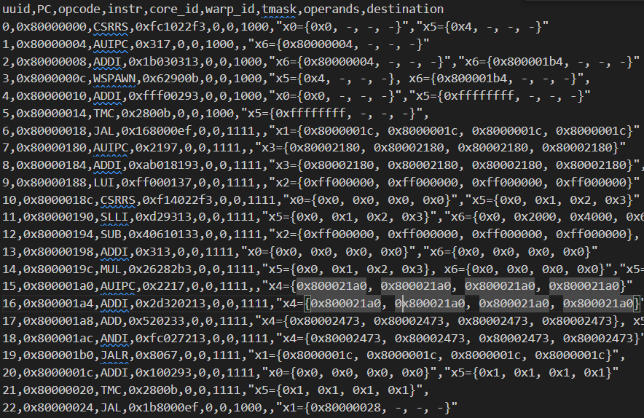
Debugging Vortex – CSV trace
Driver-independant Trace
uuid
PC
opcode
core_id
warp_id
tmask
operands
destination

Slide 33
Debugging Vortex – CSV trace (2)
Comparing RTL vs SimX
$ ./ci/blackbox.sh --driver=rtlsim --app=demo --debug=3 --log=run_rtlsim.log
$ ./ci/trace_csv.py -trtlsim run_rtlsim.log -otrace_rtlsim.csv
$ ./ci/blackbox.sh --driver=simx --app=demo --debug=3 --log=run_simx.log
$ ./ci/trace_csv.py -tsimx run_simx.log -otrace_simx.csv
$ diff trace_rtlsim.csv trace_simx.csv

Slide 34
Thank You!

