Slide 1
Vortex Tutorial
Hyesoon Kim

Slide 2


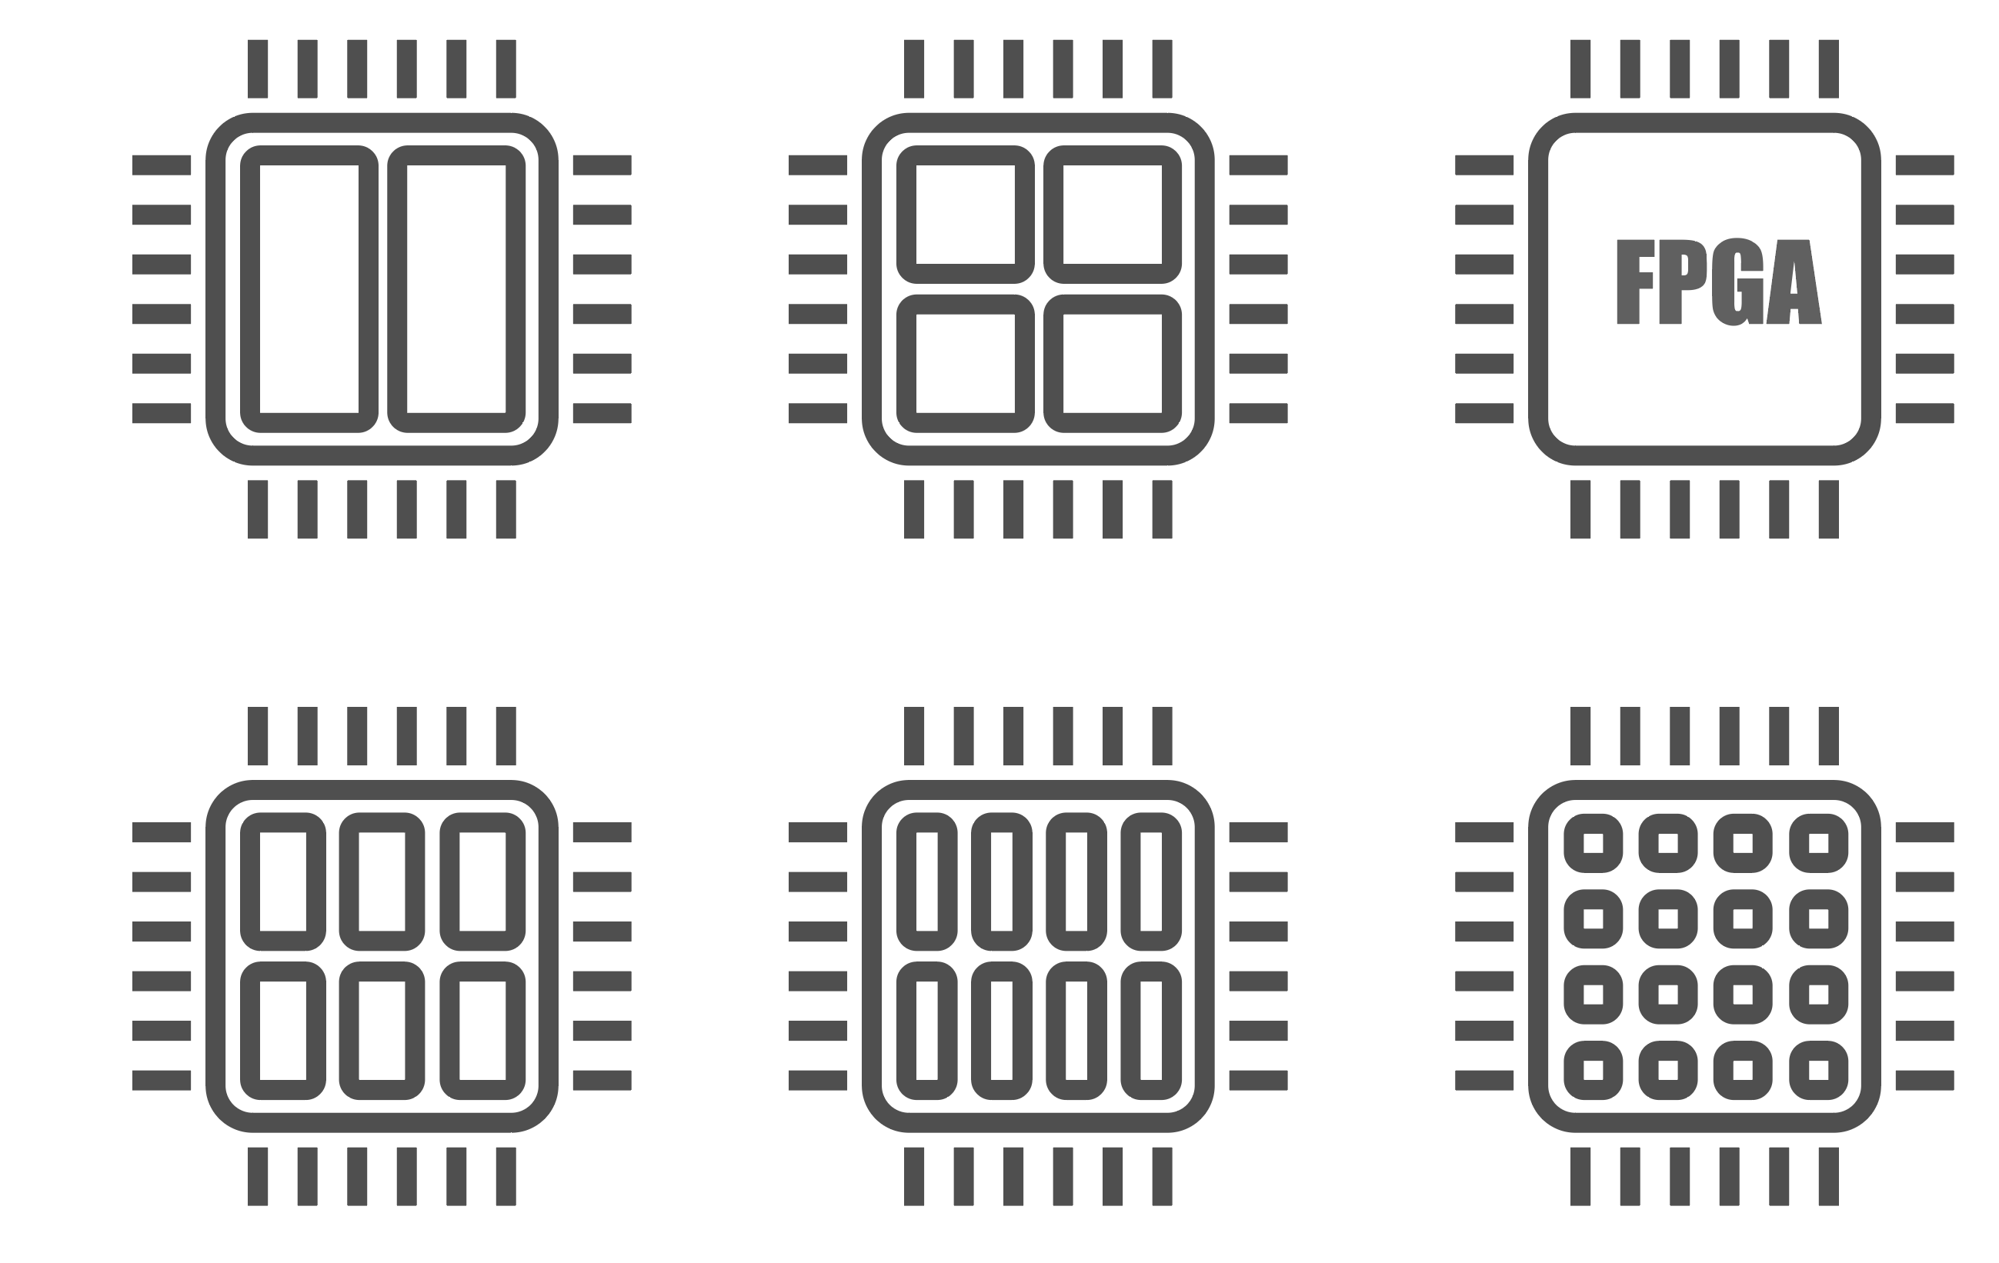



Future Applications of Vortex
Open GPU

Slide 3
Future Visions
Make Vortex ISA as one of RISC-V standard ISAs
Proposal needs to be submitted. Not yet
Provide Vortex design as a reference design
Extend the supporting programs

Slide 4
Wish Lists
Cloud FPGA
Multi-FPGA/GPU
HBM support and optimizations for HBM
Auto tunning for applications
Regular Vortex open source meeting and communication channels
Plan to release cupbop frame in public soon.

Slide 5
Open Discussions
What features do you want?
Good communication channels?
E.g.) slack, github issues, discord, mailinglist …

Slide 6
If you are interested in, please contact
https://vortex.cc.gatech.edu/
Vortexgpu vortexgpu@cc.gatech.edu

