Slide 1
Using Vortex for Class and Research
https://github.com/vortexgpgpu/vortex_tutorials
Presenter: Hyesoon Kim / Liam Cooper
Notes:
1

Slide 2
Pre-exercise Setup: VM Download (Recommended)
Install VirtualBox and Vagrant
Download the Vagrant Box image from the tutorial repo
Add and initialize the Box image
Download the Vagrantfile from the tutorial repo
Boot the VM with vagrant up
Finally, run vagrant ssh to connect to VM
Detailed setup instructions in VM_README.md
Test Vortex:
./ci/blackbox.sh --cores=2 --app=demo
Notes:
2

Slide 3
Pre-exercise Setup: Remote Account in Browser
Log into rg-ood.crnch.gatech.edu with provided login
Select the Vortex Tutorial option under the Reconfig tab
Set 2 CPUs and press the Launch button to start a terminal job
Press Connect to open a remote terminal on the server
Detailed setup instructions in REMOTE_ACCESS.md
Test Vortex:
./ci/blackbox.sh --cores=2 --app=demo
Notes:
3

Slide 4
Blackbox
Vortex's main test driver
Arguments
Clusters, cores, warps, threads
L2cache, L3cache
Driver
rtlsim, vlsim, fpga, simx
Debug
Perf
App
Args
Arguments
Notes:
4

Slide 5
6 Tutorial Assignments
Vortex tutorial assignments
Designed to cover different components of Vortex
Introduction assignments for RTL: Assignments #1 & #2
How to modify LSU (lost-store unit) and debug: Assignments #3 & #4
How to add a custom new instruction: Assignment #5
Assignments #1 and #2 only explain the steps
Assignments #3 and #5 provide a solution
Please use the old VM (the latest repo already includes the solution)
Assignment #6 New!
https://github.com/vortexgpgpu/vortex_tutorials.git
Notes:
5

Slide 6
Assignment 1
Add a new performance counter for the average number of active threads per cycle
Check if instruction is being issued
Count number of active threads in the active thread mask
Divide total number of active threads by cycle count in driver
Test with output of demo program kernel
Notes:
6

Slide 7
Assignment 2
Count the number of coalesced memory requests
GPUs generate multiple memory requests from the same warp/wave front, often with duplicate memory addresses across multiple threads in the warp
Increment counter in LSU when memory requests in other threads are the same
Increment only once per warp
Test with output of demo program kernel
Notes:
7

Slide 8
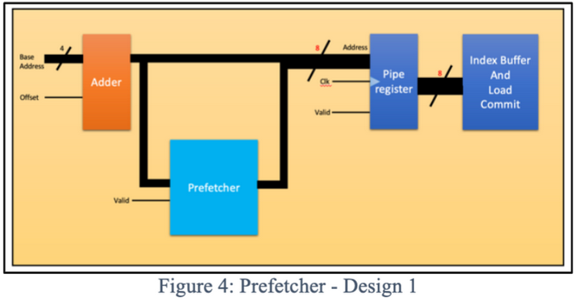
Assignment 3/4
Add a simple next line prefetcher in LSU
Every time a load request is computed, generate the next cache line address and send to d-cache
Request metadata must be stored somewhere so the processor knows the correct memory requested
Verify implementation by using the debug trace to see if prefetch requests are generated and used correctly
Notes:
8

Slide 9
Assignment 5
Add a new instruction for prefetching
Add an intrinsic for the new instruction (to generate a binary with new instruction)
Define the new instruction in SimX
Extend the pipeline/decoder
Modify the LSU to take in prefetch instructions
Develop a test to check functionality of the new instruction
Debug using kernel dump and run log
Notes:
9

Slide 10
Checking Solutions for Assignments #3 & #5
Check solutions folder on Github
Solution overview and code provided
Download and execute solution
Solution code formatted as git pull requests
Assignment 3:
git fetch origin pull/22/head:A3_solution git checkout A3_solution
Assignment 5:
git fetch origin pull/25/head:A5_solution git checkout A5_solution
Notes:
10

Slide 11
Assignment 6
Add Performance counters to test software prefetcher
Measure prefetch metrics
# of unique prefetch requests
# of unused prefetched blocks
# of late prefetches
Part #1: extending the cache tag
Part #2: extending bank.v to keep track of the meta data
Notes:
11

Slide 12
Class Project Topics
Architecture design space explorations with Sim-X
Microarchitecture studies
Add different prefetchers
Different cache hierarchies
Integration with SOC designs
On-going work with Columbia ESP project
Notes:
12

Slide 13
Looking for contributions
RTL design additions
Programming support
Platform support
Please contact us vortexgpu@cc.gatech.edu
Notes:
13

Slide 14
Now Open Discussions
Notes:
14

