Slide 1
Vortex Microarchitecture
Blaise Tine
Notes:
Narration:
This poster presents Vortex, a reconfigurable and scalable RISC-V GPGPU accelerator.
Vortex’s main goal is to use RISC-V to utilize the advantages of SIMT execution model and provide a customizable design to facilitate architecture research.
In addition, we show that a minimal set of 5 instructions is enough to achieve a highly parallel execution model on RISC-V.
Single Instruction Multiple Threads execution model, or SIMT, has the advantage of having a scalar based programming model, which makes it easier to program on.
Through POCL, an open-source framework to implement the compiler and runtime software for OpenCL, we were able to execute unmodified OpenCL kernels on Vortex.
We achieved that by linking POCL with Vortex's runtime kernel, which provides warp and thread creation, warp barriers, and control divergence.
Vortex microarchitecture has two main configuration methods to scale for various application domains: increasing the number of parallel work-items and configuring the cache system. Each one of these methods has its own unique trade-offs, both in terms of performance for different applications and hardware and energy cost. The first method is to increase the parallel work-items in the design by either increasing the number of threads per warp, number of warps per core, number of cores per clusters, and the number of clusters. The second method is by configuring the cache system. Our L1, shared memory, L2, and L3 are all based on the same high-throughput banked design that supports a snoop protocol and prefetching.
We have evaluated our design both 15 nm educational library and Arria 10 Intel FPGA on a subset of Rhodina benchmarks and were able to achieve frequencies of 300 MHz and 192 MHz respectively.
In addition, we were able to fit a 2 cluster 8 core configuration with a total of 256 work units on Arria 10 Intel FPGA.
We also used the OPAE open-source accelerator API to be able to execute OpenCL kernels on the FPGA.

Slide 2
Agenda
ISA Extension
Microarchitecture
Hardware Scaling and Configuration
High-Bandwidth Caches

Slide 3
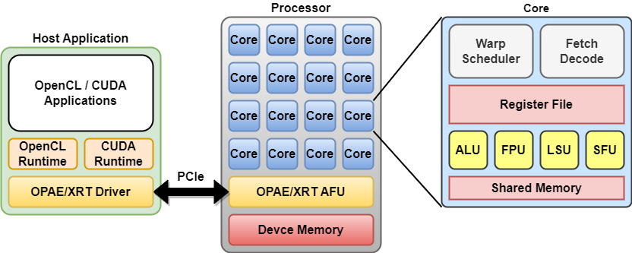
Vortex GPGPU Platform
Hardware
Fully configurable multi-core GPU
PCIe host-device interface
Caches & shared Memory
Floating-point Units
32 and 64-bit ISA
Open-source toolchain
LLVM: Compiler
POCL: OpenCL
CuPBoP: CUDA
OPAE: Intel FPGA API
XRT: Xilinx FPGA API
Verilator: RTL simulation
Yosys: FPGA Synthesis
FPGA Synthesis
Altera: Arria10, Stratix 10
Xilinx: Alveo U50, U250, U280

Slide 4
RISC-V ISA Extension for Vortex
Threading model
Wavefronts
Threads
Thread Divergence Handling
Split/Join stack based
Thread predication
Memory model
Global memory
Shared memory
Register File
RISC-V Integers and floats
32 * #warps * #threads regs
Synchronization
Global and local barriers
RISC-V fence
Instruction | Description
wspawn #warps, %PC | Wavefronts activation
tmc #threads | Thread mask control
#addr ← split #pred | Control flow divergence
join #addr | Control flow reconvergence
pred #pred, #mask | Thread predication
bar #id, #warps bar #id, #cores | Wavefront local barrier (positive id) Wavefront global barrier (negative id)

Slide 5
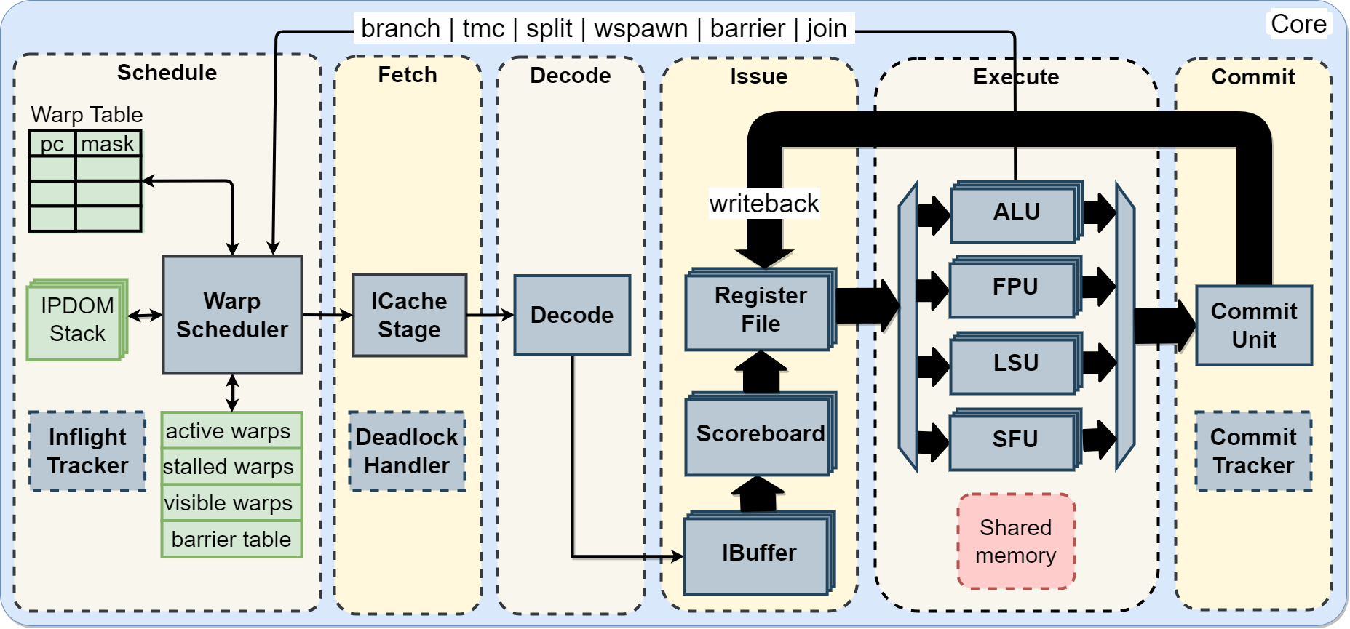
Vortex GPU Microarchitecture
Six-stage RISC-V in-order issue out-of-order commit Pipeline

Slide 6
Vortex GPU Microarchitecture (2)
Schedule Stage
Warp scheduler
Warp Table
IPDOM Table
Inflight Tracker

Slide 7
Vortex GPU Microarchitecture (3)
Fetch Stage
Icache Request
Deadlock avoidance
Cacheless config.

Slide 8
Vortex GPU Microarchitecture (4)
Decode Stage
Decode instruction
Unlock warp
!branch
!csrs
!wctl

Slide 9
Vortex GPU Microarchitecture (5)
Issue Stage
Instruction Buffer
Per Issue Width
Scoreboard
Per Issue Width
Register File
Operand Fetch
Multi-Cycle
Multi-Banked
Per Issue width
Operand cache
Operands Dispatch
IW x #Threads

Slide 10
Vortex GPU Microarchitecture (6)
Execute Stage
ALU cluster
FPU cluster
LSU cluster
SFU cluster
CSR unit
WCTL unit
<Custom>

Slide 11
Vortex GPU Microarchitecture (7)
Commit Stage
Per-unit gather
Writeback
Commit tracker

Slide 12
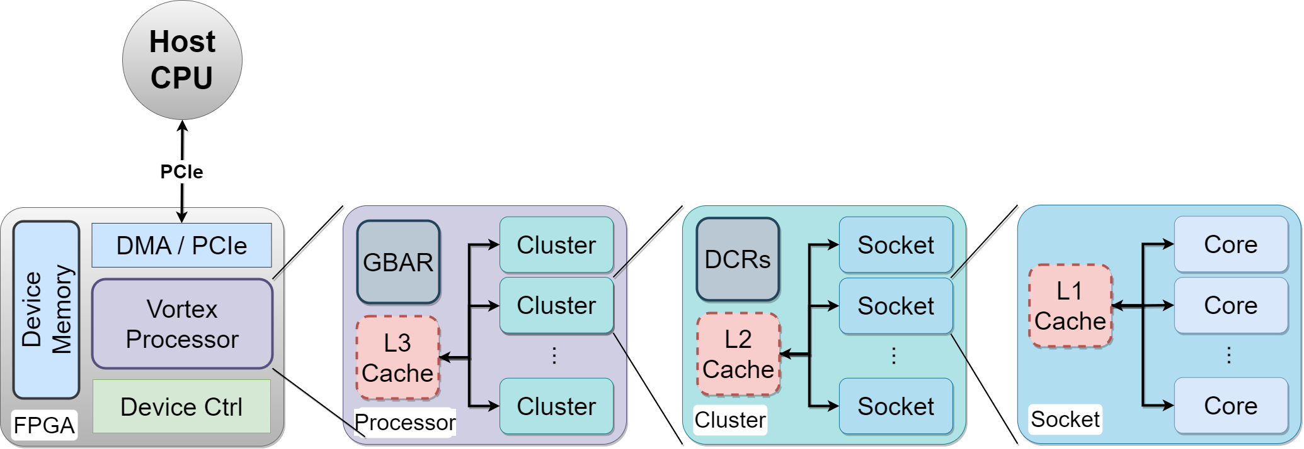
GPU Hierarchical Clustering
Socket
Multiple cores
Optional L1 cache
Cluster
Multiple sockets
Optional L2 cache
Processor
Global barrier
Optional L3 cache
FPGA
Vortex Processor
Device Controller
DMA/PCIe Controllers
Device Memory

Slide 13
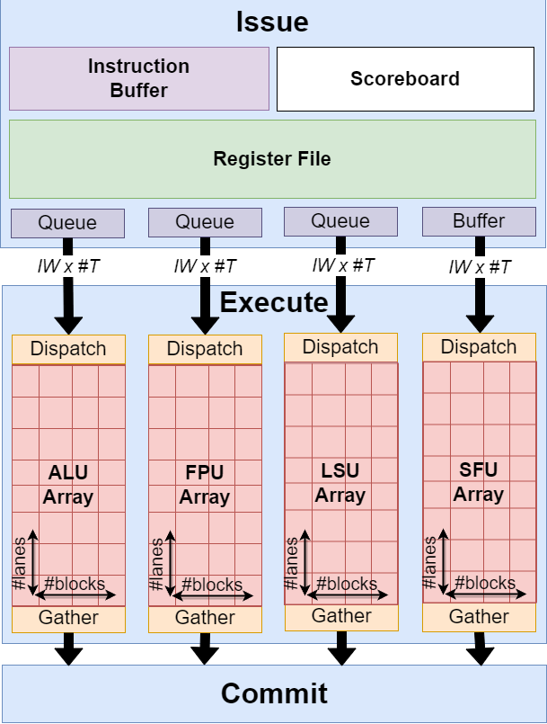
Execute Unit Array
Dispatch Queues
Flow control
Per execute unit
Dispatch Unit
Read IW x #T data from queue
Send #Block x #lanes data to array
Per execute unit
Gather Unit
Merge outputs from array
Return IW x #T results
Per execute unit

Slide 14
Pipeline Compute Scaling
Pipeline Configuration
Number of wavefronts (#W)
Number of threads (#T)
Issue width (IW)
Execute Unit Configuration
Number of blocks (#B)
Number of lanes (#L)
Dispatch Capacity
IW * #T total work items
Execute Capacity
#B * #L total processing element
Full Compute Capacity
#B=#IW and #L=#T

Slide 15
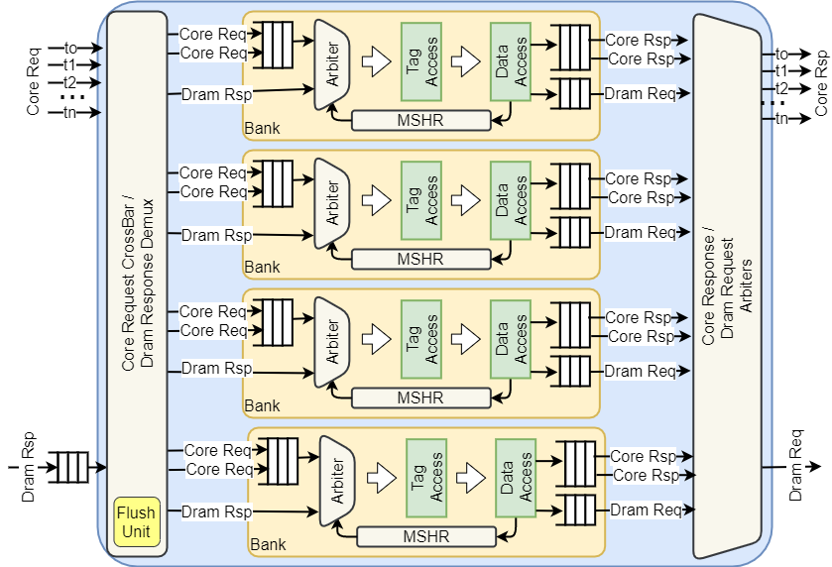
Vortex High-bandwidth Caches
Design goals
High-bandwidth transactions
Non-blocking operation
Highly Configurable
Challenges
Handling bank conflicts
FPGA constraints
SRAM ports
Area cost

Slide 16
Vortex High-bandwidth Caches (2)
Our solution: Virtual multi-porting
Perform coalescing inside the cache
How?
Add virtual ports to each bank
Ports hold requests to same line
Advantages
No cycle overhead
Added to the bank select logic
Maximize cache line read access
Minimal storage overhead in MSHR
Reuse exiting SRAM port
Configurable number ports
Area vs Perf.
Bank
Conflict!
Pipeline Register
Pipeline Register
Pipeline Register
CL1
ARB
Tag Access
Data Access
AddrA
CL2
ARB
Tag Access
Data Access
AddrB
CL3
ARB
Tag Access
Data Access
AddrC
CL3
ARB
Tag Access
Data Access
AddrD
Bank select
And
Coalescing
Core
Response
Merge

Slide 17
Thank You!

