Slide 1
GPGPU Background
Presenter: Hyesoon Kim

Slide 2
CPU pipeline
CPU pipeline
Increasing the performance in the execution units
Increase the issue width (superscalar)
Multi-threading
Front-end
Decode
Rename
Schedule
Execution
Write-back
Memory
F
D
S
E
W
F
D
S
E
W
F
D
S
E
W
F
D
S
E
W
F
D
S
E
W
F
D
S
E
W
F
D
S
E
W
F
D
S
E
W
F
D
S
E
W
F
D
S
E
W
F
D
S
E
W
F
D
S
E
W
F
D
S
E
W
F
D
S
E
W
F
D
S
E
W
F
D
S
E
W
5-stage pipeline
F
D
S
E
W
F
D
S
E
W
F
D
S
E
W
F
D
S
E
W
Multi-threading
Superscalar

Slide 3
GPU pipeline
Warp/Wave-front execution model
SPMD programming model (Single Program Multiple Data)
…
Tn
T4
Inst 1
T
T
T
T
T
T
T
T
T
T
T
T
T
T
T
T3
T
T1
T2
Inst 2
Inst 3
One warp
One warp
Inst 1
Inst 2
Inst 3
Fetch 1 instruction and each instruction has multiple threads are associated.
The group of instruction is called warp/wave-front
All threads have the same program

Slide 4
GPU Pipeline
Scheduler
Active bit mask vectors/
score boarding
Fetch
One instruction for each warp
Multiple PC registers exist to support multi-threaded architecture
Round-robin scheduler
Wide execution width
I-cache
Fetch unit
Decoder
Register
Scheduler (Score boarding)
Lane 0
Lane 1
. . . . . .
Lane N-1
Memory
Memory access unit
Lane 0
Lane 1
. . . . . .
Lane N-1
Writeback

Slide 5
Scheduling
In-order scheduler
(a) Static code
(b) Dynamic instruction trace
Inst1 // warp1
warp 4
Inst2 // warp1
warp 3
Inst1 // warp2
warp 2
warp 1
Inst1
Inst2 // warp2
Inst2
Inst3
Inst3 // warp1
Inst1 // warp3
Inst1 // warp4
Isnt2 // warp4
Inst3 // warp2
Inst2 // warp3
Inst3 // warp3
Isnt3 //warp4

Slide 6
Thread Scheduling Policies
comp_inst1
comp_inst2
mem_inst3
w1
w2
w3
w4
Round-robin
M
M
M
M
stall
w1
w2
w3
w4
w1
w2
w3
w4
w1
w2
w3
w4
w1
w2
w3
w4
Greedy-then-Oldest (GTO)
M
M
M
M
stall
w1
w1
w1
w2
w2
w2
w3
w3
w3
w4
w4
w4
w4
w1
w1
w1

Slide 7
GPU Register Files
To accommodate a large number of active threads, a large number of register files are essential.
e.g.) 128 threads, 64 registers = 128X64 = 8KB
NVIDIA G80 architecture: 64KB registers (16KB cache)
Vortex: 32-registers # of threads per warp x # of warps x # or cores
Register read BW
1Tflop/s peak performance (2 read, 1 write)
-2T * 32B/s = 64TB/s register read BW
Highly banked register files

Slide 8
Register File Structures: Multiple Banks
Th 0
…
Th N-1
Warp 0’s reg file
. . . . . .
Warp ID.Reg ID
. . . . . .
. . .
Register files
Warp M-1’s reg file
. . . . . .
Lane 0
Lane 1
. . . . . .
Lane N-1
Writeback
All threads in a warp read the register values in parallel.
Register is indexed with register ID, warp ID
Multiple banks (Narasiman’s figure)

Slide 9
Handling Branch Instructions
A reduction example
What about other threads?
What about different paths?
0
1
2
3
4
5
6
7
If (threadId.x%==2)
0
2
4
6
If (threadId.x%==4)
0
4
If (threadId.x%==8)
0
A
If (threadid.x>2) {
do work B}
else {
do work C
}
B
C
Divergent branch!
D
From Fung et al. MICRO ‘07

Slide 10
Split/Join
Compiler inserts split/join in Vortex
Split:
Put tmask in the ipdom stack (do work c part}
Put next PC in the stack (not-taken path. // do work c part )
Join
Pop from a stack
If (threadid.x>2)
// split
{
do work B
}
else {
// join
do work C
}

Slide 11
GPGPU Programming
CUDA (Compute Unified Device Architecture)
OpenCL
AMD's HIP
Intel's DPC
OpenMP
And more (RUST etc.)

Slide 12
Quick Summary of CUDA Programming Model
SIMD or SIMT
Single instruction multiple data or single instruction multiple thread
Unified Memory space (global memory space)
Program hierarchy
Thread, block, kernel

Slide 13
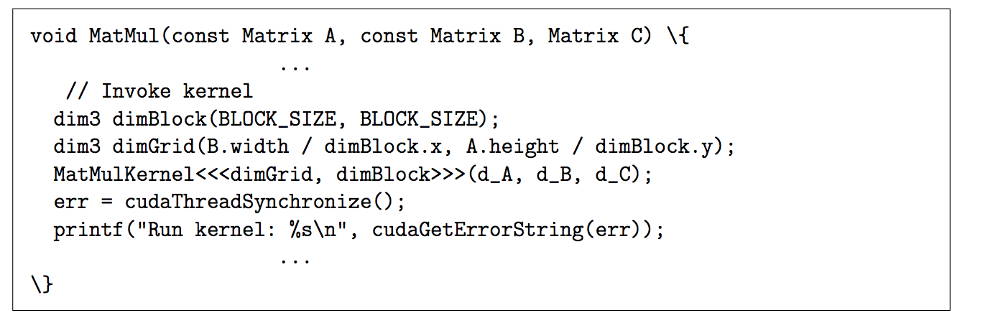
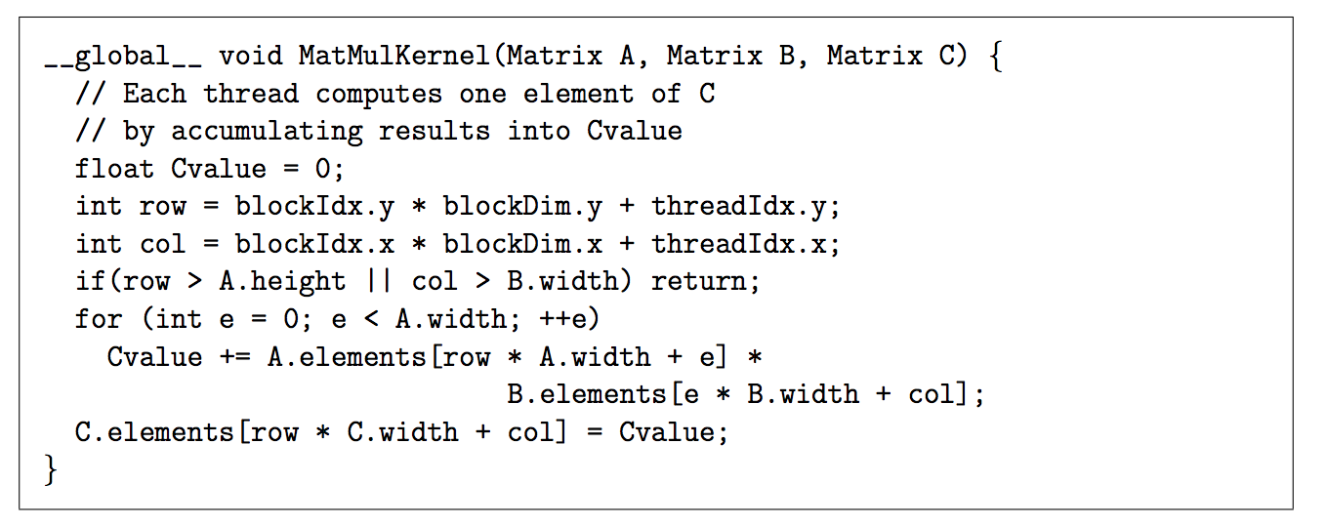
CUDA Program Example

Slide 14
Execution Model
Thread & Block
Block
Block
Inst 1
T
T
T
T
T
T
T
T
T
T
T
T
T
T
T
T
T
T
T
T
T
T
T
T
Inst 2
Inst 3
warp
warp
warp
warp
warp
warp
SM
SM
Kernel
Shared Memory
Shared Memory
SP
SP
SP
SP
SP
SP
SP
SP
Sing instruction multiple thread
Block = a group of thread which share “the shared memory space”
Warp

Slide 15
Memory Space
Thread, block, and kernel have different memory spaces
 | Space | ~= CPU
Local Memory | Within Threads | Stack
Shared Memory | Within Blocks | Distributed memory space
Global Memory | All | Centralized storage
Constant Memory | All | Centralized read-only storage (very small)
Texture Memory | All | Centralized read-only storage (medium size, 2D- cache)

Slide 16
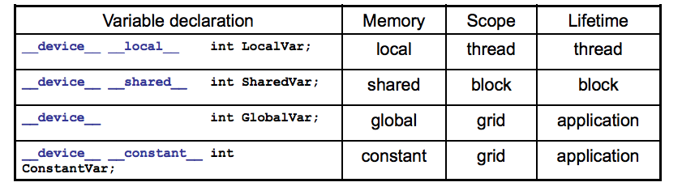
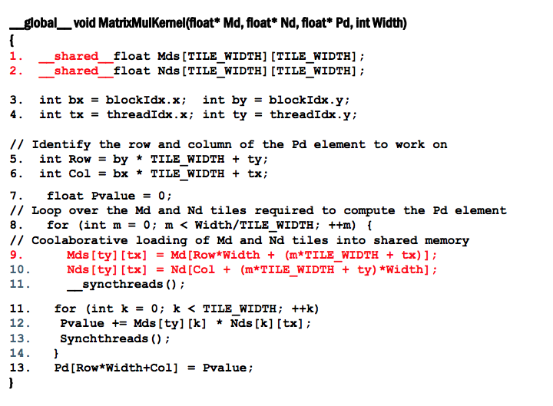
Shared Memory
From: http://accel.cs.vt.edu/files/lecture10.pdf

Slide 17
Memory Data Indexing
SIMT-execution model
Use thread id and block id to index data
Let’s assume N=16, blockDim=4 → 4 blocks
0
1
2
3
4
5
6
7
8
9
10
11
12
13
14
15
+
0
1
2
3
4
5
6
7
8
9
10
11
12
13
14
15
+
+
+
+
blockIdx.x = 0
blockDim.x = 4
threadIdx.x = 0,1,2,3
Idx= 0,1,2,3
blockIdx.x = 1
blockDim.x = 4
threadIdx.x = 0,1,2,3
Idx= 4,5,6,7
blockIdx.x = 2
blockDim.x = 4
threadIdx.x = 0,1,2,3
Idx= 8,9,10,11
blockIdx.x = 3
blockDim.x = 4
threadIdx.x = 0,1,2,3
Idx= 12,13,14,15

Slide 18
1D, 2D, 3D data structures
A kernel is executed as a grid of thread blocks
Threads and blocks have IDs
So each thread can decide what data to work on
Block ID: 1D or 2D
Thread ID: 1D, 2D, or 3D
Loop index in sequential loop
Use thread ids, block ids
1D array index= c1*threadId.x + c2*block Id.x
2D array index = c1*threadId.x+c2*blockId.x+c3*threadId.y+c4*blockId.y
CPU code
for (ii = 0; ii < 100; ++ii) {
C[ii] = A[ii] + B[ii];
}
CUDA code
// there are 100 threads
__global__ void KernelFunction(…) {
int tid = blockDim.x * blockIdx.x + threadIdx.x;
int varA = aa[tid];
int varB = bb[tid];
C[tid] = varA + varB;
}

Slide 19
Synchronization Model
Bulk-Synchronous Parallel (BSP) program (Valiant [90])
Synchronization within blocks using explicit barrier
Implicit barrier across kernels
Kernel 1 → Kernel 2
C.f.) Cuda 3.x
Kernel1
Block
Block
barrier
barrier
Block
barrier
barrier
Barrier
Kernel2
Block
Block
barrier
barrier

Slide 20
OpenCL vs. CUDA
 | OpenCL | CUDA
Execution Model | Work-groups/work-items | Block/Thread
Memory model | Global/constant/local/private | Global/constant/shared/local + Texture
Memory consistency | Weak consistency | Weak consistency
Synchronization | Synchronization using a work-group barrier (between work-items) | Using synch_threads Between threads

