Slide 1
Vortex Code Structure
Blaise Tine

Slide 2
Agenda
Source Tree
Documentation
Hardware
Synthesis
Simulation
Runtime
Drivers
Testing and Integration
Configuration
Coding Convention
Debugging Vortex
Multi-threading

Slide 3
Source Tree
Reference: /vortex
/ci: Continuous integration
/doc Documentation
/hw Hardware
/runtime Runtime
/driver Drivers
/sim Simulation
/tests Testing

Slide 4
Documentation
Reference: /vortex/doc
Vortex.md
Codebase Layout
Microarchitecture
Cache Subsystem
Software
Simulation
FPGA Setup Guide
Debugging

Slide 5
Hardware
Reference: /vortex/hw
/dpi Verilog DPI library
/scripts Scripting tools
/syn Synthesis tree
/unit_tests Hardware unit tests

Slide 6
Hardware - RTL
Reference: /vortex/rtl
/afu Command processor
/cache Cache source tree
/fp_cores floating-point cores
/tex_unit Texture unit
/interfaces Module interfaces
/libs Library modules

Slide 7
Hardware – Processor Dependency Tree
scheduler
icache
fetch
ibuffer
decode
core
scoreboad
pipeline
issue
cluster
core
GPR
mem_unit
execute
alu_unit
vortex
cluster
core
lsu_unit
commit
cluster
fpu_unit
dcache
writeback
csr_unit
sharedmem
gpu_unit

Slide 8
Hardware – AFU
Reference: /vortex/rtl/afu
vortex: Main processor
vx_to_mem: Vortex request
cci_to_mem: PCIe request
avs_wrapper: Avalon request
scope: Scope analyzer
vortex
vx_to_mem
AFU
cci_to_mem
avs_wrapper
scope

Slide 9
Hardware – Cache
Reference: /vortex/rtl/cache
nc_bypass: cache bypassing
flush_ctrl: flushing
bank_sel: bank select
rsp_merge: response merge
nc_bypass
flush_ctrl
tag_access
bank_sel
data_access
cache
bank
mshr
rsp_merge

Slide 10
Synthesis
Reference: /vortex/hw/syn
/opae Intel OPAE FPGA synthesis
/quartus Intel Quartus synthesis
/yosys Yosys
/synopsys Synopsys
/modelsim Modelsim
/xilinx <coming soon>

Slide 11
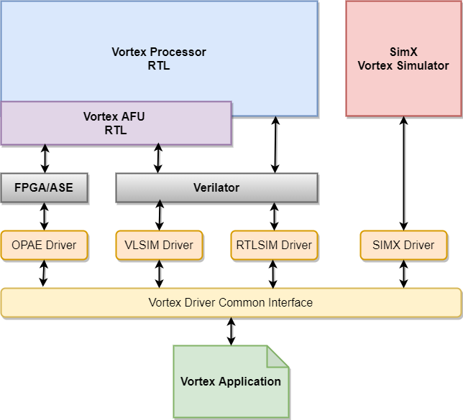
Simulation
Reference: /vortex/sim
rtlsim: Processor RTL
vlsim: AFU RTL
simX: cycle-level

Slide 12
Runtime
Reference: /vortex/runtime
/linker Loader scripts
/src Runtime API sources
start.* Startup routine
print.* Standard out print
spawn.* Tasks scheduler
perf.* Performance counter logger
syscalls.* System calls handling

Slide 13
Driver
Reference: /vortex/driver
/stub Stub library for applications
/fpga OPAE FPGA driver
/asesim OPAE simulation driver
/vlsim VLSIM driver
/rtlsim RTLSIM driver
/simX SimX driver

Slide 14
Testing - Coverage
Reference: /vortex/tests
/runtime Runtime tests
/regression C++ applications tests
/opencl OpenCL benchmarks
/riscv RISC-V standard tests

Slide 15
Testing - Integration
Reference: /vortex/ci
blackbox.sh Apps runner driver
regression.sh CI regression suite
Test_compiler.sh CI compiler suite
prebuild.sh Build prebuilt binaries
toolchain_install.sh Install prebuild binaries
Usage: <tool> --help

Slide 16
Configuration - VX_config.vh
Reference: /vortex/hw/rtl/VX_config.vh
Contains all HW configuration parameters
e.g. NUM_CORES, NUM_THREADS, L2_ENABLE
Autogen C++ header: VX_config.h
$ make –s

Slide 17
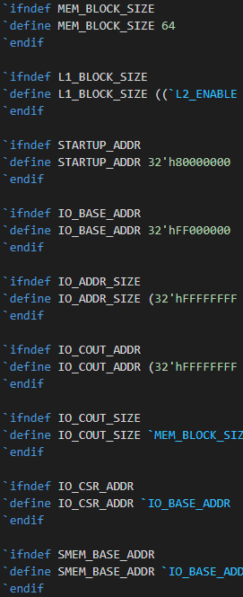
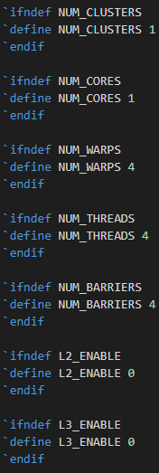
Configuration – VX_config.vh (2)
Structure
Memory

Slide 18
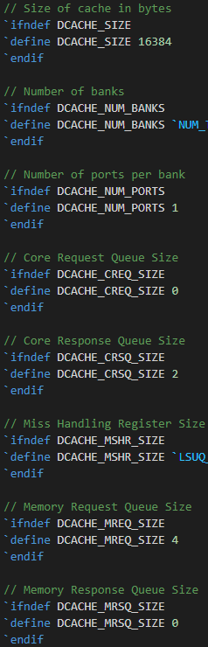
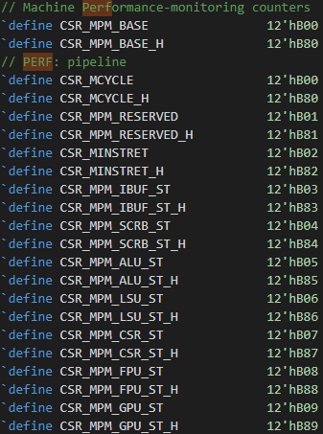
Configuration – VX_config.vh (3)
Structure
Memory
CSRs
Caches

Slide 19
Configuration - Software
Reference: /vortex/hw/VX_config.h
Consumed by all SW components
Vortex Runtime
All simulators
Blackbox examples:
./ci/blackbox.sh --cores=2 --warps=2 --threads=8 –app=vecadd
CONFIGS=“-DNUM_CORES=2 -DDNUM_BANKS=1“ ./ci/blackbox.sh --app=sgemm
CONFIGS="-DMEM_LATENCY=100“ ./ci/blackbox.sh --app=demo

Slide 20
Configuration - Synthesis
Reference: /vortex/hw/syn/opae
FPGA build scripts allows customization
Use parameters from VX_config.vh
FPGA synthesis examples:
CONFIGS="-DNUM_THREADS=4“ make fpga-4c
CONFIGS="-DNUM_WARPS=4“ make fpga-4c
CONFIGS=“-DPERF_ENABLE=4“ make fpga-4c

Slide 21
Coding Convention – Naming
Benefits of coding standard
Self-documentation
Refactoring
Extensibility
Module files: VX_<module>.sv
Interfaces: VX_<interface>_if.sv
Header: VX_<name>.vh
Data Types: VX_<name>_types.vh

Slide 22
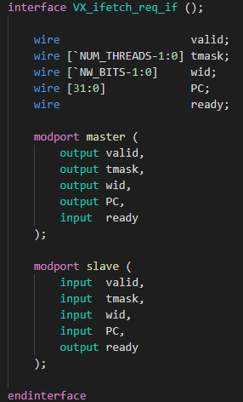
Coding Convention - Interfaces
Reference: /vortex/hw/rtl/interfaces
Grouping of related signals
Master/slave interconnect
Master: outgoing
Slave: incoming

Slide 23
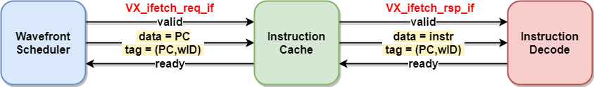
Coding Convention – Handshaking
Elastic Pipeline Pattern
valid/ready interfaces
out: data Data to transfer
out: valid Producer has valid data to transfer
in: ready Consumer is ready to accept data
fire => valid && ready;

Slide 24
Debugging Vortex - Modes
Three debugging modes
Cycle-Level Debugging
Using Simx simulator
RTL Debugging
Using RTLsim or Vlsim simulators
FPGA Debugging
Using integrated scope analyzer

Slide 25
Debugging Vortex - SimX
When to use this mode?
User application debugging
Vortex S/W stack debugging
New SimX extension
Command lines
$ blackbox.sh --driver=simx --app=demo –debug
Controlling debug levels: 1-5
$ CONFIGS=-DDEBUG_LEVEL=2 blackbox.sh --driver=simx --app=demo –debug

Slide 26
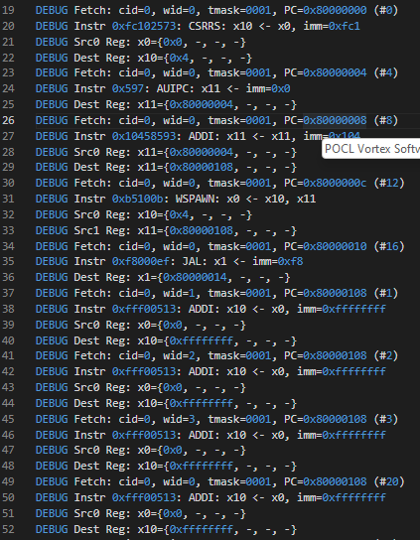
Debugging Vortex – SimX (2)
Generated output: run.log
Instructions trace
Fetched instruction
Source operands
Destination result
Memory trace
Stalls with info

Slide 27
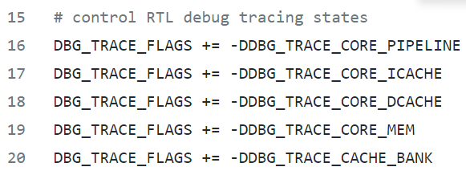
Debugging Vortex - RTL
When to use this mode?
RTL code debugging
Command lines
$ blackbox.sh --driver=rtlsim --app=demo –debug
$ blackbox.sh --driver=vlsim --app=demo –debug
Controlling debug trace via Makefile
vortex/sim/rtlsim/Makefile

Slide 28
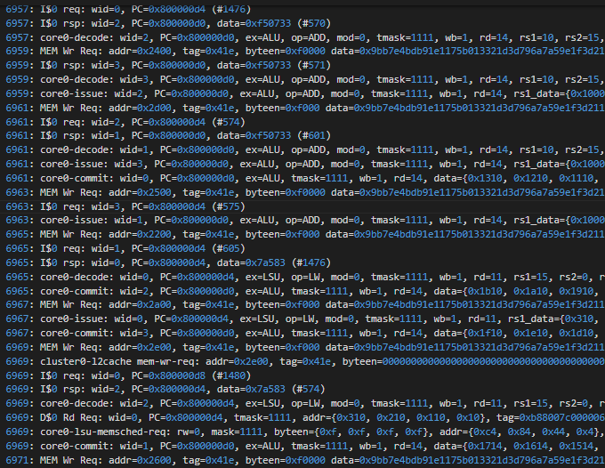
Debugging Vortex – RTL (2)
Generated output: run.log
Instructions trace
Fetched instruction
Source operands
Destination result
Memory trace
Stalls with info
Waveform: trace.vcd
Detail is controllable
Using Verilator annotation
vortex/sim/rtlsim/Makefile

Slide 29
Debugging Vortex - FPGA
When to use this mode?
FPGA debugging
The EDA tool lacks a logic analyzer
Synthesis
$ CONFIGS=-DSCOPE=1 make fpga-4c
Runtime
$ blackbox.sh --driver=fpga --app=demo –scope
Generated Output: trace.vcd

Slide 30
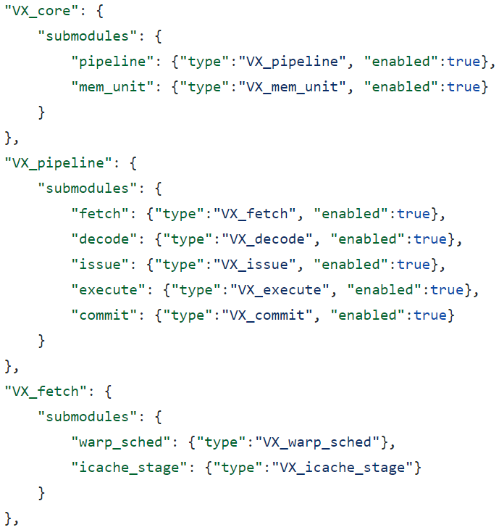
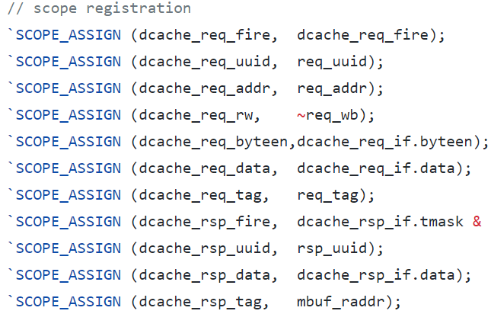
Debugging Vortex – FPGA (2)
Code Instrumentation
/hw/scripts/scope.json
Probe assignments
Use default template
hw/scripts/scope.json
hw/rtl/VX_lsu_unit.sv

Slide 31
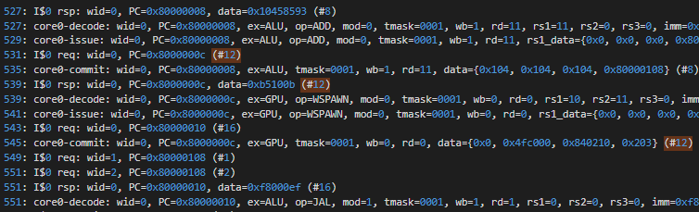
Debugging Vortex - UUID
Universal Unique Identifier
Static number across runs
Track instruction life cycle
From fetch to commit
Match RTL with SimX
Simx Trace
RTL Trace

Slide 32
Thank You!

