Slide 1
Vortex OpenCL Software stack
Blaise Tine
Notes:
Hello everyone, I am Ruobing. It’s my pleasure to have this chance to share some Vortex knowledge with all of you. In this slide, I will introduce the Vortex softweare stack, for how we interactive with Vortex hardward and how our software programs be compiled and executed on Vortex.

Slide 2
Agenda
Kernel Runtime Library
OpenCL Infrastructure
Mapping POCL Kernel to Vortex H/W
Compiler Support
Notes:
Here is the agenda of my introduction. I only put some basic introduction in this slide. For more detail information, I put them together with the intrudction of executing CUDA/OpenCL on Vortex in the next part.

Slide 3
Vortex Kernel Runtime Library
Running Native applications on Vortex
Schedule a task on the parallel H/W?
void vx_spawn_tasks(int num_tasks, vx_spawn_tasks_cb callback, void * arg)
Query hardware specifications
vx_num_cores(), vx_num_warps(), vx_num_threads()
Query the current thread or wavefront
vx_thread_tid(), vx_warp_id()
Terminate program execution
vx_tmc(0);
Debug print to the console
vx_printf(format, …);
Other utility APIs
3
Notes:
Thus, to support Vortex as a new backend to POCL, we need to care about the following parts: for compilation, we need to modify the POCL Compiler and provide a Vortex Runtime library. For the Vortex programs, they have different interface as other devices, thus, we have to modify the original pocl compiler to generate the programs have the interface that Vortex need. Besides, Vortex has some specific built-in functions, we have to implement these functions in Vortex Runtime library, and this library will link with the kernel at compilation time. For execution, we need to provide a Vortex Driver for POCL runtime. To integrate a new device into POCL, we have to implement some basic operations, like memory copy, memory allocation and kernel launch and put all these functions into Vortex Driver. POCL framework will use the Vortex Driver to control and communicate with Vortex.

Slide 4
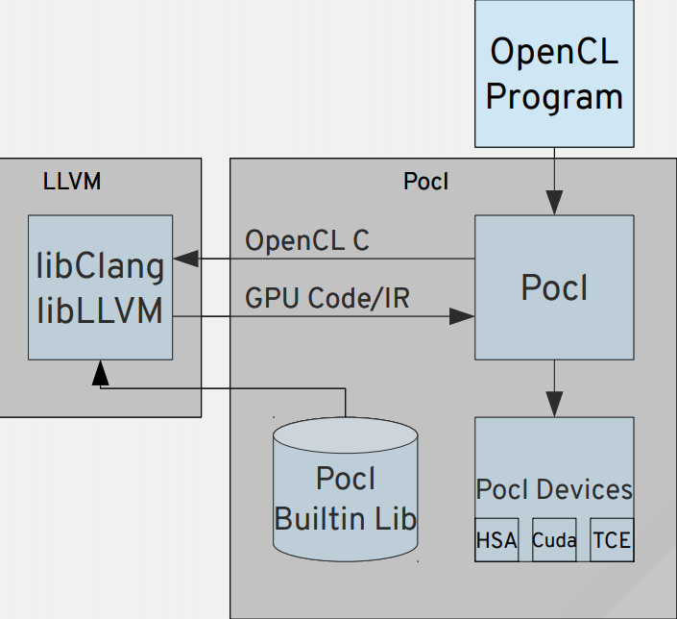
POCL: A Performance Portable OpenCL Implementation
Key Insights:
Use target-specific execution model
SIMT -> GPUs
MIMD, SIMD -> CPUs
Target-specific compiler transformations
Using LLVM
Key Features:
A single interface with multiple target devices
Support HSAIL export
Support PTX export
Support x86 export
Custom accelerator support via TCE*
Support SPIR-V import
POCL Software Stack
* TTA-based Co-design Environment - http://openasip.org/
Notes:
For Vortex software, we high depends on another project, POCL. POCL is an implementation of OpenCL. In other word, it can support executing OpenCL programs on different hardware devices. It consits of two parts: compilation and runtime. For compilation, it based on LLVM. It implements a series of LLVM translation to optimize the input OpenCL programs. It supports several backend devices, including NVIDIA GPU, x86 CPU and even customized accelerator. Besides, it accepts not only OpenCL programs, but also SPIR-V IR as input. To execute an opencl programs on a backend device. First, POCL compiles the program, and link it with hardward dependent runtime library and also Pocl's optimized hardware independent library. Then, the POCL runtime will use the devices drivers to control the devices. It will allocate and manage the memory on devices side, also send and launch the kernel to the devices and fetch the result data from devices side to host side.

Slide 5
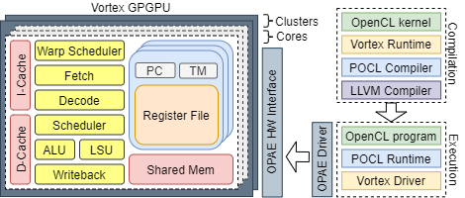
Vortex OpenCL System Architecture
Compilation:
Vortex Runtime
POCL Compiler
Execution:
Vortex Driver
POCL Runtime
5
Notes:
Thus, to support Vortex as a new backend to POCL, we need to care about the following parts: for compilation, we need to modify the POCL Compiler and provide a Vortex Runtime library. For the Vortex programs, they have different interface as other devices, thus, we have to modify the original pocl compiler to generate the programs have the interface that Vortex need. Besides, Vortex has some specific built-in functions, we have to implement these functions in Vortex Runtime library, and this library will link with the kernel at compilation time. For execution, we need to provide a Vortex Driver for POCL runtime. To integrate a new device into POCL, we have to implement some basic operations, like memory copy, memory allocation and kernel launch and put all these functions into Vortex Driver. POCL framework will use the Vortex Driver to control and communicate with Vortex.

Slide 6
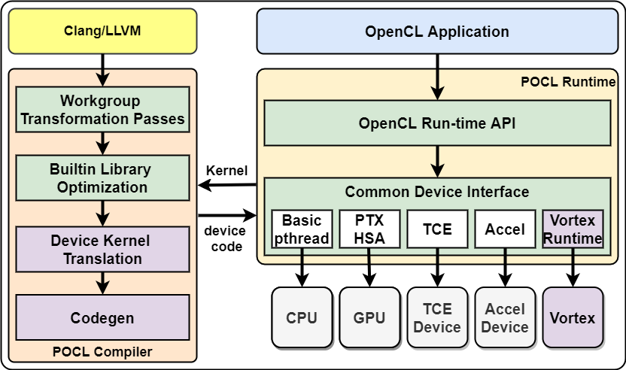
POCL Vortex Extension
Device kernel Translation
Kernel Invocation
Warp/thread scheduling
Device runtime library
Codegen
Target CPU, features, ABI
Linked libraries
Vortex runtime and other deps.
Vortex runtime
Kernel compilation
Vortex driver communication
GPU resource allocation and loading
Kernel offloading and execution
Notes:
In summary, the whole Vortex software stack is the library needed to integrate Vortex into POCL, the Vortex Runtime and Vortex Driver. Not let's go through the process of how to execute a program on Vortex. First, we compile the program with POCL Compiler. Insides the POCL compiler, Vortex runtime library will be linked with compiled kernel. Before generate the binary, as Vortex kernel has different interface, we use device kernel translation to translate the pocl generated programs. After got the generated programs, POCL runtime uses Vortex Driver to offload this kernel to Vortex and launch it.

Slide 7
OpenCL on Vortex
Input: OpenCL programs (host&&kernel)
Step1: Compile OpenCL kernel to risc-v binary (by POCL Compiler)
Step2: Manually edit the host OpenCL programs, to load risc-v binary as kernel.
Step3: Compile edited OpenCL host (by gcc/clang), and link with Vortex Driver.
Step4: Execute compiled OpenCL host programs with POCL Runtime, which loads risc-v binary generated in Step2 as kernel.
Notes:
Here is the steps to execute OpenCL. Now let's have a look for each step. Assuming our input is a opencl program, which consists of two parts: the host part and kernel parts

Slide 8
OpenCL on Vortex
Input: OpenCL programs (host&&kernel)
Step1: Compile OpenCL kernel to risc-v binary (by POCL Compiler)
Step2: Manually edit the host OpenCL programs, to load risc-v binary as kernel.
Step3: Compile edited OpenCL host (by gcc/clang), and link with Vortex Driver.
Step4: Execute compiled OpenCL host programs with POCL Runtime, which loads risc-v binary generated in Step2 as kernel.
NOTE:
1) integrate the Vortex Runtime library into the original POCL Compiler.
2) translate the generated kernel with Device kernel translation, as Vortex requires different kernel interface.
Notes:
In this first step, we have to compile the kernel part into risc-v binary. We will use modied POCL compiler in this step. As the original POCL doesn't support risc-v architecture. Also, after generated the POCL compiled programs, we have to further translate it with our device kernel translation, as so functions needed by Vortex, like initilization and scheduling, are not generated by POCL

Slide 9
OpenCL on Vortex
Input: OpenCL programs (host&&kernel)
Step1: Compile OpenCL kernel to risc-v binary (by POCL Compiler)
Step2: Manually edit the host OpenCL programs, to load risc-v binary as kernel.
Step3: Compile edited OpenCL host (by gcc/clang), and link with Vortex Driver.
Step4: Execute compiled OpenCL host programs with POCL Runtime, which loads risc-v binary generated in Step2 as kernel.
NOTE:
1) we only need to edit the kernel loading code (e.g. clCreateProgramWithBinary). We can reuse the other codes (e.g. set kernel arguments, create command queue).
2) we are working on totally reusing the host programs on CUDA-Vortex route.
Notes:
After we generated the binary kernel, now, for our host program, instead of loading the kernel as a text file, now it need to directly load the binary kernel. Thus, we have to manually modify the host programs. It is not a heavy workload, as we only need to modify the kernel loading code. As for the rest parts, like set kernel arguments and create command queue, we can diretcly reuse the original host codes.
Besides, currently, we are also working on automatically generate the host programs on CUDA route so that we can avoid any manually edition in the whole process.

Slide 10
OpenCL on Vortex
Input: OpenCL programs (host&&kernel)
Step1: Compile OpenCL kernel to risc-v binary (by POCL Compiler)
Step2: Manually edit the host OpenCL programs, to load risc-v binary as kernel.
Step3: Compile edited OpenCL host (by gcc/clang), and link with Vortex Driver.
Step4: Execute compiled OpenCL host programs with POCL Runtime, which loads risc-v binary generated in Step2 as kernel.
NOTE:
1) links Vortex Driver with compiled host programs, so they can communicate with Vortex devices (e.g. memory copy, kernel launch)
Notes:
In the third step, we compile the edited host programs, and link it with Vortex Driver, which is used for host programs to communicate with Vortex devices. As the compiled host programs will be executed on host machine, we can compile it with normal compiler, like gcc and clang. We do not need to use POCL compiler

Slide 11
OpenCL on Vortex
Input: OpenCL programs (host&&kernel)
Step1: Compile OpenCL kernel to risc-v binary (by POCL Compiler)
Step2: Manually edit the host OpenCL programs, to load risc-v binary as kernel.
Step3: Compile edited OpenCL host (by gcc/clang), and link with Vortex Driver.
Step4: Execute compiled OpenCL host programs with POCL Runtime, which loads risc-v binary generated in Step2 as kernel.
NOTE:
1) POCL runtime uses Vortex Driver, linked in Step3, to communicate with Vortex devices.
Notes:
Finally, we just execute the compiled host programs. It will load the risc-v binary kernel and execute it on Vortex devices by communicating with Vortex driver.

Slide 12
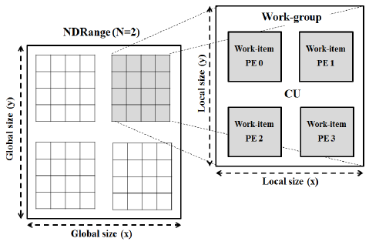
Mapping OpenCL Kernel to Vortex H/W
OpenCL Work-items
Global size (X, Y)
Local size (x, y)
Vortex Work-items
Wavefronts
Threads
Distribution
POCL workgroup function
Executes all work-items in a workgroup
Distribute workgroup among all threads
All threads : wavefronts * threads
for (all threads) {
}
Wavefront 0~N
pocl::wg_func()
for (remaining threads) {
}
Wavefront (0)
pocl::wg_func()
Notes:
Among all these Vortex software stack, one the most important parts is scheduler. How to map computation to hardware is critical for achieving high performance. In opencl, work-item distributed among workgroups. As for Vortex, instead of workgroup, we use wavefront to schedule. A wavefront is a group of work items and work items within one wavefront are executed in parallel and in lock steps. In Vortex, we use wavefront as the unit for scheduling. NVIDIA GPU has a same concept named warp. In NVIDIA GPU, GPUs have the same size of warp, 32 threads within a warp. However, in Vortex, wrap size is configurable. Although this feature make Vortex more flexiable, we have to put more effort for the shcedule algorithms. Although for most high-level users, they can directly execute Vortex without worry about scheduling. If you have interest in changing Vortex's software stack to achieve high performance, these concepts are critical for you.

Slide 13
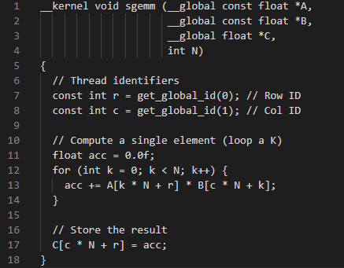
Mapping OpenCL Kernel to Vortex H/W (2)
Example: SGEMM
row_Id: get_global_id(0)
col_Id: get_global_id(1)
A: source buffer A
B: source buffer B
C: destination buffer C

Slide 14
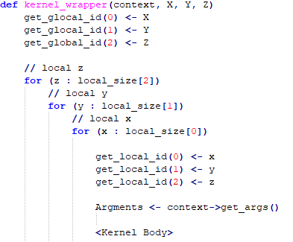
Mapping OpenCL Kernel to Vortex H/W (3)
Vortex processing elements
Wavefronts
Threads
Workgroups Scheduling
vx_spawn_kernel(kernel_wrapper)
distribution: work_groups => threads
priority: Maximize wavefront occupancy
generate global ids: {X, Y, Z}
Work-items scheduling
inline loop iterations

Slide 15
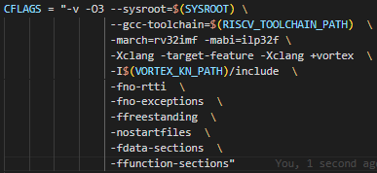
Compiler Support
LLVM Compiler Extension
New RISCV target feature
+vortex
Toolchain integration
GCC toolchain
Kernel runtime
Assembler/Disassembler
GPGPU ISA Extension
Wspawn, tmc, split,join, bar, tex
Split/Join auto-insertion

Slide 16
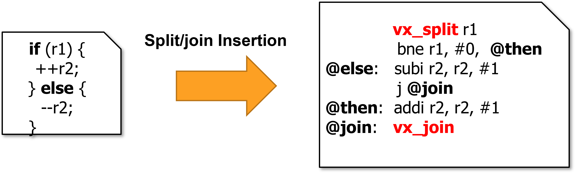
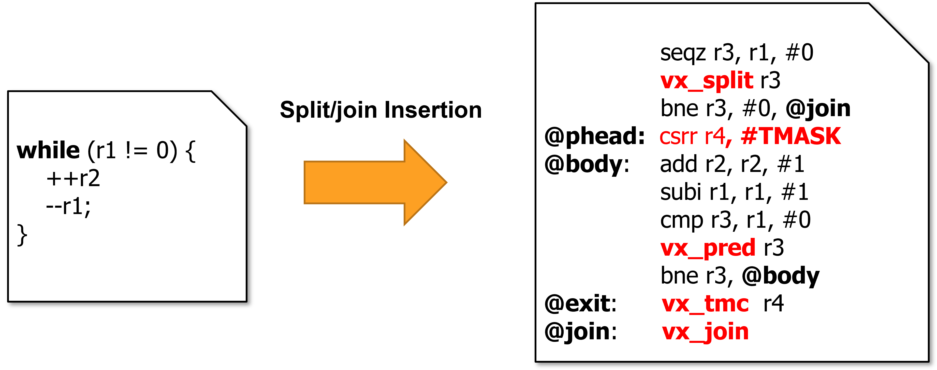
Compiler Support (2)
Split/Join Auto-insertion
Identify Divergent Branches
Divergent conditional variable
Divergence Analysis
An optimization pass
A node is marked as divergent
If any operand is divergent
Track divergence across instruction
Function scope
Code Annotation
Insert split and join instructions
Handling loops is more complex
Use vx_pred to disable threads on conditional

Slide 17
CUDA on Vortex
Roubing Han

Slide 18
CUDA on Vortex
CUDA Application
SPIR-V Application
POCL runtime support both OpenCL and SPIR-V inputs
Notes:
For CUDA, not like OpenCL, which is supported by POCL naturally, we can not directly following the same route to execute it. POCL supports two format of input kernel, OpenCL format and SPIR-V format.

Slide 19
CUDA on Vortex
CUDA Application
NVPTX-SPIRV translator
SPIR-V Application
POCL runtime support both OpenCL and SPIR-V inputs
Notes:
So, to support CUDA on Vortex, we have to implement an extra step. We built a translator to translate CUDA into SPIR-V. Thus, after getting the SPIR-V, we can input it into POCL and following the same step as OpenCL.

Slide 20
Background
Code migration:
HIPIFY: Only for CUDA->HIP
SYCL: Re-implement CUDA programs by SYCL libraries
Notes:
Not like OpenCL which is proposed for targeting multi-backend devices, CUDA can only be executed by NVIDIA GPU. However, we are not the first project tries to execute CUDA on other devices. There is a previous project aims to excute CUDA on AMD GPUs, and it called HIPIFY. Thanks to the similiarilty between CUDA and HIP, the front end language for AMD devices, HIPIFY can use Regular expression to convert CUDA sourcce code to HIP source code. However, as HIP can not be execute on risc-v devices, and other front end language which supports risc-v does not have high similiarity with CUDA, we can not follow this route to solve our challenges.
For another project SYCL, it provides a high level language, which can generate programs be executed on several back-end devices, including risc-v. But it can not directly use existing cuda code. Instead, it requires users to re-implement cuda programs by apis provided by SYCL. In summary, although there are several code migration project, none of them can be used to support risc-v backend. So for the best of our knowledge, our project is the only one that supports CUDA on RISC-V backend

Slide 21
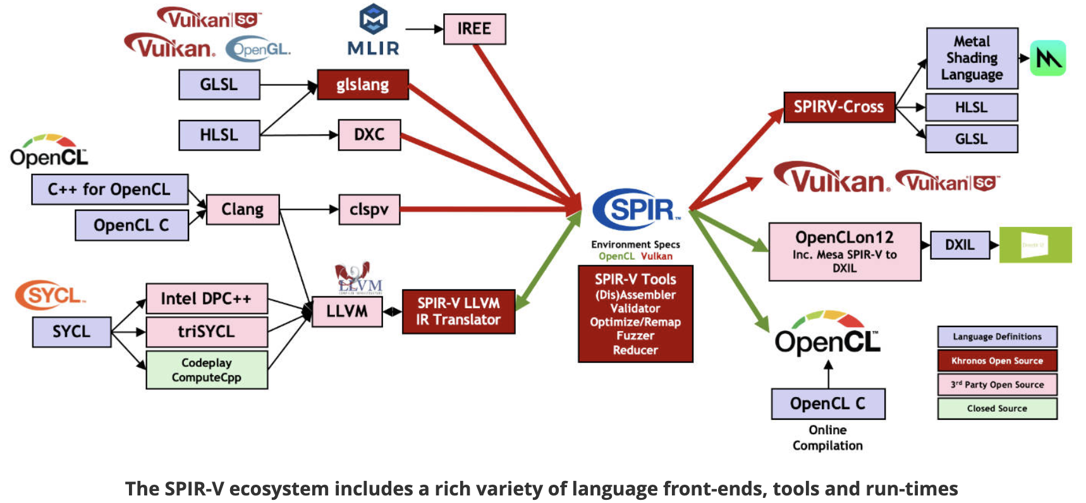
Background
Code migration:
HIPIFY: Only for CUDA->HIP
SYCL: Re-implement CUDA programs by SYCL libraries
SPIR/SPIR-V:
source: https://www.khronos.org/spir/
Notes:
Another project I want to introduce is SPIR, it is critial for the scaleable of our framework. SPIR is an IR special for high performace computing and parallel computing, can be regarded as an isolation between frontend language and backend devices. With SPIR, we can compile a source code for different backend devices. In other word, thanks for the scalbility of SPIR, our framework can not only execute CUDA on Vortex devices, but also open to execute on other devices. And we can support other frontend languages as well.

Slide 22
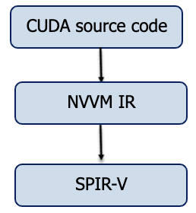
Overview of the NVPTX-SPIRV translator
clang
Notes:
Now let's have a look of the NVPYX-SPIRV translator. It consists of two step: our translator accepts CUDA source codes as inputs, then, in the first step, we use clang to compile CUDA source code into NVVM IR. NVVM IR is an intermediate representation proposed by NVIDIA, and it can be regarded as a subset of LLVM IR.

Slide 23
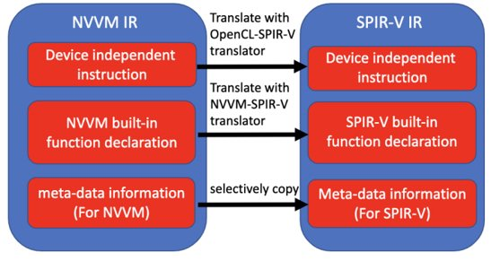
NVVM IR-SPIRV
Notes:
After that, in the second step, we need to translate a NVVM IR into SPIR-V IR. Each NVVM IR and SPIR-V IR are consists of three parts: device independent instructions, such as load, store, jump and some basical operations. Device specific built-in function, for example, NVVM and SPIR-V has different function to get the thread index and block index. As for the third part, metadata, which is used for code generation. The metadata is different between different backend devices. Thus, for these three parts, we have to handle each part separately.

Slide 24
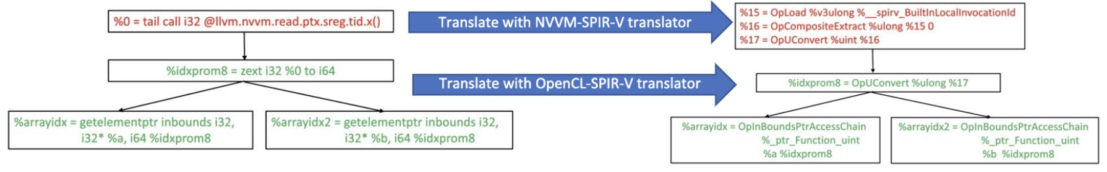
NVVM IR-SPIRV
For device independent instructions (load, store, binaryOp...): use OpenCL-SPIR-V translator
For NVVM special built-in function (llvm.nvvm.read.ptx.sreg.tid.x()...): use NVVM-SPIR-V translator
Notes:
For device indeppendent instructions, the instructions in NVVM is exactly the same in OpenCL. Thus, we can utilize the OpenCL_SPIR-V translator, a third-party library for translating between OpenCL and SPIR-V. However, we can not directly use it on NVVM special built-in functions. As these functions are speciaicly for CUDA, OpenCL does not have these features. So, our major contributions are supporting these CUDA features to be translated to SPIR-V. As for the metadata, as it's also hardware dependent, we have to also implement the translation by ourself, instead of relying on any existing third-party library.

Slide 25
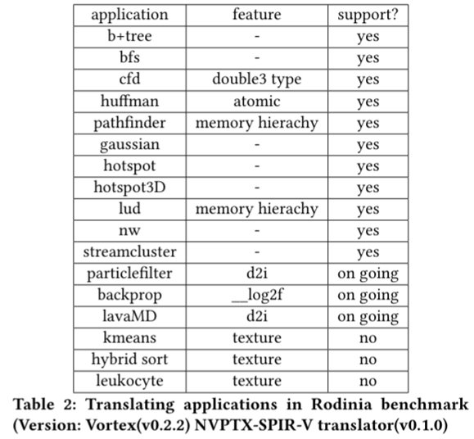
Evaluation
Notes:
To verify the Availability of our translator, we try to execute CUDA examples in Rodinia benchmark on Vortex, and get the following results. Our pipeline can support most of examples. For the remaining unsupported examples, Vortex can support them as soon as we add some mathmatical built-in function and texture memory features

Slide 26
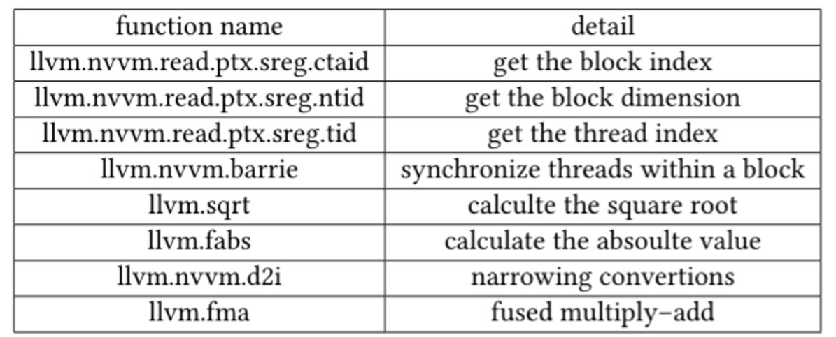
Features (NVPTX-SPIR-V translator: version v0.1.0, Vortex: version v0.2.0)
Memory hierarchy
Synchronization
Some mathematics operations (square root, log, absolute value)
Notes:
I also summary the CUDA features supported by Vortex currently. Now, Vortex can support memory hierarchy, synchronization and several mathematics operations. In the future, we will upgrade both NVPYX-SPIRV translator and Vortex so that we can high a higher coverage for CUDA programs.

Slide 27
Thanks for listening
Github link:
1) POCL (Vortex version): https://github.com/vortexgpgpu/pocl
2) NVPTX-SPIRV translator: https://github.com/vortexgpgpu/NVPTX-SPIRV-Translator
3) LLVM (Vortex version): https://github.com/vortexgpgpu/llvm
Notes:
Last but not least, all our corresponding repo are open-sourced. If you interested in any part of them, you can directly access the source code on github. If you have any questions, please feel free to contact me. Thanks for your listening.

Slide 28
Thank You!

