Slide 1

DATE HERE
Personalized Healthcare Appointment Scheduling via Deep Reinforcement Learning
Team: Subhiksha Saravanasundaram , Gauri Pawar
Texas A&M University
Notes:
Hi, this project is titled Personalized Healthcare Appointment Scheduling using Deep Reinforcement Learning, done by Gauri and Subhiksha.The goal is to improve outpatient scheduling using reinforcement learning instead of static heuristics like FIFO or Shortest-Job-First.

Slide 2
Problem Motivation
Why appointment scheduling matters?
Outpatient clinics suffer from:
    Uncertain arrivals & durations
    No-show patients
    Overcrowding and long waiting times
Traditional methods used:
    FIFO (fair but inefficient)
    SJF (efficient but unfair)
    Need adaptive scheduling that reacts to real-time changes
Notes:
Outpatient clinics face several challenges — patient arrivals are unpredictable, consultation times vary, and no-shows create gaps.Traditional scheduling methods like FIFO are simple and fair, but they don’t use any predictive information.SJF improves throughput by serving short consultations first, but this can lead to extremely long waiting times for other patients.We need a method that is adaptive, handles uncertainty, and can dynamically balance efficiency and fairness.

Slide 3



RL Problem Framing
State
Scheduling as a Sequential Decision Problem
State features:
    Queue length, Patient severity, Predicted duration, No-show probability, Time of day
Action: pick appointment slot: immediate / +1hr / +2hr / next day
    FIFO (fair but inefficient)
    SJF (efficient but unfair)
    Reward penalizes:
    waiting time
    doctor idle time
    missed appointments
Agent
Action
New State
Notes:
We model appointment scheduling as a Markov Decision Process.Each patient arrival represents a decision point for allocating a time slot.The state includes the queue length, predicted duration, severity, no-show probability, and time of day.The action is choosing one of several upcoming appointment slots.The reward penalizes waiting time, idle time, and no-shows, encouraging the agent to maximize throughput without harming patient experience.

Slide 4
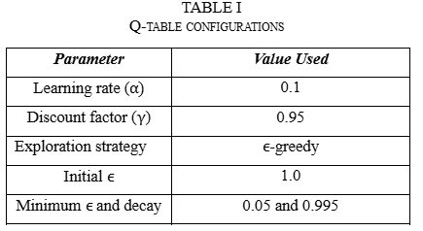
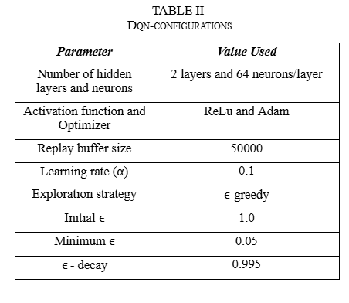
Algorithms Compared
Compared Approaches
FIFO — first-come, first-serve
SJF — shortest consultation first
Tabular Q-Learning
Discretized state space
ε-greedy, α=0.1, γ=0.95
    Deep Q-Network (DQN)
    Neural network (2×64 units)
    Replay buffer with Adam optimizer
    Continuous state features
Notes:
We compare four approaches.Two heuristics: FIFO and SJF.And two reinforcement learning agents: tabular Q-learning and Deep Q-Networks.Q-learning uses a discretized state representation and an ε-greedy exploration strategy.DQN uses a neural network to learn value functions over continuous state spaces, with replay buffers and the Adam optimizer.

Slide 5
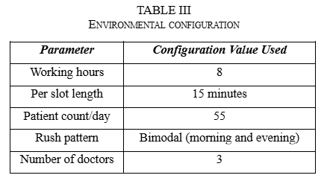
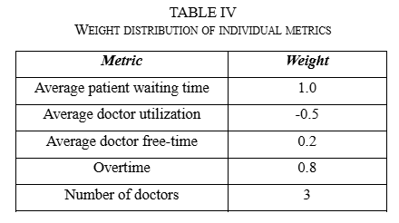
Simulation Setup
How We Evaluated the Methods
Clinic Simulation
8-hour day
~55 patients/day
3 doctors15-minute slots
Arrival model:
Poisson + bimodal rush
    Metrics:
    Avg waiting time
    Doctor utilization
    Free time
    Overtime
    Combined cost (weighted)
Notes:
We simulate a single-day outpatient clinic with 3 doctors, ~55 patients, and 15-minute slots across 8 hours.We used a Poisson arrival model with morning and afternoon rush patterns.Performance was evaluated using average patient waiting time, doctor utilization, overtime, and a combined cost metric that balances all the objectives.

Slide 6
Results

Slide 7
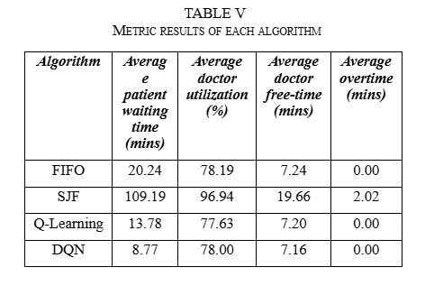
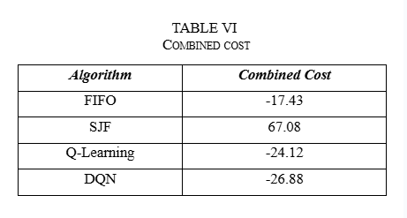
Performance Comparison
SJF over-optimizes utilization → huge waiting times
DQN reduces waiting by ~50% vs FIFO
DQN generalizes better than Q-learning
No overtime, balanced metrics
Notes:
These are our results.FIFO achieved moderate waiting time and utilization.SJF had the highest utilization, but average waiting time increased to more than 100 minutes — which is unrealistic in clinics.Q-Learning reduced waiting times to about 13 minutes.DQN achieved the best performance, with less than 9 minutes of waiting, while maintaining similar utilization and no overtime.This shows that reinforcement learning can learn smarter allocation policies than both heuristics.

Slide 8
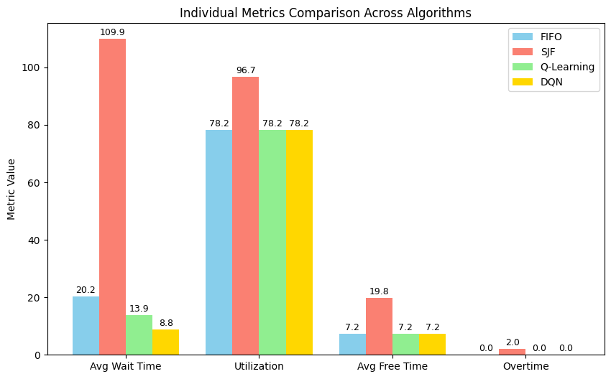
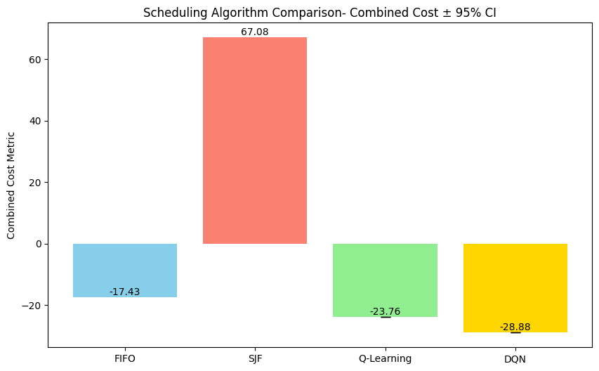

Slide 9
Insights & Discussion
Key Takeaways
Reinforcement learning learns adaptive slot allocation.
RL balances multiple goals, unlike heuristics
Low waiting time
Stable utilization
Low overtime
Reward design is crucial.
Continuous state features → strong generalization.
Q-Learning is interpretable, DQN is stronger
Notes:
The key takeaway is that RL balances multiple objectives simultaneously.Classical methods optimize for one metric, but RL can sacrifice a little utilization to significantly improve waiting time.We also observed that reward design is important — tuning reward weights impacts the learned policy behavior.Q-Learning is easier to interpret, but DQN is able to generalize better due to continuous states.

Slide 10
Conclusion & Future Work
Key Takeaways
Conclusion
RL significantly improves outpatient scheduling
DQN → best trade-off between patient experience & workload
Heuristics are fast but inflexible
Future Work
Multi-Agent RL for multi-doctor coordination
Use real hospital data (e.g., MIMIC-III)
Better no-show predictionActor-Critic approaches
Automated hyperparameter tuning
Notes:
In conclusion, Deep Reinforcement Learning significantly improves outpatient scheduling, particularly when patient arrivals and consultation durations are uncertain.Future work includes using multi-agent RL for coordination across multiple doctors, integrating real hospital data, and exploring advanced RL algorithms like Actor-Critic.Thank you.

Slide 11
Texas A&M University

