Slide 1

Predictive Model for DECILE Score of a Criminal Offender
Predicting **v_decile_score** using Criminal Offender Screening Data (Florida, 2013–2014)
This project focuses on building predictive models for the response variable: v_decile_score using demographic, criminal history, and custody-related predictors from a criminal offender screening dataset.
Name – Subhodeep Bhattacharjee
Roll no – 746
M.Sc Data Science’27
GitHub Link

Slide 2
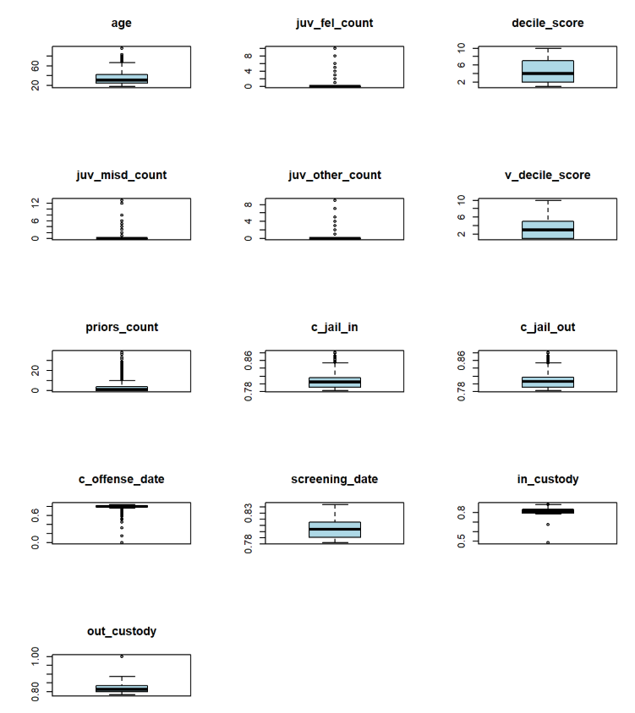
EXPLORATORY DATA ANALYSIS [ EDA ]
Observations – 5855
Variables- 16
1-Response & 15-Predictors
No Null/Missing Values
Summary of the Dataset
-> Mean shows average behavior -> Median helps identify skewness -> Large differences between mean and median indicate outliers
Points outside whiskers indicate potential outliers and here we see that variables like priors_count may contain extreme outliers amongst others.
Box Plot for Outlier Detection
Check Point – Check for Correlation among the variables

Slide 3
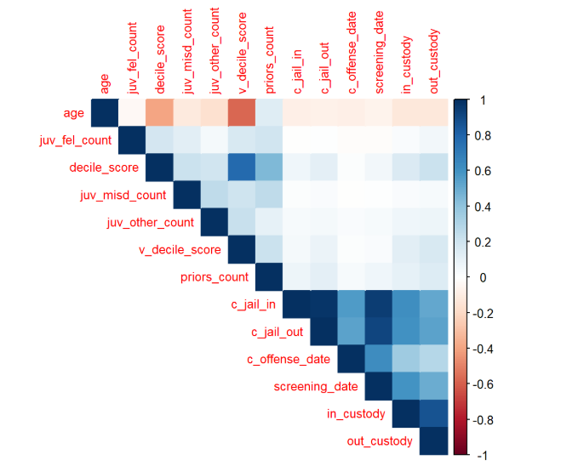
EXPLORATORY DATA ANALYSIS [ EDA ]
Observations – 5855
Variables- 16
1-Response & 15-Predictors
No Null/Missing Values
Correlation close to +1 → strong positive relationship Correlation close to -1 → strong negative relationship High correlation among predictors may create multicollinearity
We pay special attention to: decile_score priors_count juvenile counts custody variables
These are likely important predictors.
Correlation Plot
Check Point – To find Predictive Models for we segregate our data as 70% Train Data (used to build model) and 30% as Test data(to check accuracy). We further fit Full Model, Subset Model and use Ridge and Lasso since we have multi collinearity

Slide 4
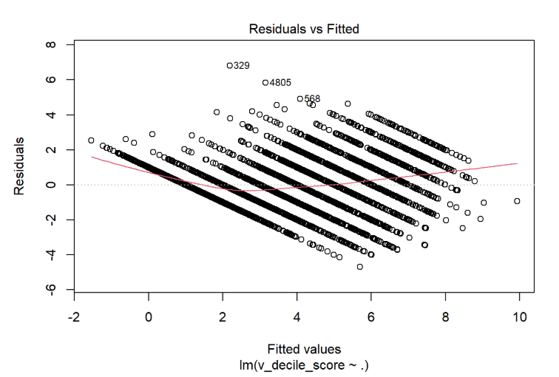
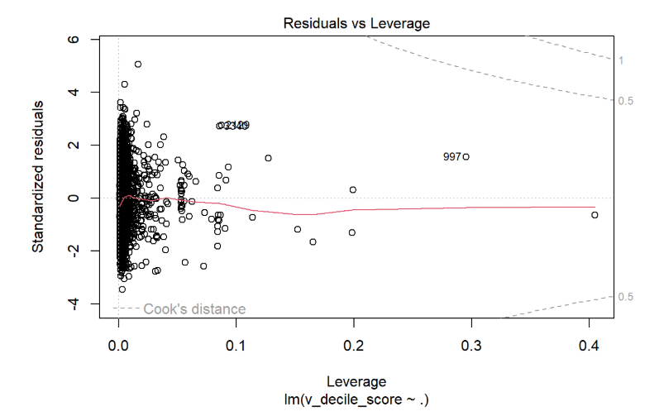
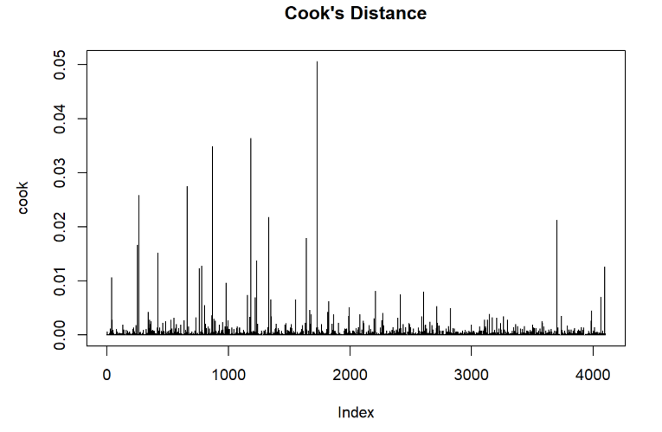
FULL Multiple Linear Regression Model
Fitting a Full Model -> lm(v_decile_score ~ . ,data=train)
Adjusted R-Square = 0.7021, Test MSE= 1.852994
Outliers Detected
Leverage Points Found
No Influential Points found
These points are deleted from the dataset and then we fit a new full model using the cleaned dataset
Check Point - Here in this Full Model all variables are used to predict the response, in further step of refinement we check for a subset where the same response can be predicted using less numbers of predictors.

Slide 5
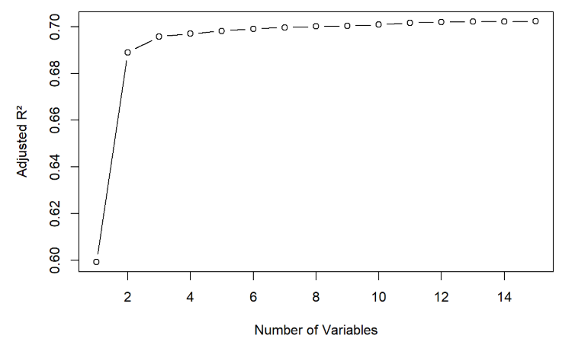
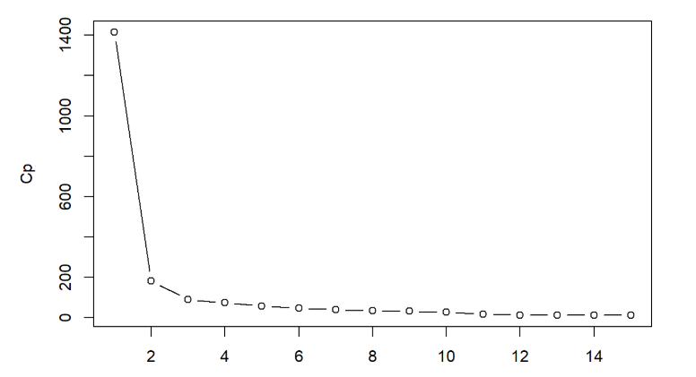
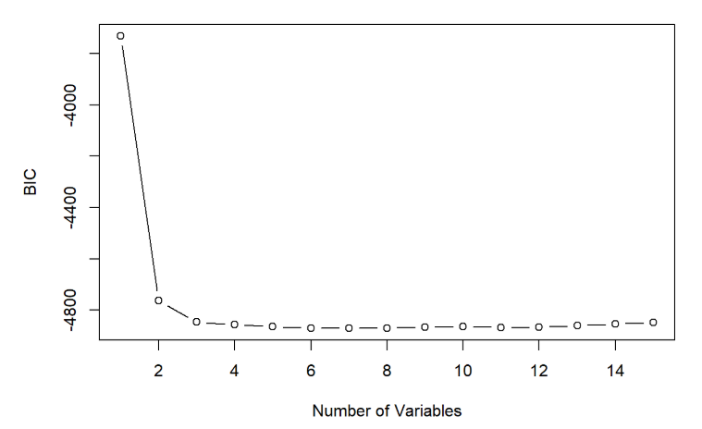
Subset Selection For Model
Forward Stepwise Technique have been used to make the subsets of model and hence factors like Adjusted R-Square, BIC and Mallow’s Cp have been calculated
Consider the Highest Adj R-Sq Value Consider lowest Cp Value Consider lowest BIC Value
Here model of adjr2 and cp has approximately equal R-sq and Adj R-sq value so we choose the best subset model with less number of predictors that is Cp which has 12 predictors.
best_model= lm(v_decile_score ~ age + juv_fel_count + decile_score + juv_misd_count + juv_other_count + priors_count + sex + two_year_recid + race + c_jail_in + c_jail_out + screening_date , data = train )
Adj R-Sq = 0.7022, Test MSE = 1.8233
Check Point – Best Subset Model is better than Full Model

Slide 6
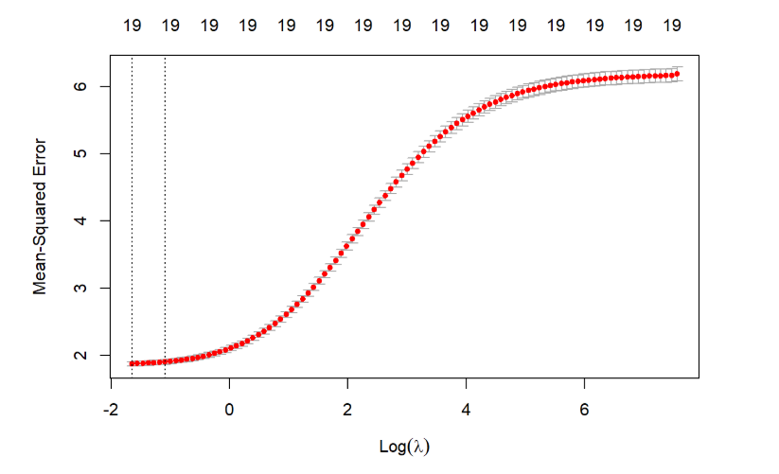
Ridge Regression For Model
Since we have categorical variables in this dataset and multicollinearity then we perform the regression using Ridge and Lasso taking the values of Tuning Parameter through cross validation technique
Ridge helps reducing overfitting of model and multicollinearity among the variables.
ridge_model = glmnet(
x_train,
y_train,
alpha = 0,
lambda = ridge_cv$lambda.min
)
Best Tuning Parameter = 0.1925
Test MSE = 1.85277
Values of Lambda Using Cross Validation

Slide 7
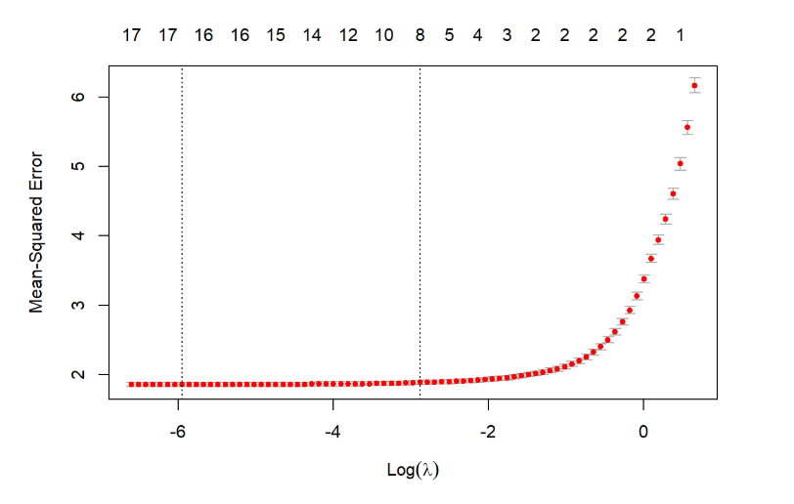

LASSO Regression For Model
LASSO helps for variable selection and shrinkage of coefficients making model performance better.
lasso_model = glmnet(
x_train,
y_train,
alpha = 1,
lambda = lasso_cv$lambda.min
)
Best Tuning Parameter = 0.0025
Test MSE = 1.83685
Values of Lambda Using Cross Validation
Check Point - Compare the Test MSE of all Models and choose the best for Predicting the Decile score of Offender.

Slide 8
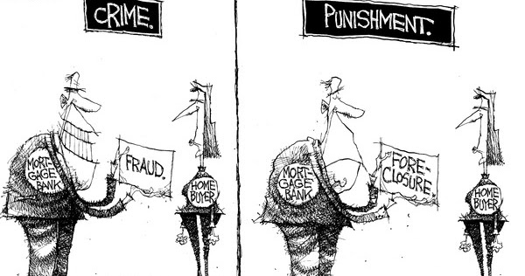
CONCLUSION
Model Test_MSE
Full Regression 1.825994
Best Subset 1.822380
Ridge 1.852778
Lasso 1.836850
Since the TEST MSE of Best subset selected through forward stepwise selection is lower we choose this model over others, here the number of predictors used is also less as compared to other model.
Important predictors are age, COMPASS score decile, Number of other juvenile convictions, Race, Number of prior crimes committed and recidivism within two years as these directly reflect criminal history and risk.
FINDINGS
Criminal history variables strongly influence violent decile risk score. Prior offenses and recidivism indicators are major predictors. Ridge and Lasso improve prediction stability. Removing influential observations improves model reliability. Forward subset selection reduces unnecessary variables.
THANK YOU !!!!!!!!!!!

