Slide 1
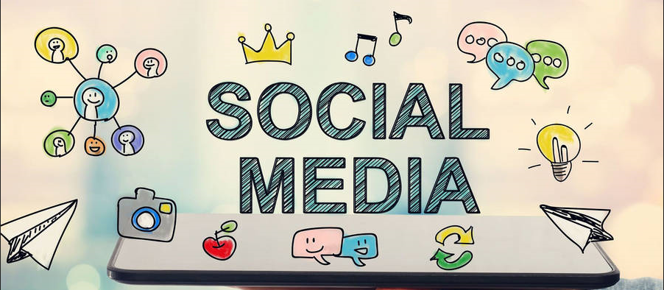
SOCIAL MEDIA ANALYSIS PROJECT
By – Subhrajyoti Guha

Slide 2
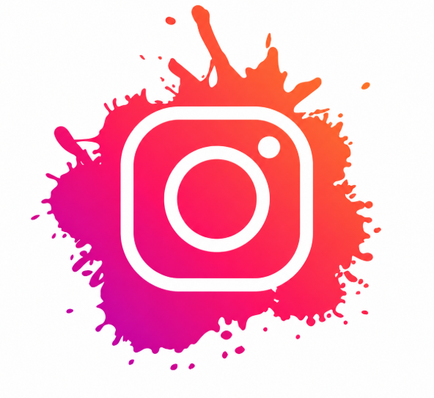
Problem Statement
Context: You are hired as a Data Analyst at Meta to collaborate with the Marketing team.
Objective: The Marketing team wants to leverage Instagram user data to:
Develop targeted marketing strategies
Increase user engagement, retention, and acquisition
Identify actionable insights and provide recommendations
Your Task: Analyze the dataset and provide insights to address these objectives through SQL queries, observations, and strategic recommendations

Slide 3
Instagram Dataset: Columns and Descriptions
Key Data Attributes:
user_id: A unique numeric ID assigned to each registered user on the platform.
username: The public name or handle that identifies the user.
photo_id: A unique identifier for every photo uploaded by users.
image_url: The link pointing directly to the uploaded image.
created_at: The exact timestamp when a record (post, like, comment, follow, or tag) was generated.
comment_id: A unique key assigned to each comment made on a photo.
comment_text: The actual message or feedback written by a user in a comment.
follower_id: Refers to the user who is following another user.
followee_id: Refers to the user who is being followed.
tag_id: A distinct identifier representing a tag applied to a photo (e.g., hashtags or keywords).

Slide 4
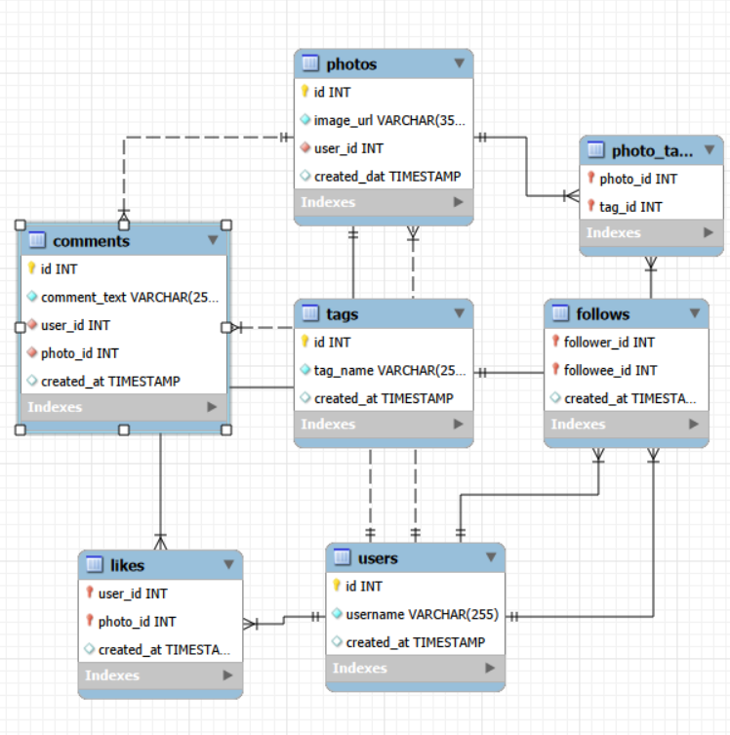
Data Schema

Slide 5
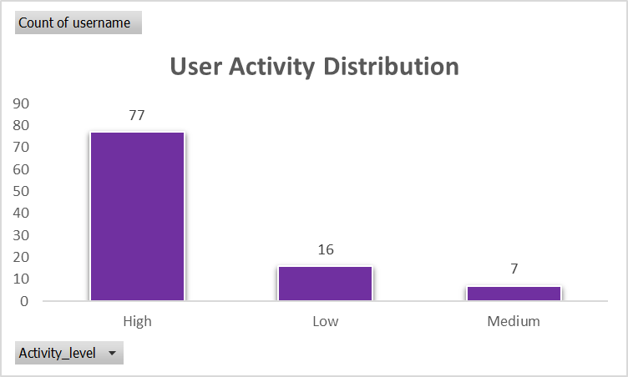
User Activity Distribution
Insights:
Majority of users (77%) are highly active.
Medium activity users are the smallest group (7%), indicating a core but small segment.
Low activity users (16%) may need engagement strategies.
Recommendations:
Focus on encouraging low activity users.
Leverage high activity users to drive engagement.
Target medium users with campaigns to boost activity.

Slide 6
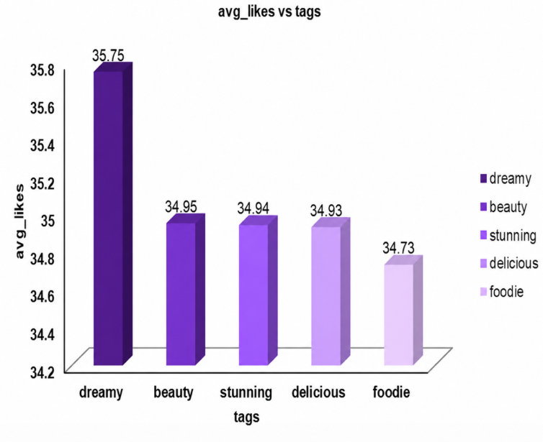
Content Performance
Dreamy Tag has the highest likes where as foodie tags has lowest number of likes.
Hashtags with high count of Likes are the popular tags among all.
Popular tags will be promoted and influencers will promote popular tags by using them in their posts.
Contents related to these tags should be frequently shown on explore pages of the users to engage them.
Tags other than dreamy have very much same no. of likes so they should also be optimised

Slide 7
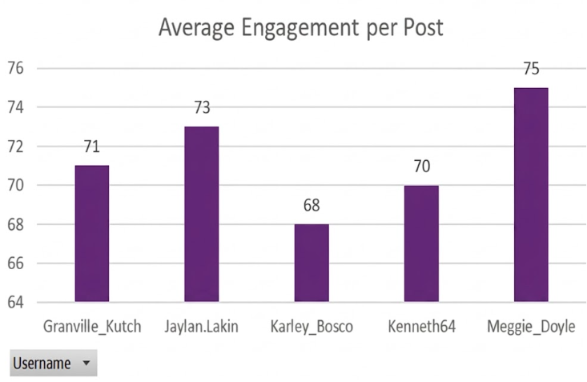
Top Users by Average Engagement per Post
Key Insights:
These users consistently get high engagement.
Their content resonates strongly, indicating influential reach.
Can guide content strategy and influencer campaigns.
Recommendations:
Partner with them for promotions or campaigns.
Analyze their content style to boost engagement platform-wide.
Recognize/reward these users to maintain high activity.

Slide 8
Hashtags Driving Highest Engagement
Output Story:
Among all hashtags, #dreamy stands out with an average of 35.75 likes per post.
This indicates that posts tagged with #dreamy capture users’ attention and consistently generate engagement.
It’s clear that content associated with dreamy, visually appealing, or aspirational themes resonates most with the Instagram audience.
Observations:
dreamy leads in engagement, suggesting user preference for visually aesthetic or inspirational content.
Trending hashtags significantly boost visibility and interaction.
Other high-performing hashtags can provide additional insights into popular content themes.

Slide 9
Summary
Checked for duplicates and missing values; data integrity is intact.
User engagement varies: identified Top 5 users with the highest average engagement.
#dreamy is the most engaging hashtag, indicating user preference for aspirational or visually appealing content.
Follower and followee analysis highlights highly connected users for potential influencer collaboration.

Slide 10
Key Recommendations
Content:-
Smile, Beach, Party, Fun, Food, Concert has highest comments, likes and tags count content around these contents will boost engagement by users
Ads featuring these themes can boost the reach among audiences interested in lifestyle and leisure
Hashtags:-
Popular hashtags like #Photography, #Landscapes, #Beach, and #Stunning are highly effective for expanding reach and attracting a broader audience.
Using these hashtags, along with niche-specific tags, can enhance visibility and drive engagement among users interested in similar content themes.

Slide 11
MORE RECOMMENDATIONS
Selection of Influencer/Brand Ambassador:-
Meggie Doyle, Jaylan. Lakin, Granville Kutch, have the highest engagement rate among other followers
High-engagement users often maintain regular interactions, increasing the likelihood of spreading brand messages organically and boosting credibility.
Rewards/ Incentive to Inactive users:-
Enter active users into a monthly raffle to win rewards such as gift cards, brand merchandise, or premium subscriptions.
Create a points system or badges for engagement (likes, comments, shares) that users can redeem for perks like profile customization, exclusive filters, or even discounts with partner brands

Slide 12
CONCLUSION
Content centered around popular themes like "Smile, Beach, Party, Fun, Food, and Concert" resonates well with audiences, making it ideal for both organic posts and targeted ads to attract lifestyle and leisure-focused users.
Incorporating top-performing hashtags (#Photography, #Landscapes, #Beach, and #Stunning) will further enhance visibility, tapping into a broader audience interested in these themes.
Collaborating with high-engagement influencers such as Meggie Doyle, Jaylan. Lakin, and Granville Kutch will amplify our reach authentically, as their strong follower interactions increase credibility and encourage organic sharing.
Finally, implementing rewards and incentives like raffles and a points-based system will re-engage inactive users, motivating them to participate more frequently.

Slide 13
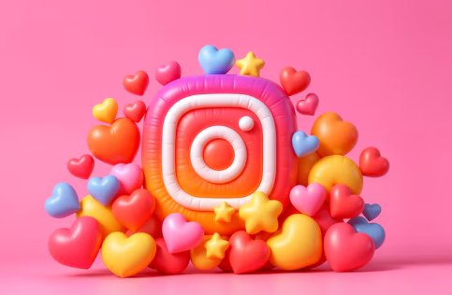
THANK YOU

