Slide 1


LOK SABHA ELECTION 2024
DATA ANALYSIS
REPORT
BY SUBHRANKA DEBNATH

Slide 2

CONTENT
01
INTRODUCTION
02
DATA SCRAPING
03
KEY INSIGHTS
04
CONCLUSION
05
APPENDIX

Slide 3
01
INTRODUCTION
THE RECENT LOK SABHA ELECTIONS IN INDIA HAVE PROVIDED A WEALTH OF DATA THAT CAN BE ANALYZED TO GAIN INSIGHTS INTO VOTING PATTERNS, CONSTITUENCY DYNAMICS, PARTY PERFORMANCES, AND MORE. IN THIS PROJECT, WE AIM TO DELVE INTO THE RESULTS OF THE 2024 INDIAN LOK SABHA ELECTIONS USING DATA SCRAPED FROM THE ELECTION COMMISSION OF INDIA’S OFFICIAL WEBSITE. BY ANALYZING THIS DATA, WE HOPE TO UNCOVER KEY TRENDS AND INSIGHTS THAT CAN INFORM FUTURE ELECTORAL STRATEGIES, UNDERSTAND VOTER BEHAVIOR, AND PROVIDE A COMPREHENSIVE OVERVIEW OF THE ELECTION OUTCOMES.
THIS REPORT WILL DETAIL THE METHODOLOGY USED FOR DATA SCRAPING, THE SUBSEQUENT DATA ANALYSIS, AND THE VISUALIZATION OF KEY INSIGHTS. THE ANALYSIS WILL COVER VARIOUS ASPECTS SUCH AS VOTER TURNOUT, CONSTITUENCY-WISE PERFORMANCE, STATE-WISE CANDIDATE DISTRIBUTION, AND THE PERFORMANCE OF MAJOR POLITICAL PARTIES.

Slide 4
02
DATA SCRAPING
TO GATHER THE NECESSARY DATA FOR OUR ANALYSIS, WE USED WEB SCRAPING TECHNIQUES TO EXTRACT INFORMATION FROM THE ELECTION COMMISSION OF INDIA’S OFFICIAL RESULTS WEBSITE. THE WEBSITE PROVIDES DETAILED RESULTS OF THE LOK SABHA ELECTIONS, INCLUDING CONSTITUENCY-WISE VOTE COUNTS, CANDIDATE DETAILS, PARTY PERFORMANCE, AND MORE. THE DATA SCRAPING PROCESS INVOLVED THE FOLLOWING STEPS:
IDENTIFYING THE DATA SOURCE: THE OFFICIAL RESULTS PAGE OF THE ELECTION COMMISSION OF INDIA (HTTPS://RESULTS.ECI.GOV.IN) WAS IDENTIFIED AS THE PRIMARY SOURCE OF DATA. THIS PAGE CONTAINS COMPREHENSIVE ELECTION RESULTS, INCLUDING DETAILS ON EACH CONSTITUENCY.

Slide 5
2.
3.
4.
5.
WEB SCRAPING TOOLS: PYTHON LIBRARIES SUCH AS ‘REQUESTS’ AND ‘BEAUTIFULSOUP’ WERE USED TO PERFORM WEB SCRAPING. THESE LIBRARIES ALLOW FOR THE EXTRACTION OF HTML CONTENT FROM WEB PAGES AND PARSING OF THE REQUIRED INFORMATION.
DATA EXTRACTION: SPECIFIC ELEMENTS ON THE WEB PAGE CONTAINING THE ELECTION RESULTS WERE TARGETED. THIS INVOLVED IDENTIFYING THE HTML TAGS AND CLASSES THAT ENCAPSULATE THE DATA. THE DATA WAS THEN EXTRACTED AND STORED IN A STRUCTURED FORMAT, SUCH AS A CSV FILE, FOR FURTHER ANALYSIS.
DATA CLEANING: THE EXTRACTED DATA WAS CLEANED TO ENSURE ACCURACY AND CONSISTENCY. THIS INCLUDED HANDLING MISSING VALUES, CORRECTING DATA TYPES, AND REMOVING ANY IRRELEVANT INFORMATION.
DATA STORAGE: THE CLEANED DATA WAS STORED IN A CSV FILE, MAKING IT EASY TO LOAD INTO DATA ANALYSIS TOOLS AND LIBRARIES FOR FURTHER PROCESSING.

Slide 6
import requests
from bs4 import BeautifulSoup
import pandas as pd
# URL of the Election Commission of India's results page
url = 'https://results.eci.gov.in'
# Send a request to the website and get the HTML content
response = requests.get(url)
soup = BeautifulSoup(response.content, 'html.parser')
# Extract the required data
# This part will depend on the structure of the webpage
# For example, to extract constituency-wise results:
data = []
for row in soup.find_all('tr'):
cols = row.find_all('td')
cols = [ele.text.strip() for ele in cols]
if len(cols) > 1: # Ensure that the row is not empty
data.append(cols)
# Convert the extracted data into a DataFrame
df = pd.DataFrame(data, columns=['State', 'Constituency Name', 'Constituency Number', 'Candidate', 'Party', 'EVM Votes', 'Postal Votes', 'Total Votes', '% of Votes'])
# Clean and process the data
df['EVM Votes'] = pd.to_numeric(df['EVM Votes'], errors='coerce')
df['Postal Votes'] = pd.to_numeric(df['Postal Votes'], errors='coerce')
df['Total Votes'] = pd.to_numeric(df['Total Votes'], errors='coerce')
df['% of Votes'] = pd.to_numeric(df['% of Votes'], errors='coerce')
# Save the data to a CSV file
df.to_csv('loksabha_election_results_2024.csv', index=False)
THE FOLLOWING PYTHON CODE SNIPPET DEMONSTRATES THE DATA SCRAPING PROCESS:

Slide 7
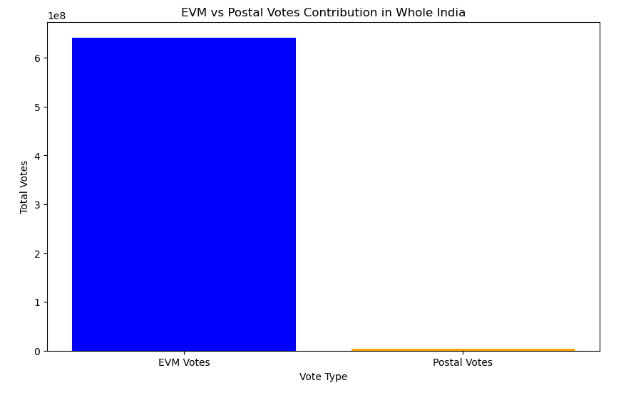
03
KEY INSIGHTS
1.EVMS DOMINATED THE VOTING PROCESS:
EVMS ACCOUNTED FOR 99.42% OF THE TOTAL VOTES CAST.
POSTAL VOTES CONTRIBUTED ONLY 0.58%.
THE MAJORITY OF VOTERS PREFERRED USING EVMS TO CAST THEIR BALLOTS.

Slide 8
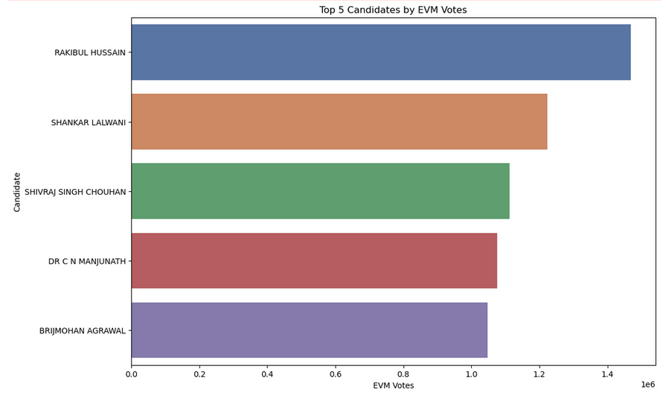
2.TOP 5 CANDIDATES WITH HIGHEST EVM VOTES:
THREE OUT OF THE TOP FIVE CANDIDATES WITH THE HIGHEST EVM VOTES ARE FROM THE BJP (SHANKAR LALWANI, SHIVRAJ SINGH CHOUHAN, BRIJMOHAN AGRAWAL), INDICATING SIGNIFICANT DOMINANCE IN THE 2024 LOK SABHA ELECTIONS.
VOTER PREFERENCE SUGGESTS VOTERS IN THESE CONSTITUENCIES HAVE A STRONG PREFERENCE FOR BJP'S POLICIES AND CANDIDATES.
INCLUSION OF CANDIDATES FROM INC(RAKIBUL HUSSAIN) AND JD(S)(DR. C N MANJUNATH) AMONG THE TOP FIVE INDICATES A COMPETITIVE POLITICAL LANDSCAPE WITH SIGNIFICANT REPRESENTATION FROM MAJOR NATIONAL AND REGIONAL PARTIES.

Slide 9
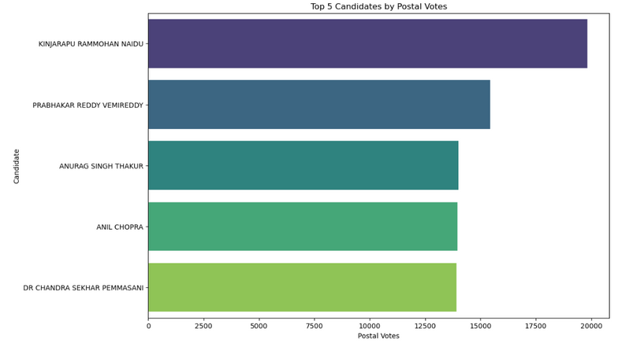
3.TOP 5 CANDIDATES WITH HIGHEST POSTAL VOTES:
TELEGU DESAM PARTY(TDP) LEADS IN THE TOP TWO SPOTS FOR POSTAL VOTES.
BJP IS IN THIRD PLACE, INC IN FOURTH, AND ANOTHER TDP CANDIDATE IN FIFTH PLACE.
INDICATES A STRONG TDP PRESENCE AMONG POSTAL VOTERS, WITH BJP AND INC ALSO HAVING SIGNIFICANT SUPPORT.
UNDERSTANDING POSTAL VOTE TRENDS HELPS IN ANALYZING THE VOTING PREFERENCES OF DIFFERENT PARTIES' SUPPORTERS.

Slide 10
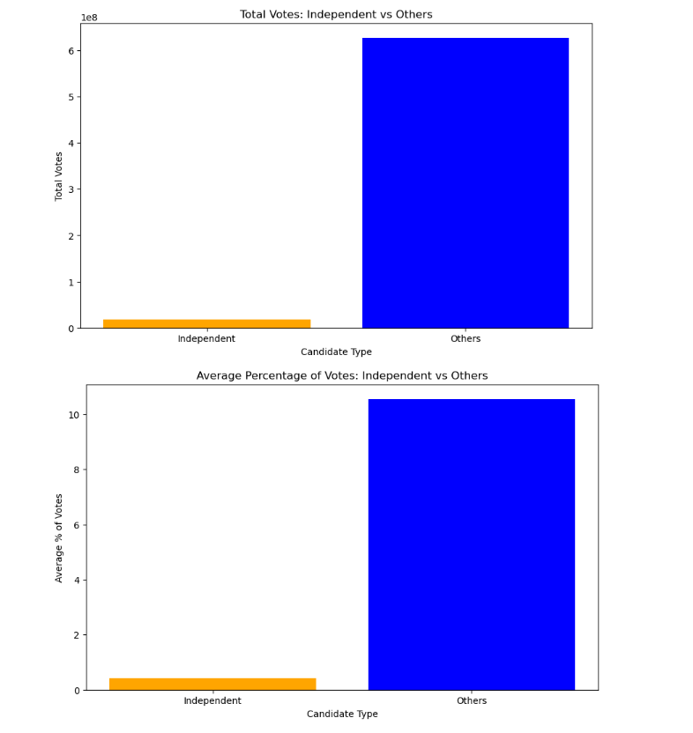
4.PERFORMANCE OF INDEPENDENT CANDIDATES:
INDEPENDENT CANDIDATES RECEIVED SIGNIFICANTLY FEWER VOTES AND A SMALLER PERCENTAGE OF VOTES COMPARED TO OTHER CANDIDATES.
INDICATES THAT INDEPENDENT CANDIDATES STRUGGLE TO COMPETE WITH PARTY-AFFILIATED CANDIDATES.
OUT OF 543 LOK SABHA SEATS, ONLY 7 WERE WON BY INDEPENDENT CANDIDATES.
MOST INDEPENDENT WINNERS WERE FROM SPECIFIC REGIONS, WITH 3 FROM TAMIL NADU AND 2 FROM UTTAR PRADESH.

Slide 11
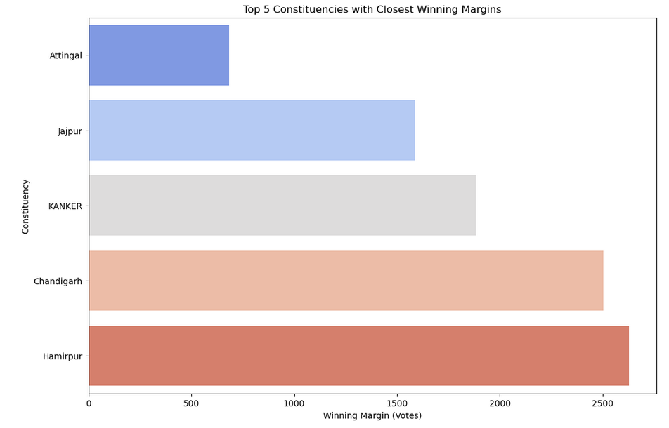
5.TOP 5 CONSTITUENCIES WITH CLOSEST WINNING MARGINS:
CLOSE RACES INDICATE A DEEPLY POLARIZED ELECTORATE WITH STRONG SUPPORT FOR RESPECTIVE CANDIDATES.
VOTERS' CHOICES WERE LIKELY INFLUENCED BY A FOCUS ON LOCAL ISSUES AND CONCERNS.
THESE CLOSE CONTESTS COULD SIGNIFICANTLY IMPACT THE FUTURE POLITICAL LANDSCAPE OF THESE REGIONS.
WINNING CANDIDATES MAY FACE CHALLENGES IN RETAINING THEIR SEATS IN FUTURE ELECTIONS DUE TO NARROW MARGINS.
HIGH LEVELS OF VOTER ENGAGEMENT AND SENSITIVITY TO LOCAL ISSUES ARE EVIDENT.

Slide 12
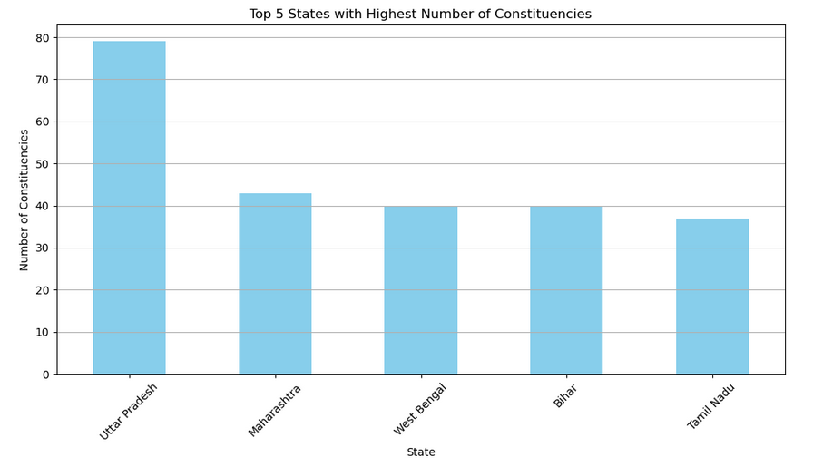
6.TOP 5 STATES WITH HIGHEST NUMBER OF CONSTITUENCIES:
UTTAR PRADESH, MAHARASHTRA, WEST BENGAL, BIHAR, AND TAMIL NADU HAVE THE HIGHEST NUMBER OF CONSTITUENCIES.
UTTAR PRADESH: LEADS WITH AROUND 80 CONSTITUENCIES.
MAHARASHTRA: FOLLOWS WITH AROUND 45 CONSTITUENCIES.
WEST BENGAL, BIHAR, AND TAMIL NADU: EACH HAS AROUND 40 CONSTITUENCIES.
THESE STATES HAVE LARGE POPULATIONS, RESULTING IN SIGNIFICANT REPRESENTATION IN THE INDIAN PARLIAMENT.

Slide 13
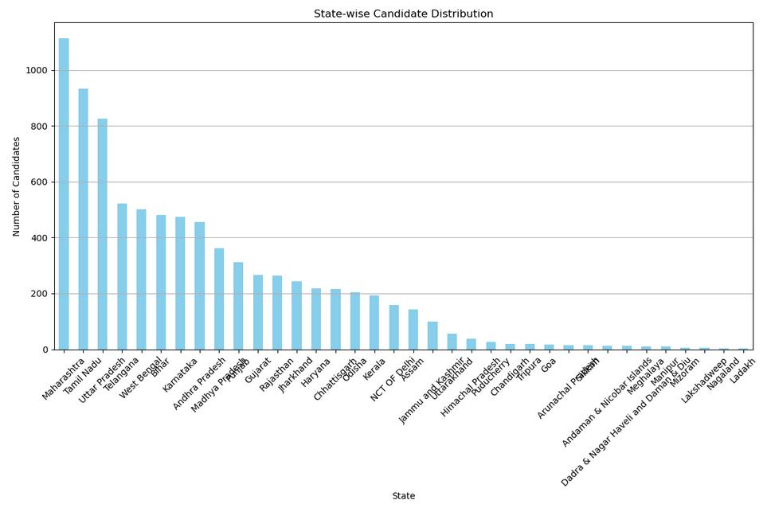
7.STATE-WISE CANDIDATE DISTRIBUTION:
MAHARASHTRA LEADS IN CANDIDATE COUNT, FOLLOWED BY TAMIL NADU AND UTTAR PRADESH.
INDICATES STRONG POLITICAL PARTICIPATION AND COMPETITION IN THESE STATES.
STATES LIKE LADAKH AND LAKSHADWEEP HAVE THE FEWEST CANDIDATES.
STATE SIZE, NUMBER OF CONSTITUENCIES, AND POLITICAL CLIMATE INFLUENCE CANDIDATE DISTRIBUTION.
THIS VARIATION IN CANDIDATE DISTRIBUTION CAN BE EXPLORED TO UNDERSTAND THE UNDERLYING REASONS ACROSS DIFFERENT STATES.

Slide 14
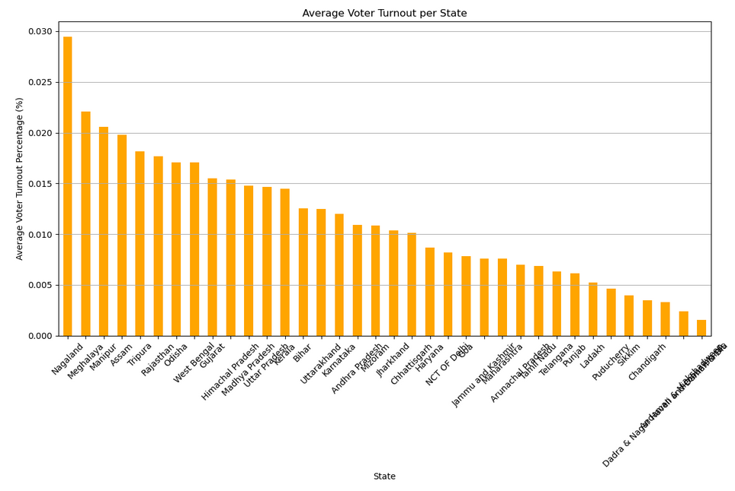
8.AVERAGE VOTER TURNOUT PER STATE:
NAGALAND, MEGHALAYA, AND MANIPUR HAVE THE HIGHEST AVERAGE VOTER TURNOUT PERCENTAGES, INDICATING STRONG CIVIC ENGAGEMENT.
LAKSHADWEEP RECORDED THE LOWEST AVERAGE VOTER TURNOUT PERCENTAGE.
HIGH VOTER TURNOUT IN CERTAIN STATES SUGGESTS EFFECTIVE VOTER MOBILIZATION.
LOWER TURNOUT IN OTHER STATES INDICATES CHALLENGES IN ENCOURAGING VOTER PARTICIPATION.
UNDERSTANDING THESE DISPARITIES CAN HELP DEVELOP STRATEGIES TO IMPROVE VOTER TURNOUT AND STRENGTHEN DEMOCRATIC PROCESSES.

Slide 15
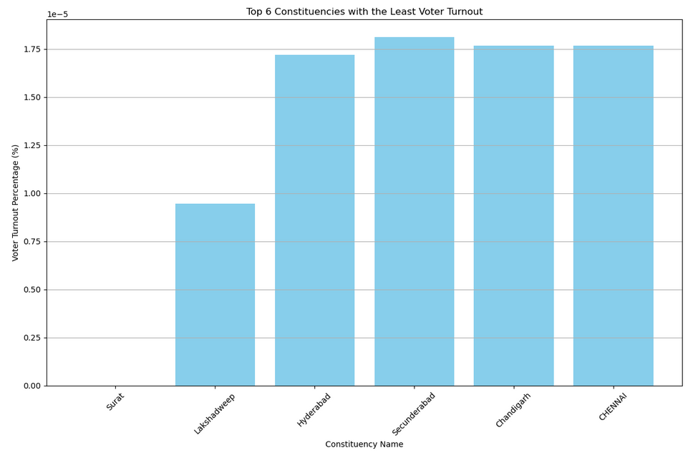
9. CONSTITUENCIES WITH LEAST VOTER TURNOUT:
VOTER TURNOUT PERCENTAGE CRUCIAL FOR CIVIC ENGAGEMENT AND DEMOCRATIC PARTICIPATION.
SOME CONSTITUENCIES SHOW ALARMINGLY LOW TURNOUT RATES.
THESE FINDINGS INDICATE CHALLENGES IN MOBILIZING THE ELECTORATE.
LOW TURNOUT RATES CAN IMPACT DEMOCRATIC REPRESENTATION AND GOVERNANCE.
UNDERSTANDING CONTRIBUTING FACTORS ESSENTIAL FOR TARGETED ENGAGEMENT STRATEGIES.

Slide 16
10. PARTY PERFORMANCE IN MAJOR STATES:
BJP'S STRONG PERFORMANCE: THE BHARATIYA JANATA PARTY (BJP) SHOWCASED STRONG PERFORMANCE IN KEY STATES LIKE UTTAR PRADESH, MAHARASHTRA, AND BIHAR, REFLECTING THEIR STRATEGIC CAMPAIGN EFFORTS AND VOTER OUTREACH.
REGIONAL PARTY DOMINANCE: REGIONAL PARTIES SUCH AS TMC IN WEST BENGAL AND DMK IN TAMIL NADU DEMONSTRATED THEIR STRONG INFLUENCE AND ABILITY TO SECURE VOTER SUPPORT.
OPPOSITION STRUGGLES: THE INDIAN NATIONAL CONGRESS (INC) AND OTHER SMALLER PARTIES FACED CHALLENGES IN SECURING SIGNIFICANT SEATS, INDICATING A NEED FOR BETTER ENGAGEMENT AND STRATEGIES TO WIN OVER THE ELECTORATE.

Slide 17
04
CONCLUSION
IN CONCLUSION, THIS REPORT PROVIDES A COMPREHENSIVE ANALYSIS OF THE LOK SABHA ELECTION 2024 DATA, OFFERING VALUABLE INSIGHTS INTO THE ELECTORAL LANDSCAPE OF INDIA. THE FINDINGS HIGHLIGHT THE DOMINANCE OF EVMS IN THE VOTING PROCESS, THE PERFORMANCE OF TOP CANDIDATES, AND THE STRUGGLES OF INDEPENDENT CANDIDATES. THE REPORT ALSO SHEDS LIGHT ON THE CLOSEST WINNING MARGINS, STATE-WISE CANDIDATE DISTRIBUTION, AND AVERAGE VOTER TURNOUT. FURTHERMORE, IT IDENTIFIES THE CONSTITUENCIES WITH THE LEAST VOTER TURNOUT AND PARTY PERFORMANCE IN MAJOR STATES.
THE ANALYSIS IS SUPPORTED BY DATA VISUALIZATIONS CREATED USING PYTHON'S PANDAS AND MATPLOTLIB LIBRARIES, WHICH FACILITATE A DEEPER UNDERSTANDING OF THE TRENDS AND PATTERNS IN THE DATA. THE REPORT'S FINDINGS CAN INFORM ELECTORAL STRATEGIES, POLICY DECISIONS, AND CIVIC ENGAGEMENT INITIATIVES.

Slide 18
APPENDIX
05
DATA COLLECTION METHODOLOGY:
THE DATA FOR THIS REPORT WAS SCRAPED FROM THE OFFICIAL WEBSITE OF THE ELECTION COMMISSION OF INDIA (https://results.eci.gov.in) USING PYTHON'S REQUESTS, CSV, PANDAS, AND BEAUTIFULSOUP LIBRARIES.
TECHNICAL SPECIFICATIONS:
PROGRAMMING LANGUAGE: PYTHON 3.X
LIBRARIES USED: PANDAS, MATPLOTLIB, REQUESTS, CSV, BEAUTIFULSOUP
DATA VISUALIZATION TOOLS: MATPLOTLIB
DATA SOURCE: ELECTION COMMISSION OF INDIA WEBSITE (https://results.eci.gov.in)
ACKNOWLEDGMENTS:
THE AUTHOR WOULD LIKE TO ACKNOWLEDGE THE ASSISTANCE PROVIDED BY CHATGPT AND OTHER AI TOOLS IN GENERATING CODE SNIPPETS, DATA VISUALIZATION IDEAS, AND REPORT WRITING SUGGESTIONS.

Slide 19
THANK YOU

