Slide 1


LOK SABHA ELECTION 2024
DATA ANALYSIS
REPORT
BY SUBHRANKA DEBNATH

Slide 2

CONTENT
01
INTRODUCTION
02
DATA SCRAPING
03
KEY INSIGHTS
04
CONCLUSION
05
APPENDIX

Slide 3
01
INTRODUCTION
THE RECENT LOK SABHA ELECTIONS IN INDIA HAVE PROVIDED A WEALTH OF DATA THAT CAN BE ANALYZED TO GAIN INSIGHTS INTO VOTING PATTERNS, CONSTITUENCY DYNAMICS, PARTY PERFORMANCES, AND MORE. IN THIS PROJECT, WE AIM TO DELVE INTO THE RESULTS OF THE 2024 INDIAN LOK SABHA ELECTIONS USING DATA SCRAPED FROM THE ELECTION COMMISSION OF INDIA’S OFFICIAL WEBSITE. BY ANALYZING THIS DATA, WE HOPE TO UNCOVER KEY TRENDS AND INSIGHTS THAT CAN INFORM FUTURE ELECTORAL STRATEGIES, UNDERSTAND VOTER BEHAVIOR, AND PROVIDE A COMPREHENSIVE OVERVIEW OF THE ELECTION OUTCOMES.
This report will detail the methodology used for data scraping, the subsequent data analysis, and the visualization of key insights. The analysis will cover various aspects such as voter turnout, constituency-wise performance, state-wise candidate distribution, and the performance of major political parties.

Slide 4
02
DATA SCRAPING
TO GATHER THE NECESSARY DATA FOR OUR ANALYSIS, WE USED WEB SCRAPING TECHNIQUES TO EXTRACT INFORMATION FROM THE ELECTION COMMISSION OF INDIA’S OFFICIAL RESULTS WEBSITE. THE WEBSITE PROVIDES DETAILED RESULTS OF THE LOK SABHA ELECTIONS, INCLUDING CONSTITUENCY-WISE VOTE COUNTS, CANDIDATE DETAILS, PARTY PERFORMANCE, AND MORE. THE DATA SCRAPING PROCESS INVOLVED THE FOLLOWING STEPS:
Identifying the Data Source: The official results page of the Election Commission of India (https://results.eci.gov.in) was identified as the primary source of data. This page contains comprehensive election results, including details on each constituency.

Slide 5
2.
3.
4.
5.
WEB SCRAPING TOOLS: PYTHON LIBRARIES SUCH AS ‘REQUESTS’ AND ‘BEAUTIFULSOUP’ WERE USED TO PERFORM WEB SCRAPING. THESE LIBRARIES ALLOW FOR THE EXTRACTION OF HTML CONTENT FROM WEB PAGES AND PARSING OF THE REQUIRED INFORMATION.
Data Extraction: Specific elements on the web page containing the election results were targeted. This involved identifying the HTML tags and classes that encapsulate the data. The data was then extracted and stored in a structured format, such as a CSV file, for further analysis.
Data Cleaning: The extracted data was cleaned to ensure accuracy and consistency. This included handling missing values, correcting data types, and removing any irrelevant information.
DATA STORAGE: THE CLEANED DATA WAS STORED IN A CSV FILE, MAKING IT EASY TO LOAD INTO DATA ANALYSIS TOOLS AND LIBRARIES FOR FURTHER PROCESSING.

Slide 6
import requests
from bs4 import BeautifulSoup
import pandas as pd
# URL of the Election Commission of India's results page
url = 'https://results.eci.gov.in'
# Send a request to the website and get the HTML content
response = requests.get(url)
soup = BeautifulSoup(response.content, 'html.parser')
# Extract the required data
# This part will depend on the structure of the webpage
# For example, to extract constituency-wise results:
data = []
for row in soup.find_all('tr'):
cols = row.find_all('td')
cols = [ele.text.strip() for ele in cols]
if len(cols) > 1: # Ensure that the row is not empty
data.append(cols)
# Convert the extracted data into a DataFrame
df = pd.DataFrame(data, columns=['State', 'Constituency Name', 'Constituency Number', 'Candidate', 'Party', 'EVM Votes', 'Postal Votes', 'Total Votes', '% of Votes'])
# Clean and process the data
df['EVM Votes'] = pd.to_numeric(df['EVM Votes'], errors='coerce')
df['Postal Votes'] = pd.to_numeric(df['Postal Votes'], errors='coerce')
df['Total Votes'] = pd.to_numeric(df['Total Votes'], errors='coerce')
df['% of Votes'] = pd.to_numeric(df['% of Votes'], errors='coerce')
# Save the data to a CSV file
df.to_csv('loksabha_election_results_2024.csv', index=False)
The following Python code snippet demonstrates the data scraping process:

Slide 7
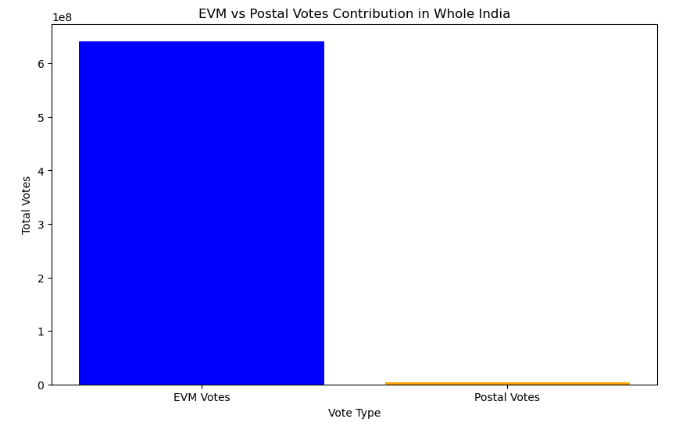
03
KEY INSIGHTS
1.EVMS DOMINATED THE VOTING PROCESS:
OUR ANALYSIS REVEALS THAT ELECTRONIC VOTING MACHINES (EVMS) ACCOUNTED FOR 99.42% OF THE TOTAL VOTES CAST IN THE 2024 INDIAN LOK SABHA ELECTION, WHILE POSTAL VOTES CONTRIBUTED 0.58%. THIS SUGGESTS THAT EVMS WERE THE PRIMARY MODE OF VOTING IN THE ELECTION, WITH THE MAJORITY OF VOTERS OPTING TO CAST THEIR BALLOTS THROUGH THIS METHOD.

Slide 8
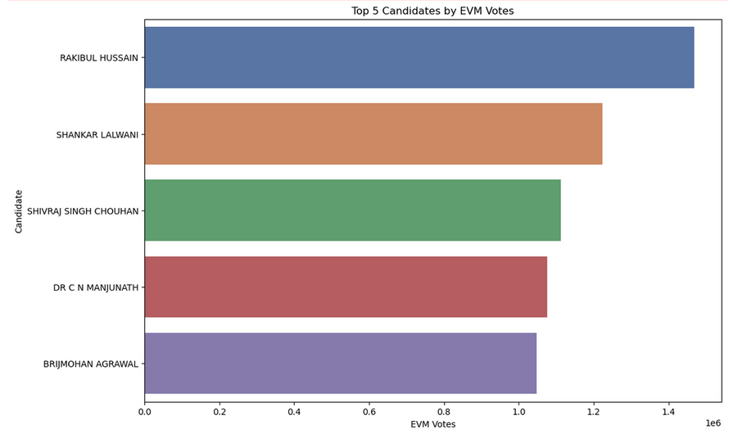
2.TOP 5 CANDIDATES WITH HIGHEST EVM VOTES:
RAKIBUL HUSSAIN (INC) LEADS WITH THE HIGHEST NUMBER OF EVM VOTES, INDICATING STRONG VOTER SUPPORT, SHANKAR LALWANI (BJP) SECURES THE SECOND-HIGHEST EVM VOTES, SHOWCASING SIGNIFICANT BACKING, SHIVRAJ SINGH CHOUHAN (BJP) ANOTHER MAJOR BJP CANDIDATE WITH SUBSTANTIAL EVM VOTES, DR. C N MANJUNATH (JD(S)) WITH A HIGH NUMBER OF EVM VOTES, HIGHLIGHTING REGIONAL PARTY INFLUENCE AND BRIJMOHAN AGRAWAL (BJP) FURTHER STRENGTHENS THE BJP'S REPRESENTATION AMONG THE TOP CANDIDATES BY EVM VOTES.

Slide 9
THE FACT THAT THREE OUT OF THE TOP FIVE CANDIDATES WITH THE HIGHEST EVM VOTES ARE FROM THE BHARATIYA JANATA PARTY (BJP) INDICATES A SIGNIFICANT DOMINANCE OF THE BJP IN THE 2024 LOK SABHA ELECTIONS. THIS HIGHLIGHTS THE PARTY'S EFFECTIVE CAMPAIGNING AND STRONG VOTER BASE.
The dominance of BJP candidates in the top ranks suggests that voters in these constituencies have a strong preference for BJP's policies and candidates.
The inclusion of candidates from INC and JD(S) among the top five indicates a competitive political landscape, with significant representation from major national and regional parties.

Slide 10
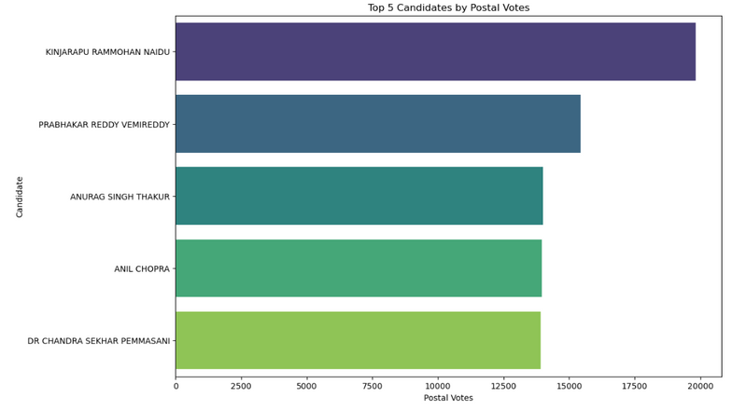
3.TOP 5 CANDIDATES WITH HIGHEST POSTAL VOTES:
THE ANALYSIS OF POSTAL VOTES REVEALS AN INTERESTING TREND, WITH THE TELUGU DESAM PARTY (TDP) DOMINATING THE TOP TWO SPOTS, FOLLOWED BY THE BHARATIYA JANATA PARTY (BJP) IN THIRD PLACE, THE INDIAN NATIONAL CONGRESS (INC) IN FOURTH PLACE, AND ANOTHER TDP CANDIDATE IN FIFTH PLACE. THIS SUGGESTS THAT THE TDP HAS A STRONG PRESENCE AMONG VOTERS WHO PREFER TO CAST THEIR VOTES BY POST, WHILE THE BJP AND INC ALSO HAVE A SIGNIFICANT PRESENCE IN THIS DEMOGRAPHIC. THIS COULD BE AN IMPORTANT FACTOR TO CONSIDER IN UNDERSTANDING THE VOTING PATTERNS AND PREFERENCES OF DIFFERENT PARTIES' SUPPORTERS.

Slide 11
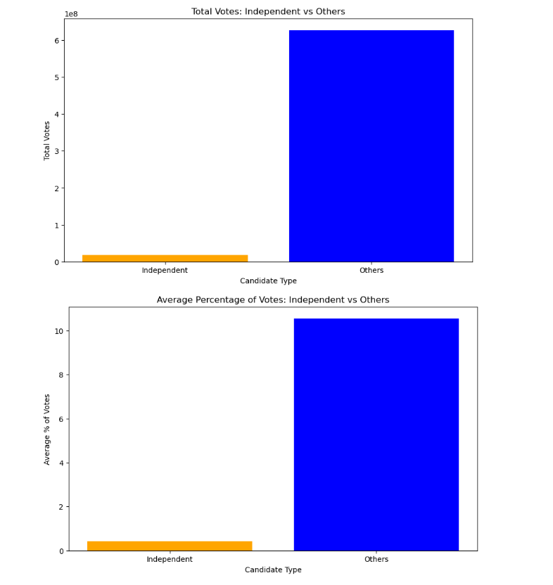
4.PERFORMANCE OF INDEPENDENT CANDIDATES:
INDEPENDENT CANDIDATES RECEIVED SIGNIFICANTLY FEWER VOTES THAN OTHER CANDIDATES. THEY ALSO RECEIVED A MUCH SMALLER PERCENTAGE OF VOTES. THIS SUGGESTS THAT INDEPENDENT CANDIDATES STRUGGLE TO COMPETE WITH OTHER TYPES OF CANDIDATES.
OUT OF A TOTAL OF 543 LOK SABHA SEATS, ONLY 7 WERE WON BY INDEPENDENT CANDIDATES, WHICH IS A SMALL FRACTION.
MOST OF THE INDEPENDENT WINNERS CAME FROM SPECIFIC REGIONS, SUCH AS TAMIL NADU (3 WINNERS) AND UTTAR PRADESH (2 WINNERS).

Slide 12
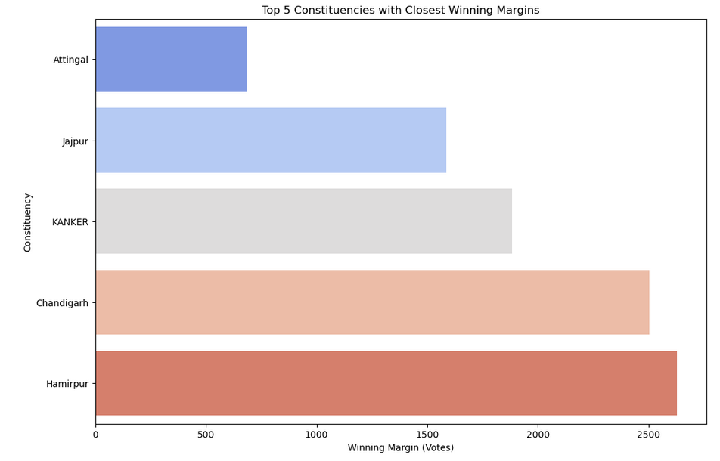
5.TOP 5 CONSTITUENCIES WITH CLOSEST WINNING MARGINS:
THE CLOSE RACES SUGGEST A DEEPLY POLARIZED ELECTORATE, WITH VOTERS STRONGLY SUPPORTING THEIR RESPECTIVE CANDIDATES. THE FOCUS ON LOCAL ISSUES AND CONCERNS MIGHT HAVE PLAYED A SIGNIFICANT ROLE IN INFLUENCING VOTERS' CHOICES, LEADING TO CLOSE CONTESTS.
THESE CLOSE CONTESTS COULD HAVE SIGNIFICANT IMPLICATIONS FOR THE FUTURE POLITICAL LANDSCAPE OF THESE REGIONS. THE WINNING CANDIDATES MIGHT FACE A CONSTANT CHALLENGE IN RETAINING THEIR SEATS IN THE NEXT ELECTIONS, AS THE NARROW MARGINS INDICATE A HIGH LEVEL OF VOTER ENGAGEMENT AND SENSITIVITY TO LOCAL ISSUES.

Slide 13
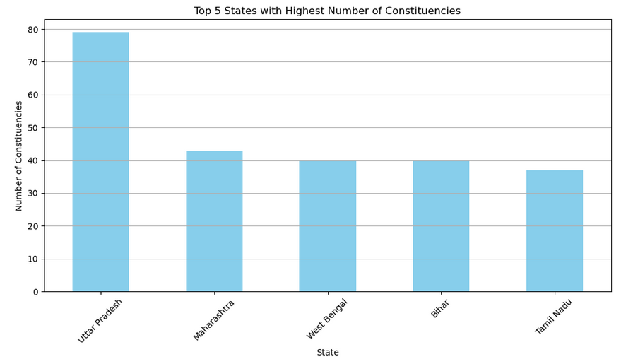
6.TOP 5 STATES WITH HIGHEST NUMBER OF CONSTITUENCIES:
THE TOP 5 STATES WITH THE HIGHEST NUMBER OF CONSTITUENCIES ARE UTTAR PRADESH, MAHARASHTRA, WEST BENGAL, BIHAR, AND TAMIL NADU. UTTAR PRADESH HAS THE MOST WITH AROUND 80 CONSTITUENCIES, FOLLOWED BY MAHARASHTRA WITH AROUND 45 CONSTITUENCIES.
WEST BENGAL, BIHAR, AND TAMIL NADU EACH HAVE AROUND 40 CONSTITUENCIES. THIS SUGGESTS THAT THESE STATES HAVE A LARGE POPULATION AND ARE THEREFORE WELL REPRESENTED IN THE INDIAN PARLIAMENT.

Slide 14
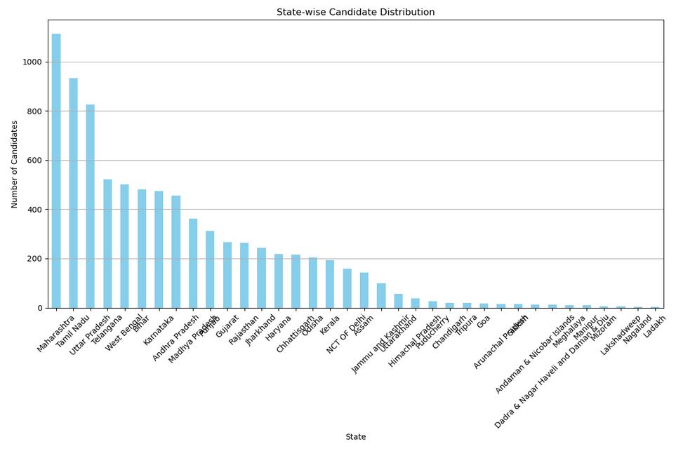
7.STATE-WISE CANDIDATE DISTRIBUTION:
THE STATE-WISE CANDIDATE DISTRIBUTION CHART REVEALS THAT MAHARASHTRA HAS THE HIGHEST NUMBER OF CANDIDATES, FOLLOWED BY TAMIL NADU AND UTTAR PRADESH. THIS INDICATES A STRONG POLITICAL PARTICIPATION AND COMPETITION IN THESE STATES. THE NUMBER OF CANDIDATES GRADUALLY DECREASES AS WE MOVE DOWN THE CHART, WITH STATES LIKE LADAKH AND LAKSHADWEEP HAVING THE FEWEST CANDIDATES. THIS COULD BE ATTRIBUTED TO VARIOUS FACTORS, INCLUDING THE SIZE OF THE STATE, THE NUMBER OF CONSTITUENCIES, AND THE POLITICAL CLIMATE.
IT IS ALSO INTERESTING TO NOTE THAT THERE IS A CLUSTER OF STATES IN THE MIDDLE WITH SIMILAR NUMBERS OF CANDIDATES, SUGGESTING A BALANCED LEVEL OF POLITICAL ENGAGEMENT. THIS INFORMATION CAN BE FURTHER EXPLORED TO UNDERSTAND THE REASONS BEHIND THE VARIATION IN CANDIDATE DISTRIBUTION ACROSS DIFFERENT STATES.

Slide 15
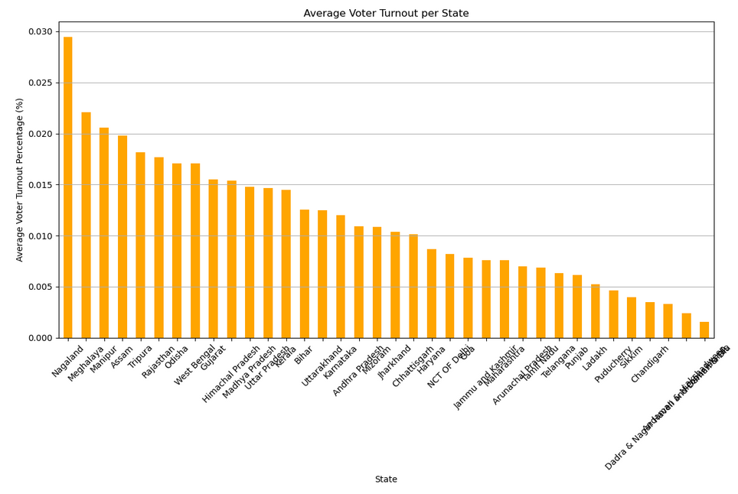
8.AVERAGE VOTER TURNOUT PER STATE:
THE AVERAGE VOTER TURNOUT PER STATE IS A CRUCIAL INDICATOR OF CIVIC ENGAGEMENT AND DEMOCRATIC PARTICIPATION. As depicted in the bar chart, Nagaland tops the list with the highest average voter turnout percentage, followed closely by meghalaya and manipur. On the other end, lakshwadeep recorded the lowest average voter turnout percentage.
THESE FINDINGS SUGGEST THAT CERTAIN STATES HAVE BEEN MORE SUCCESSFUL IN MOBILIZING THEIR ELECTORATE, WHILE OTHERS FACE CHALLENGES IN ENCOURAGING CITIZENS TO EXERCISE THEIR RIGHT TO VOTE. UNDERSTANDING THE FACTORS CONTRIBUTING TO THESE DISPARITIES CAN INFORM STRATEGIES TO IMPROVE VOTER TURNOUT AND STRENGTHEN DEMOCRATIC PROCESSES.

Slide 16
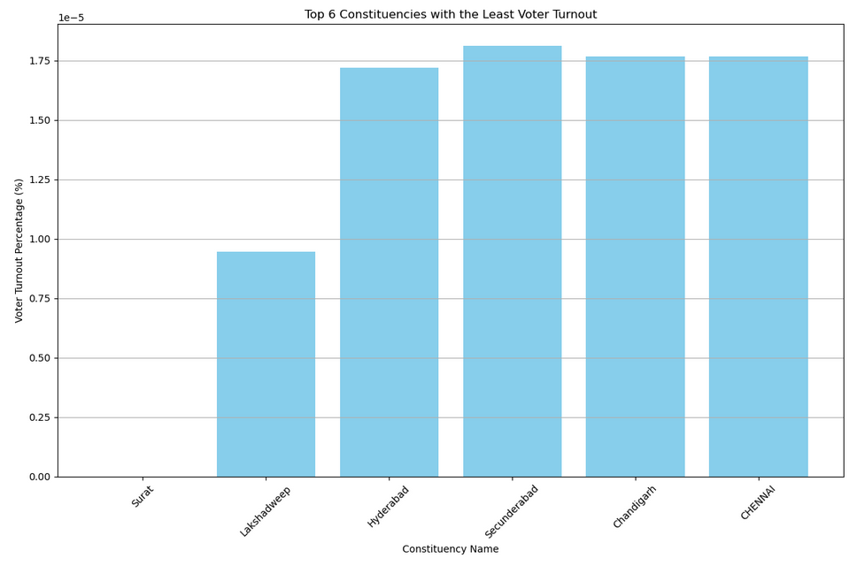
9. CONSTITUENCIES WITH LEAST VOTER TURNOUT:
THE VOTER TURNOUT PERCENTAGE IS A CRITICAL INDICATOR OF CIVIC ENGAGEMENT AND DEMOCRATIC PARTICIPATION. OUR ANALYSIS REVEALS THAT CERTAIN CONSTITUENCIES LAG BEHIND IN TERMS OF VOTER TURNOUT, WITH SOME RECORDING ALARMINGLY LOW PERCENTAGES. THESE FINDINGS SUGGEST THAT THESE CONSTITUENCIES FACE SIGNIFICANT CHALLENGES IN MOBILIZING THEIR ELECTORATE, WHICH CAN HAVE FAR-REACHING IMPLICATIONS FOR DEMOCRATIC REPRESENTATION AND GOVERNANCE.
UNDERSTANDING THE UNDERLYING FACTORS CONTRIBUTING TO THESE LOW TURNOUT RATES IS ESSENTIAL TO DEVELOP TARGETED STRATEGIES TO IMPROVE VOTER ENGAGEMENT AND PARTICIPATION.

Slide 17
10. PARTY PERFORMANCE IN MAJOR STATES:
BJP'S STRONG PERFORMANCE: THE BHARATIYA JANATA PARTY (BJP) SHOWCASED STRONG PERFORMANCE IN KEY STATES LIKE UTTAR PRADESH, MAHARASHTRA, AND BIHAR, REFLECTING THEIR STRATEGIC CAMPAIGN EFFORTS AND VOTER OUTREACH.
REGIONAL PARTY DOMINANCE: REGIONAL PARTIES SUCH AS TMC IN WEST BENGAL AND DMK IN TAMIL NADU DEMONSTRATED THEIR STRONG INFLUENCE AND ABILITY TO SECURE VOTER SUPPORT.
OPPOSITION STRUGGLES: THE INDIAN NATIONAL CONGRESS (INC) AND OTHER SMALLER PARTIES FACED CHALLENGES IN SECURING SIGNIFICANT SEATS, INDICATING A NEED FOR BETTER ENGAGEMENT AND STRATEGIES TO WIN OVER THE ELECTORATE.

Slide 18
04
CONCLUSION
IN CONCLUSION, THIS REPORT PROVIDES A COMPREHENSIVE ANALYSIS OF THE LOK SABHA ELECTION 2024 DATA, OFFERING VALUABLE INSIGHTS INTO THE ELECTORAL LANDSCAPE OF INDIA. THE FINDINGS HIGHLIGHT THE DOMINANCE OF EVMS IN THE VOTING PROCESS, THE PERFORMANCE OF TOP CANDIDATES, AND THE STRUGGLES OF INDEPENDENT CANDIDATES. THE REPORT ALSO SHEDS LIGHT ON THE CLOSEST WINNING MARGINS, STATE-WISE CANDIDATE DISTRIBUTION, AND AVERAGE VOTER TURNOUT. FURTHERMORE, IT IDENTIFIES THE CONSTITUENCIES WITH THE LEAST VOTER TURNOUT AND PARTY PERFORMANCE IN MAJOR STATES.
The analysis is supported by data visualizations created using Python's pandas and matplotlib libraries, which facilitate a deeper understanding of the trends and patterns in the data. The report's findings can inform electoral strategies, policy decisions, and civic engagement initiatives.

Slide 19
APPENDIX
05
DATA COLLECTION METHODOLOGY:
The data for this report was scraped from the official website of the Election Commission of India (https://results.eci.gov.in) using Python's requests, csv, pandas, and BeautifulSoup libraries.
Technical Specifications:
Programming language: Python 3.x
Libraries used: pandas, matplotlib, requests, csv, BeautifulSoup
Data visualization tools: matplotlib
Data source: Election Commission of India website (https://results.eci.gov.in)
Acknowledgments:
The author would like to acknowledge the assistance provided by ChatGPT and other AI tools in generating code snippets, data visualization ideas, and report writing suggestions.

Slide 20
THANK YOU

