Slide 1
SQLite

Slide 2
Relational Database
A database is an organised collection of structured information, or data, typically stored electronically in a computer system.
For examples, all students and lecturers are stored in databases.
Data in a database are stored in tables. For example, a table called students will contain the details of all the students in the university or a particular school.
Relational database: This is an approach where we consider our collections of information about objects such as Tables with columns and rows. A database can have many tables. A relational database organises data into related tables made up of rows and columns.
Object-oriented databases. Information in an object-oriented database is represented in the form of objects, as in object-oriented programming.

Slide 3
Relational Database
You will notice that more than one student takes the same class. In most databases you will find repetitive data such as this. To make database work more efficiently, the repeated data is often stored in a separate table. In this case there is a class table which would store all the information about each class to save having to repeat all the class details for each student.
Table: students
ID | name | class | grade
1899877D | Mary | Python | 67
2223998M | John | Maths | 34
2348990M | Anne | Python | 70
Table: class
class | lecturer
Python | Jack
Maths | Laurie
Java | Joe
By splitting the data into two tables, if we need to update the lecturer, it will only need to be updated once rather than updating it several times, which would have happened if it was all stored in one table.
This is a one-to-many relationship: one class can be associated with many students.

Slide 4
Primary Keys
A primary key A primary key is a field, or combination of fields, whose value uniquely identifies each record in a table.
For example, in the students table, the primary key will be the ID column and in the class table, the primary key is the class column.
Each item in the supermarket has a bar-code, The bar code represents the product-code. The product-code is the key of the item in the database.
Your telephone has a unique number which no-one else has. This is the key of your phone's record held by your service provider
When creating a table, you need to identify the following for each field:
  The name of the field (field name cannot contain spaces and must follow the same rules as variables names)
  If it is a primary key
  The data type for that field

Slide 5
Data types for fields(SQLite storage classes)
INTEGER: the value is an integer value
REAL: the value is a floating-pint value
TEXT: the value is a string text
BLOB: the value is stored exactly as it was input.
You can also specify if the field cannot be left blank by adding NOT NULL to the end of the field when you create it

Slide 6
SQLite
SQL stands for “Structured Query Language” and is the main language that large database packages use. An open-source relational database management system based on SQL.
SQLite is a lightweight relational database system that stores a database in a single file and can be accessed from Python using the built-in sqlite3 module.
Python already includes the sqlite3 module; you do not need to download SQLite separately just to use it from Python.
To use SQLite as optional graphical tool, you need to load the DB Browser for SQLite from https://sqlitebrowser.org

Slide 7
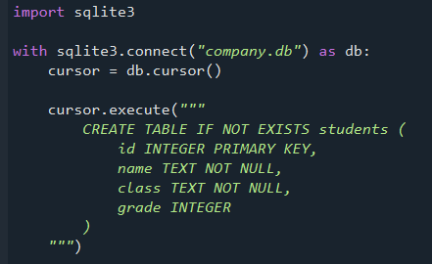
SQLite3 - Example code
import sqlite3 Allows Python to use the SQLite3 library
with sqlite3.connect(“company.db”) as db:
  cursor=db.cursor() Connects to the company database. If no such database exists, it will create one. The file will be stored in the same folder as the programme.
cursor.execute()creates a table called students which has four fields (id, name, class and grade). It specifies the data type for each field, defines which field is the primary key and which field cannot be left blank. The triple speech marks allow the code to be split over several lines to make it easier to read rather than having it all displayed in one line.

Slide 8
Example code
cursor.execute(
"INSERT INTO students (id, name, class, grade) VALUES (?, ?, ?, ?)",
(1, "Mary", "Python", 67)
)
db.commit() Inserts data into the students table. The db.commit() line saves the changes.
newID = input (“Enter ID number: ”)
newName = input(“Enter name: ”)
newClass = input(“Enter class: ”)
newGrade = input(“Enter grade: ”)
cursor.execute(“““INSERT INTO students(id, name, class, grade)
VALUES(?, ?, ?, ?)”””, (newID, newName, newClass, newGrade))
db.commit() allows a user to enter new data, which is then inserted into the students table
cursor.execute(“SELECT * FROM students”)
print(cursor.fetchall()) displays all the data from the students table.
db.close() Close the database connection when you have finished using it

Slide 9
Example code
cursor.execute(“SELECT * FROM students”) for x in cursor.fetchall():
print(x) Displays all the data from the students table and displays each record on a separate line
cursor.execute(“SELECT * FROM students ORDER By name”) for x in cursor.fetchall():
print(x) Selects all the data from the students table, sorted by name and displays each record on a separate line.
cursor.execute(“SELECT * FROM students WHERE grade>50”) Selects all the data from the students table where the grade is over 50.
cursor.execute(“SELECT * FROM students WHERE class = ‘Python’”) selects all the data from the students table where the class is “Python”.
cursor.execute(“““SELECT students.id, students.name, students.lecturer
FROM students, class WHERE students.class=class.class
AND students.grade > 70”””) Selects the ID and name fields from the students table and the lecturer field from the class table if the grade is over 70.
cursor.execute(“SELECT id, name, grade FROM students”) Selects the ID, name and grade from the students table.

Slide 10
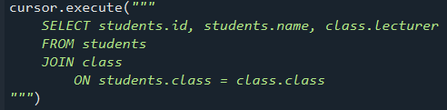
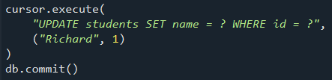
Example code
whichClass = input(Enter a class: ”)
cursor.execute(“SELECT * FROM employees WHERE class=?”, (whichClass,)
for x in cursor.fetchall():
print (x) allows the user to enter a class and displays the records of all the students in that class.
cursor.execute(“““SELECT students.id, students.name, class.lecturer
FROM students,class WHERE students.class= class.class”””) selects the ID and name fields from the students table and the lecturer filed from the class table, using the class filed to link the data. If you do not specify how the tables are linked, Python will assume every students takes every class and you will not get the results you are expecting.
cursor.execute(“UPDATE students SET name = ‘Richard’ WHERE id = 1”) db.commit() updates the data in the table(overwriting the original) to change the name to “Richard” for student ID 1
cursor.execute(“DELETE FROM students WHERE id=1”) deletes any data in the students table where the id is 1

Slide 11
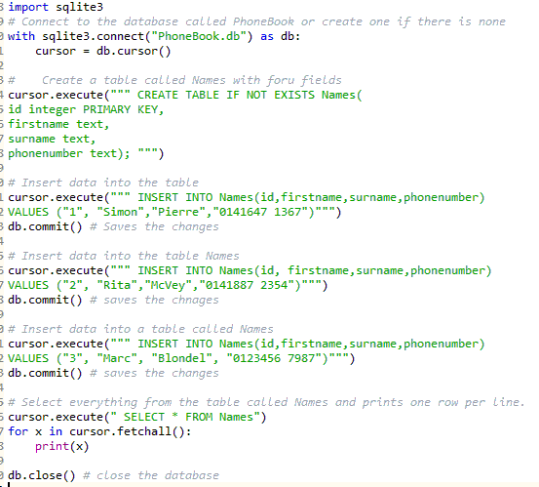

Example code
Create an SQL database called PhoneBook that contains a table called Names with the following data as seen in the code

