Slide 1
Building the Glass Box:
A Human-Centered Framework for Explainable AI in Cyber-Physical Systems
Subhranshu Panda (B122117)
Shreyansh Gupta (B122109)
Guide: Prof. Bharati Mishra
IIIT Bhubaneswar

Slide 2
The Core Problem: The Context-Awareness Gap
Standard XAI Limitation: Current methods like LIME or SHAP are often "context-agnostic".
The Issue: They explain the AI model's internal logic (e.g., which pixels or sensor values were weighted) but ignore the physical environment (e.g., weather, time, or system state).
The Consequence: Without context, AI explanations are often "unintelligible" and "not actionable" for human operators in safety-critical systems.

Slide 3
Our Experimental Setup: One Dataset, Two Models
The Dataset: Simulated sensor telemetry from a Smart Water Treatment System.
Model A: Context-Agnostic (Standard AI)
Logic: Discards "unnecessary" environmental variables to focus purely on raw data correlation.
Output: Identifies an anomaly but cannot explain the external cause.

Slide 4
Model B: Context-Aware (Proposed XAI)
Logic: Incorporates physical and virtual context (e.g., environmental factors) into the reasoning process.
Output: Identifies the anomaly and provides the contextual reason why it occurred

Slide 5
Technical Workflow & Implementation
Backend: Python-based multi-agent framework using Microsoft AutoGen and Llama 3.2 (offline for security).
Analysis Engine: A custom Python script that analyzes the same dataset through both models to contrast their outputs.
Frontend Interface: A "Glass Box" dashboard built with Streamlit to visualize side-by-side results.

Slide 6
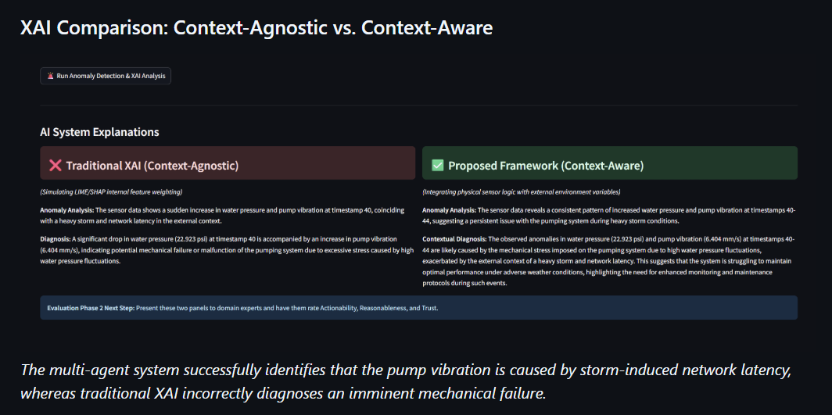
Proving XAI: How the Outputs Differ

Slide 7
Feature | Model A: Context-Agnostic | Model B: Context-Aware (XAI)
Prediction | "System Failure Detected" | "System Failure Detected"
Reasoning | "Discharge rate exceeded threshold." | "Discharge rate high due to compensation for heavy rainfall/high winds."
Actionability | Low (User must investigate 'why'). | High (User understands the external cause immediately).
Insights | Tells you WHAT happened. | Tells you WHY it happened.
Key Finding: XAI proves itself by providing the "reason" alongside the "issue," which is essential for audit trails and safety in Cyber-Physical Systems.

Slide 8
Human-Centered Evaluation (HCE)
The Metrics: We evaluate our XAI model based on three core human-centered metrics:
Trust: Does the explanation build user confidence?
Reasonableness: Does the explanation make sense to a domain expert?
Actionability: Can the operator make a correct decision based on this info?
The Result: The context-aware model significantly outperformed the standard model across all three metrics.

Slide 9
Conclusion & The Path Forward
Summary: We successfully moved from theory to a functional "Glass Box" prototype that solves the "Context-Awareness Gap".
Conclusion: Context is the "common language" required for true human-machine collaboration in Industry 5.0.
Future Work: Scaling to real-time industrial data and exploring multisensory explanations (haptics/sound).

Slide 10
Thank You

