Slide 1
Building the Glass Box:
A Human-Centered Framework for Explainable AI in Cyber-Physical Systems
Subhranshu Panda (B122117)
Shreyansh Gupta (B122109)
Guide: Prof. Bharati Mishra
IIIT Bhubaneswar

Slide 2
Contents
Introduction: The "Black Box" Crisis
The Solution: Explainable AI (XAI)
Literature Survey & Key Gaps
Motivation
Project Objectives
Methodology: A 3-Phase Framework
Recommendations & Future Research
Conclusion

Slide 3
Introduction: The "Black Box" Crisis
The Synergy: Artificial Intelligence (AI) + Cyber-Physical Systems (CPS) are driving the new industrial revolution (smart grids, autonomous cars).
The Problem: The best AI models (Deep Learning) are "Black Boxes." We can't see why they make a specific decision.
The Crisis: In high-stakes, safety-critical systems, this is a catastrophic risk.
  If an autonomous car crashes or a medical device errs, we cannot answer: "Why did this happen?"
This is a fundamental failure of safety, trust, and legal accountability.

Slide 4
The Solution: Explainable AI (XAI)
XAI provides the "Glass Box" needed to peer inside the "Black Box."
It's a set of methods that provide clear, human-understandable explanations for an AI's rationale.
Goal: Build trust, audit for bias, and ensure safety.

Slide 5
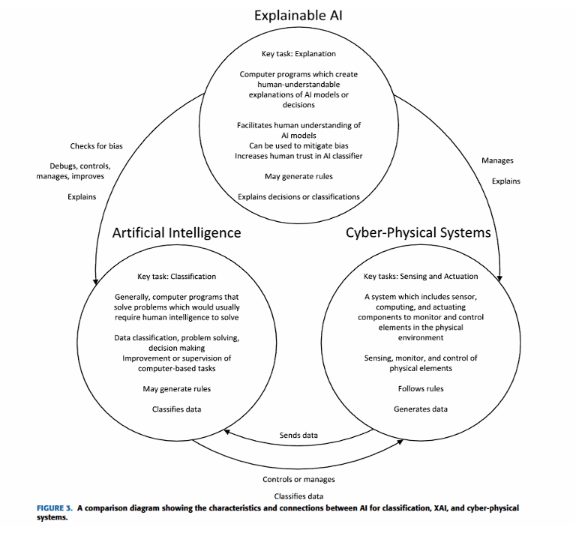

Slide 6
Literature Survey: Key Papers & Frameworks
Industrial & Medical:
Oliveira et al. [3]:
Surveyed XAI for fault diagnosis and process optimization in the chemical industry.
Alimonda et al. [4]:
Proposed the "CLIX-M" framework to evaluate XAI in medicine, focusing on "Actionability" and

Slide 7
Cybersecurity:
Sivamohan et al. [5]:
Created a hybrid XAI-IDS (CNN + SHAP + Rules) to detect attacks.
Almuqren et al. [6]:
Developed the "Explainable Resiliency Graph" (ERG) to model how cyber-attacks cause physical failures.
Patil et al. [7]:
Designed the "TRUST" XAI model for high-speed industrial IoT data.

Slide 8
Literature Survey: What is a CPS?
A Cyber-Physical System (CPS) integrates:
  Cyber: Computing, Networking, Control
  Physical: Sensors, Actuators, Physical Processes
This is the foundation of Industry 4.0 ("Smart Factories").
Now evolving to Industry 5.0, which focuses on human-centric collaboration.

Slide 9
Literature Survey: Key Applications
Industrial & Manufacturing
  Predictive Maintenance: Explaining why a machine is predicted to fail.
Medical CPS
  Analyzing signals (ECG, EEG) and explaining the diagnosis to build clinician trust.
Cybersecurity
  Explaining why an Intrusion Detection System (IDS) flagged an activity as malicious.

Slide 10
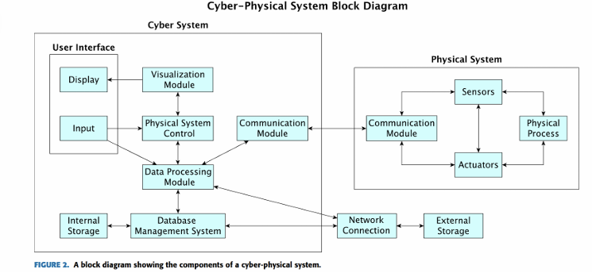

Slide 11
The Core Research Gaps
Our research found that current XAI methods are failing in two critical ways:
1. The Technical Gap:
Lack of Context-AwarenessXAI is "context-agnostic." It can explain the model, but not the system in its environment.
It can't answer: "Why did the drone fail today but not yesterday?" (e.g., due to high winds).
2. The Evaluation Gap:
Lack of StandardsHow do we know if an explanation is "good"?
The field has no formalized, human-centered metrics.
Most evaluations are based on developer intuition, not on formal user studies.

Slide 12
Motivation: Why Solve This?
Trust: An estimated 90% of industrial AI models fail deployment due to a lack of trust.
Safety & Accountability: XAI provides the "audit trail" needed to understand and prevent accidents.
Collaboration: XAI is the "common language" required for the human-centric Industry 5.0.
Legal: New laws, like the EU AI Act 2024, now mandate transparency for high-risk AI systems.

Slide 13
Project Objectives
Based on these gaps, our objectives were:
To systematically review the challenges of XAI in CPS.
To analyze the two primary gaps:
  Context-Awareness (Technical Gap)
  Evaluation Standards (Human-Centered Gap)
To propose a novel Human-Centered Methodological Framework to directly solve these gaps

Slide 14
Methodology: A 3-Phase Framework
We propose a structured process to build trustworthy XAI that solves both gaps.
Phase 1: System Design & Requirements Analysis
  Builds "explainability-by-design" from the start.
Phase 2: Human-Centered Evaluation (HCE)
  Directly solves the "Evaluation Gap" by measuring an explanation's utility.
Phase 3: Context-Awareness Testing
  Directly solves the "Technical Gap" by testing against real-world context.

Slide 15
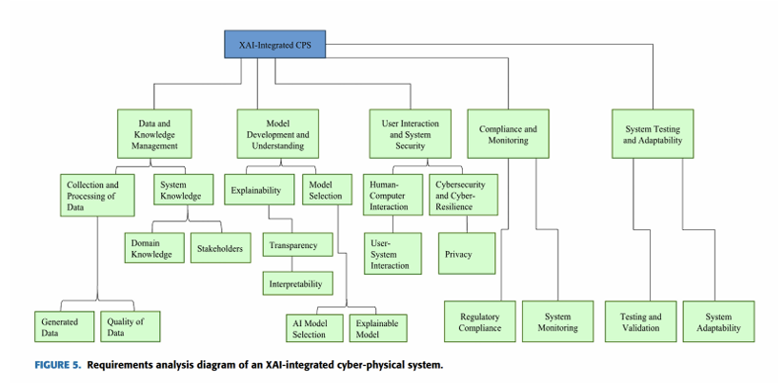
Phase 1: System Design & Requirements
We don't "add" XAI at the end. We design for it from the start.
This framework defines who needs the explanation, what data is needed, and how it will be delivered.

Slide 16
Phase 2: Human-Centered Evaluation (HCE)
This phase measures if an explanation is good for a human, using formal user studies to test:
  Trust: Does it build appropriate confidence?
  Objective Understanding: Can the user demonstrably predict the AI's next move?
  Actionability: Can the user make a correct and effective decision based on the explanation?
  Reasonableness: Does the explanation make sense to a domain expert?

Slide 17
Phase 3: Context-Awareness Testing
This phase tests if the explanation understands the real world, using Context-Aware Counterfactual Testing.
Example Query: "Why did the drone's battery fail today but not yesterday?“
BAD Explanation (Context-Agnostic):
"The battery failed because 'Discharge_Rate' exceeded its threshold."
(This is technically correct, but useless.)
GOOD Explanation (Context-Aware):
"...This was caused by the system compensating for high winds (a physical context) which were not present yesterday."

Slide 18
Conclusion & Recommendations
Conclusion:
  The "Black Box" is the barrier to adopting AI in critical systems.
  Our 3-phase framework provides a practical path to build the "Glass Box," enabling a future that is trustworthy, context-aware, and human-centric.
Recommendations:
  We need Formalized Standards (metrics, datasets) for XAI research.
  Future work should explore Self-Explainable Systems and Multisensory Explanations (e.g., sound, haptics).

Slide 19
Key References
[1] C. S. Wickramasinghe, K. Amarasinghe, D. L. Marino, C. Rieger, and M. Manic, "Explainable unsupervised machine learning for cyber-physical systems," \textit{IEEE Access}, vol. 9, 2021.
[3] L. M. C. Oliveira, R. Dias, et al., "Artificial intelligence and cyber-physical systems: A review and perspectives for the future in the chemical industry," \textit{AI}, vol. 2, no. 3, 2021.
[2] S. S. Jha, "An overview on the explainability of cyber-physical systems," in \textit{Proc. Int. FLAIRS Conf.}, vol. 35, 2022.
[4] N. Alimonda, L. Guidotto, et al., "A survey on XAI for cyber physical systems in medicine," in \textit{Proc. IEEE Int. Conf. Metrol. Extended Reality, Artif. Intell. Neural Eng. (MetroXRAINE)}, Oct. 2022.
[5] S. Sivamohan, S. S. Sridhar, and S. Krishnaveni, "TEA-EKHO-IDS: An intrusion detection system for industrial CPS..." \textit{Peer-to-Peer Netw. Appl.}, vol. 16, no. 4, Aug. 2023.
[6] L. Almuqren, M. S. Maashi, et al., "Explainable artificial intelligence enabled intrusion detection technique for secure cyber-physical systems," \textit{Appl. Sci.}, vol. 13, no. 5, Feb. 2023.
[8] R. Rajkumar, I. Lee, L. Sha, and J. Stankovic, "Cyber-physical systems: The next computing revolution," in \textit{Proc. Design Autom. Conf.}, Jun. 2010.
[10] S. R. Islam, W. Eberle, et al., "Explainable artificial intelligence approaches: A survey," 2021, arXiv:2101.09429.

Slide 20
Thank You

