Slide 1
TELECOM CHURN PREDICTION USING DATA SCIENCE TECNIQUES
By – Subhransu Pradhan

Slide 2
INTRODUCTION
Telecommunications companies face intense competition in the marketplace, and customer churn can have a significant impact on their revenue and profitability. In addition to losing the customer's business, the company may also incur costs associated with acquiring new customers to replace those who have left.
Overall, a telecom churn prediction model can help a telecommunications company improve customer retention, reduce churn rates, and ultimately increase revenue and profitability.

Slide 3
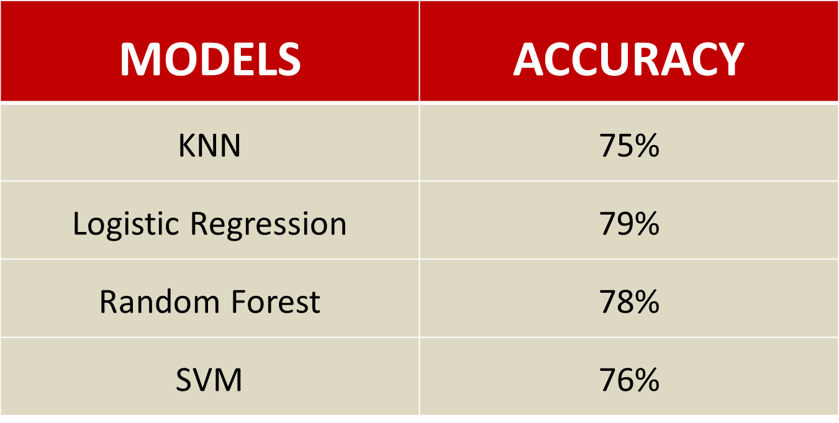
ACCURACY OF VARIOUS MODELS

Slide 4
HOW TO REDUCE CUSTOMER CHURN
Lean into your best customers.
Be proactive with communication.
Define a roadmap for your new customers.
Offer incentives.
Ask for feedback often.
Analyse churn when it happens.
Stay competitive.

Slide 5
THANK YOU

