Slide 1
Socket Programming

Slide 2
Contents
What is Socket?
Socket Programming API(C language)
  Socket
  Bind, Listen
  Accept
  Connect
  Send, Recv
  Close
Example

Slide 3
What is a socket?
An interface between application and network
  The application creates a socket
  The socket type dictates the style of communication
    reliable vs. best effort
    connection-oriented vs. connectionless
Once configured, the application can
  pass data to the socket for network transmission
  receive data from the socket (transmitted through the network by some other host)

Slide 4
Why do we need them?
Build distributed, client server applications
  Application’s capabilities are distributed on multiple machines
  Typical examples are information systems
    Database is located on a more powerful machine (server)
    GUI is on the less powerful machine (client)
  This architecture is old, from the time when hardware was very expensive
  Today, there are interesting research projects on how to build better distributed systems
    Example:
      Grid computing
      Agent based systems

Slide 5
Two essential types of sockets
SOCK_STREAM
  TCP sockets
  reliable delivery
  in-order guaranteed
  connection-oriented
SOCK_DGRAM
  UDP sockets
  unreliable delivery
  no order guarantees
  no notion of “connection”
App
App
D1
3
2
3
2
D2
1
1
socket
Dest.
socket
D3

Slide 6
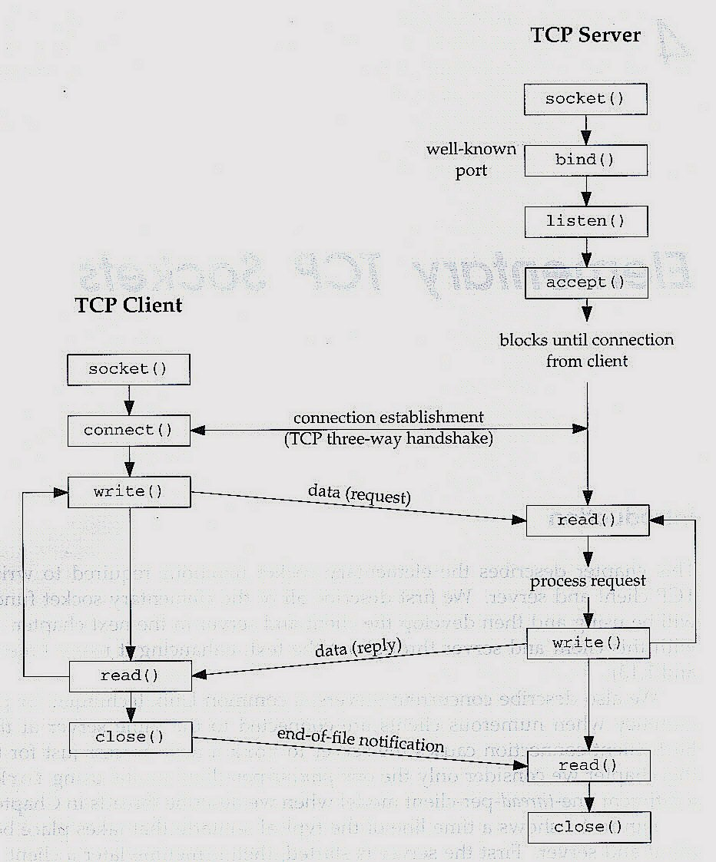
Socket Creation

Slide 7
Socket Creation in C: socket
int s = socket(domain, type, protocol);
where
  s: socket descriptor, an integer (like a file-handle)
  domain: integer, communication domain
    e.g., AF_INET (IPv4 protocol)
  type: communication type
    SOCK_STREAM: reliable, 2-way, connection-based service
    SOCK_DGRAM: unreliable, connectionless
  protocol: e.g., TCP or UDP
    use IPPROTO_TCP or IPPROTO_UDP to send/receive TCP or UDP packets

Slide 8
Socket Creation in C: socket
/* sample code to create a socket */
hSocket=socket(AF_INET, SOCK_STREAM, IPPROTO_TCP);

Slide 9
Binds a socket to an address

Slide 10
Addresses, Ports and Sockets
Like apartments and mailboxes
  You are the application
  Street address of your apartment building is the IP address
  Your mailbox is the port
  The post-office is the network
  The socket is the key that gives you access to the right mailbox
Q: How do you choose which port a socket connects to?

Slide 11
Addresses, Ports and Sockets
Choose a port number that is registered for general use, from 1024 to 49151
  Do not use ports 1 to 1023. These ports are reserved for use by the Internet Assigned Numbers Authority (IANA)
  Avoid using ports 49152 through 65535. These are dynamic ports that operating systems use randomly. If you choose one of these ports, you risk a potential port conflict

Slide 12
The bind function
associates a port for use by the socket
int status = bind(sock, &addrport, size)
where
  status: return status, 0 if successful, -1 otherwise
  sock: socket being used
  addrport: address structure
    This C structure has four parts to it (next slide)
  size: the size (in bytes) of the addrport structure
  Bind is non-blocking: returns immediately

Slide 13
The struct sockaddr
The sockaddr_in structure has four parts:
  sin_family: address family (e.g., AF_INET IP addresses)
  sin_port: port number
  sin_addr: IP-address
  sin_zero: // un-used

Slide 14
Example(Server)
Some computers put the most significant byte within a
word first (this is called “big-endian” order), and others put it last (“little-endian” order).
So that machines with different byte order conventions can communicate, the Internet protocols specify a byte order convention for data transmitted over the network.
This is known as network byte order (it is big-endian).
// first, create and fill in values for the sockaddr_in structure Address
struct sockaddr_in Address;
/* create Address stucture */
Address.sin_family = AF_INET;
/* AF_INET represents the address family INET for Internet sockets. */
Address.sin_port = htons(nHostPort);
/* The function htons() converts from host byte order to network byte order*/
Address.sin_addr.s_addr = INADDR_ANY;
/* INADDR_ANY allows us to work without knowing the IP address of the machine the client program is running on (very convenient) */
// next, bind the socket to the port
if( bind(hServerSocket, (struct sockaddr *) &Address, sizeof(Address)) == -1)
{
printf("\nCould not connect to host\n");
return -1;
}

Slide 15
Connection setup

Slide 16
Connection Setup
A connection occurs between two kinds of participants
  Passive
    waits for an active participant to request connection
  Active
    initiates connection request to passive side
Once connection is established, passive and active participants can:
  both can send & receive data
  either can terminate the connection

Slide 17
Connection setup cont’d
Passive participant
(e.g., our server)
  step 1: listen (for incoming requests)
  step 3: accept (a request)
  step 4: data transfer
The accepted connection is on a new socket connection
  need to create another socket
The old socket continues to listen for other active participants
Active participant
(e.g., our client)
  step 2: request & establish connection
  step 4: data transfer
Passive Participant
a-sock-1
l-sock
a-sock-2
Active 1
Active 2
socket
socket

Slide 18
Connection setup: listen & accept
The listen function prepares a bound socket to accept incoming connections
int status = listen(sock, queuelen)
where
  status: return value, 0 if listening, -1 if error
  sock: socket being used
  queuelen: number of active participants that can “wait” for a connection
listen is non-blocking: returns immediately
Example code:
if (listen(hServerSocket, 1) == -1)
{
printf("\nCould not listen\n");
return -1;
}

Slide 19
Connection setup: listen & accept
Use the accept function to accept a connection request from a remote host
The function returns a socket corresponding to the accepted connection
int s = accept(sock, &cliaddr, &addrlen)
where
  s: new socket used for data-transfer
  sock: original socket being listened on (e.g., server)
  cliaddr: address structure of the active participant (e.g., client)
    The accept function updates/returns the sockaddr structure with the client's address information
  addrlen: size (in bytes) of the client sockaddr structure
    The accept function updates/returns this value
accept is blocking: waits for connection before returning
Example code:
hSocket = accept(hServerSocket, (struct sockaddr *) &Address, (socklen_t *) &nAddressSize);
/* socklen_t is socket address length type, defined in sys/socket.h; in our example code it is being cast from a pointer to an integer */

Slide 20
Client create socket and connect to remote host
First, the client must create a socket (socket call as before) and fills in its address structure
Then, the client connects to the remote host
  The connect function is used by a client program to establish communication with a remote entity
int status = connect(sock, &servaddr, addrlen);
where
  status: return value, 0 if successful connect, -1 otherwise
  sock: client’s socket to be used in connection
  servaddr: server’s address structure
  addrlen: size (in bytes) of the servaddr structure
connect is blocking
Example code:
if(connect(hSocket, (struct sockaddr*) &Address, sizeof(Address)) == -1)
{
printf("\nCould not connect to host\n");
  }

Slide 21
Sending/Receiving Data

Slide 22
Sending / Receiving Data
Send data
int count = send(int s, const void * msg, int len, unsigned int falgs);
Where:
  count: number of bytes transmitted (-1 if error)
  sock: socket being used
  buf: buffer to be transmitted
  len: length of buffer (in bytes) to transmit
  flags: special options, usually just 0
Receive data
int count = recv(int s, void *buf, int len, unsigned int flags);
Where:
  count: number of bytes received (-1 if error)
  sock: socket being used
  buf: stores received bytes
  len: number of bytes received
  flags: special options, usually just 0

Slide 23
Example (Client/Server)
…
// write a message to the server
n = send(sock,buffer,strlen(buffer),0);
// do some processing
…
// read a message from the server
n = recv(sock,buffer,255,0);
// after the client executed a write(), it will read
n = recv(newsock,buffer,255,0);
// do some processing
…
// send the result to the client
n = send(newsock,resp_msg,strlen(resp_msg),0);
CLIENT
SERVER

Slide 24
close
When finished using a socket, the socket should be closed:
status = close(s);
  status: return value, 0 if successful, -1 if error
  s: the file descriptor (socket being closed)

Slide 25
Other Library Routines
in_addr_t inet_addr(const char* string)
returns the 32-bit IP address that corresponds to the A.B.C.D format string. The IP address is in network-byte order.
If no error occurs, inet_addr returns an unsigned long value containing a suitable binary representation of the Internet address given. If the string in the cp parameter does not contain a legitimate Internet address, for example if a portion of an "a.b.c.d" address exceeds 255, then inet_addr returns the value INADDR_NONE.

Slide 26
Other Library Routines
int gethostname(char* name, int nameLen)
sets the character array pointed to by name of length nameLen to a null-terminated string equal to the local host’s name.

Slide 27
Other Library Routines
in_addr_t htonl(in_addr_t hostLong)
in_addr_t htons(in_port_t hostShort)
in_addr_t ntonl(in_addr_t networkLong)
in_addr_t htons(in_port_t networkShort)
each of these functions performs a conversion between a host-format number and a network-format number.

Slide 28
Other Library Routines
void bzero(void* buffer, size_t length)
fills the array buffer of size length with zeroes
void memset(void* buffer, int value, size_t length)
fills the array buffer of size length with the value of value.

Slide 29
Compile and run?
Need some additional options to compile the client and the server
  gcc -o server server.c -lsocket -lnsl
  gcc -o client client.c -lsocket -lnsl
  Run the server first, then the client after
  For example:
  server 4444 // run this on cs1
  client cs1.aot.edu 4444 // run this on cs2

Slide 30
Summary

