Slide 1
Who will leave FreshBasket next quarter?
Loyalty churn prediction and a cheaper way to retain members
Shubiksha K | Propel Data Science Assessment 4

Slide 2
Targeting beats blanket offers
FreshBasket sends retention offers to every member. A churn score lets it spend only where risk is real.
91%
0.81
1/5
of actual churners reached by contacting the riskiest 20% of active members
PR-AUC for active members on the held-out label (base rate 9.6%)
of the blanket-coupon cost for about the same number of members retained
Most churn is visible early: 80% of churners had already stopped buying before 2024
Behaviour, not demographics: app use, email opens, coupons, purchase momentum and support tickets drive risk
Act: monthly risk list, fix service issues first, coupons for the next tier, prove it with a holdout
Notes:
Three headline numbers. Explain that results are on the official April-June 2024 label, which the model never saw during training or tuning.

Slide 3
Data cleaned before modelling: every fix logged
Issue | Found | Action
Duplicates | 8 profile, 58 activity, 5 label rows; 2 conflicting customer-months | Dropped
Text casing | 104 cities and 104 tiers with stray case/whitespace | Standardised
Spend errors | 24 negative, 20 zero with purchases, 13 outliers up to 14.7x | Rebuilt from transactions x basket
Zero-purchase months | 1,452 months report categories bought with no purchase | Categories set to 0
Missing months | 953 gaps inside 769 member histories | Treated as lost records
Missing values | Age 78, gender 52, home-store price tier 130 | Imputed / 'Unknown'
3
leaky label columns removed
LAST_PURCHASE_DATE, MONTHS_OBSERVED and INSUFFICIENT_HISTORY_FLAG are calculated over Apr-Jun 2024. LAST_PURCHASE_DATE alone reproduces the label for every member who ever bought.
Notes:
Data issues were planted on purpose. The important one is leakage: three columns in the label table use information from the label window, so they are excluded. 232 members with no purchase before April are outside the churn definition and are not scored. Official label kept as source of truth; 9 disagree with activity data.

Slide 4
Most churners had already gone quiet
80%
of churners made their last purchase before 2024: recency alone flags them
9.6%
churn among the 1,715 members still buying in Jan-Mar 2024
Every result is reported for both groups. Active members are where a model earns its keep.
Notes:
This is the key framing. A model scoring 0.99 on all members is mostly re-discovering that lapsed members stay lapsed. The real retention decision is about active members, where churn is under 10%. That is why I report both.

Slide 5
Validated on the future, never a random split
Train
Train
Validate
Test
features to Jun 2023
features to Sep 2023
features to Dec 2023
features to Mar 2024
label Jul-Sep 2023
label Oct-Dec 2023
label Jan-Mar 2024
model + threshold chosen
official label Apr-Jun 2024
scored once
Same churn rule replayed at each cutoff: no purchase in the next 3 months despite earlier purchases
40 leakage-safe features from months up to the cutoff only: recency, purchase and spend trends, rolling app / email / coupon activity, support-ticket trend, tenure, tier and demographics
Stable over time: expanding-window backtest gives active-member PR-AUC 0.78-0.82 in every fold
Notes:
Because there is one official label, I rebuilt the same churn definition at earlier cutoffs from the activity table. Train on mid-2023, tune on December 2023, test once on the official label. No feature looks past the cutoff month.

Slide 6
Support friction and disengagement precede churn
Active members only. Same pattern for email opens (25% with none vs 2%), coupons (26% vs 2%) and falling purchases. Tier and city barely matter. Associations, not proven causes.
Notes:
Task 4. Among active members churn climbs from 5% with no tickets to 27% with two. The 3+ group is small, so treat 74% as directional. Low app use is the strongest single engagement signal. These are correlations: disengaged members may be leaving for other reasons.

Slide 7
Machine learning beats the recency rule where it matters
0.75 / 0.74
precision / recall for active members at the tuned threshold
Imbalance: threshold tuned for F1 on validation (0.33); class weights changed PR-AUC by under 0.005
Why LightGBM: tied with logistic regression on ranking, but best calibrated (Brier 0.027), which the scenario maths needs
Accuracy alone misleads: "nobody churns" scores 90% on active members
Notes:
Tasks 6-8. All members: LightGBM PR-AUC 0.99, F1 0.95, accuracy 0.96. Active members: PR-AUC 0.81, F1 0.75, top-decile lift 7.52x. The recency rule collapses on active members because they all bought recently. The prediction file has probability, label, risk band and top-3 drivers for all 2,368 members.

Slide 8
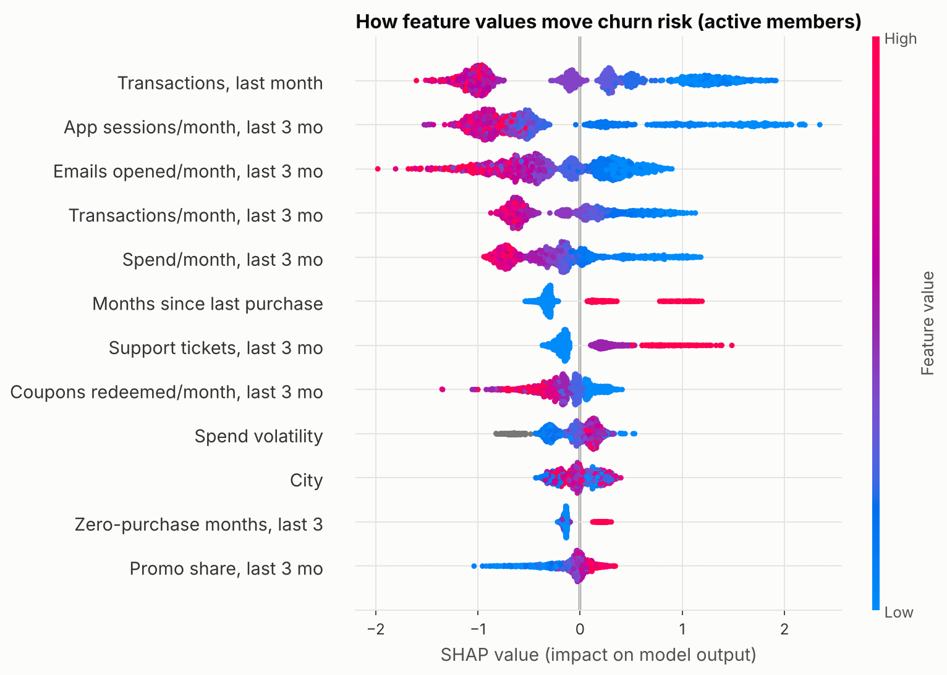
Purchase momentum and app use drive risk
Low purchases, app use, email opens and coupons push risk up (blue dots right); more support tickets push it up (red dots right). Each member's top three drivers are in the prediction file.
Notes:
Task 9. SHAP from LightGBM's exact TreeSHAP. Purchase frequency and app engagement dominate; support tickets are the strongest non-purchase signal after app and email. Demographics barely register; city is the only one in the top ten.

Slide 9
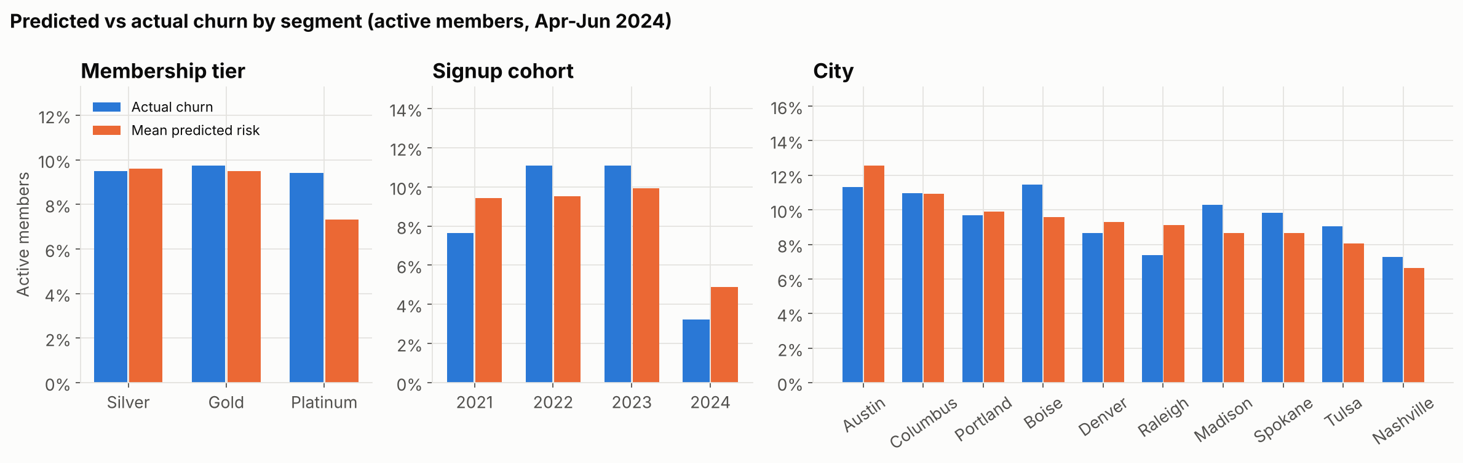
Tier and city matter far less than behaviour
Segment churn among active members ranges only 7-11%; behaviour moves it 0-74%
Predictions track actual churn in every tier, cohort and city: no segment is systematically mis-scored
Watch Platinum: actual 9.4% vs predicted 7.3%, a small under-prediction on the most valuable members
2024 joiners churn least: they have had less time to lapse
Notes:
Task 9, segment comparison. Blue is actual churn, orange is mean predicted risk, active members only. Retention should be targeted by behaviour and score, not by tier or city.

Slide 10
Engagement and support add what demographics cannot
0.10
demographics alone: no better than the 9.6% base rate
Engagement is the biggest single lift (0.69)
Support is weak alone but removing it costs 0.03 PR-AUC: it flags members whose purchases still look normal
All groups together: 0.81
Notes:
Task 10. Same model and validation, different feature sets. On all members demographics alone get 0.73 only because tenure separates long-lapsed members. On active members they carry no signal.

Slide 11
A targeted list keeps the savings and cuts the cost
Scenario | Contacted | Retained* | Cost | Cost / retained
A. Service call: ticket + high risk | 109 | 11 | $872 | $77
B. Coupon: top 20% risk | 343 | 20 | $1,715 | $88
C. Coupon: everyone (today) | 1,715 | 20 | $8,575 | $419
*Model-implied risk reduction (about 26%) x 50% assumed effectiveness. $415 annual margin per retained member; $5 per coupon, $8 per call.
Top 20% contacted reaches 91% of churners. Targeted coupons retain about as many as a blanket coupon for one-fifth of the cost; service calls are cheapest per member retained.
Notes:
Task 11. The curve is measured on real outcomes, not simulated. The table is a what-if: I changed the features each action plausibly moves (tickets resolved, or one more coupon redeemed), re-scored, and only counted half the modelled effect as causal. Blanket coupons roughly break even; targeted ones return about four times their cost.

Slide 12
Recommendations
1
Score monthly, stop blanket offers
2
Fix service first
3
Coupons for the disengaged
Fund retention for the top 10-20% of active members by risk.
High-risk members with tickets or complaints get a proactive call before any discount.
High-risk, ticket-free members get a personalised coupon or app nudge.
4
Watch app and email as early KPIs
5
Separate win-back for lapsed
6
Prove it with a holdout
Under one app session a month or no opens for a quarter triggers review.
~650 members silent since 2023 need reactivation, not retention.
Keep 10-20% of each target group untreated to measure real uplift.
Notes:
Task 12. The holdout is the most important next step: the model shows who is at risk, but only a controlled test shows how much each action really saves.

Slide 13
Assumptions, limitations and next steps
Assumptions and limitations
Next steps
Official label is the source of truth; 232 members with no prior purchase not scored
Synthetic 18-month data; expect lower accuracy in production
Snapshots share customers, so folds are not fully independent
Scenario effects are correlational what-ifs with an assumed 50% effectiveness
Fixed 3-month horizon counts paused members as churners
Run the randomised holdout and replace the assumed effectiveness with measured uplift
Move to uplift modelling: target members most likely to respond, not just most at risk
Monitor monthly: PR-AUC on the latest closed window, calibration, feature drift
Add time-to-churn (survival) modelling to catch fast-rising risk
Notes:
Close by inviting questions. Everything is reproducible: pip install -r requirements.txt, then python run_pipeline.py.

