Slide 1
Network Knights
Mythili S
Srividya SR
Subiksha T
Pradeep K
Rahul Dravid S

Slide 2
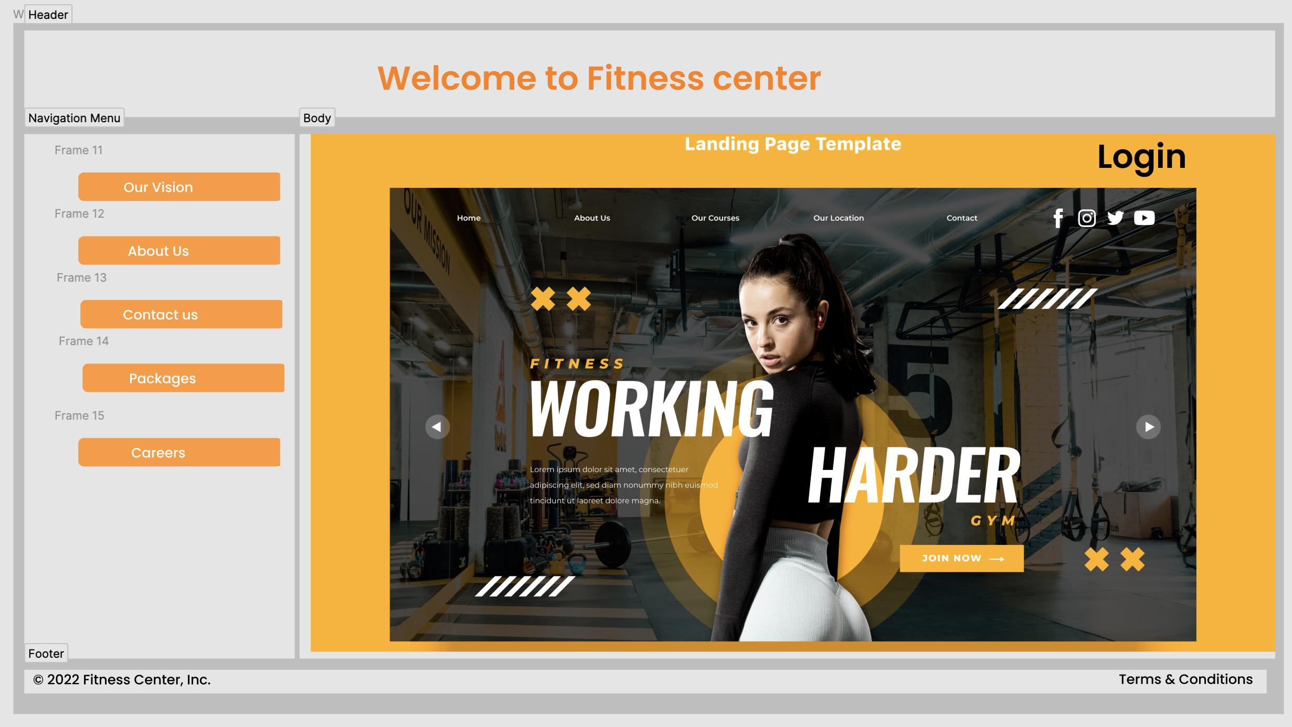
Landing Page

Slide 3
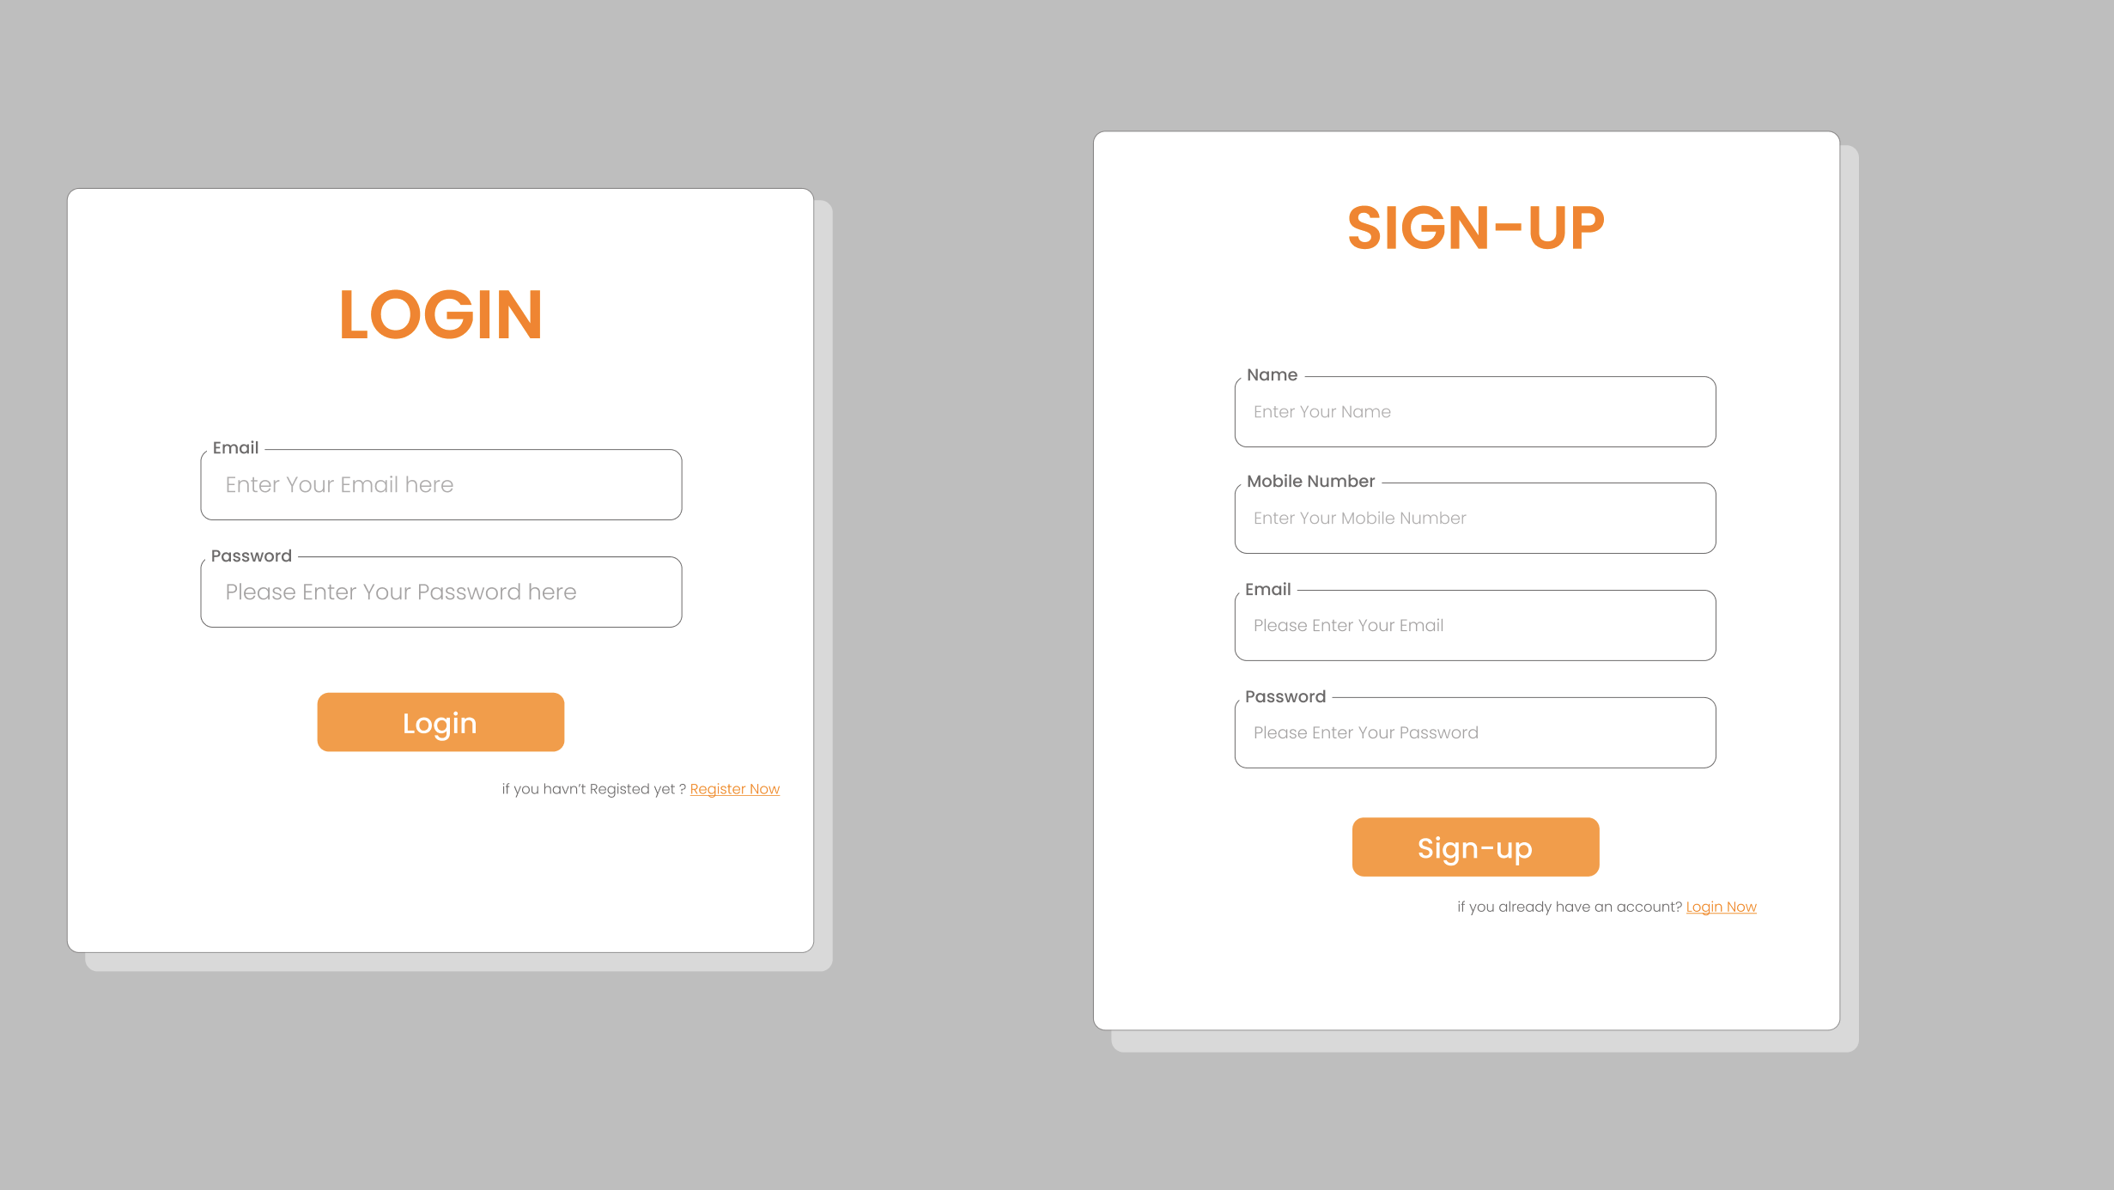
Signup/Login Page

Slide 4
Figma
https://www.figma.com/file/R4HTWcOvqh4UIaE4Zc2VJ3/Login-%2F-SignUp-Page-(Community)?node-id=0%3A1

