Slide 1
Scalable Fog–Cloud Architecture for Smart Grain Silo Monitoring System
Subin George
Student ID: 24111945

Slide 2
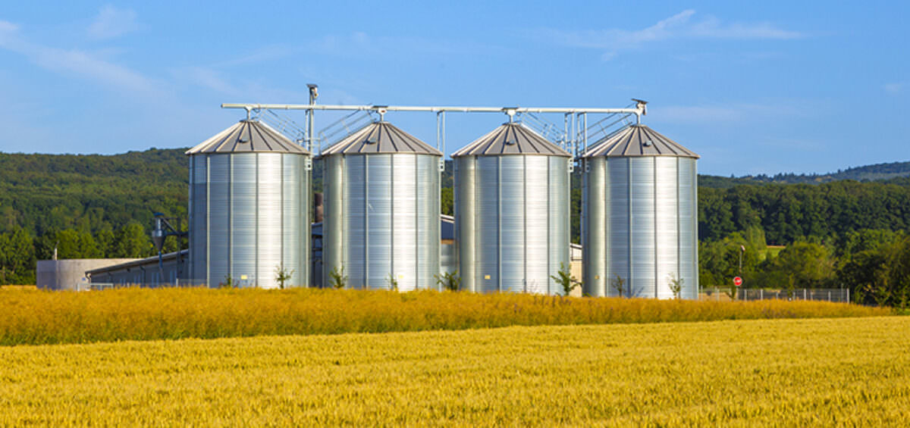
What is a Grain Silo & Why Monitor It?
A grain silo is a large storage structure used to store harvested grains such as wheat, corn, rice, and barley over long periods of time.
Temperature & Humidity — Poor conditions accelerate grain spoilage and encourage fungal and microbial growth.
CO₂ Buildup — Rising CO₂ levels inside the silo signal anaerobic fermentation or pest infestation.
Vibration — Unusual vibrations indicate structural stress or mechanical failure risks.
Grain Level — Unexpected drops in grain level may signal a leak or breach, enabling early intervention and preventing grain loss.

Slide 3
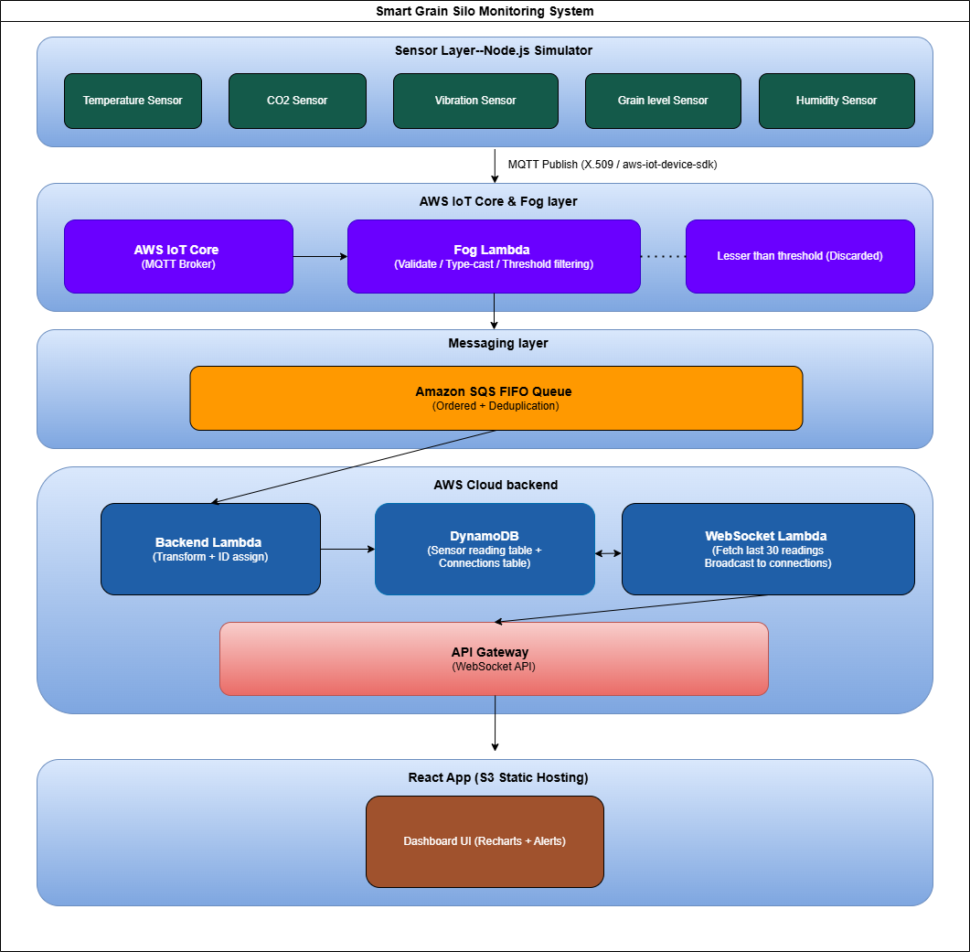
System Architecture
Sensor Layer: Node.js Simulator MQTT / AWS IoT Core
Fog Layer: AWS Lambda Filtering & Thresholds
Messaging Layer: Amazon SQS FIFO Ordering & Deduplication
Backend Layer: Lambda + DynamoDB Storage & Processing
Presentation Layer: React Dashboard WebSocket API

Slide 4
Sensor Parameters & Thresholds
Parameter | Range | Alert Threshold | Real-World Sensor
Temperature (°C) | 25 – 40 °C | > 30 °C | PT100 / DS18B20
Humidity (%) | 50 – 80 % | > 60 % | SHT31 / DHT22
CO₂ (ppm) | 400 – 1500 ppm | > 1000 ppm | MH-Z19 / SCD30
Vibration (g) | 0 – 1.5 g | > 0.5 g | ADXL345 / MPU6050
Grain Level (%) | 50 – 100 % | < 70 % | HC-SR04 / HX711

Slide 5
Design Patterns & Scalability
Serverless Computing — AWS Lambda auto-scales with workload fluctuations; pay-per-use keeps costs low.
Event-Driven Architecture — Components communicate via events (MQTT messages, SQS triggers), keeping the system loosely coupled and flexible.
Publish-Subscribe Messaging — Reducing communication overhead and enabling scalable data distribution.
Queue-Based Load Levelling — Amazon SQS absorbs data spikes, preventing overload and ensuring fault-tolerant, steady processing.
Real-Time Push via WebSockets — Bidirectional client-server communication delivers live updates to the dashboard with minimal network overhead.
DynamoDB for Scalable Storage — NoSQL database with automatic scaling, high throughput, and low-latency reads; no schema management required, ideal for variable IoT data.

Slide 6
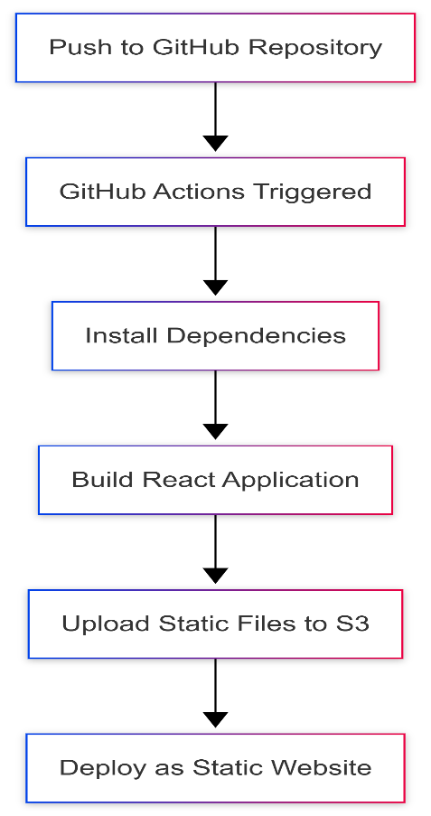
CI/CD Pipeline
Push to GitHub Repository — push updated code to the GitHub repository, triggering the automated pipeline.
GitHub Actions Triggered — The workflow is automatically activated on every push
Install Dependencies — Pipeline installs all required Node.js packages and libraries needed to build the React application.
Build React Application — The React app is compiled into optimised static files (HTML, CSS, JavaScript) ready for production.
Upload Static Files to S3 — The generated build files are uploaded to an Amazon S3 bucket configured for static website hosting.
Deploy as Static Website — S3 serves the files as a publicly accessible static website

Slide 7
Live Demo
http://smart-grain-silo-monitoring-system.s3-website-us-east-1.amazonaws.com/

Slide 8
Thank you

