Slide 1

Deep Learning for Dental Caries Detection and Orthodontic Treatment Analysis

Slide 2
CONTENTS
ABSTRACT
LITERATURE SURVEY
INTRODUCTION
METHODOLOGY
RESULTS AND DISCUSSION
CONCLUSION
REFERENCES

Slide 3
ABSTRACT
The application of deep learning methods in dentistry, focusing on dental caries detection and orthodontic treatment analysis. Through the utilization of convolutional neural networks (CNNs), the study aims to enhance the accuracy and efficiency of these diagnostic processes. Deep learning techniques are employed to analyze panoramic X-ray images, aiding in the identification of caries lesions and assessment of orthodontic parameters.

Slide 4
LITERATURE SURVEY
1. Lee et al. (2022) - "Application of AI in Dental Caries Prediction Models“.
Dental caries, characterized by decaying tooth structure leading to cavities, is a significant issue in oral healthcare due to its prevalence, discomfort, and treatment costs.
Data from the Korean Center for Disease Control and Prevention's 2018 children's oral health survey served as the basis for their study.
Various machine learning techniques were employed to evaluate the performance of these models, with metrics including accuracy, precision, recall, and F1-score.

Slide 5
LITERATURE SURVEY
2. Lian et al. (2021) - "Deep Learning for Caries Identification“.
Detect and Categorize caries lesions on dental panoramic radiographs using deep learning techniques.
The study involved creating a reference dataset where three skilled dentists marked caries lesions on 1160 panoramic films.
The dataset was divided into test, validation, and training sets for model development and evaluation.
Lesion identification was performed using the nnU-Net convolutional neural network,

Slide 6
LITERATURE SURVEY
3. Oztekin et al. (2023) - "Explainable DL for Caries Detection“.
Dental caries, a prevalent condition causing pain and infections, can significantly impact quality of life.
While machine learning can detect cavities early, its lack of explainability raises concerns.
The study utilized panoramic photos to assess ResNet-50, DenseNet-121, and EfficientNet-B0 models.
Heat maps generated by the models facilitated easier interpretation of caries regions.

Slide 7
LITERATURE SURVEY
4. Hlongwa et al. (2023) - "IPF Investigation in Orthodontic Radiographs“.
A retrospective cross-sectional examination of 100 panoramic radiographs revealed a 38% prevalence of IPFs.
Identify incidental pathologic findings, crucial for accurate treatment planning.
5. Wang et al. (2021) - "MS-D CNN for CBCT Segmentation“.
Introduces a mixed-scale dense CNN for precise CBCT image segmentation, reducing segmentation time while maintaining high accuracy, improving orthodontic treatment planning efficiency.

Slide 8
INTRODUCTION
In seminar on "Deep Learning for Dental Caries Detection and Orthodontic Treatment Analysis," we'll explore how advanced deep learning techniques, specifically leveraging the ResNet50 architecture, tackle two critical challenges in dentistry: detecting dental braces and identifying dental caries lesions.
We introduce two unique deep learning models, one for the analysis of orthodontic characteristics and the other for the detection of dental caries lesions.

Slide 9
INTRODUCTION
1. Convolutional Neural Networks (CNNs)
CNN: Specifically designed for processing grid-like data such as images. It consists of convolutional layers, pooling layers, and fully connected layers.
Hierarchical feature learning through convolutional and pooling layers, capturing local patterns and spatial hierarchies.

Slide 10
METHODOLOGY
Data Collection and Preprocessing : Data preprocessing involves essential tasks like resizing, normalizing, and enhancing dental images for effective learning by the CNN model. These processes ensure uniformity and quality in the dataset, enabling the model to learn efficiently from the provided photos.
Architecture Design : The CNN architecture, tailored for processing panoramic X-ray images, starts with an input layer receiving grayscale dental scans. Optimization algorithms like Adam update parameters to minimize loss functions during training, enhancing predictive performance.

Slide 11
METHODOLOGY
Model Training : Model training encompasses random parameter initialization, data division, batch feeding, and optimization techniques like SGD to minimize loss functions. Gradients of the loss function are computed via backpropagation, with hyperparameters adjusted to maximize performance.
Model Evaluation : Evaluation metrics such as accuracy, precision, recall, and F1-score are crucial for assessing the model's performance on a separate validation dataset. These metrics provide insights into the model's accuracy and effectiveness in image classification tasks.

Slide 12
METHODOLOGY
Fine-tuning and Optimization : Fine-tuning strategies, such as adjusting learning rates or modifying architecture, may be employed to enhance model accuracy based on evaluation results. Optimization techniques aim to improve the model's performance and ensure its effectiveness in dental care applications.

Slide 13
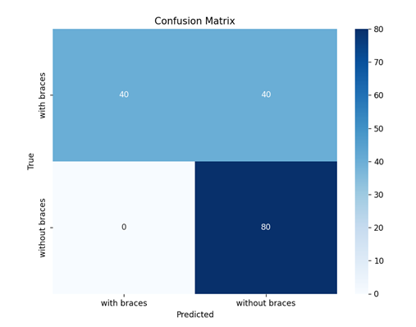
RESULTS AND DISCUSSION
Dental Orthodontic Analysis
Confusion Matrix : Classification Report :
Precision : 0.8333333
Recall : 0.75
F1-score : 0.7333333
Support : 160.0

Slide 14
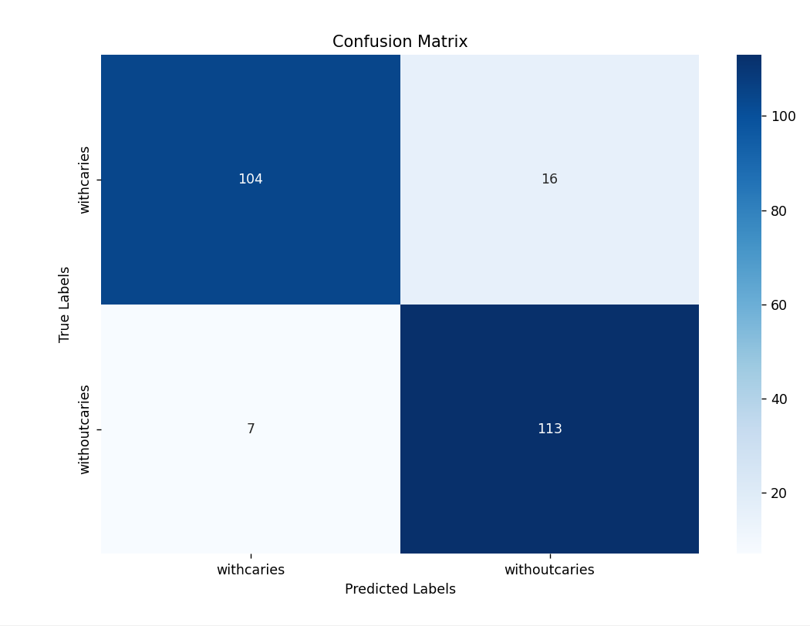
RESULTS AND DISCUSSION
Dental Caries Detection
Confusion Matrix : Classification Report :
Precision : 0.9433333
Recall : 0.87
F1-score : 0.9033333
Support : 120.0
14

Slide 15
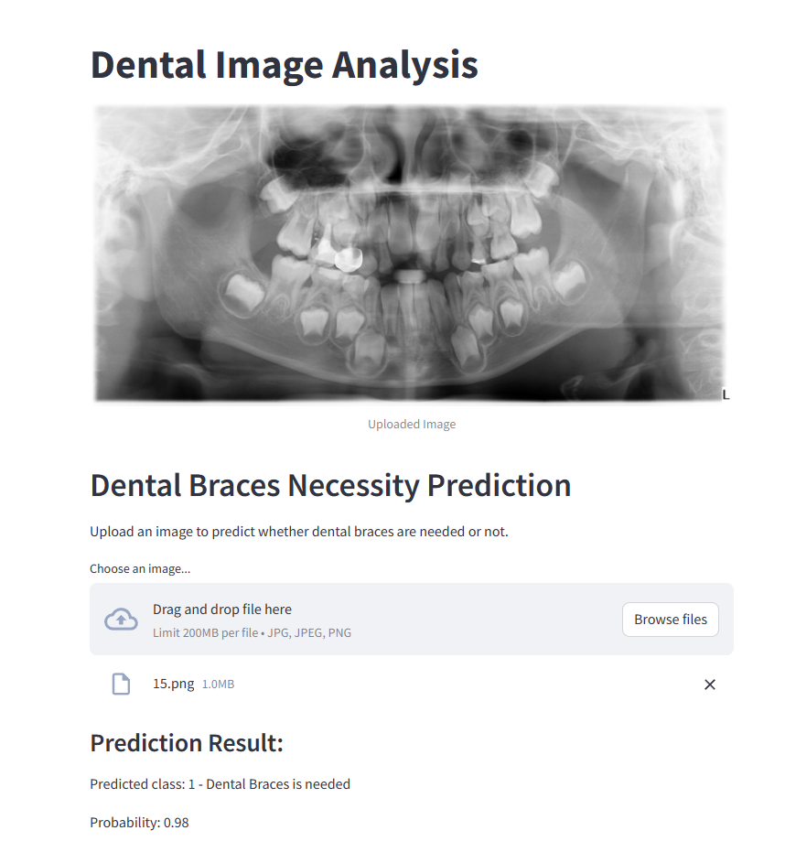
RESULTS AND DISCUSSION Dental Orthodontic Analysis

Slide 16
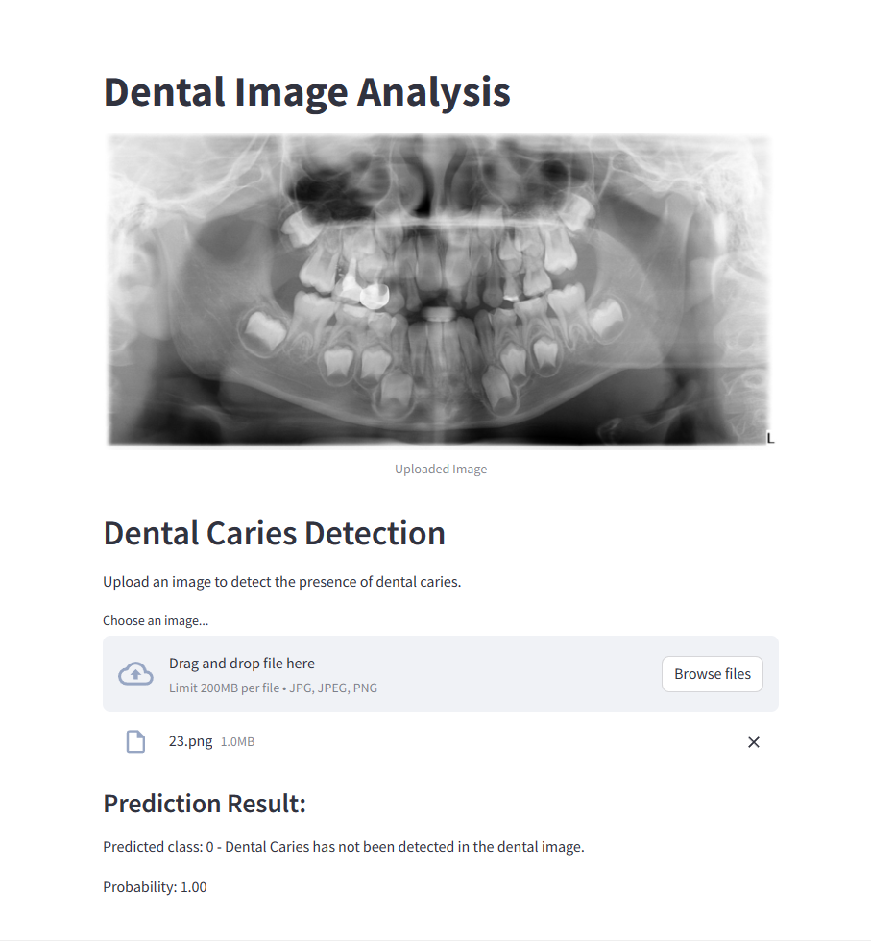
RESULTS AND DISCUSSION Dental Caries Detection

Slide 17
CONCLUSION
Deep learning holds immense promise for transforming oral healthcare by improving dental diagnostics and orthodontic treatment analysis. With effective data preprocessing, deep learning models accurately analyze panoramic X-ray images, enhancing the detection of dental issues such as caries. These models achieve high levels of accuracy while maintaining computational efficiency, ensuring reliable and swift results. Moving forward, further advancements in deep learning can expand the scope of these models by integrating real-time data and extending their applicability to various areas of dentistry, promising even more significant improvements in patient care and overall oral health.

Slide 18
REFERENCES
[1] Lee et al. DCP: Prediction of Dental Caries Using Machine Learning in Personalized Medicine. Appl. Sci. 2022, 2022, 12, 3043. https://doi.org/ 10.3390/app12063043
[2] Lian et al. Deep Learning for Caries Detection and Classification. Diagnostics 2021, 11, 1672. https://doi.org/10.3390/ diagnostics11091672
[3] Oztekin et al. An Explainable Deep Learning Model to Prediction Dental Caries Using Panoramic Radiograph Images. Diagnostics 2023, 13, 226. https://doi.org/10.3390/ diagnostics13020226

Slide 19
REFERENCES
[4] Hlongwa et al. Incidental PathologicFindings from OrthodonticPretreatment Panoramic Radiographs. Int. J. Environ. Res. Public Health 2023, 20, 3479. https://doi.org/10.3390/ijerph20043479
[5] Wang et al. Multiclass CBCT Image Segmentation for Orthodontics with Deep Learning, Journal of Dental Research 2021, Vol. 100(9) 943–949 © International & American Associations for Dental Research 2021

Slide 20
THANK YOU

