Slide 1
MODULE 1
RELATIONAL DATABASE

Slide 2
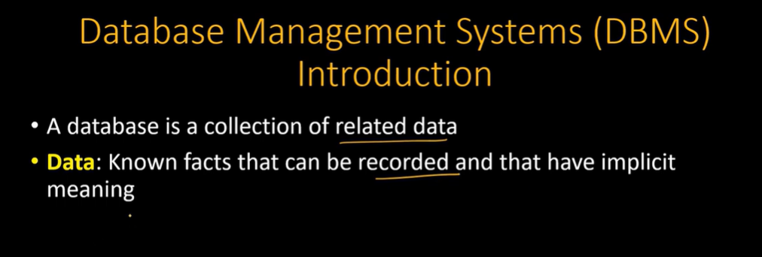

Slide 3
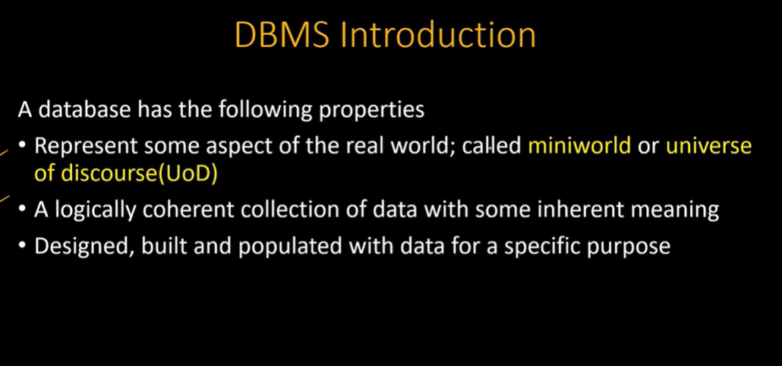

Slide 4
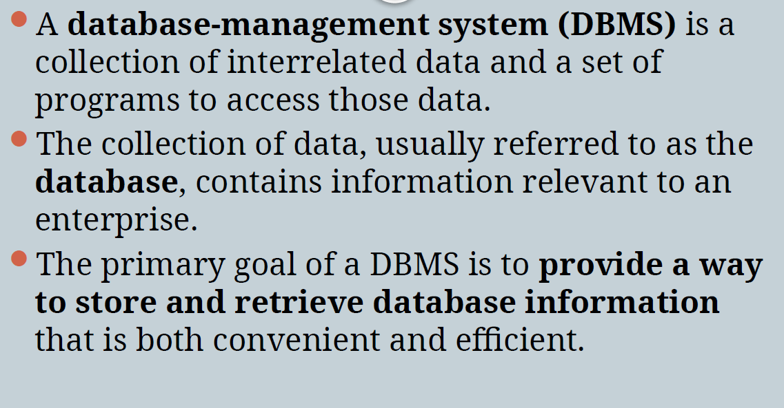

Slide 5
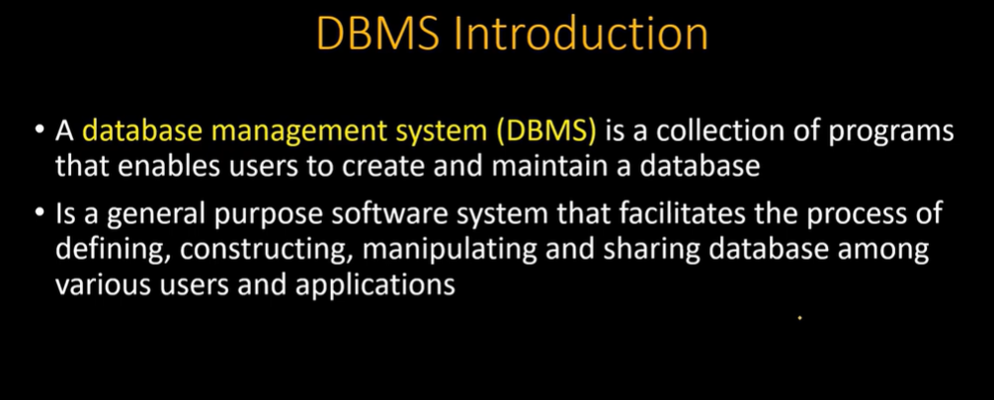

Slide 6
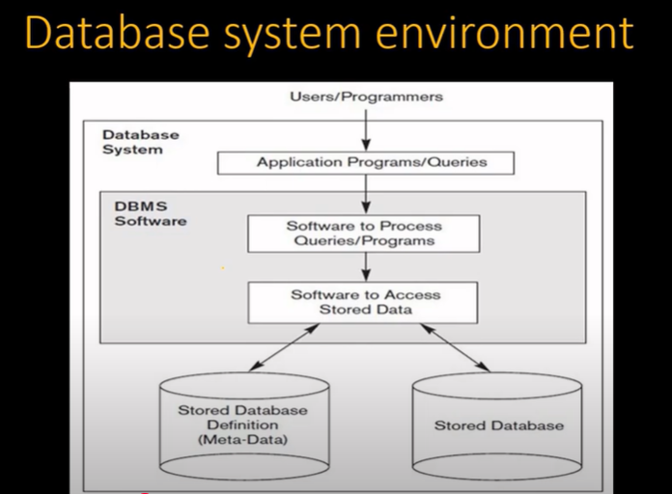

Slide 7
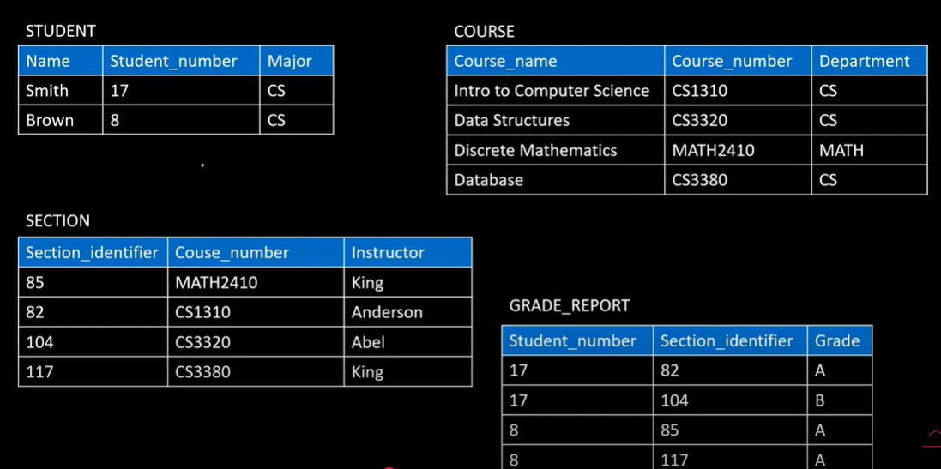

Slide 8
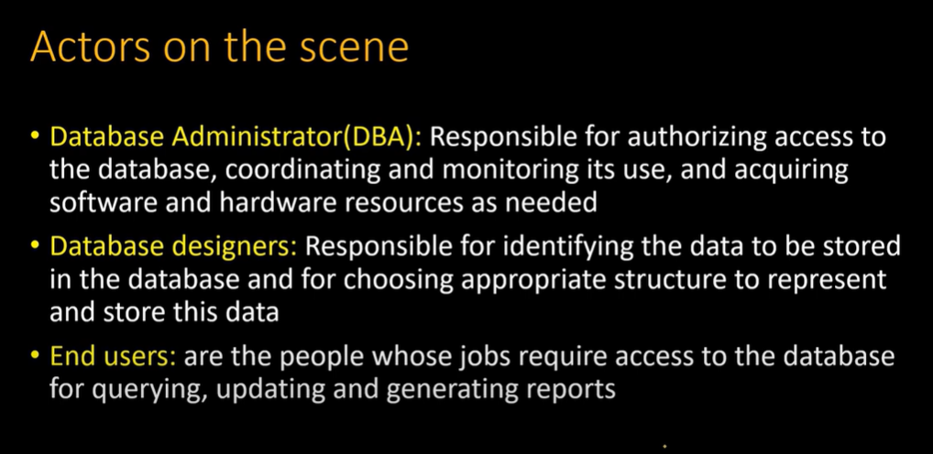

Slide 9
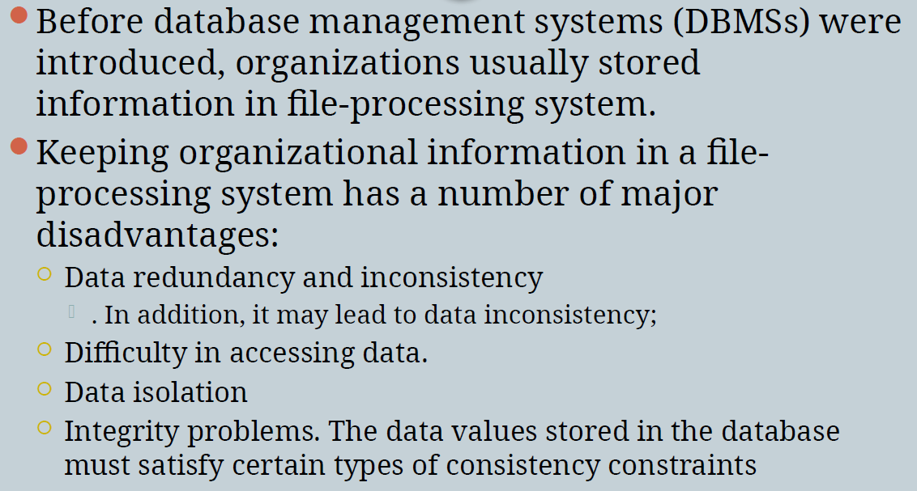
Purpose of Database System

Slide 10
Applications of Database System
Database systems have a prominent effect in many industries which includes finance, telecommunications, logistics, manufacturing, entertainment, and more. They enable efficient data storage, retrieval, and analysis, for the user or the organization helping in fast and efficient decision-making.

Slide 11
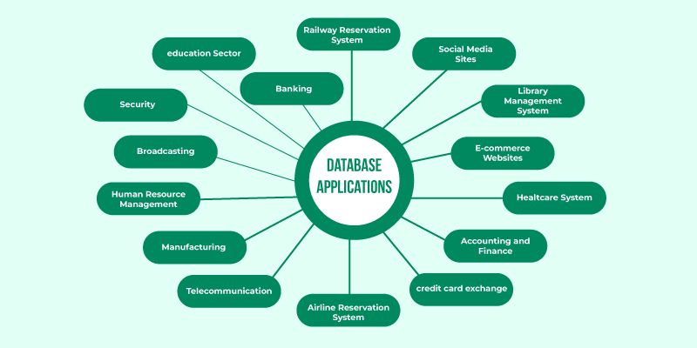

Slide 12
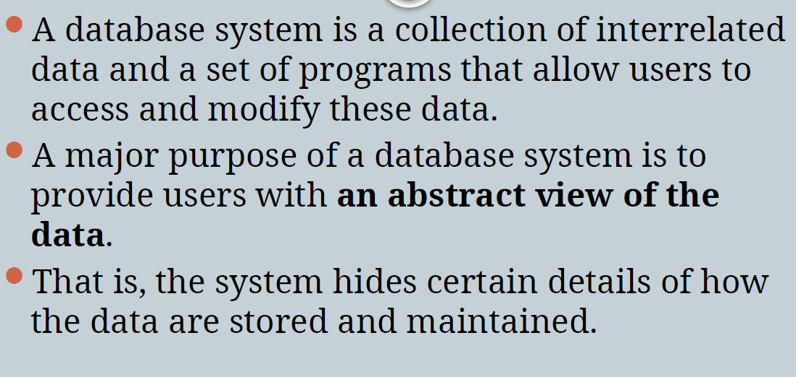
View of Data

Slide 13
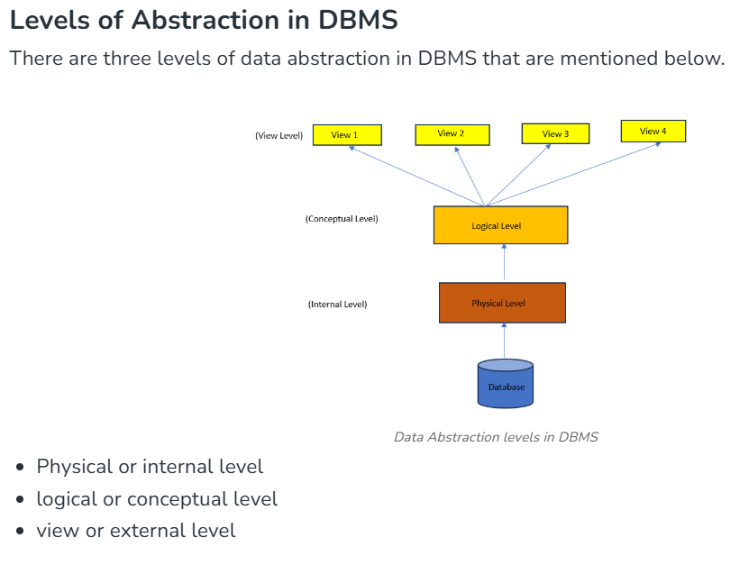
Data Abstraction

Slide 14
Physical or Internal Level
It is the lowest level of data abstraction which defines how data is stored in database .
It defines data structures used to store data and methods to access data in database.
It is very complex to understand and hence kept hidden from user.
Database administrator decides how and where to store the data in database.
Physical level deals with actual storage details like data organization, disk space allocation and data access methods.

Slide 15
Logical or Conceptual Level
It is intermediate level present next to physical level.
It defines what data is present in database and their relationships between them .
It is less complex as compared to physical level.
Programmers generally work at this level and depending on data, structure of tables, relationships and their constraints is decided at this level.

Slide 16
View or External Level
It is the highest level in abstraction.
Many users of the database system do not need all information; instead, they need to access only a part of the database.
The system may provide many views for the same database.
There are different levels of views and each view defines only a part of whole data required to user.

Slide 17
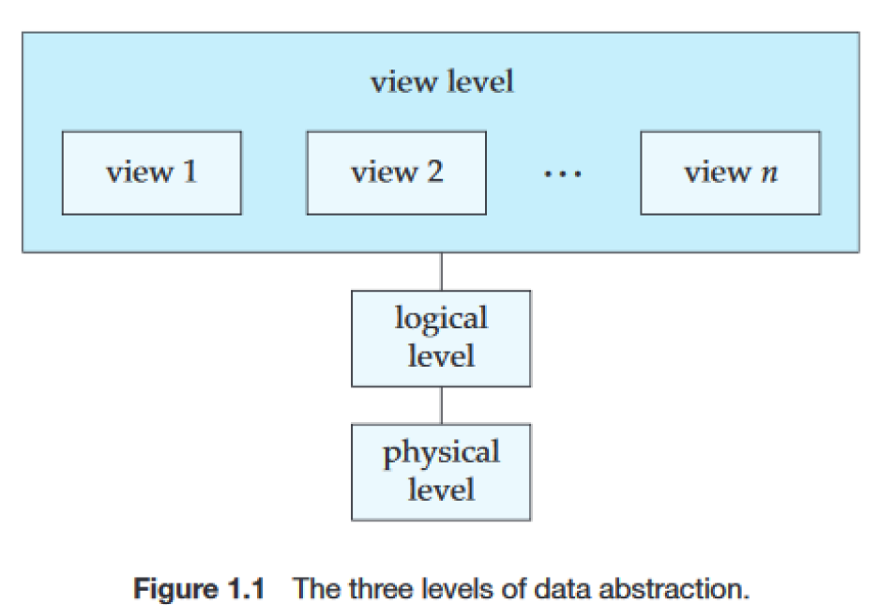

Slide 18
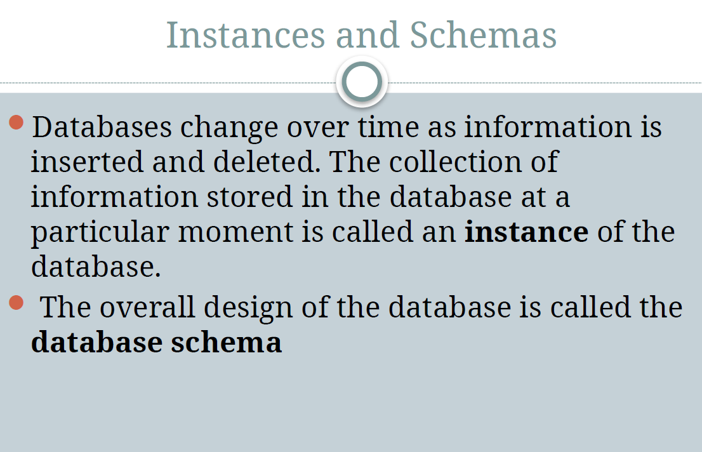

Slide 19
“Schema” and “Instance” are key ideas in a database management system (DBMS) that help organize and manage data.
A schema can be referred to as the blueprint of the database while an instance is the actual contents of the database at a given point of time.

Slide 20
What is Schema?
Schema is the overall description of the database.
It outlines the tables, fields, relationships, views, indexes, and other elements within the database.
The basic structure of how the data will be stored in the database is called schema.
In DBMS, the term schema refers to the architecture of the database which describes how it will appear or will be constructed.
It describes the organization of data such as tables, relationships as well as constraints.
A schema is a template that dictates how data items in a database will be stored, arranged, and accessed.

Slide 21
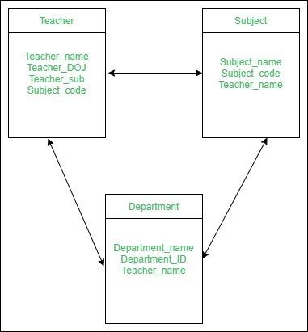
Schema

Slide 22
Schema is of three types: Logical Schema, Physical Schema and view Schema.
Logical Schema – It describes the database designed at a logical level.
Physical Schema – It describes the database designed at the physical level.
View Schema – It defines the design of the database at the view level. (sometimes called sub schemas)

Slide 23
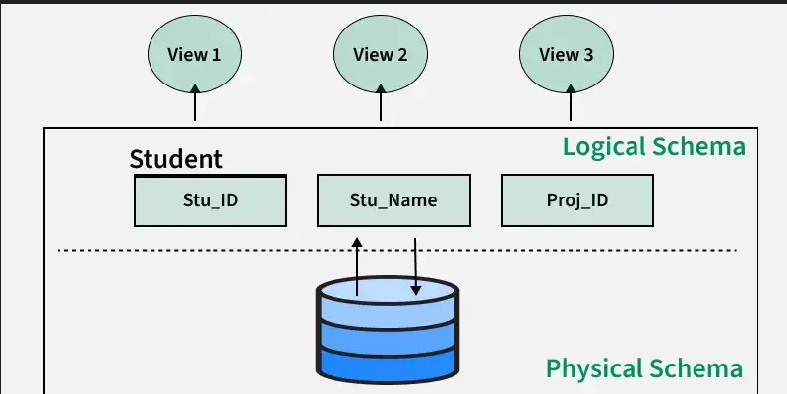

Slide 24
What is Instance?
An instance of DBMS refers to real data in a database coming at some particular point in time.
Instance on the other hand refers to the content in the database in as much as it refers to the structure defined under a particular schema at a given point.
Example
Let’s say a table teacher in our database whose name is School, suppose the table has 50 records so the instance of the database has 50 records for now and tomorrow we are going to add another fifty records so tomorrow the instance has a total of 100 records. This is called an instance.

Slide 25
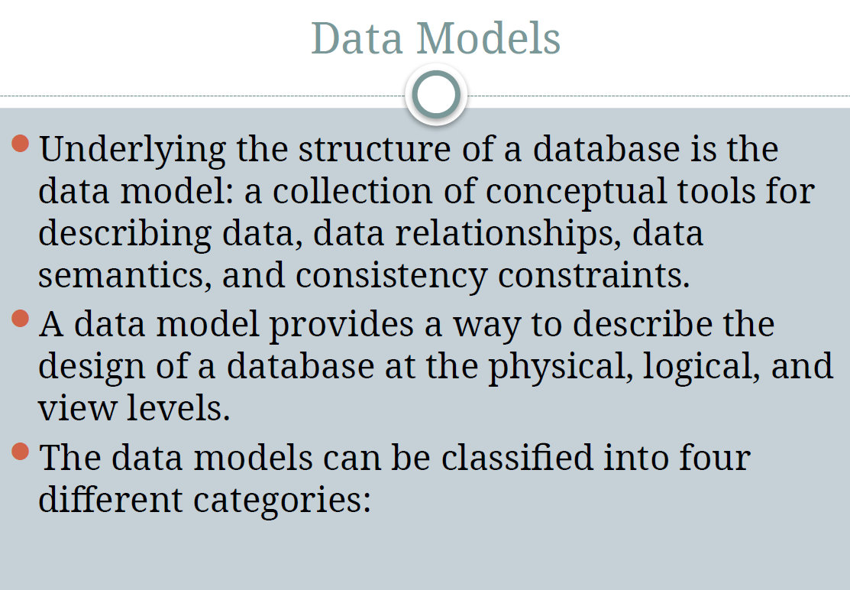

Slide 26
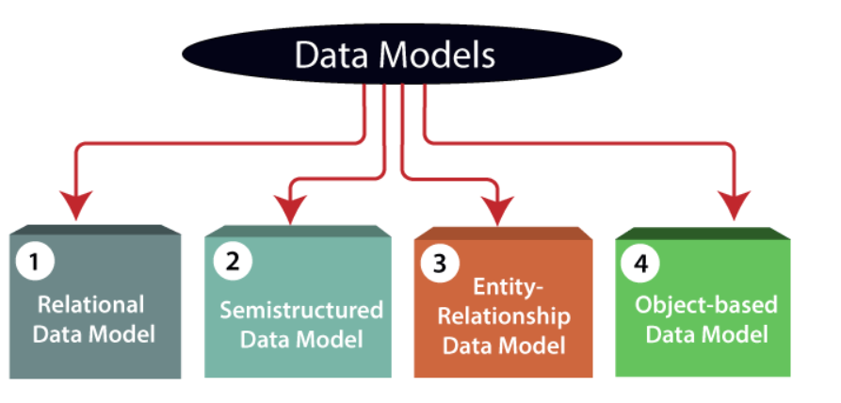

Slide 27
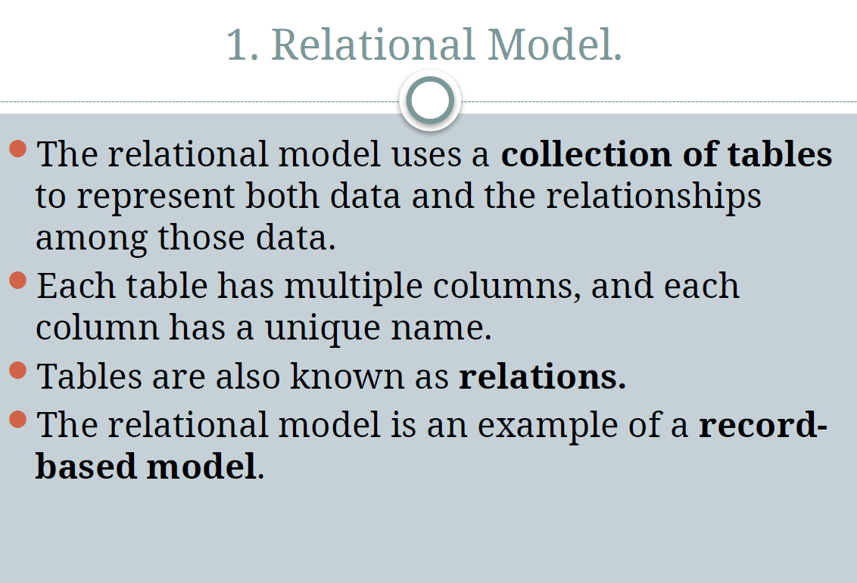

Slide 28
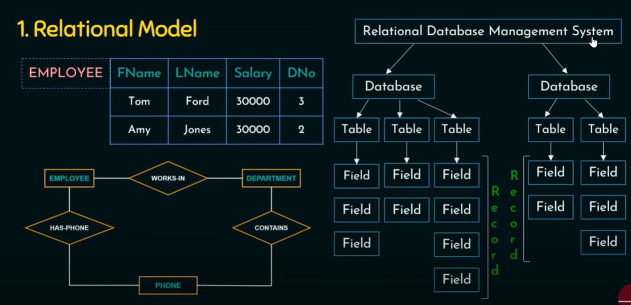

Slide 29
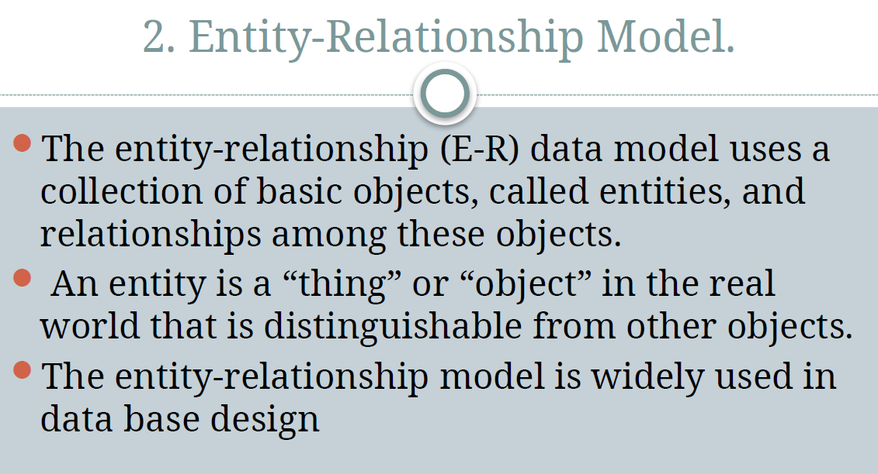

Slide 30
We typically follow the below steps for designing a database for an application.
Gather the requirements (functional and data) by asking questions to the database users.
Do a logical or conceptual design of the database. This is where ER model plays a role. It is the most used graphical representation of the conceptual design of a database.
The Entity Relationship Model is a model for identifying entities (like student, car or company) to be represented in the database and representation of how those entities are related.

Slide 31
Why Use ER Diagrams In DBMS?
ER diagrams represent the E-R model in a database, making them easy to convert into relations (tables).
ER diagrams provide the purpose of real-world modeling of objects which makes them intently useful.
ER diagrams require no technical knowledge of the underlying DBMS used.
It gives a standard solution for visualizing the data logically.

Slide 32
Symbols Used in ER Model
ER Model is used to model the logical view of the system from a data perspective which consists of these symbols:
Rectangles: Rectangles represent Entities in the ER Model.
Ellipses: Ellipses represent Attributes in the ER Model.
Diamond: Diamonds represent Relationships among Entities.
Lines: Lines represent attributes to entities and entity sets with other relationship types.
Double Ellipse: Double Ellipses represent Multi-Valued Attributes.
Double Rectangle: Double Rectangle represents a Weak Entity.

Slide 33
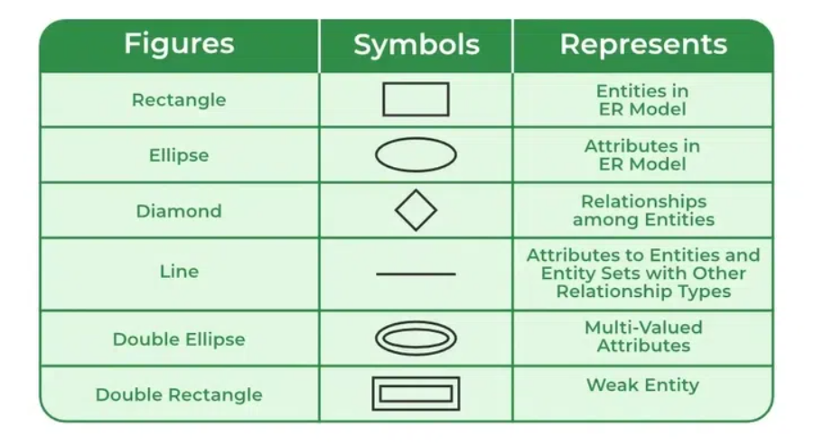

Slide 34
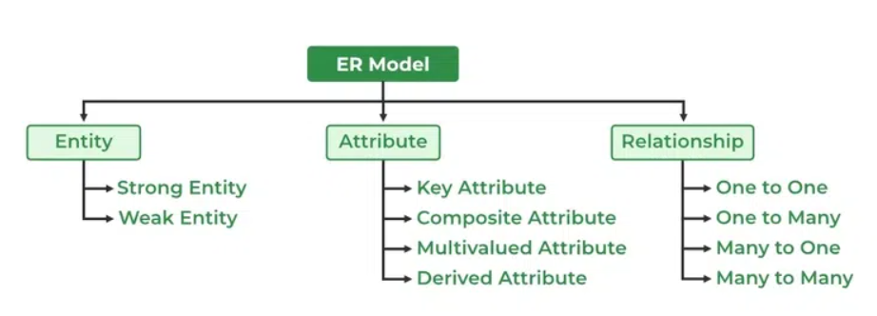
Components of ER Diagram

Slide 35
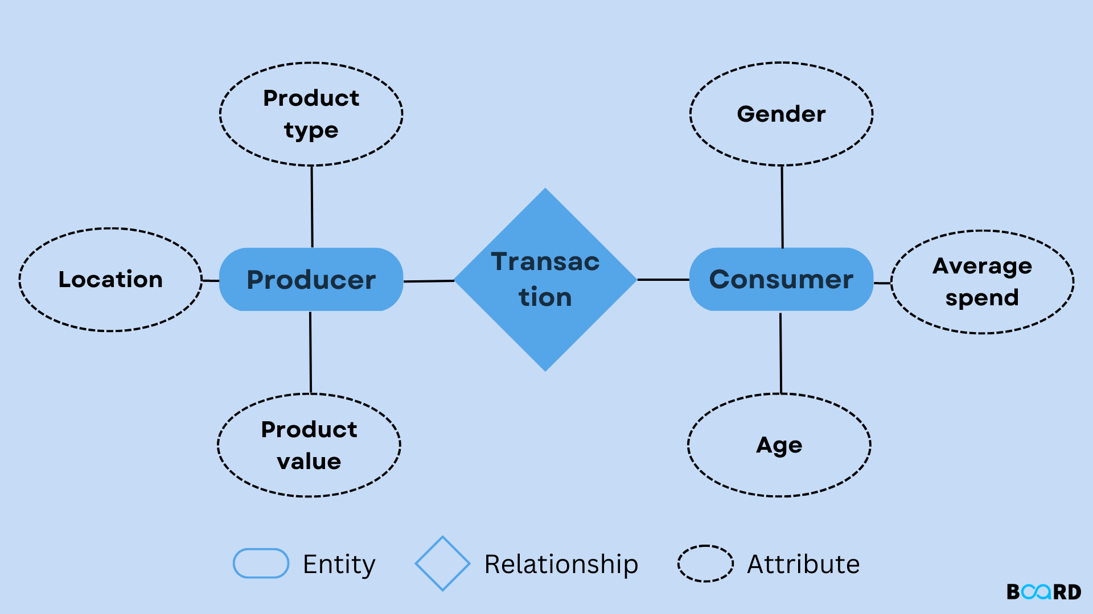

Slide 36
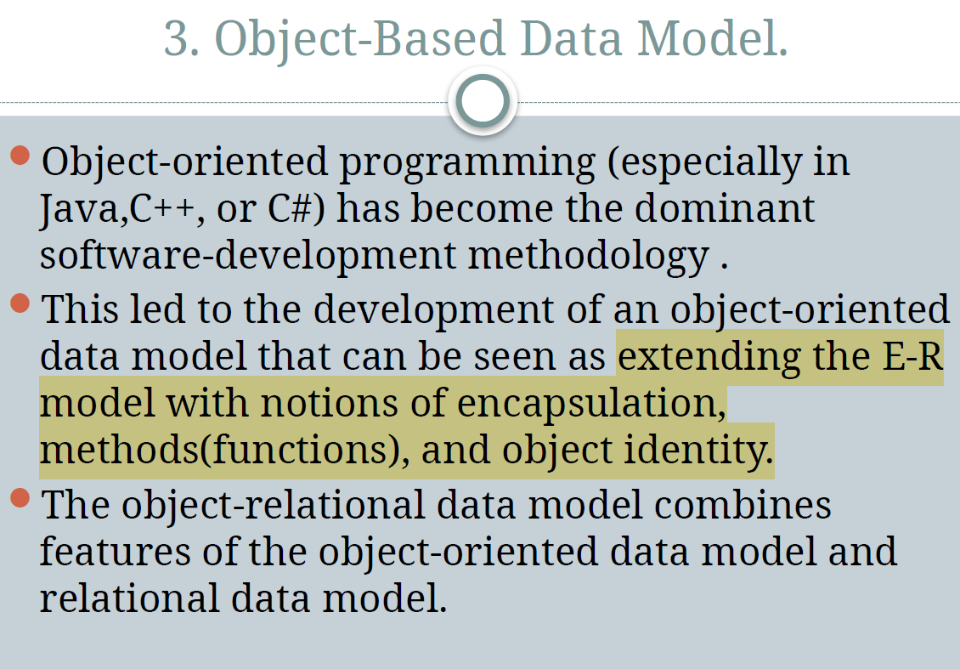

Slide 37
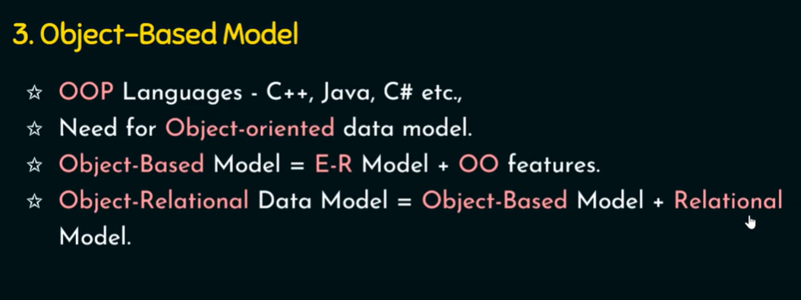

Slide 38
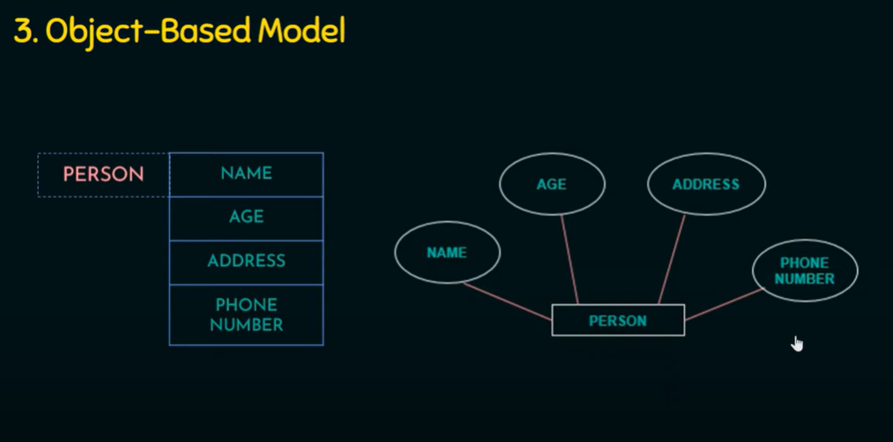

Slide 39
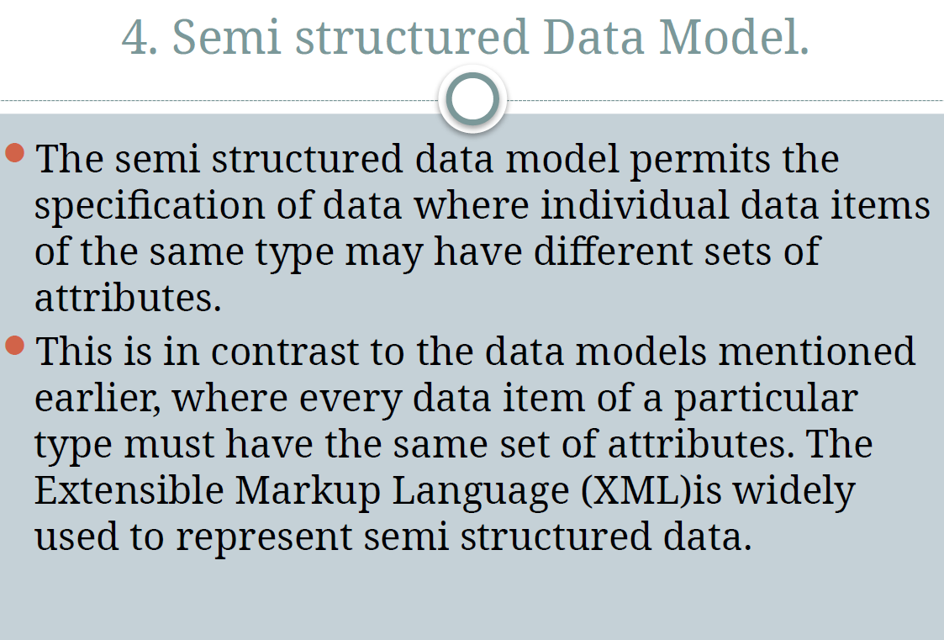

Slide 40
Semi-structured data is a type of data that is not purely structured, but also not completely unstructured.
It contains some level of organization or structure, but does not conform to a rigid schema or data model, and may contain elements that are not easily categorized or classified.
Characteristics of semi-structured Data:
Data can not be stored in the form of rows and columns as in Databases
Semi-structured data contains tags and elements (Metadata) which is used to group data and describe how the data is stored
Similar entities are grouped together and organized in a hierarchy
Entities in the same group may or may not have the same attributes or properties
Does not contain sufficient metadata which makes automation and management of data difficult
Size and type of the same attributes in a group may differ
Due to lack of a well-defined structure, it can not used by computer programs easily

