Slide 1
RAID
Redundant Array of Independent Disks

Slide 2
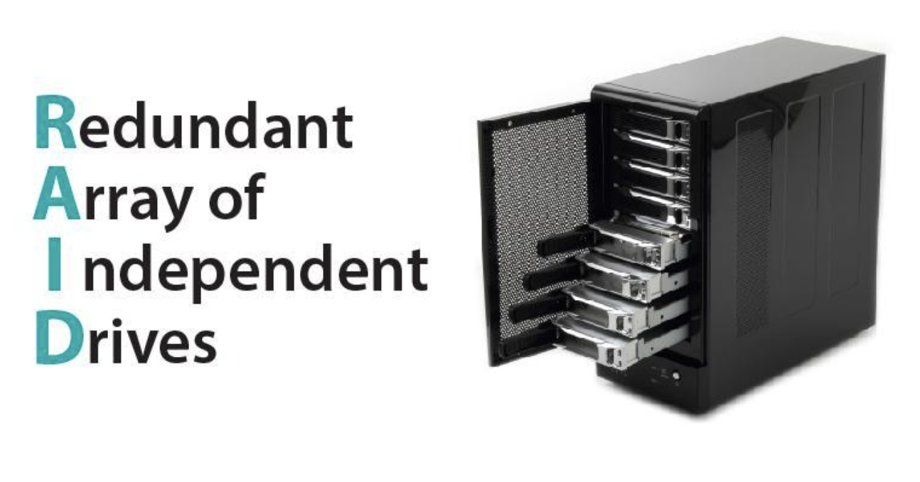
Introduction to RAID
Definition: Explain that RAID is a data storage virtualization technology that combines multiple physical disks into one or more logical units to achieve data redundancy, performance improvement, or both.
Purpose: Highlight the primary goals of RAID: enhancing data reliability and increasing input/output performance.

Slide 3
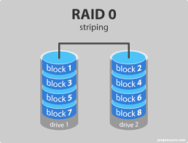
RAID 0 (Striping)
Mechanism: Data is split into blocks and written across all drives in the array without redundancy.
Pros: Improved performance due to parallel read/write operations.
Cons: No fault tolerance; failure of a single drive results in total data loss.

Slide 4
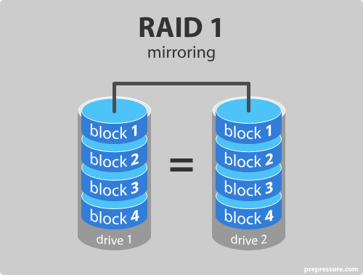
RAID 1 (Mirroring)
Mechanism: Identical copies of data are stored on two or more drives.
Pros: High data redundancy; if one drive fails, data remains accessible.
Cons: Storage capacity is halved; higher cost due to duplication.

Slide 5
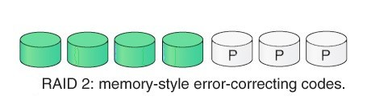
RAID 2 (Bit-Level Striping with Hamming Code)
Mechanism: Data is striped at the bit level across multiple drives with Hamming code error correction.
Pros: Capable of correcting single-bit errors.
Cons: Requires a high number of drives, complex and rarely used in practice.

Slide 6
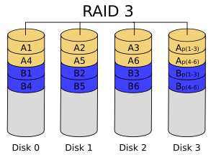
RAID 3 (Byte-Level Striping with Dedicated Parity)
Mechanism: Data is striped at the byte level across multiple drives with a dedicated parity disk.
Pros: Good performance for large sequential data access.
Cons: Dedicated parity disk can become a bottleneck, less efficient for random access.

Slide 7
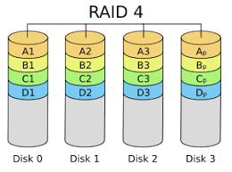
RAID 4 (Block-Level Striping with Dedicated Parity)
Mechanism: Data is striped at the block level across multiple drives with a dedicated parity disk.
Pros: Allows for individual disk reads, good for read-heavy operations.
Cons: Write performance can be hindered due to parity disk bottleneck.

Slide 8
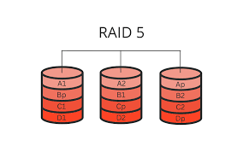
RAID 5 (Block-Level Striping with Distributed Parity)
Mechanism: Data and parity information are striped across three or more drives.
Pros: Efficient storage with fault tolerance; can withstand a single drive failure.
Cons: Rebuild times can be lengthy, performance may degrade during rebuilds.

Slide 9
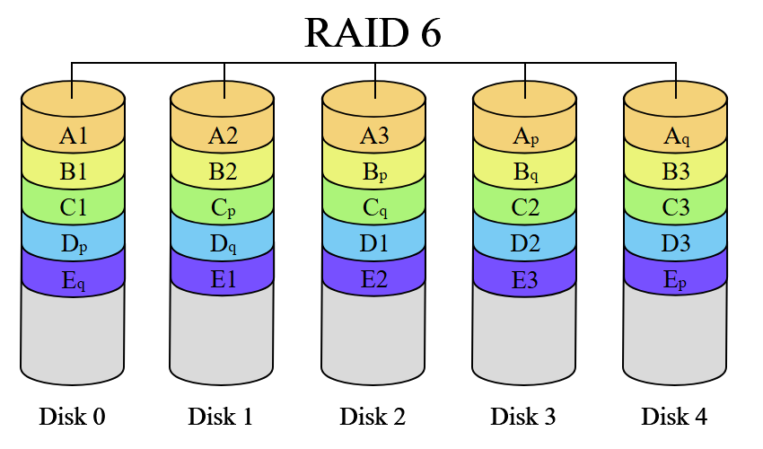
RAID 6 (Block-Level Striping with Double Distributed Parity)
Mechanism: Similar to RAID 5 but with double parity, allowing for two simultaneous drive failures.
Pros: Enhanced fault tolerance compared to RAID 5.
Cons: Reduced write performance due to additional parity calculations, requires more storage overhead.

Slide 10
Nested RAID Levels (RAID 10 and RAID 01)
RAID 10 (1+0): Combines mirroring and striping by creating mirrored sets that are then striped.
Pros: High performance and fault tolerance; can handle multiple drive failures if they occur in different mirrored pairs.
Cons: Requires a minimum of four drives; 50% storage efficiency.
RAID 01 (0+1): Combines striping and mirroring by creating striped sets that are then mirrored.
Pros: Improved performance with fault tolerance.
Cons: Less robust fault tolerance compared to RAID 10; failure of a single drive can make an entire striped set vulnerable.

Slide 11
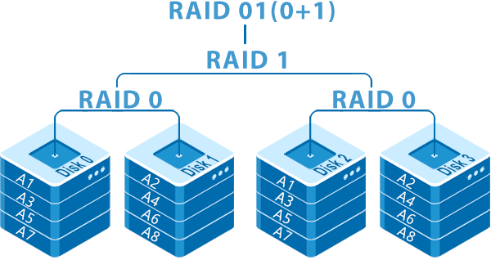
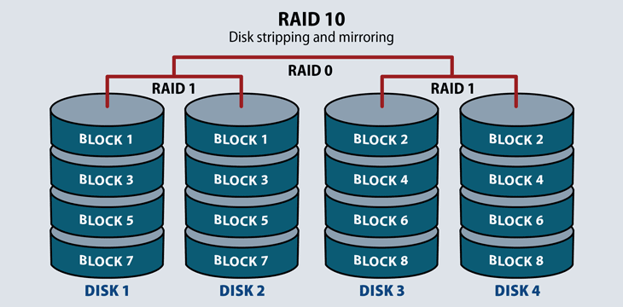
Nested RAID

Slide 12
Benefits of Implementing RAID
Increased Performance: Certain RAID levels (e.g., RAID 0, RAID 10) offer enhanced read/write speeds.
Data Redundancy: Levels like RAID 1, 5, and 6 provide mechanisms to protect against data loss due to hardware failures.
Scalability: RAID configurations can be adjusted to accommodate growing storage needs.

Slide 13
Potential Drawbacks
Cost: Implementing RAID can be expensive due to the need for additional drives and specialized hardware.
Complexity: Managing and maintaining RAID systems can be complex, requiring specialized knowledge.
Not a Substitute for Backups: While RAID provides redundancy, it doesn't replace the need for regular data backups, especially against threats like data corruption or cyber-attacks.

Slide 14
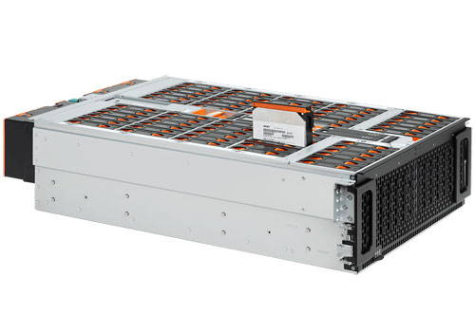
JBODS

Slide 15
Thank you

