Slide 1
Table inheritance

Slide 2
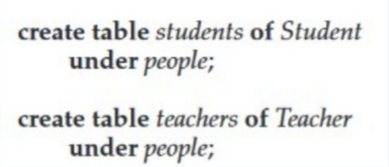
Create table people of Person;
We can then define tables students and teachers
as subtables of people,

Slide 3
Further, when we declare students and teachers as subtables of people, everytuple present in students or teachers becomes implicitly present in people.
Thus, if a query uses the table people, it will find not only tuples directly inserted into that table, but also tuples inserted into its subtables, namely students and teachers. However, only those attributes that are present in people can be accessed by that query.

Slide 4
SQL permits us to find tuples that are in people but not in its subtables by using “only people”in place of people in a query.
The only keyword can also be used in delete and update statements.
Without the only keyword, a delete statement on a supertable, such as people, also deletes tuples that were originally inserted in subtables (such as students);
delete from people where P;
would delete all tuples from the table people, as well as its subtables students and teachers, that satisfy P

Slide 5
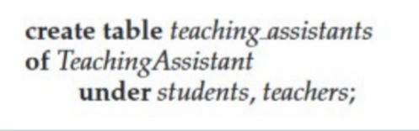
If the only keyword is added to the above statement,tuples that were inserted in subtables are not affected, even if they satisfy the where clause condition.
Multiple inheritance is possible with tables,

Slide 6
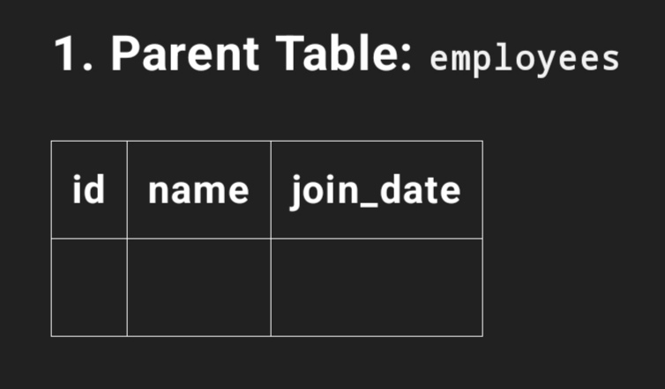
Table inheritance example

Slide 7
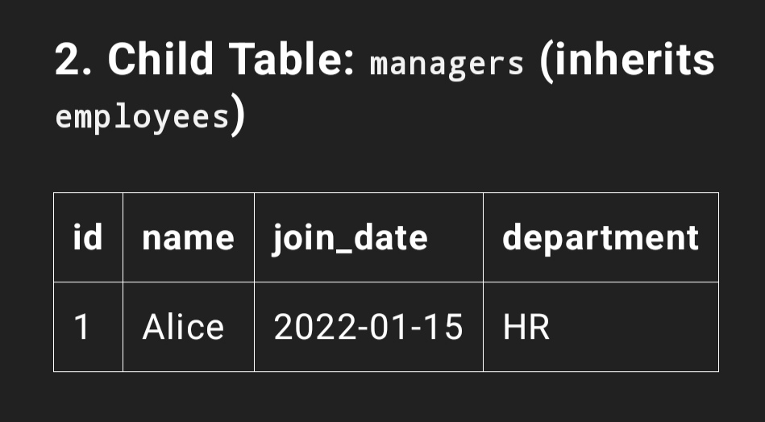
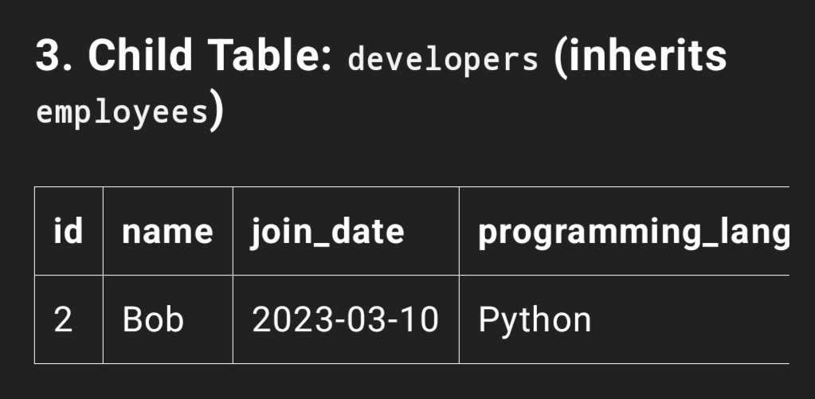

Slide 8
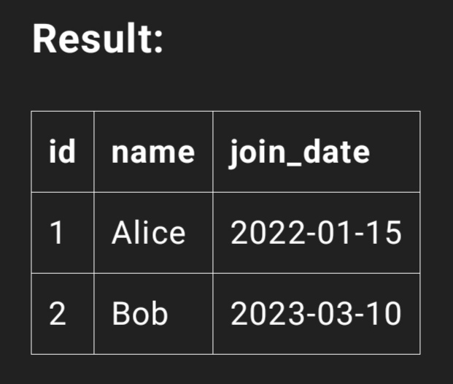
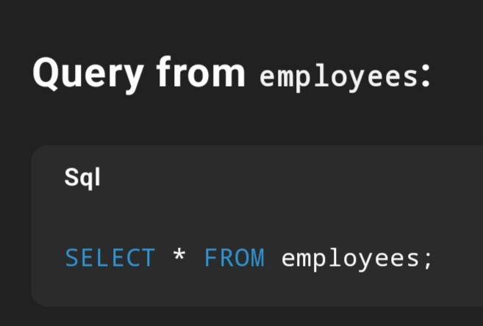

Slide 9
