Slide 1
INTRODUCTION TO KERAS
SANA S NAVAS

Slide 2
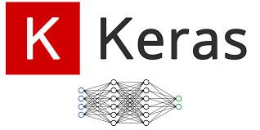
KERAS
Keras runs on top of open-source machine learning libraries like TensorFlow, Theano, or Cognitive Toolkit (CNTK).
Theano is a Python library used for fast numerical computation tasks.
TensorFlow is the most famous symbolic math library used for creating neural networks and deep learning models.
CNTK is a deep learning framework developed by Microsoft.
Keras is based on minimal structure that provides a clean and easy way to create deep learning models.
Keras is an optimal choice for deep learning applications.

Slide 3
FEATURES OF KERAS
Consistent, simple, and extensible API.
Minimal structure – easy to achieve the result without any frills.
Supports multiple platforms and backends.
User-friendly framework that runs on both CPU and GPU.
Highly scalable computation.

Slide 4
Advantages of Keras
Larger Community Support → Active developer and user base means better help, documentation, and tools.
Easy to Test → Models are easy to build, modify, and test quickly.
Python-Based → Keras uses Python, making it simple and readable for developers.
Supports CNNs & RNNs → Easily build Convolutional Neural Networks (CNNs)
and Recurrent Neural Networks (RNNs).
Modular Design → Deep learning models are made of standalone building blocks (layers, optimizers, etc.)
that you can mix and match.

Slide 5
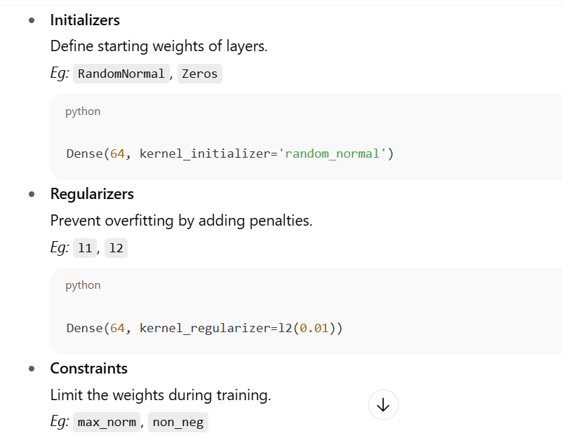

MODULES IN KERAS

Slide 6
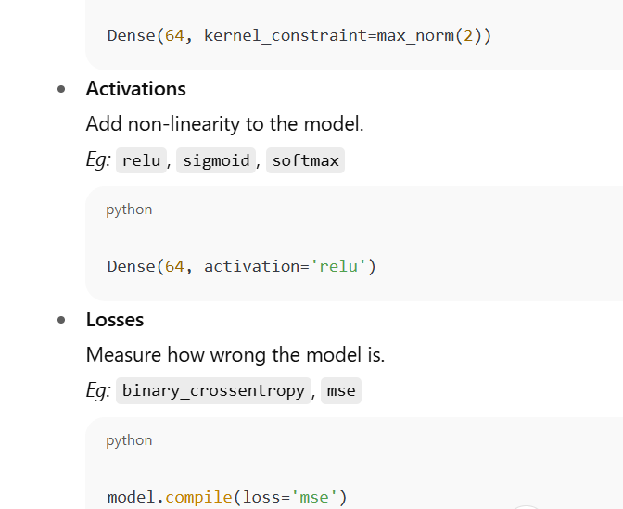

Slide 7
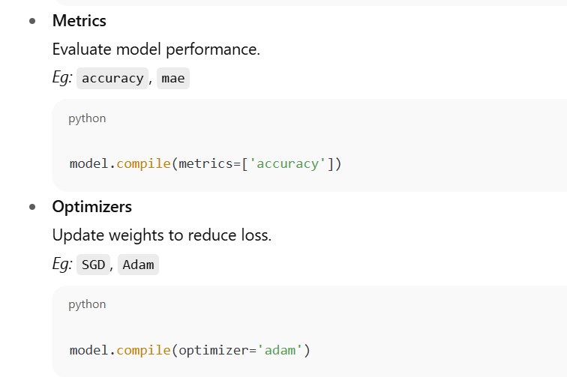

Slide 8
MORE MODULES
Callback: Functions to monitor training and stop training (e.g., EarlyStopping).
Text Processing: Converts text to NumPy arrays.
Image Processing: Converts images to NumPy arrays.
Sequence Processing: Generates time-based data.
Backend: Functions for backend libraries like TensorFlow/Theano.
Utilities: Utility functions for deep learning.

Slide 9
KERAS LAYERS
Requirements of a Dense Layer in Keras: 🔹 Input shape – Shape of data going into the layer (e.g., (batch_size, features)) 🔹 Number of neurons/units – How many neurons the layer has (e.g., Dense(64) means
64 neurons) 🔹 Initializers – How weights are initialized (e.g., RandomNormal) 🔹 Regularizers – Prevent overfitting by adding penalty (e.g., l2(0.01)) 🔹 Constraints – Limits on weights (e.g., max norm) 🔹 Activations – Adds non-linearity (e.g., relu, sigmoid)

Slide 10
KERAS LAYER EXAMPLE
from keras.models import Sequential
from keras.layers import Activation, Dense
from keras import initializers, regularizers, constraints
model = Sequential()
model.add(Dense(32, input_shape=(16,), kernel_initializer='he_uniform',
kernel_regularizer=None, kernel_constraint='MaxNorm', activation='relu'))
model.add(Dense(16, activation='relu'))
model.add(Dense(8))
Sequential() – A linear stack of layers Dense(32, input_shape=(16,), ...) – ▪ 32 neurons in the first layer ▪ Input has 16 features ▪ kernel_initializer='he_uniform' – Initializes weights using He uniform method (good for ReLU) ▪ kernel_constraint='MaxNorm' – Limits the weight values (to prevent exploding weights) ▪ activation='relu' – ReLU adds non-linearity Dense(16, activation='relu') – Second hidden layer with 16 neurons and ReLU Dense(8) – Output layer with 8 neurons, no activation (defaults to linear)

Slide 11
INPUT SHAPE BASICS
In machine learning, all data—whether it's text, images, or video—gets turned into arrays of numbers.
Think of an array as a grid or a box that holds your data. The "shape" of this array is just a set of numbers
that tells you its dimensions. It's a simple way to describe how big the grid is.
Examples:
2D Example: shape = (4, 2)
This is a 2D grid with 4 rows and 2 columns.
It's like a table with 4 items, and each item has 2 features.
3D Example: shape = (3, 4, 2)
This is a 3D box of data.
It's a collection of 3 tables, where each table has 4 rows and 2 columns.
This is useful for things like color images (height, width, color channels) or video data.

Slide 12
INITIALISERS
Before a model can start learning from data, it needs to have a starting value for its weights (the internal numbers that the model adjusts to make predictions). The initializers module assigns these initial weights to the connections in your neural network.
Common Types of Initializers:
Zeros/Ones/Constant: These are simple initializers that set all weights to zero, one, or a specific constant value. While easy to understand, they can sometimes cause problems during training.
RandomNormal/RandomUniform: These are more common. They assign random weights drawn from a normal (bell curve) or uniform distribution. This randomness helps the model avoid getting stuck in a bad starting point.
Specialized Initializers (e.g., Glorot, He, Lecun): These are advanced initializers designed to work well with specific types of neural network layers. They carefully choose initial weights to help the training process converge faster and more reliably.

Slide 13
Simple Initializers
Constant: Sets all weights to a single, constant value.
my_init = initializers.Constant(value=0)
RandomNormal & RandomUniform: Assigns random weights based on a distribution.
Normal: Weights follow a bell curve.
Uniform: Weights are evenly distributed within a range.
Parameters: mean, stddev, minval, maxval
my_init = initializers.RandomNormal(mean=0.0, stddev=0.05)
my_init = initializers.RandomUniform(minval=-0.05, maxval=0.05)
Specialized Initializers
TruncatedNormal & VarianceScaling: Adaptive scaling based on input/output size.
TruncatedNormal: Similar to RandomNormal but values outside a range are re-sampled.
VarianceScaling: Scales weights based on fan_in (number of input units) or fan_out
(number of output units).
my_init = initializers.TruncatedNormal(mean=0.0, stddev=0.05)
my_init = initializers.VarianceScaling(scale=1.0, mode='fan_in', distribution='normal')

Slide 14
Advanced Initializers
Glorot Normal (Xavier): Designed for layers with tanh or sigmoid activation functions.
stddev = sqrt(2 / (fan_in + fan_out))
my_init = initializers.glorot_normal()
He Normal: Designed for layers with ReLU activation functions.
stddev = sqrt(2 / fan_in)
my_init = initializers.he_normal()
Lecun Normal: Optimized for self-normalizing neural networks.
stddev = sqrt(1 / fan_in)
my_init = initializers.lecun_normal()
Lecun Uniform: Similar to Lecun Normal but uses a uniform distribution.
limit = sqrt(3 / fan_in)
my_init = initializers.lecun_uniform()

Slide 15
Orthogonal Initializer
Creates a random orthogonal matrix.
orthogonal matrix is a square matrix where:
All rows are perpendicular (orthogonal) to each other.
All columns are also orthogonal to each other.
Each row and column has a length (or norm) of 1.
Maintains stability of gradients (prevents vanishing/exploding gradients).
Useful in deep networks like RNNs.
python
my_init = initializers.Orthogonal(gain=1.0) Keeps training stable by preserving the norm of the data through layers.
Identity Initializer
Creates an identity matrix, optionally scaled.
Often used in residual networks or when input = output size.
python
my_init = initializers.Identity(gain=1.0)

Slide 16
CONCLUSION
Keras provides a high-level, user-friendly API to build deep learning models efficiently.
It acts as a wrapper over powerful libraries like TensorFlow, Theano, and CNTK.
Key components include:
Modules: initializers, regularizers, constraints, losses, optimizers, etc.
Layers: defined with input shape, activation functions, and various configurations.
Keras supports both CPU and GPU, and is known for its flexibility, extensibility, and performance.
Ideal for beginners and researchers looking for rapid experimentation and prototyping.

