Slide 1
Subithra C
Final Project
3/21/2024 Annual Review

Slide 2
PROJECT TITLE
House price prediction using Convoluted Neural Networks(CNN)
3/21/2024 Annual Review

Slide 3


AGENDA
The project aims to predict the housing prices in Boston using Convoluted Neural Networks (CNN) machine learning model from the previous data.
This involves preprocessing the dataset, creating and training a machie learning model, assessing its accuracy, and implementing it for real-time prediction and price management.
3/21/2024 Annual Review

Slide 4

PROBLEM STATEMENT
The project aims to develop a machine learning model capable of accurately predicting housing prices in the Boston area based on various features such as crime rate, property tax, proximity to employment centers, and others. By leveraging historical housing data, the model seeks to provide valuable insights for homebuyers, sellers, and real estate professionals, facilitating informed decision-making and enhancing market efficiency. The project addresses the need for reliable and transparent pricing mechanisms in the real estate industry, ultimately contributing to improved affordability, investment opportunities, and overall satisfaction in the housing market.
3/21/2024 Annual Review

Slide 5

PROJECT OVERVIEW
The project focuses on developing a machine learning solution to predict housing prices in Boston. By leveraging historical housing data and various property features, the model aims to provide accurate price estimates for real estate in the area. This predictive tool will assist homebuyers and sellers in making informed decisions, while also benefiting real estate professionals and market analysts. Ultimately, the project seeks to enhance market transparency and efficiency, contributing to a more informed and vibrant real estate market in Boston.
3/21/2024 Annual Review

Slide 6

WHO ARE THE END USERS?
Homebuyers: Individuals or families seeking to purchase property in Boston can utilize the predicted housing prices to make informed decisions about affordability and value.
Home Sellers: The predicted housing prices can be used to set competitive listing prices, attract potential buyers, and optimize their selling strategies for maximum returns.
Real Estate Professionals: Agents can leverage the predicted prices to provide accurate pricing guidance to clients, facilitate smooth transactions, and enhance overall client satisfaction.
Investors: Investors can use the predicted prices to identify promising investment opportunities, assess risks, and optimize their investment strategies for profitable outcomes.
Market Analysts and Researchers: Researchers analyzing can utilize the predicted prices to conduct market studies, forecast trends, and gain insights into the underlying factors driving housing price movements.
3/21/2024 Annual Review

Slide 7

YOUR SOLUTION AND ITS VALUE PROPOSITION
The prooject utilizes historical housing data and various property features to generate accurate price estimates, enabling users to make informed decisions when buying, selling, or investing in real estate in the Boston area.
The value proposition lies in its ability to provide actionable insights and guidance to users across the real estate ecosystem. Whether you're a homebuyer, seller, real estate professional, investor, or market analyst, the predictive model offers valuable tools to optimize decision-making, enhance market transparency, and identify profitable opportunities in the dynamic Boston housing market.
3/21/2024 Annual Review

Slide 8

THE WOW IN YOUR SOLUTION
the scalability and adaptability allow it to evolve alongside the ever-changing real estate landscape, ensuring continued relevance and value for users in the long term. Whether it's finding the perfect home, maximizing returns on investment properties, or conducting in-depth market analysis, your solution is poised to revolutionize the way people interact with the Boston real estate market.
3/21/2024 Annual Review

Slide 9
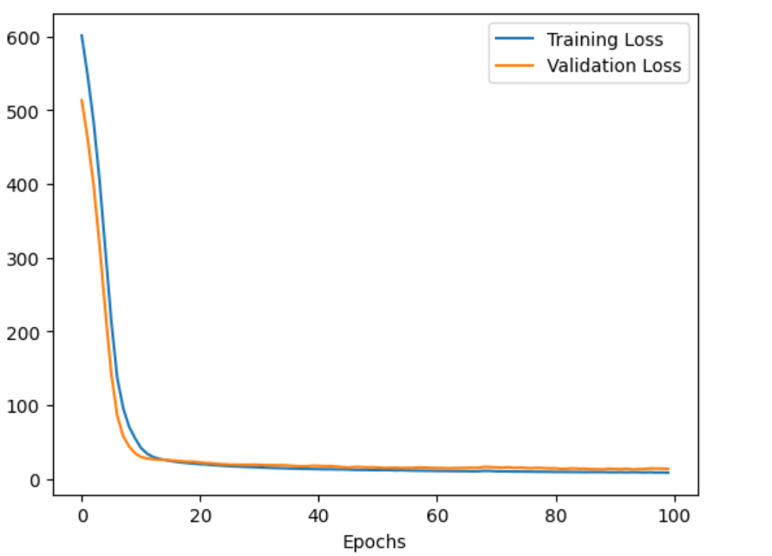
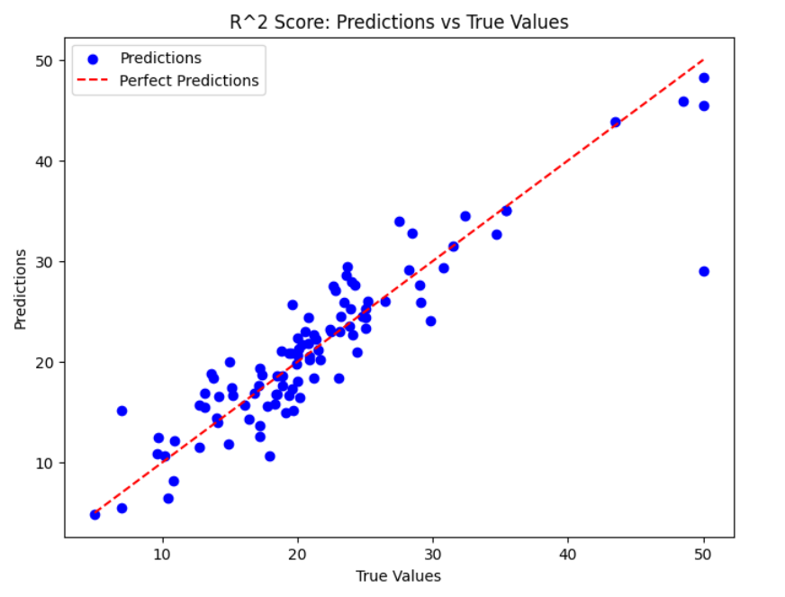
MODELLING
The following graph shows the training los and validation loss of the project
3/21/2024 Annual Review

Slide 10
RESULTS
Overall, the project housing price prediction in Boston offers a valuable tool for stakeholders in the real estate market. By leveraging machine learning techniques, we aim to empower users with accurate insights into housing price trends and dynamics, facilitating informed decision-making and enhancing market efficiency
https://colab.research.google.com/drive/1AVZ5yFZCJ_imwiRMRNc2M_BnIYFSFFKB?usp=sharing

