Slide 1
Squad Lvl 1
Custom Weaponry
Supply Buff
Cross-Training
Special Operations
Crush
Sabatoge
Duel of the Fates
Fight to the Death
Ranged Sabatoge
Cardio
Strategic Retreat
Raiders
Level 2
Level 3

Slide 2
Super Dispenser
Engie Lvl 1
Eureka Effect
Insta-Retreat
Rescue Ranger
Sigafoo Save
Omni-presence
Wrangler
Area Denial
Aerial Deployment
Grava-Controller
Ubered Buildings
Ninjaneer
Frontier Justices
Level 2
Level 3

Slide 3
Medic Lvl 1
Quick-Fix
Mega-Heal
Crossbow
Overdose
Blutsager
Ubersaw
Vampirism
Going Viral
Medi-Vac
Godlike
Vaccinator
Kritzkreig
Level 2
Level 3

Slide 4

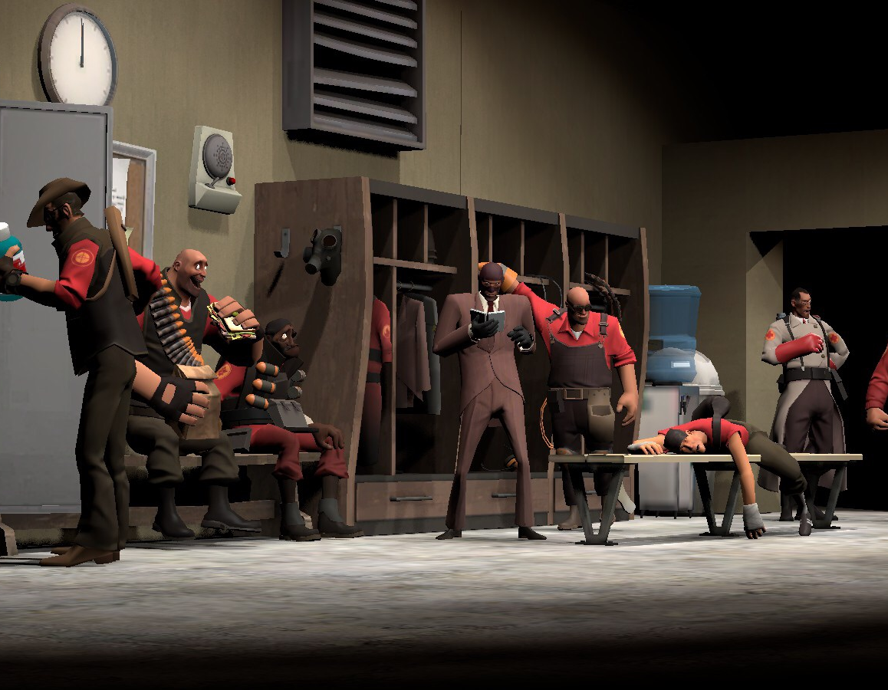

Training Roster - SQUAD
LEVEL 3
LEVEL 2
LEVEL 1

Slide 5
Training Roster – FIELD ENGINEER
LEVEL 3
LEVEL 2
LEVEL 1

Slide 6
Training Roster – Field MEdic
LEVEL 3
LEVEL 2
LEVEL 1

