Slide 1

Meilenstein 1 – Gruppe 11 Bordeau Ink cs108 Programmierprojekt, FS18
Rik de Graaff
Lucas Galery
Luc Kury
David Lengweiler

Slide 2
we are Bordeaux Ink.
Rik de Graaff, Lucas Galery Käser, Luc Kury, David Lengwiler

Slide 3
basic overview of the key features:
the goal is to conquer as many stars as possible
maps are generated procedurely
each player’s mother ship is placed on a random starting position
the stars a player owns constantly produce new ships
you can travel to any star to gain access to its resources
real time

Slide 4
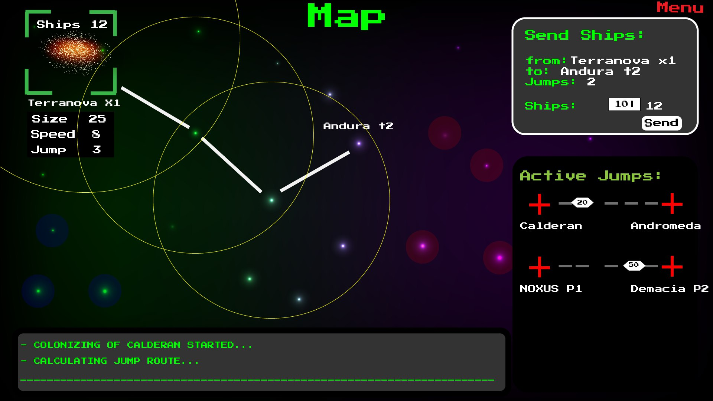
one of our mock-ups:

Slide 5
game rules:
stars:
attributes: basic defense, production frequency, colonization difficulty
multiple players on same star: mutual de-materialization
ships:
mother ship: origin of orders, delay of information, movable
regular ships: move by hopping, equally strong

Slide 6
requirements (non-functional)
server can host 10 games simloultaneously at 8 players per game
server tickrate @20Hz
client tickrate @60Hz
client can compensate for packet loss

Slide 7
requirements (functional)
usual stuff (create lobby, join, quit, chat, …)
move mother ship
send units around the map
view unit positions
view star attributes and status

Slide 8
client-server interface:
server:
generates the map and distributes it to the clients
holds the star coordinates and their attributes and manages their status
holds a history of all past events
accepts hopping paths from the clients, validates and executes them
sends information to clients with a position-dependant delay
calculates de-materialization outcome
Notes:
skip default client-server stuff

Slide 9
client-server interface:
client:
calculates hopping paths and sends them to server
updates GUI according to game info from server
Notes:
skip default client-server stuff

Slide 10
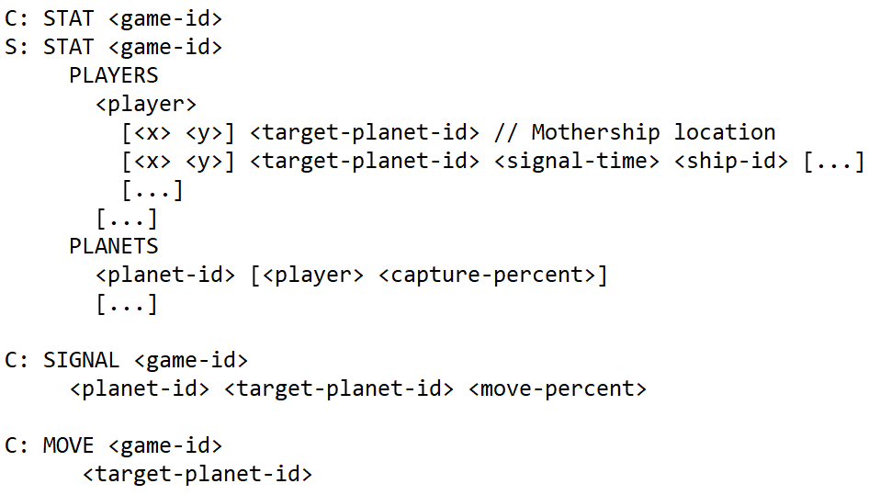
screenshot of the client-server protocol:

Slide 11
project plan:
management-side:
sysAdmin, project lead: Luc
UX and lead artist: David
lead programmer: Rik
progress manager: Lucas

Slide 12
project plan:
programming-side:
server-side game and user management: Luc, Rik
server-side game logic: Rik, David
networking: Lucas, Luc
client-side game logic: David, Lucas
GUIs: David, all

Slide 13
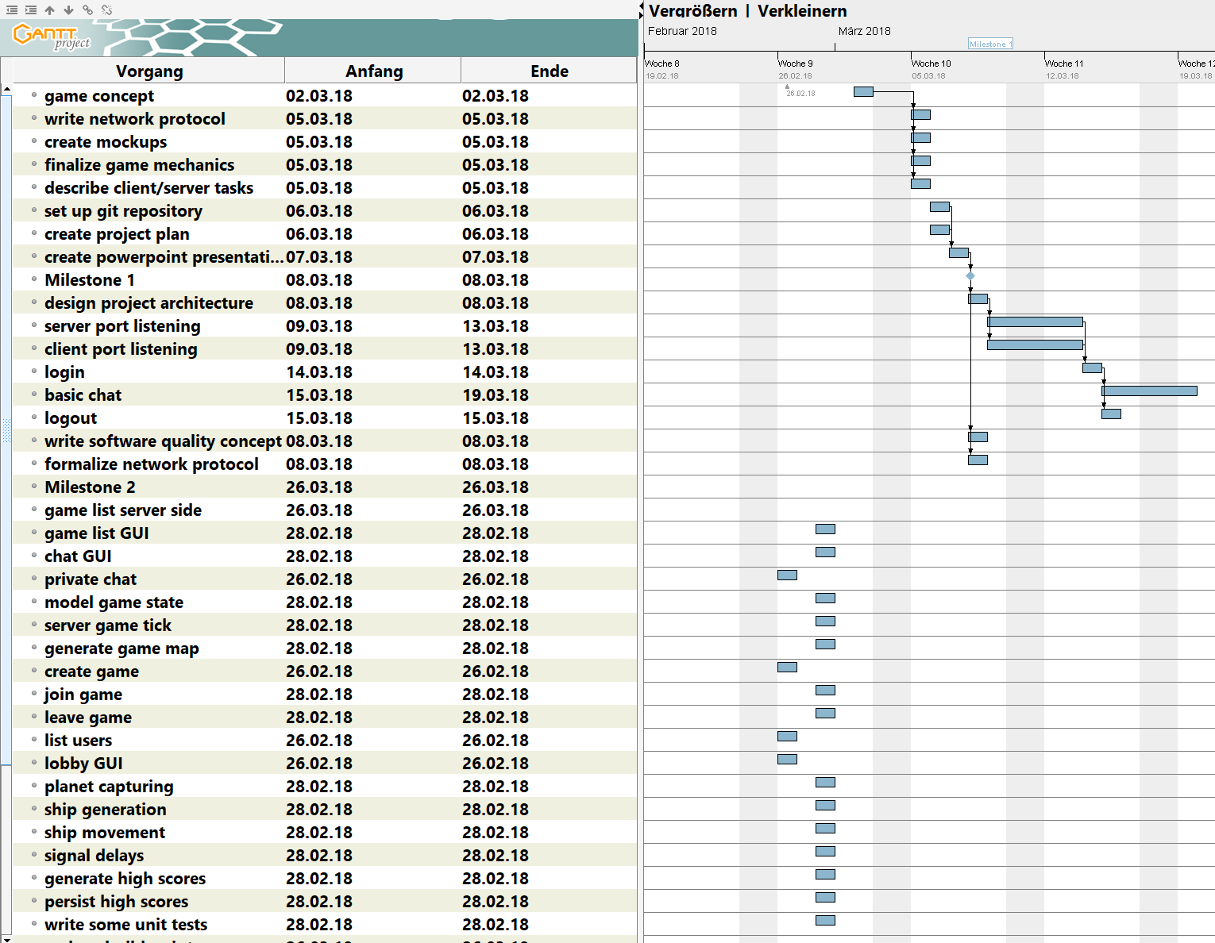
screenshot of our gantt project:

Slide 14
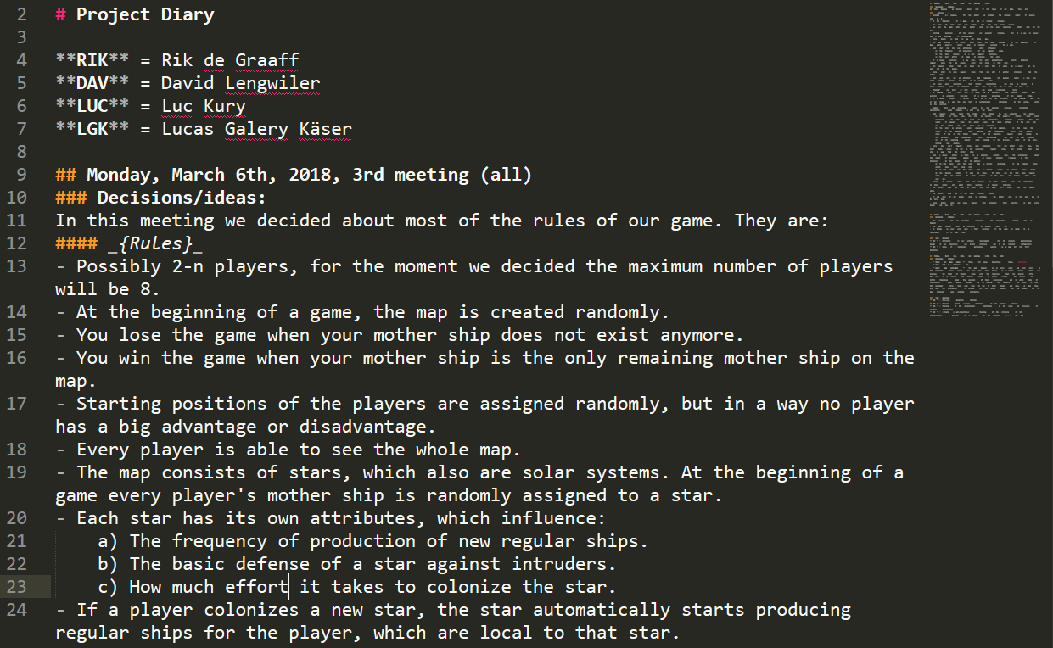
our project diary, written in mardown:

Slide 15
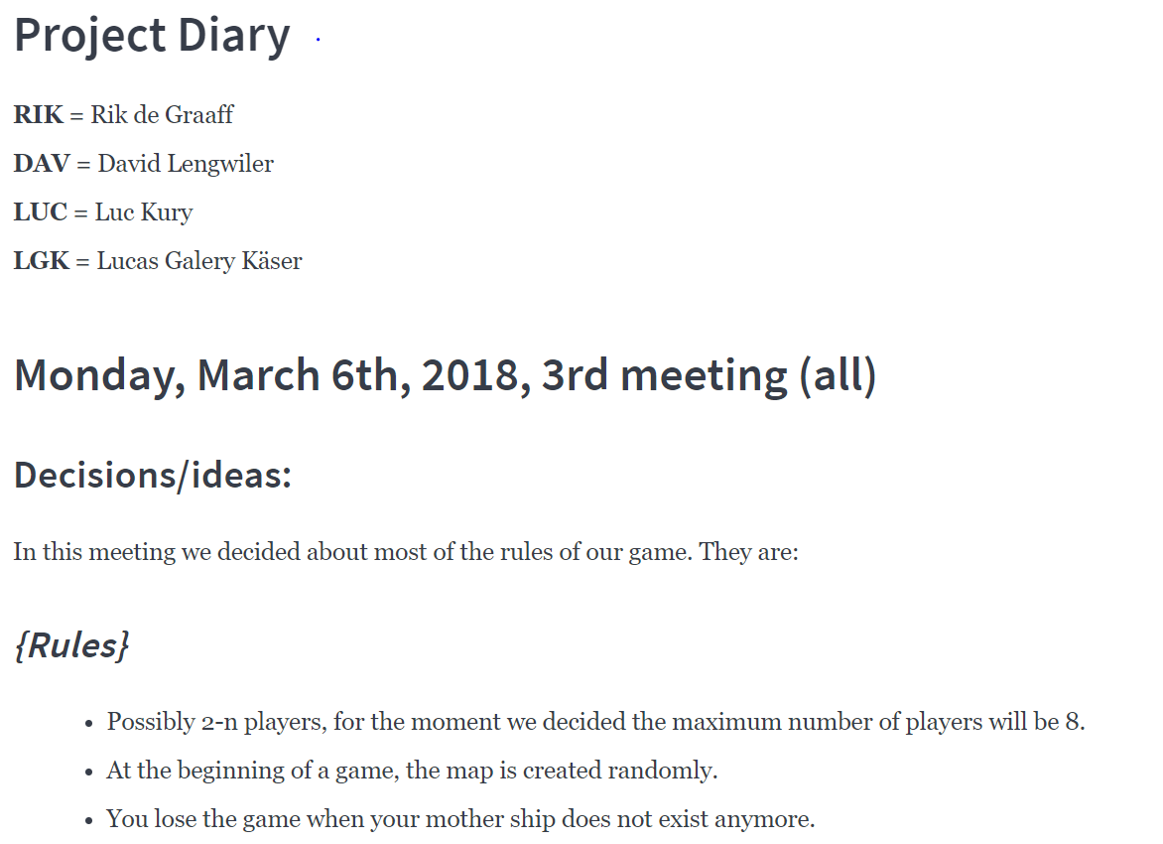
our project diary, written in mardown:

Slide 16
any questions?

Slide 17
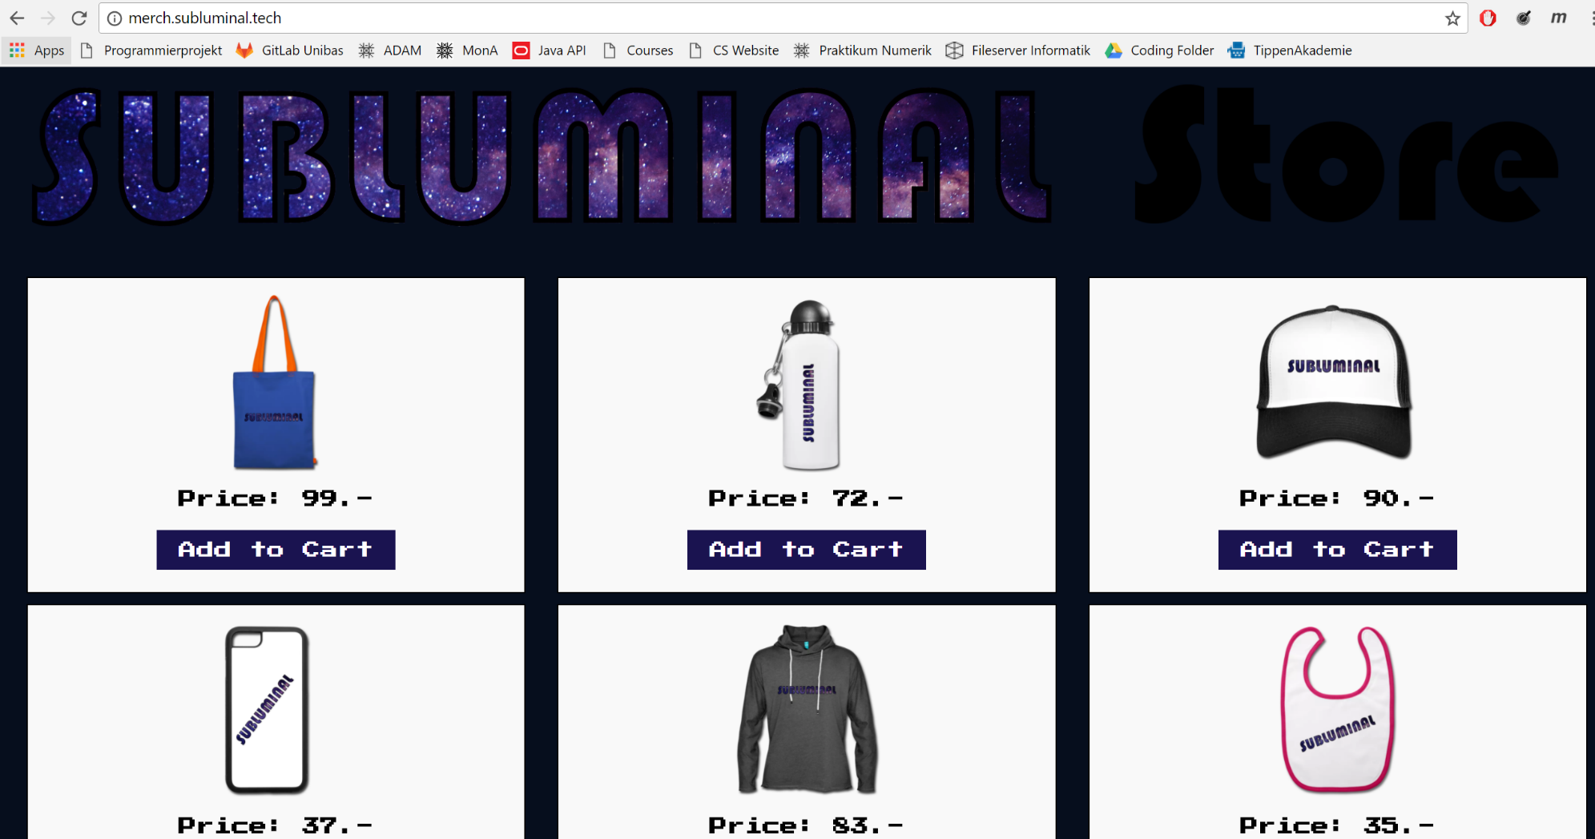
if you want to support us:

