Slide 1
Online Quiz Application
Developed by: Subodh Budhe

Slide 2
Project Abstraction
Objective: To design and implement a console-based quiz management system.
Description: The project allows users to attempt quizzes and admins to manage quizzes and questions.
Features include authentication, quiz creation, question management, and result tracking.

Slide 3
Tech Stack
Programming Language: Java (JDK 17)
Database: MySQL
Build Tool: Maven
Logging Framework: SLF4J
Architecture: DAO-Service-Controller
IDE: IntelliJ IDEA
Unit Testing – Junit 5

Slide 4
System Architecture
Controller Layer: Handles user input.
Service Layer: Contains business logic.
DAO Layer: Interacts with the database.
Util Layer: Manages database connection.
Model Layer: Represents entities (User, Quiz, Question).
Flow: User → Controller → Service → DAO → Database

Slide 5
ER Diagram (Text View)
Entities:
Users (id, username, password, role)
Quizzes (id, title, description)
Questions (id, quiz_id, question_text, options, correct_option)
Results (id, user_id, quiz_id, score)
Relationships:
1 Quiz → Many Questions
1 User → Many Results
1 Quiz → Many Results

Slide 6
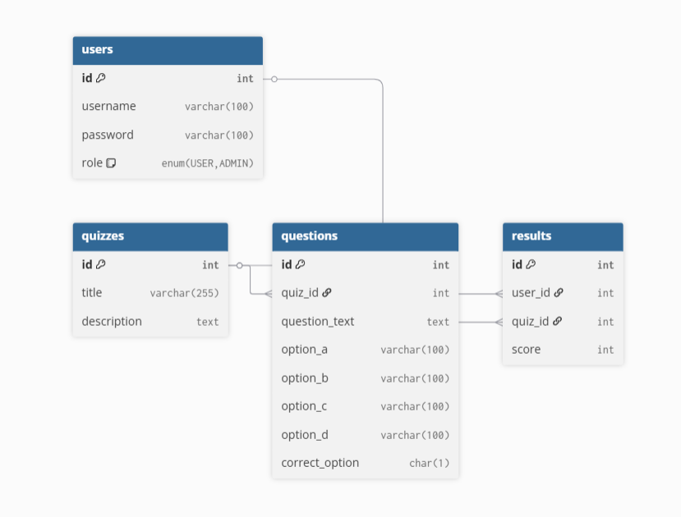
ER Diagram

Slide 7
Key Features
Admin login & management
User registration & quiz attempts
Add/View/Delete quizzes and questions By Admin
Score calculation and leaderboard
Logging and Exception Handling

Slide 8
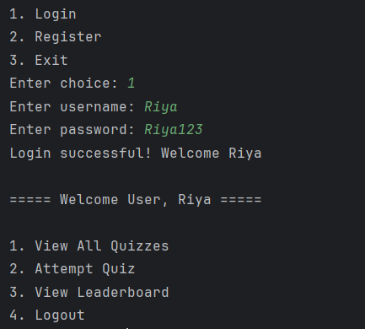
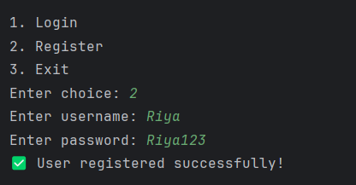
Outputs
User Login->
User Register->

Slide 9
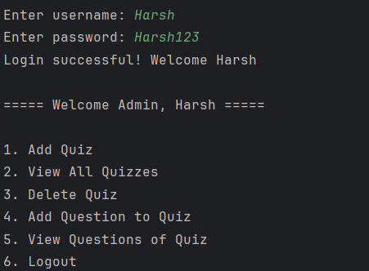
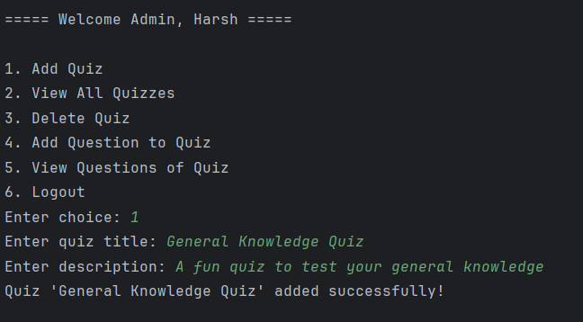
Outputs
Admin Login ->
<- Add Quiz

Slide 10
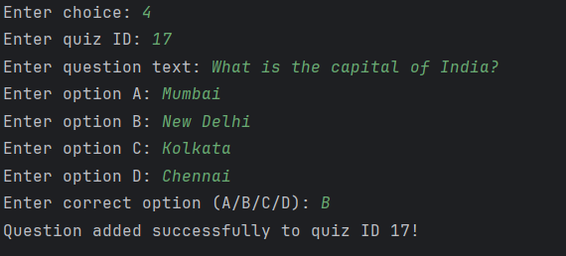

Outputs
<-Add Question to Quiz
<-Delete Quiz

Slide 11
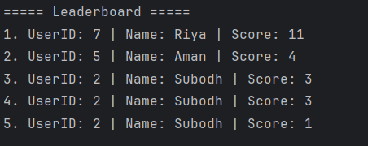
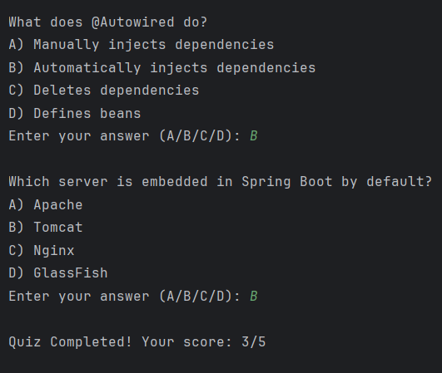
Outputs
<-Leaderboard based on the quiz Id
Your score->

Slide 12
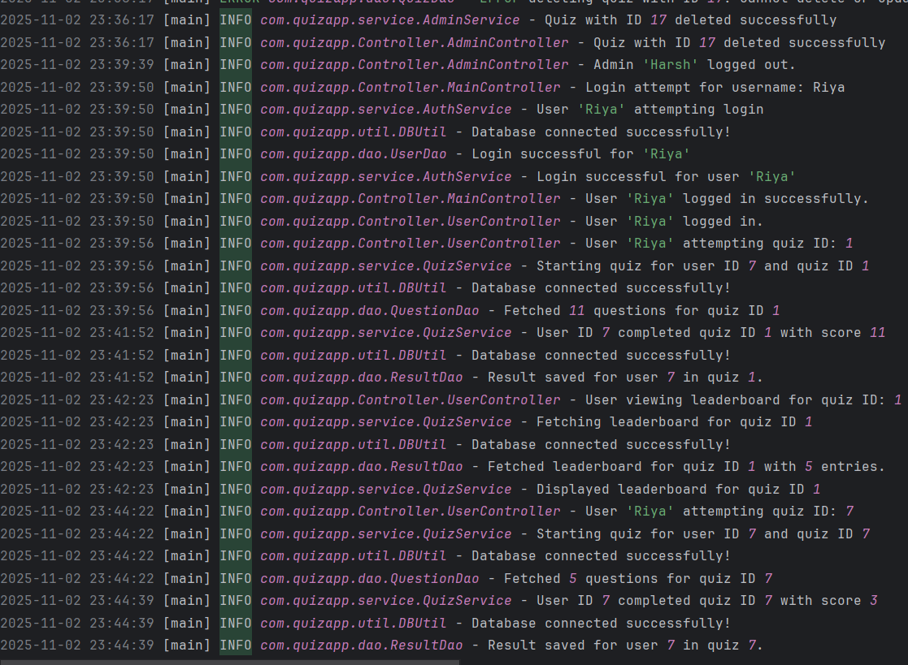
Outputs
Log file->

Slide 13
Future Enhancements
Add GUI using JavaFX or Spring Boot (Web)
Email-based quiz invitations
Timer-based quizzes
Analytics dashboard for performance insights

Slide 14
Conclusion
The project demonstrates core Java and JDBC concepts.
Follows modular design principles (DAO-Service-Controller).
Implements real-world problem-solving using logging and exceptions.

