Slide 1
Data Preparation
Modules
Process
Amazon S3
Table 1
Table 2
Spark
ETL Process
pgAdmin4
and RDS
Union Two Tables
Create new table
sqlalchemy
Read tables for ML

Slide 2
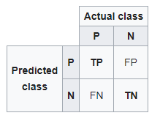
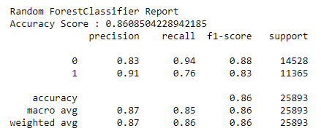
 |  | Predicted class
 |  | neutral or dissatisfied | satisfied
Actual class | neutral or dissatisfied | TP | FN
 | satisfied | FP | TN

