Slide 1
Rocket Propulsion Term Project Study of Oxidation of CO under moist conditions by Modelling a Well Stirred Reactor
Group Members :
Jay Rathod
Siddharth J Gantawar
Subrahmanya V Bhide
Sawvranu Dey
Muvvala Rahul

Slide 2
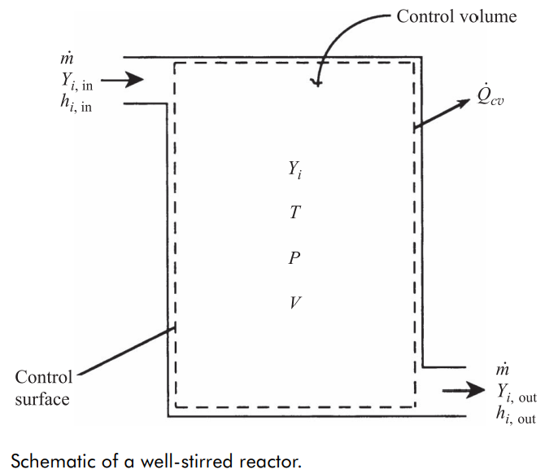
Well Stirred / Perfectly Stirred Reactor :
Conservation equations for energy and mass of species are solved, to get the mass fractions and temperature of products for given inlet conditions.
Mixture is completely mixed.
Steady state operation is assumed.
No transport processes are involved.
(i.e. No diffusion of momentum, species and heat.)
Zero-Dimensional Reactor
(i.e. Only inlet & outlet conditions)

Slide 3
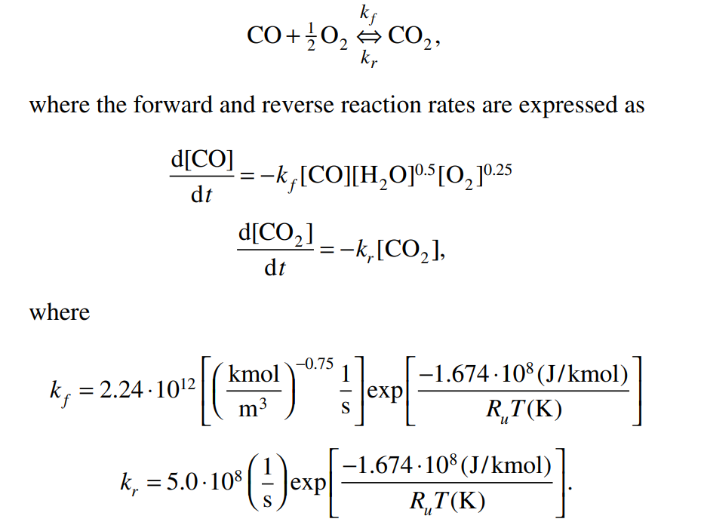
Problem Statement :
Application of Well / Perfectly Stirred Reactor
Global CO Kinetic Scheme given by Glassman
Stoichiometric CO + air mixture with moisture enters the reactor at 298K and 1 bar.
Moisture is a catalyst in this reaction and hence, its mass fraction of H2O is preserved.
Specific heat capacity of each species should be estimated at 2000 K and assumed to be constant.
Objective : Influence of Initial Mole fraction (0.1 - 0.3 %) of H2O on the blowout limit mass flow rate.

Slide 4
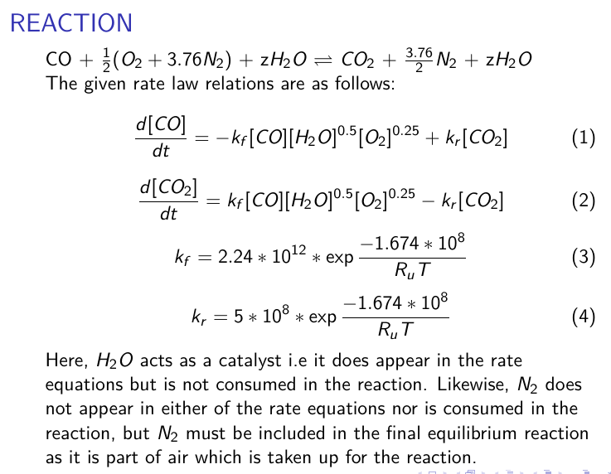

Slide 5
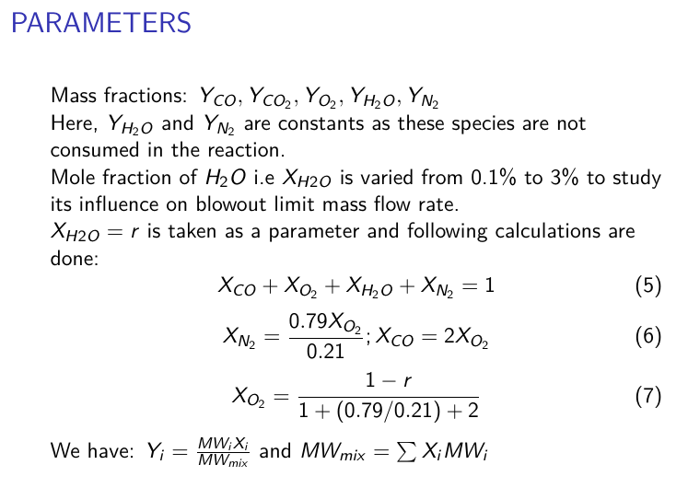

Slide 6
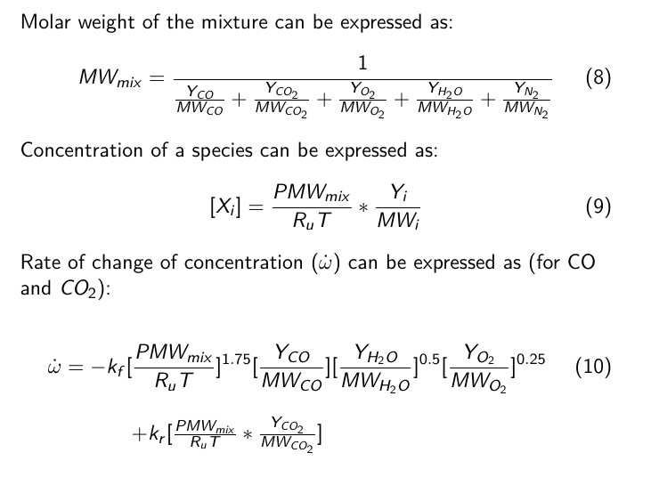

Slide 7
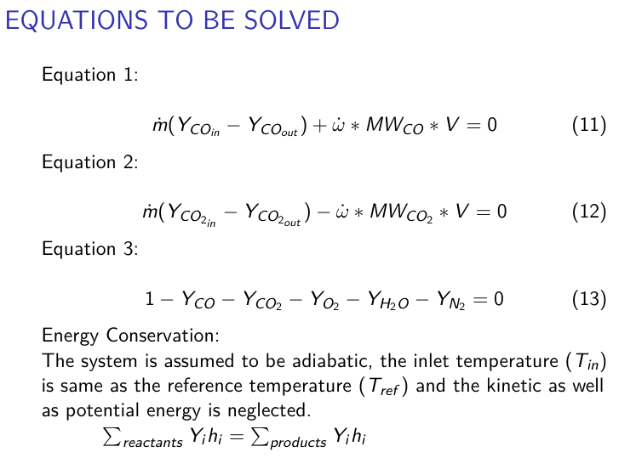

Slide 8
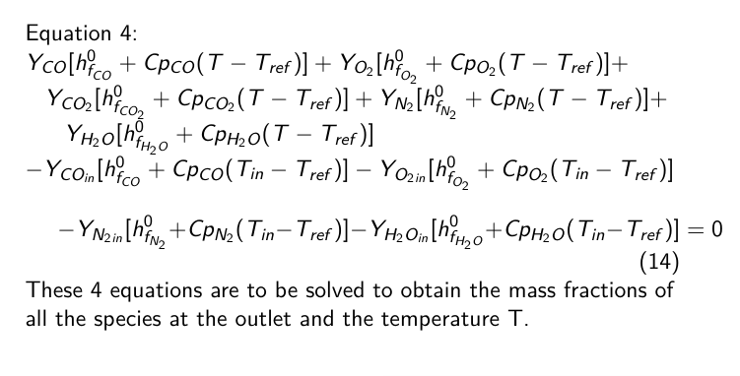
Diameter of spherical tank taken is 50mm.

Slide 9
Methods followed to solve the WSR
Newton Method for 3 balance equation and Interpolation for Temperature Eq
Iterative Newton Method for both 3 balance and Energy equations
The generalized Newtons' method given in the Appendix of the book by Stephen R. Turns is used.

Slide 10
Newton Method for 3 balance equation and Interpolation for Temperature Eq
Pseudocode:
Start Iterations for N mdots:
For M Temperatures:
Solve Eqns. 1, 2, 3 using Newton's method and find corresponding Y vector
Use the Y vector and find the value of Eqn 4
Compare all M f4 and chose the one which satisfies f4 = 0
For a particular Mdot we have [Y, T]' as our solution.
For each Mdot obtain solutions and at a particular Mdot there doesn't exist a solution
Thus, Blowdown occurs

Slide 11
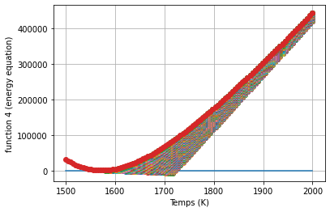
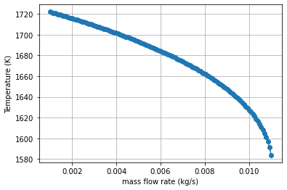
Results
Moisture Mole fraction is r = 0.1%

Slide 12
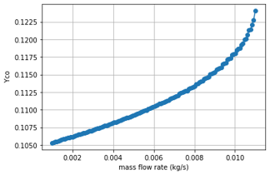
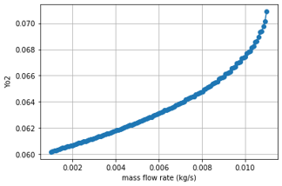
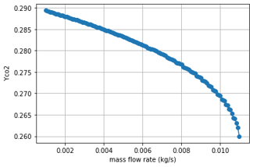

Slide 13
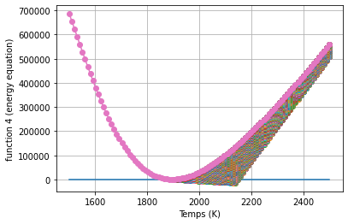
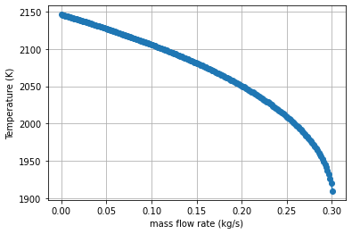
Results
Moisture Mole fraction is r = 3%

Slide 14

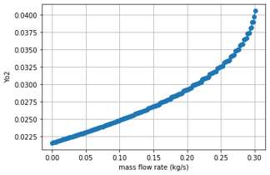
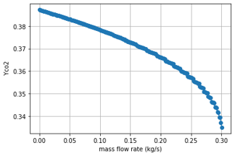

Slide 15
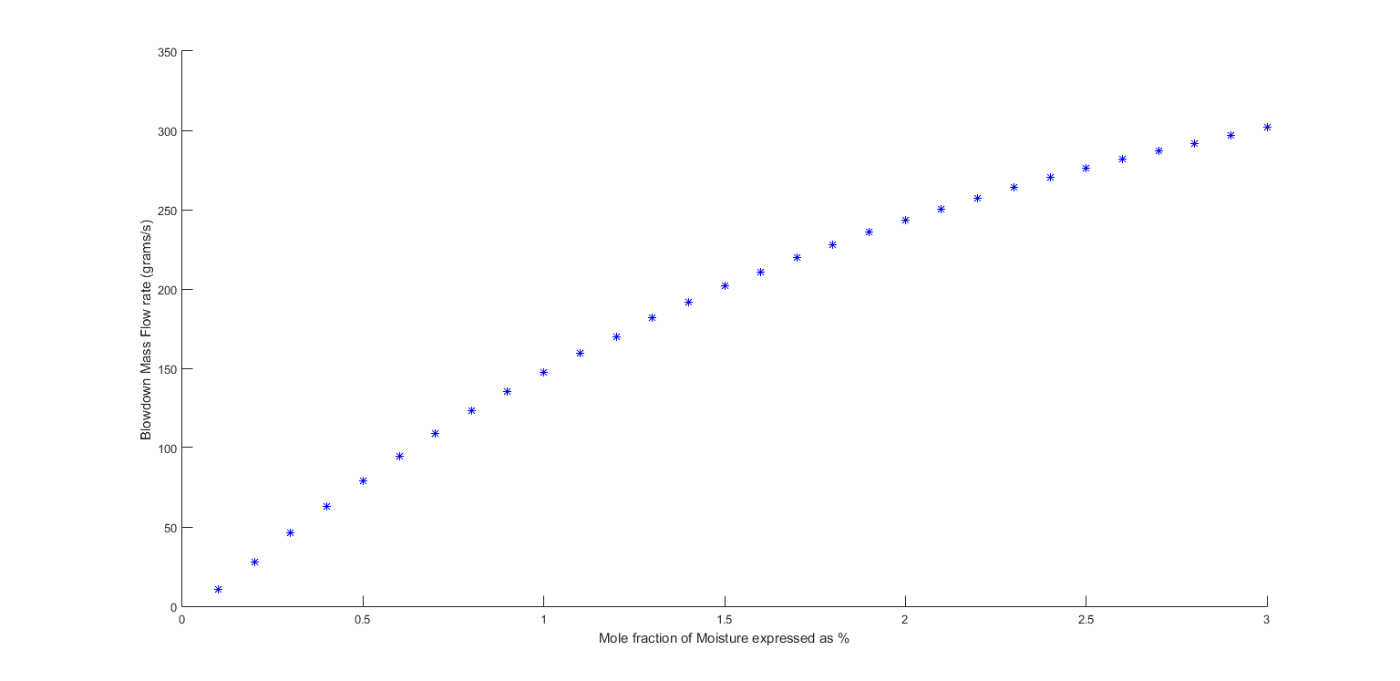

Slide 16
Iterative Newton Method for both 3 balance and Energy equations
Pseudocode:
Start Iterations for N mdots:
For M iterations (upto convergence) :
Assume a T = To and Solve Eqns. 1, 2, 3 using Newton's method and find corresponding Y =Yo
Evaluate T1 using the Newtons method and Y1
Set T = T1
For the blowdown Mdot the solution obtained is same as the inlet conditions.
Thus we obtain the blowdown Mdot.

Slide 17
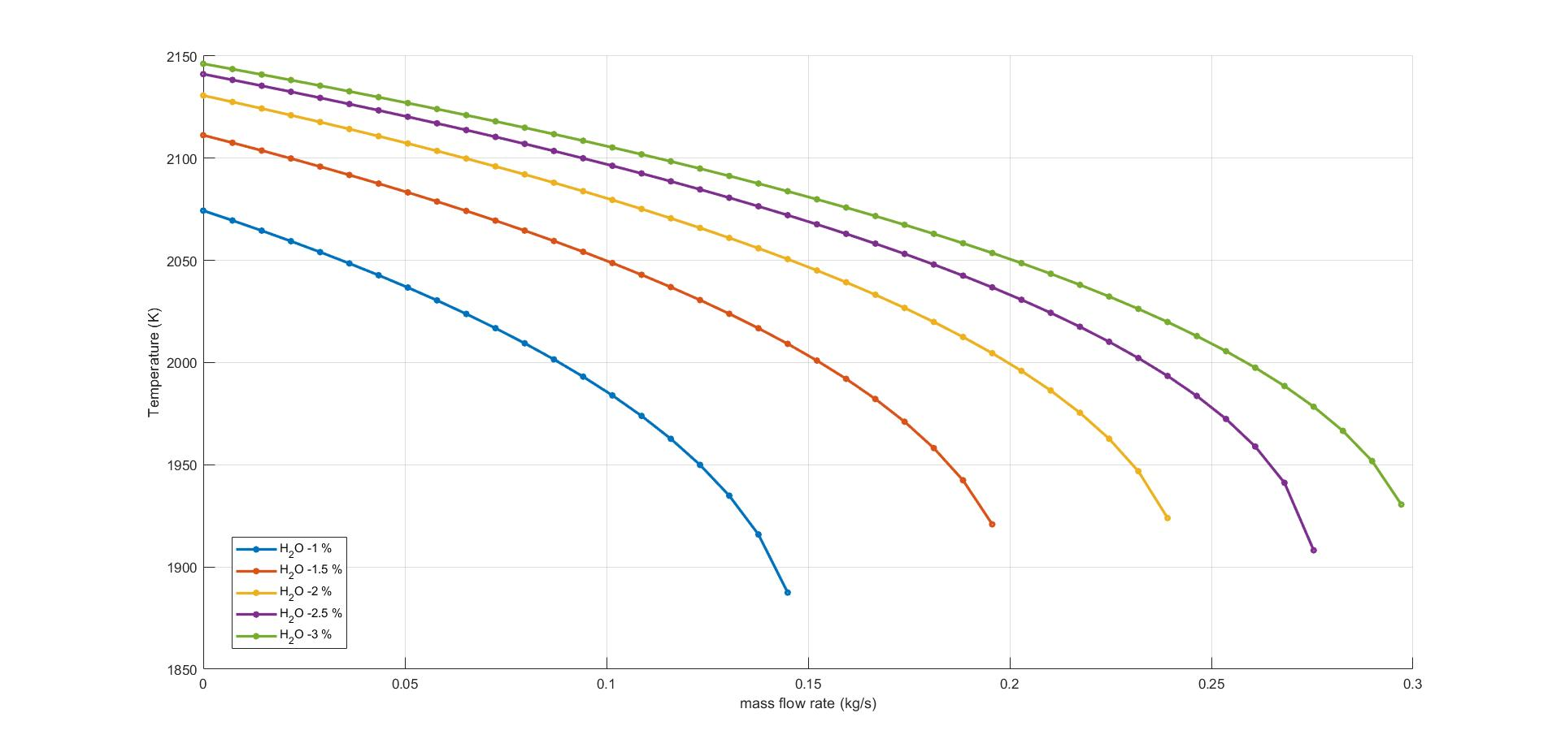

Slide 18
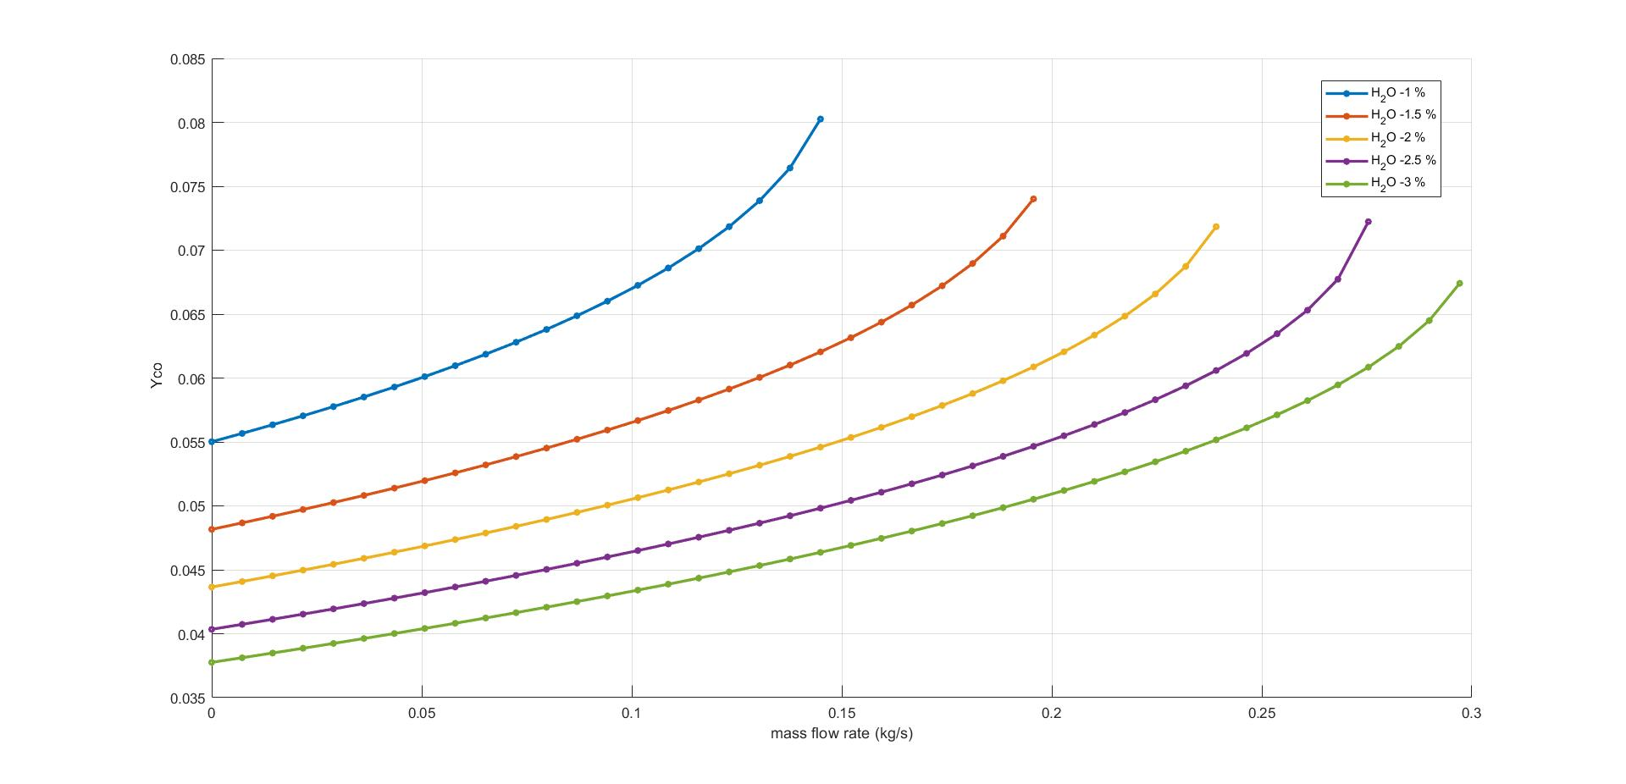

Slide 19
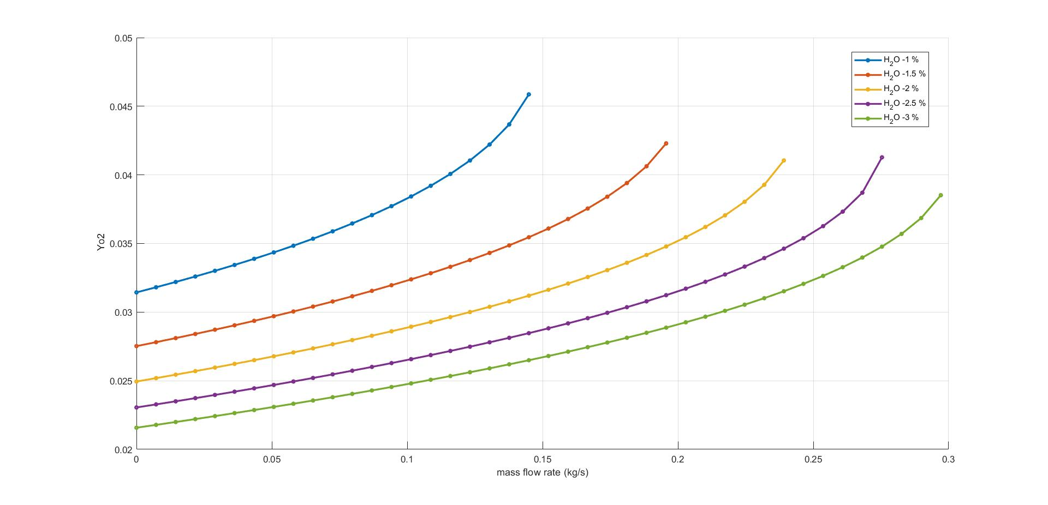

Slide 20
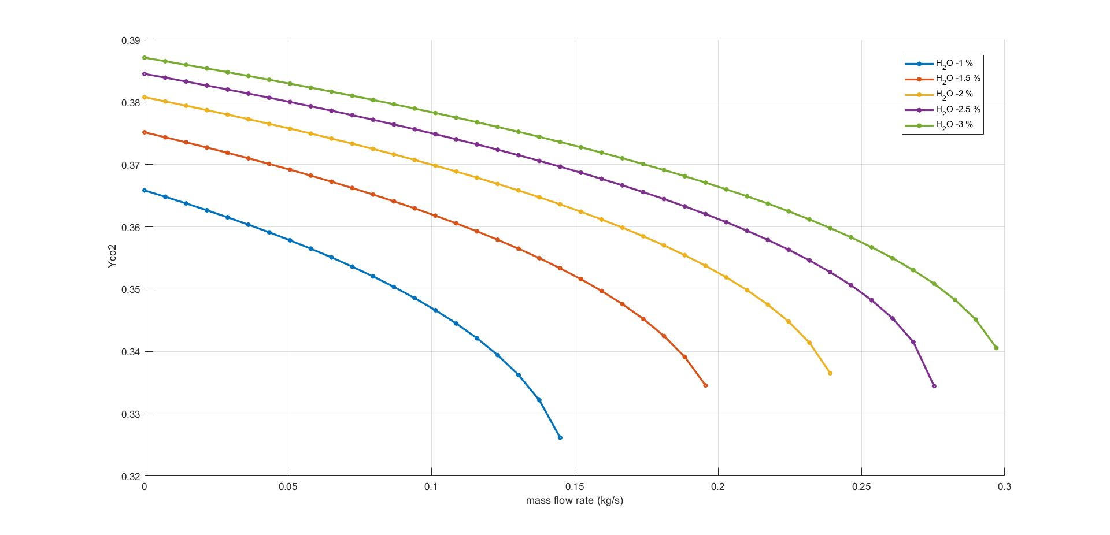

Slide 21
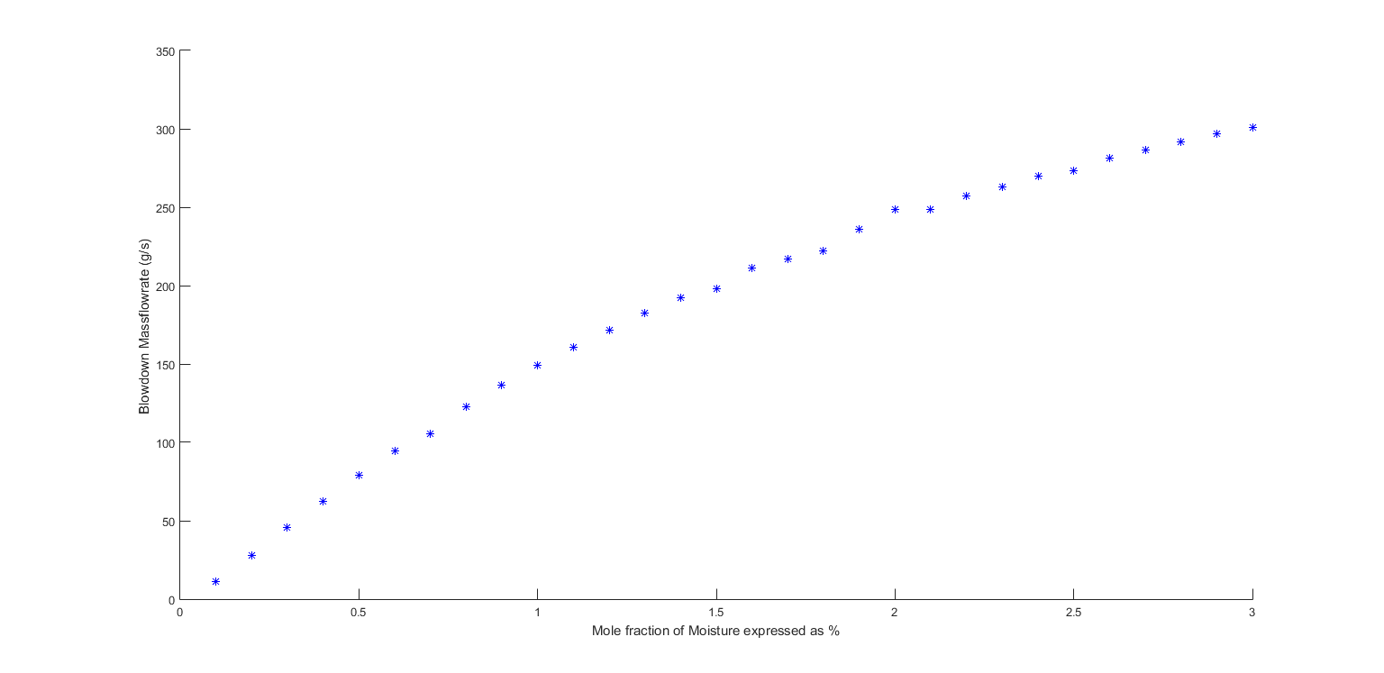

Slide 22
