Slide 1

TEAM DETAILS · MEDIA, CONTENT & DIGITAL EXPERIENCES
Revelink
Keep the curiosity.
Keep the learning connected.
Watch. Discover. Connect the dots.
Problem: learners lose context and momentum moving between
video discovery, explanations, and saved learning.
TEAM SSRD TEAM LEADER Subram Das
REVELINK / SSRD / AI BUILDER CUP 2026
01
Notes:
Opening: I wanted to understand GPUs. I found videos, searched for explanations, and asked follow-up questions in separate tools. Revelink brings that journey together. The registered theme is Media, Content & Digital Experiences. The public prototype currently retains the earlier name Curiosity; the repository contains the approved Revelink rebrand. Team details supplied by founder. Original template administrative download note and blank closing slides omitted; all substantive prompts are covered.

Slide 2
BRIEF ABOUT THE IDEA
A question should start a learning journey.
For adult students and early-career professionals in India, starting with English-language discovery.
THE STARTING MOMENT
THE FRICTION
THE IDEA
“How do GPUs work?”
Context gets lost.
One connected workspace.
A learner finds a video, but the next question sends them to another tool.
Search, watch, ask, and remember are separate tasks. Unrelated feeds interrupt the journey.
YouTube discovery + a Gemini teacher + organised topics + saved playback.
REVELINK / SSRD / AI BUILDER CUP 2026
02
Notes:
Source: STARTUP_IDEA.md latest agreed direction and founder GPU example; src/App.tsx and shared feature modules. This is a founder-observed problem and product hypothesis, not a surveyed prevalence claim. Computing has prepared checked source notes; broader search does not imply reviewed teaching content across every subject.

Slide 3
OPPORTUNITIES · DIFFERENTIATION · USP
The learning context travels with the learner.
USP: video discovery, in-context explanation, and the next useful action in one continuous journey.
LEARNER NEED
FRAGMENTED WORKFLOW
REVELINK WORKFLOW
Find a useful starting point
Search for videos separately
Educational intent checks and learning-angle choices
Resolve the doubt
Explain the context again in chat
Teacher uses question, conversation and eligible video
Act on the explanation
Find the section or search again
Jump to an AI-matched section or open a real result
Return to the interest
Reconstruct the previous session
Organised subjects and saved playback position
Starting opportunity: adult self-directed learners exploring a concept, not a full course.
REVELINK / SSRD / AI BUILDER CUP 2026
03
Notes:
Comparison is a workflow framing, not an exhaustive competitor feature audit or a claim that other products cannot offer these capabilities. Desktop educational guardrails and Universe navigation are local implementations, not verified public-deployment features. Differentiation derives from integration and intentional transitions, not proprietary foundation-model ownership. Demand and willingness to pay remain unvalidated.

Slide 4
LIST OF FEATURES OFFERED
Built around discovery, clarity, and continuity.
01 / DISCOVER
02 / UNDERSTAND
03 / CONTINUE
Find your starting point
Ask beside the video
Resume your learning
Search, video results, long videos and a short-video feed.
Follow-ups, simpler explanations and relevant video sections.
Saved topics, watch history and last playback position.
04 / ORGANISE
05 / STAY ON TASK
06 / RESET
Explore three Universes
Guide learning intent
Take a bounded break
Science & Technology; Commerce & Business; Arts & Humanities.
Clarify ambiguous intent; filter results using metadata.
Optional topic-related clips after 12 active minutes; at most three.
Latest local build shown. Public demo is an earlier revision; learning outcomes have not yet been measured.
REVELINK / SSRD / AI BUILDER CUP 2026
04
Notes:
Sources: shared/features/videos, chat, topics, progress, learning; desktop-ui/features/universes and history; backend/search. Break active time is measured by the browser; the server gate checks elapsed session time and is not proof of attention. Account progress code exists but wider live two-account sync/isolation review remains. Graph is intentionally omitted from active feature list because it defaults off.

Slide 5
PROCESS FLOW DIAGRAM
From “I wonder…” to “I can keep going.”
Illustrative GPU journey • implemented paths; AI decisions can be uncertain.
01
02
03
04
05
SEARCH
›
CHOOSE
›
WATCH
›
ASK
›
CONTINUE
“How do GPUs work?”
Clarify intent if needed
Open a learning video
“Why useful for AI?”
Resume or explore next
Teacher decision
Matching section → seek • No match → explanation + actual video suggestions
REVELINK / SSRD / AI BUILDER CUP 2026
05
Notes:
Source: backend/search/routes.mjs, backend/chat/teacher.mjs and gemini-teacher.mjs, shared/features/chat/useTutorChat.ts and src/App.tsx. The teacher can answer another subject without forcing a player change. Timestamp requires eligible analyzed video, related question, valid bounds and nonempty evidence; it remains AI-matched and may be approximate. Ineligible video uses a clearly labeled general explanation without a timestamp.

Slide 6
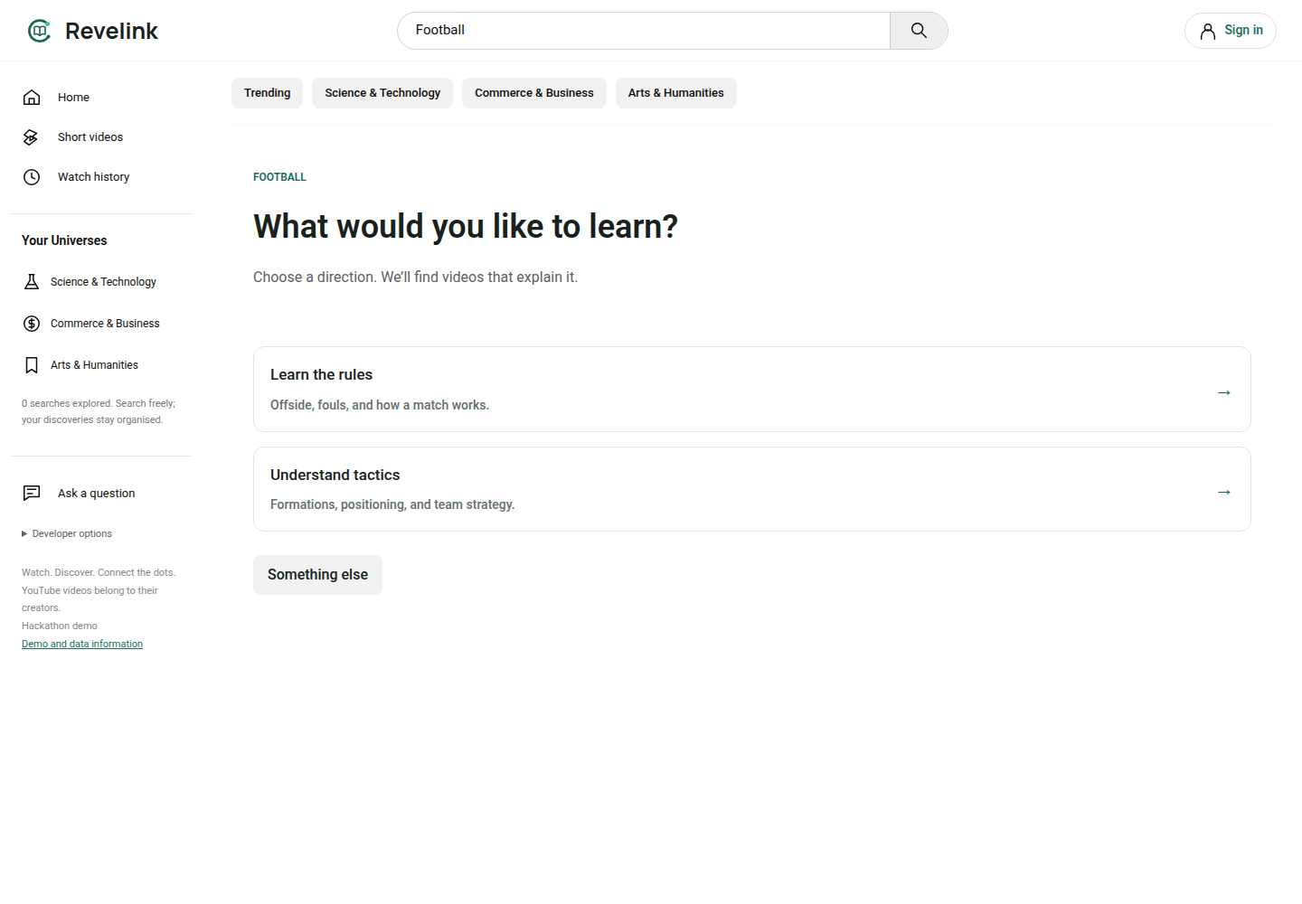
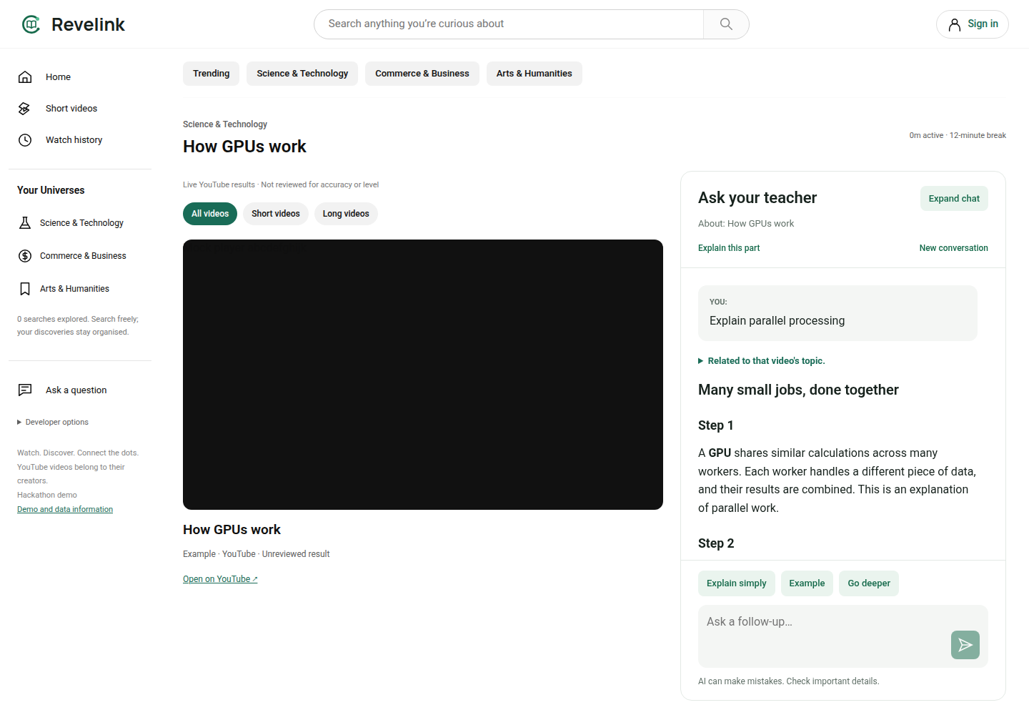
WIREFRAMES / MOCK DIAGRAMS
An interface designed around the learning task.
Actual local React interface • simulated API responses and player in these captures.
01 Clarify the learning angle before searching.
02 Keep the teacher beside the video.
REVELINK / SSRD / AI BUILDER CUP 2026
06
Notes:
Captured by the repository browser regression tests on 2026-10-18, not a live AI-answer demonstration. Penpot is the project design source; inspected New File 1 / Revelink — Brand explorations and curiosity-desktop-universe through the connected MCP. Native text/shapes used throughout this PowerPoint; application screenshots are the only flattened panels. Source captures: tests/browser/search.spec.ts and chat-readability.spec.ts.

Slide 7
ARCHITECTURE DIAGRAM
Google Cloud runs the application. Gemini powers the learning decisions.
Latest repository architecture • browser calls the API; provider credentials stay on the server.
GOOGLE CLOUD RUN / NODE API
GEMINI DEVELOPER API
REACT CLIENT
API
Teaching, intent and topic decisions
Desktop / mobile
Shared features
Guest storage
Validation + access checks
Teacher • search • classification
Shared Gemini priority queue
YOUTUBE + WIKIDATA
Video metadata + concept candidates
Firestore: metadata cache + atomic budgets
Secret Manager: provider credentials
SUPABASE
Auth + private topics / playback
Video streams directly through the official YouTube player. No media is hosted by Revelink.
REVELINK / SSRD / AI BUILDER CUP 2026
07
Notes:
Sources: backend/production.mjs, backend/server.mjs, backend/storage, backend/http, backend/providers, backend/supabase.mjs, Dockerfile, deployment docs. Gemini uses Developer API REST, not Vertex AI. Google Cloud is primary app hosting; Supabase is supporting auth/private storage. The browser also uses the Supabase public auth client. Latest classification/search queue is local; the hosted Cloud Run revision predates those modules. One process-local Gemini queue requires distributed coordination before multiple replicas.

Slide 8
TECHNICAL DEPTH · MEANINGFUL GENERATIVE AI
Three decisions that connect the experience.
TEACHER
SEARCH
CLASSIFICATION
Explain → act
Intent → useful results
Concept → discovery
Question + history + eligible video → structured answer, source basis and validated section or real video suggestions.
Question → learning choices or approval → YouTube retrieval → batched educational-purpose decisions.
Video metadata → Gemini topic extraction → Wikidata candidates → validated primary and related Universes.
Validated outputs / explicit uncertainty / cached decisions / teacher-first scheduling
REVELINK / SSRD / AI BUILDER CUP 2026
08
Notes:
Source implementation: backend/chat/gemini-teacher.mjs validates structured answers and known source IDs; backend/chat/teacher.mjs retrieves actual YouTube recommendations. backend/search validates model decisions, IDs and intent. backend/classification performs two-stage extraction/resolution with Wikidata and provisional fallback. Sources do not imply factual verification of all videos. Gemini model is configured via GEMINI_MODEL; historical project notes record gemini-3.5-flash-lite, but this slide deliberately does not promise a particular billing/model tier. Queue priority teacher, search, background classification; default 15-second start spacing. No universal latency claim.

Slide 9
TECHNOLOGIES USED
A small, modular stack with clear responsibilities.
Experience
React · TypeScript · Vite
Shared learning features; dedicated desktop and mobile layouts.
Application
Node.js · REST API
Provider adapters, validation, background jobs and budgets.
AI & discovery
Gemini API · YouTube Data API · Wikidata
Teaching, educational intent, video retrieval and concept labels.
Cloud platform
Cloud Run · Firestore · Secret Manager
App hosting, persistent cache/counters and managed secrets.
Accounts
Supabase Auth · PostgreSQL / RLS
Sign-in, user-owned topics and playback records.
Verification
Playwright · Node tests · Penpot
Repeatable browser journeys, service rules and editable designs.
REVELINK / SSRD / AI BUILDER CUP 2026
09
Notes:
Source: package.json, ARCHITECTURE.md, backend/production.mjs, migrations and browser tests. Production backend does not depend on experiments; shared UI does not import layout folders or backend. src coordinates feature state. Penpot approved Orbit Book visual language is reused. Technologies listed are present in repository, not prospective additions.

Slide 10
ESTIMATED IMPLEMENTATION COST · OPTIONAL
Designed for a small, quota-controlled pilot.
Illustrative compute estimate, not an actual bill or a quote for the Mumbai deployment.
REFERENCE COMPUTE
What the estimate includes
≈ $2.74
Reference request-based Cloud Run rates:
108,000 sec × ($0.000024 + 0.5 × $0.0000025)
+ 0.03 million requests × $0.40 = $2.739
per month before free-tier credits
30 active hours · 1 vCPU · 0.5 GiB
30,000 requests
What must be priced separately
Gemini tokens / video input, Firestore, secrets, builds, image storage, network transfer, Supabase and labour. Region and billing tier change totals.
Rate reference: cloud.google.com/run/pricing • Full assumptions and exclusions are in the speaker notes.
REVELINK / SSRD / AI BUILDER CUP 2026
10
Notes:
Estimate assumptions only, not observed demand. Cloud Run default us-central1 active request-based list prices from https://cloud.google.com/run/pricing, checked 2026-10-18: CPU .000024 USD/vCPU-sec, RAM .0000025 USD/GiB-sec, .40 USD/million requests. Mumbai may have different rates; compute estimate is a reference calculation, NOT total project cost. No free-tier entitlement assumed. Gemini model/tier must be priced at https://ai.google.dev/gemini-api/docs/pricing against actual billed input/output/video tokens. Prototype uses bounded daily allowances and caching; minimum instances zero, max one. No fabricated total spend. Founder labour excluded.

Slide 11
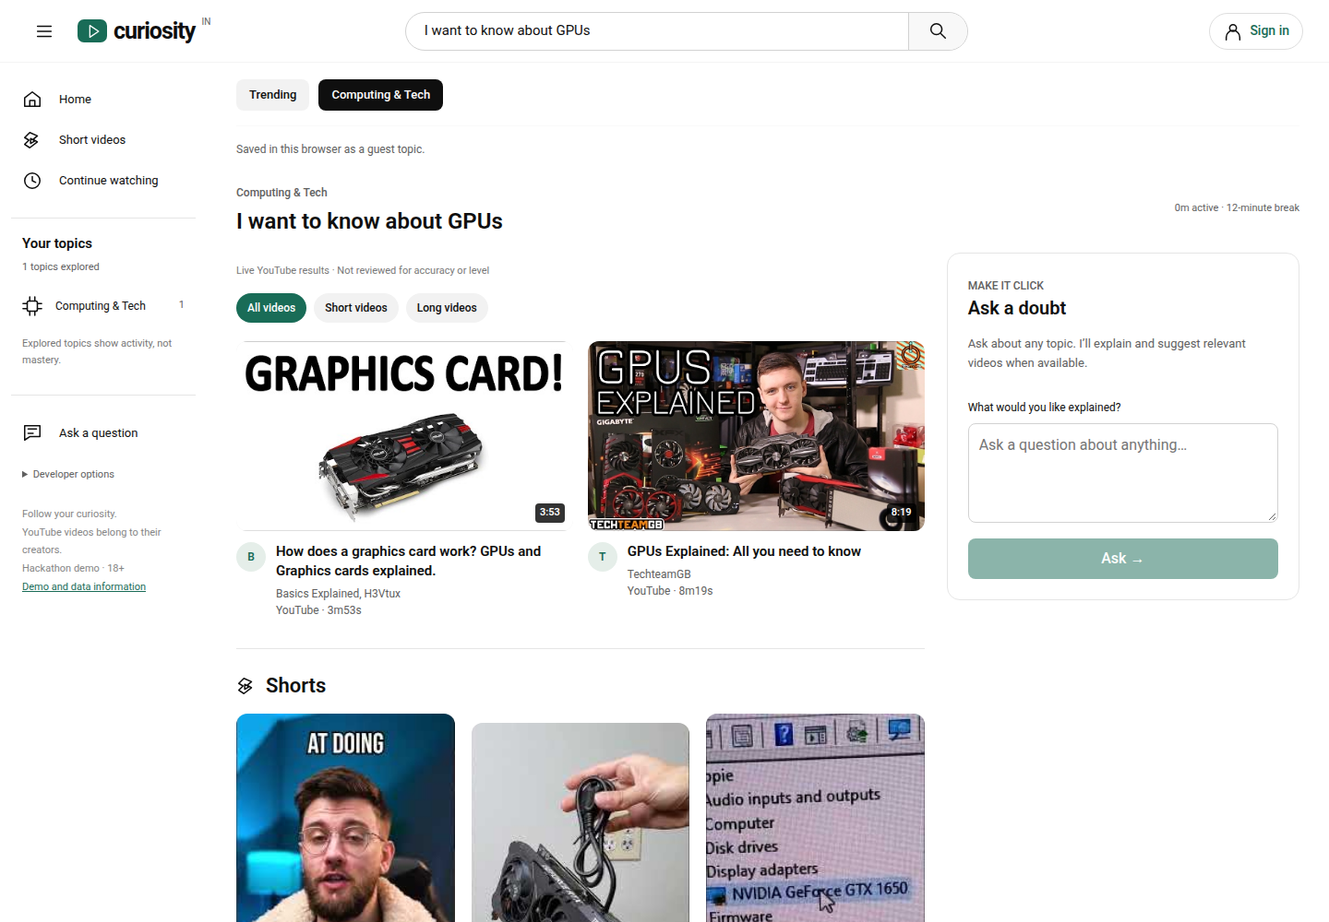
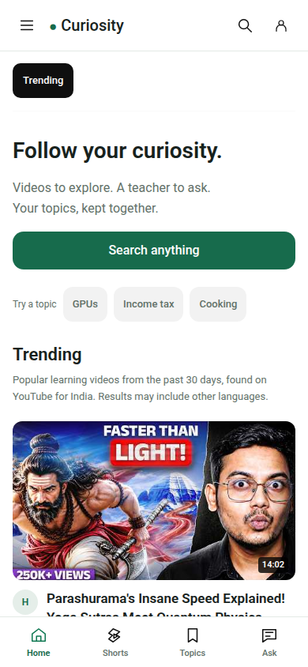
SNAPSHOTS OF THE PROTOTYPE
A deployed product judges can open today.
Live Cloud Run screenshots • 18 October 2026 • deployed under the earlier Curiosity name.
Desktop: GPU results and the teacher workspace.
Same URL on a phone.
REVELINK / SSRD / AI BUILDER CUP 2026
11
Notes:
Actual public site captures from https://curiosity-u2ubbw6fra-el.a.run.app taken 2026-10-18, not invented mockups. Homepage and GPU results were visible; this screenshot does not by itself prove chat answer quality or live playback. Newer Revelink branding, desktop guardrails, Universe classification and history refinements are local, not claimed deployed. YouTube thumbnail/content rights remain with creators. The phone capture uses a desktop browser mobile viewport, not a physical phone test.

Slide 12
PROTOTYPE PERFORMANCE REPORT / BENCHMARKING
Evidence you can inspect. Limits we can name.
Fresh local verification + one live hosted teacher request + historical retrieval evidence.
95 / 95
63 / 64
PASS
Service / rule checks
Browser journeys
Production build
10 experiment + 85 current tests
Simulated APIs, accounts and player
Type checks + browser bundle
Live hosted check · 18 October
2.53 seconds: one hosted teacher response + two video suggestions.
Earlier YouTube check: 18 unique videos in 867 ms (13 October).
Single observations, not load tests. One legacy saved-search browser path failed; learning impact is unmeasured.
REVELINK / SSRD / AI BUILDER CUP 2026
12
Notes:
Fresh run 2026-10-18: npm test 10+85=95 passed, npm run build passed (main JS bundle size advisory remains), npm run test:browser 63 passed / 1 failed. Failure: universes.spec.ts:228, Other saved searches is absent; do not interpret as a fully green browser suite. No production code changed as part of deck preparation. Logs in submission/evidence. Historical timings are from PHASE_2_RESULTS.md Successful live retry, 2026-10-13; they do not measure current queue, video analysis, load or p95 latency. One live hosted general question on 2026-10-18 returned HTTP 200 in 2529 ms including two actual YouTube suggestions. No video context or timestamp was requested in that run. No measured learning improvement, retention or user adoption is claimed.

Slide 13
ADDITIONAL DETAILS / FUTURE DEVELOPMENT
Prove the learning value. Then expand the map.
A focused next step, with outcomes measured before broader scale.
NEXT / RELEASE READINESS
NEXT / LEARNER PILOT
LATER / DISCOVERY
Align the demo
Test the core hypothesis
Connect adjacent ideas
Deploy the approved build, resolve the legacy-search regression, review real account sync and run a hosted end-to-end check.
Recruit 10–15 adult learners. Compare time to resolve a doubt, task completion, context switches and voluntary return.
Activate the reviewed learning graph, test progress assessments, and add distributed scheduling before multiple replicas.
REVELINK / SSRD / AI BUILDER CUP 2026
13
Notes:
Roadmap and pilot are proposals, not completed milestones. Graph code exists locally but defaults off: 30 draft concepts and 26 connections; migration/publication and real access checks outstanding; no published videos/events. Graph exploration is activity, not mastery. Monetisation is unvalidated: begin free, test willingness to pay only after learner value is demonstrated. Paid-course integrations require separate rights/partnerships and are deferred. Scaling requires more than Cloud Run replicas because Gemini scheduler is process-local. Main hypothesis: reduced friction while resolving a self-directed doubt; test against current learner workflow.

Slide 14
SUBMISSION LINKS
Try one curiosity. Follow it through.
Search “GPUs” → ask a question → explore → return later.
FINAL PRODUCT
https://curiosity-u2ubbw6fra-el.a.run.app
PUBLIC GITHUB REPOSITORY
https://github.com/SubramDas/Curiosity
DEMO VIDEO · UNDER 3 MINUTES
[ADD PUBLIC DEMO VIDEO — UNDER 3 MINUTES]
SSRD / Subram Das / Watch. Discover. Connect the dots.
REVELINK / SSRD / AI BUILDER CUP 2026
14
Notes:
Public repository verified via unauthenticated GitHub API 2026-10-18. Hosted URL returned HTTP 200 and rendered video results. Founder will add demo video later; replace the marked field before submitting and verify public unauthenticated access. Official submission requirements: https://aibuildercup.com/themes.html and https://aibuildercup.com/Faqs.html. PDF export included because official requirements ask for deck/PPT converted to PDF. No deployment or repository publication performed here.

