Slide 1

Speech to Google Search using Recurrent Neural Network
Presented By :
Name : Subramaniyam S
Reg No : 730321104054
Department : Computer Science and Engineering

Slide 2

PROJECT TITLE :
Speech to Google Search using Recurrent Neural Network (RNN)

Slide 3


AGENDA :
Problem Statement
Project Overview
End Users
Our Solution
Special Features
Modelling Approach
Results
Conclusion

Slide 4

PROBLEM STATEMENT :
Speech recognition systems may struggle with accurately transcribing spoken words, especially in noisy environments or with speakers who have accents or speech impediments.
Background noise, such as music, conversations, or machinery, can interfere with speech recognition accuracy, making it difficult to distinguish spoken words from ambient sounds.
So, Let’s implement the new speech recognition system with the help of python program to overcome the issue and solve it.

Slide 5

PROJECT OVERVIEW :
Our project aims to develop a RNN-based system for speech to google search.
Leveraging deep learning techniques, we seek to accurately identify and capture the user voice and avoid the background and surrounding noise to perform the google search.
That is similar to Google Assistant or Apple Siri.
The system will serve as a tool for blind person’s and the other user’s to quickly perform the search operation without typing the words.

Slide 6

WHO ARE THE END USERS?
Blind persons,
Dyslexia persons,
Customer service automation,
Call center operations,
Healthcare professionals,
Educators.

Slide 7

YOUR SOLUTION AND ITS VALUE PROPOSITION
It enables individuals with disabilities to interact with technology more easily, providing a means for those with mobility impairments or dyslexia to communicate.
In professional settings, speech recognition can significantly boost productivity by enabling hands-free operation, facilitating multitasking, and accelerating data entry processes.
Voice interfaces enhance user experience in devices and applications, offering a more intuitive and natural way to interact with technology, particularly in contexts where typing is inconvenient or impossible.

Slide 8
SPECIAL FEATURES :
Advanced speech recognition systems employ noise cancellation algorithms to filter out background noise, ensuring accurate transcription even in noisy environments.
This feature enables the detection of specific keywords or phrases within spoken content, facilitating tasks such as voice-activated commands or triggering actions based on predefined keywords.
It enables individuals with disabilities to interact with technology more easily, providing a means for those with mobility impairments or dyslexia to communicate.

Slide 9
MODELLING :
Feature Extraction: The first step in speech recognition is to extract relevant features from the audio data. Commonly used features include Mel-Frequency Cepstral Coefficients (MFCCs), which represent the short-term power spectrum of a sound, and spectrograms, which visualize the frequency content of audio signals over time.
Inputting the user voice: After feature extraction, the audio data needs to be represented in a format suitable for machine learning algorithms. This typically involves converting the extracted features into numerical arrays or matrices.
Evaluation: Evaluate the performance of your model using appropriate metrics such as accuracy, precision, recall, or F1-score.
Deployment: Once you're satisfied with the performance of your model, you can deploy it in your application or system.

Slide 10
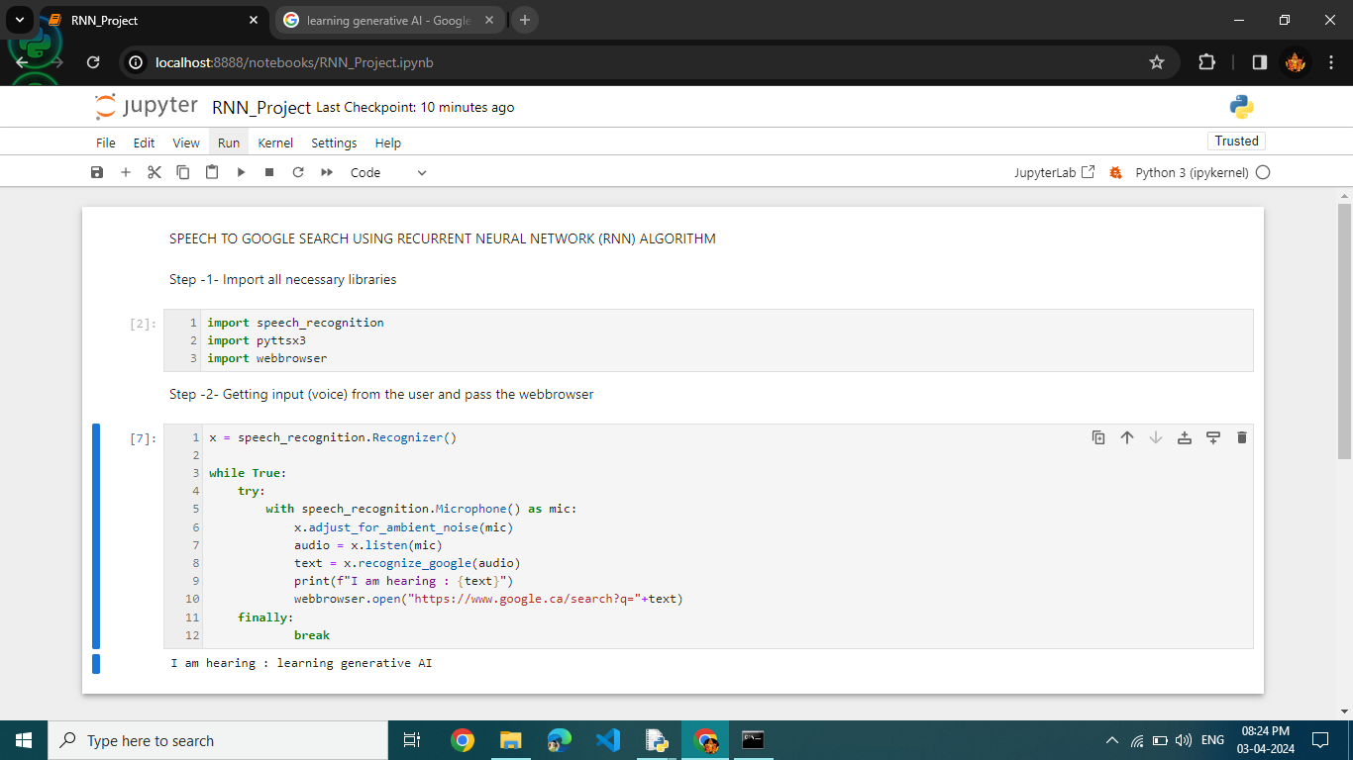
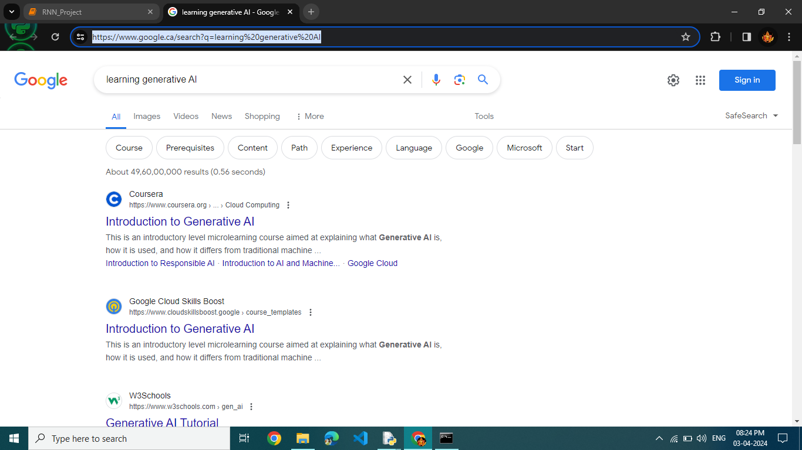
RESULTS :
INPUT CODE
OUTPUT
10

Slide 11

CONCLUSION :
In conclusion, speech recognition technology represents a pivotal advancement in human-computer interaction, offering a wide array of applications and benefits across various industries and domains.
Finally, we successfully developed the speech to google search using the Recurrent Neural Network Algorithm.
THANK YOU

