Slide 1

SUPERMARKET SALES
PRESENTED BY:
SUBRAMANIYAN K

Slide 2

OVERVIEW
DATA CLEANING
EDA
testing

Slide 3
INTRODUCTION
The supermarket sales dataset provides a detailed record of sales transactions in a supermarket, capturing various aspects such as customer demographics,
product categories, pricing, and sales quantities.
This dataset includes information on customer gender, invoice IDs, store branches, cities, customer types, product lines, unit prices, quantities sold, and applicable taxes.
It offers valuable insights into consumer purchasing behavior, sales trends, and the performance of different product categories.

Slide 4
DATA CLEANING
Data cleaning involves several steps to ensure the dataset is ready for analysis:
Handling Missing Values: Check for any missing values in the dataset and decide on a strategy to handle them.
Removing Duplicates: Identify and remove any duplicate records to ensure each transaction is unique.

Slide 5
Descriptive Statistics
Summary: Key statistics such as mean, median, mode, standard deviation, and range for numerical columns.
Example: "The average unit price is $15.50 with a standard deviation of $5.20."
Explanation: Explain how these statistics help in understanding the data distribution and central tendencies

Slide 6
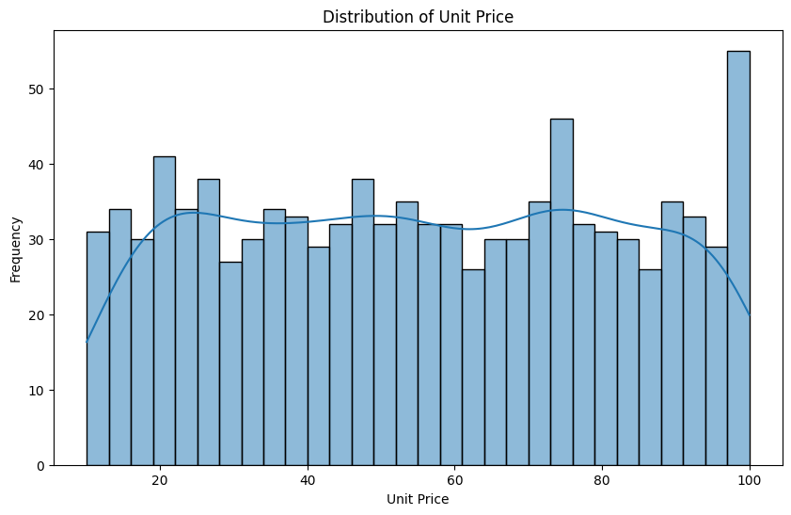
Data Visualization - Histogram
Plot: Histogram for Unit Price.
Explanation: Shows the distribution of unit prices, highlighting the most common price ranges.

Slide 7
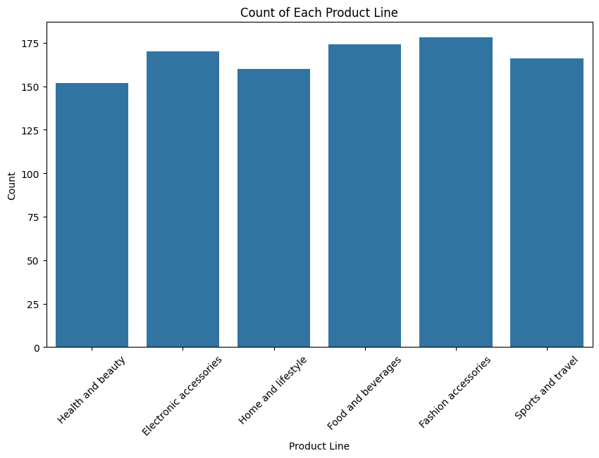
Data Visualization - Bar Chart
Plot: Bar Chart for Product Line.
Explanation: Compares the count of each product line, identifying the most popular categories.

Slide 8
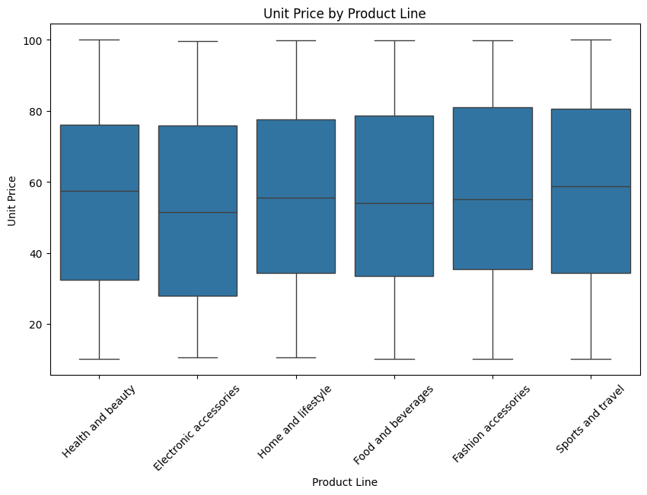
Data Visualization - Box Plot
Plot: Box Plot for Unit Price by Product Line.
Explanation: Visualizes the distribution of unit prices across different product lines, identifying outliers.

Slide 9
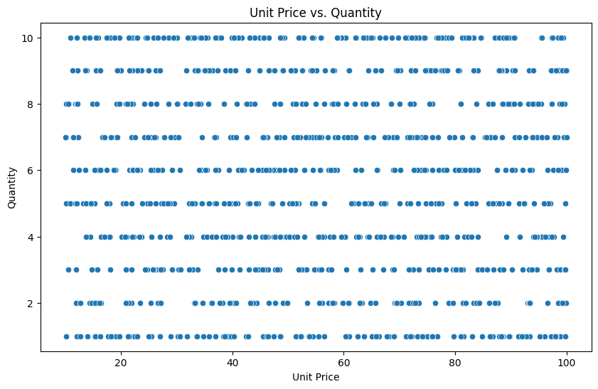
Data Visualization - Scatter Plot
Plot: Scatter Plot for Unit Price vs. Quantity.
Explanation: Examines the relationship between unit price and quantity sold.

Slide 10
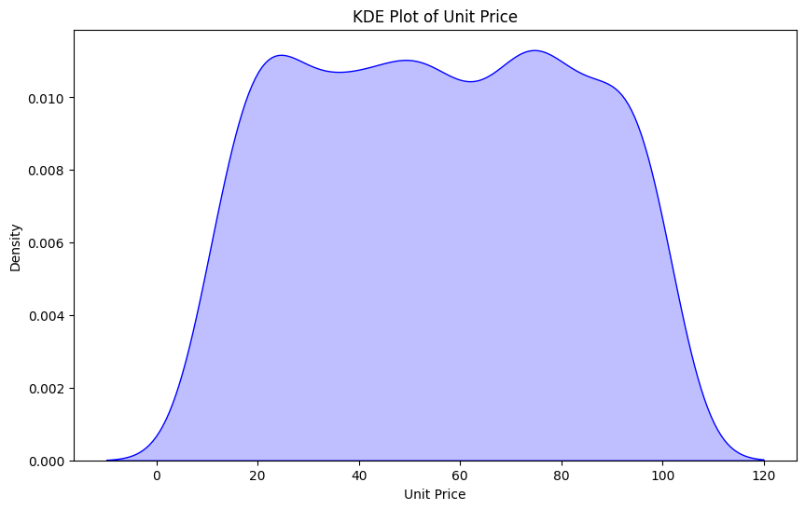
Data Visualization - KDE Plot
Plot: KDE Plot for Unit Price.
Explanation: Provides a smoothed estimate of the distribution of unit prices.

Slide 11
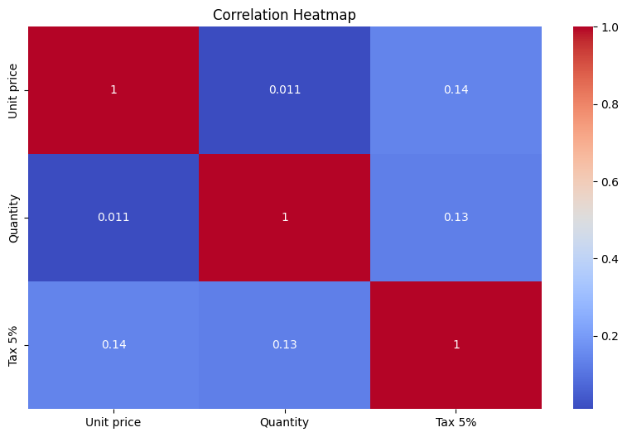
Correlation Analysis
Plot: Correlation Heatmap.
Explanation: Shows the correlations between numerical variables like Unit Price, Quantity, and Tax.

Slide 12
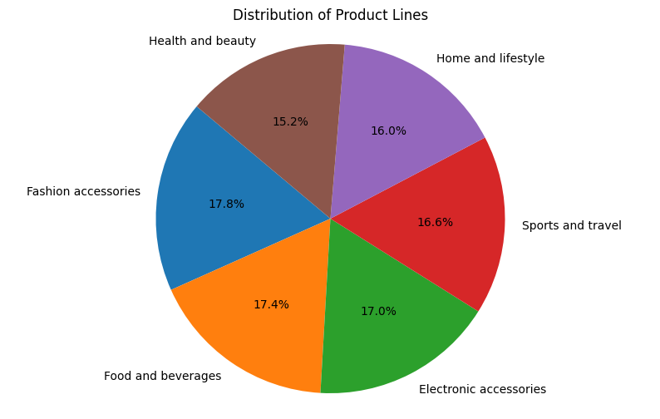
PIE CHART
Plot: pie chart
Explanation: The pie chart reveals that the 'Health and Beauty' product line is the most popular among customers, followed by 'Electronic Accessories' and 'Home and Lifestyle’.

Slide 13
HYPOTHESIS TESTING
One-Sample T-Test:
Test if the mean 'Unit price' is significantly different from a hypothesized value (e.g., 50).
Two-Sample T-Test:
Compare the mean 'Unit price' between two groups (e.g., Male vs. Female customers).
One-Way ANOVA:
Compare the mean 'Unit price' across multiple groups (e.g., different product lines).
Chi-Square Test of Independence:
Test if there is a significant association between two categorical variables (e.g., Gender and Customer Type).

Slide 14
ONE SAMPLE TEST
The one-sample t-test results indicate that the mean 'Unit price’ in your sample is significantly different from 50, as evidenced by a very low p-value.
This suggests that the average unit price in your dataset is not equal to 50, and the difference is statistically significant.
There is significant evidence to the population mean in your sample mean
t-statistic=6.769994939739997, p-value=2.1931691091447766e-11

Slide 15
TWO SAMPLE TEST
P-statistics value:0.48797163734606525
T-statistics value:0.6256771156169185
The two-sample t-test results indicate that there is no significant difference in 'Unit price' between male and female customers, as evidenced by a high p-value. Therefore, we fail to reject the null hypothesis.
INTERPRETATION:
There is no significant difference in 'Unit price' between male and female customers.

