Slide 1
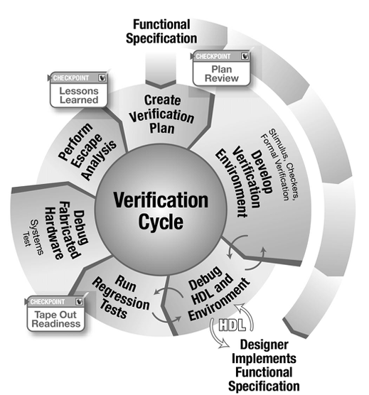


ECE 593 Fundamentals of Pre-Silicon Validation
Venkatesh Patil Electrical and Computer Engineering Department Maseeh College of Engineering and Computer Science

Slide 2
Design and Verification of Asynchronous FIFO Winter 2025 – Session 2 – Group 10
Aadityasingh Chouhan Moulya Raju Machohalli Thimmaraju
Email Id : aadityac@pdx.edu Email Id : moulya@pdx.edu
PSU ID : 960054443 PSU ID : 947898393
Rakshith Rajashekhara Bharadwaj Subramanya Dhanajaya
Email Id : rbharadw@pdx.edu Email Id : subrama@pdx.edu
PSU ID : 929940720 PSU ID : 941540243

Slide 3
Project Introduction
Aadithyasingh Chouhan
System Verilog
Design
FIFO Depth Calculation
Class Based Verification
Generator
Interface
Environment
UVM Verification Environment
Environment
Interface
Sequence
Rakshith Rajashekara Bharadhwaj
System Verilog
Flat Testbench
Class Based Verification
Finalized RTL
Class based Testbench
UVM Verification Environment
UVM Scoreboard
Monitor
TLM Communications

Slide 4
Project Introduction
Subramanya Dhanajay
System Verilog
FIFO Write
Class Based Verification
Driver
Transaction
Scoreboard
UVM Verification Environment
Sequence
Sequencer
Driver
Moulya Raju
System Verilog
Top Design
Class Based Verification
Randomized Test cases
Constraints and Coverage
Verification Document
UVM Verification Environment
Coverage
Verification Document
Presentation Document
Git releases

Slide 5
Project Introduction
The Asynchronous FIFO (First-In-First-Out) is a type of memory buffer used in digital systems to transfer data between two clock domains operating at different frequencies. It ensures smooth data transfer while handling clock domain crossing issues.
The design typically consists of write and read pointers, memory storage, control logic for full and empty flags, and synchronization mechanisms to prevent metastability when transferring control signals between clock domains
Asynchronous FIFOs are widely used in high-speed communication interfaces, data buffering between different clock domains in FPGA and ASIC designs, and in systems requiring reliable data transfer with varying clock rates.
The primary challenges include metastability, pointer synchronization, and ensuring data integrity. These are addressed using Gray-coded pointers, dual-port memory, and proper synchronizer circuits.

Slide 6
Specifications
Producer Clk frequency (clk 1): 80 MHz
Consumer Clk frequency (clk 2): 50 MHz
Maximum write burst size: 120
FIFO Depth : 45

Slide 7
Specifications
Producer is writing at 0 clock cycle.
Consumer is reading at 0 clock cycles.
Time required to write one data item = 1/80Mhz = 12.5 ns.
Time required to write all data items = 120 * 12.5 = 1500ns.
Time required to read one data item = 1/50Mhz = 20 ns.
No of data items that can be read in a period of 1500 ns = 1500/20 =75.
Thus, the number of data items needs to be stored = 120–75=45.
Therefore, logarithm of 64 with base 2 will result in 6 bits. Thus, we can either choose a FIFO that is 64 in depth or design a FIFO with 45 in size. The Width of the FIFO is 6 bits.

Slide 8
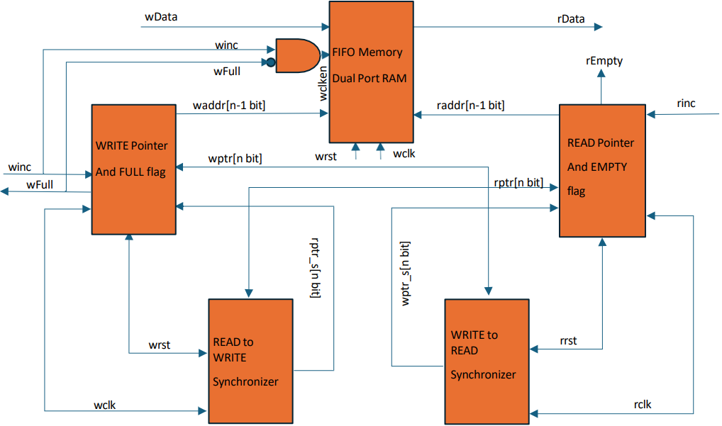
Design Implementation
Talk about design Implementation
Source of design
Your groups contribution over the source of design
Quick specification of your design to be verified

Slide 9
Design Implementation
Empty Condition:
The FIFO is empty when there is no valid data to read.
This happens when the read pointer catches up to the write pointer.
The empty flag is asserted, preventing further reads until new data is written.
Proper synchronization ensures the read domain correctly detects the empty condition.
Full Condition:
The FIFO is full when all available memory locations are occupied.
This occurs when the write pointer reaches the read pointer after completing a full cycle (considering circular buffer implementation).
The full flag is asserted, stopping further writes until space is available.
Gray-coded pointers and synchronization help avoid incorrect full flag assertions.

Slide 10
Design Implementation
An additional bit is utilized to determine the FULL and EMPTY conditions.
Gray coding is used, and the most significant bit (MSB) of the pointers is compared to assess these states.
During reset, both the read and write pointers are initialized to zero.
After data is written to the memory at the address indicated by the write pointer, the pointer advances to the next location.
The FIFO is considered empty when the read and write pointers hold the same value, either at reset or when the read pointer catches up to the write pointer.
The FIFO becomes full when the write pointer wraps around and matches the read pointer again.

Slide 11
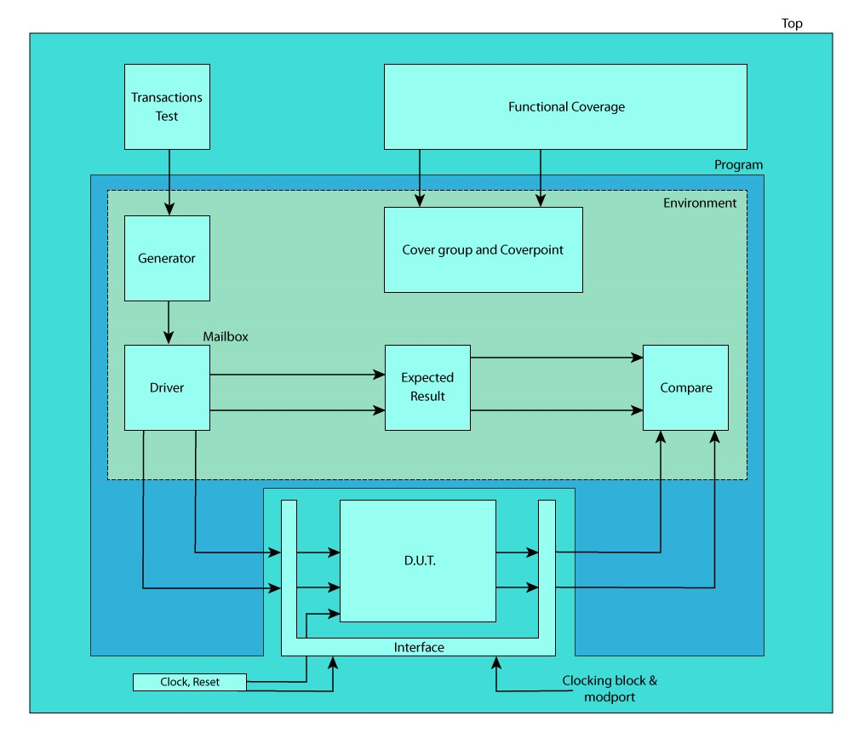
Design Implementation

Slide 12
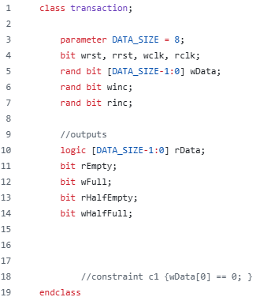
Class based Verification
Transaction Class

Slide 13
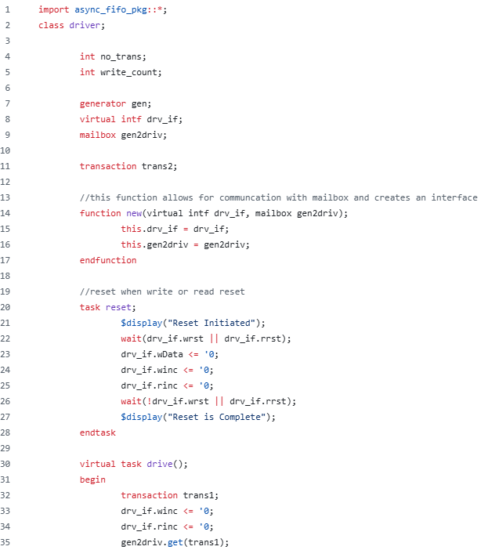
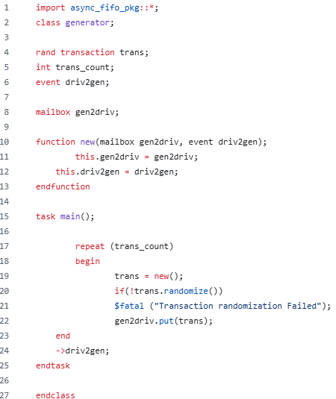
Class based Verification
Generator
Driver

Slide 14
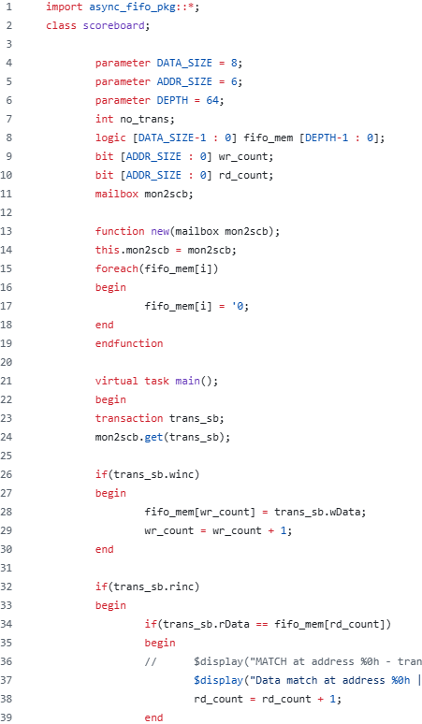
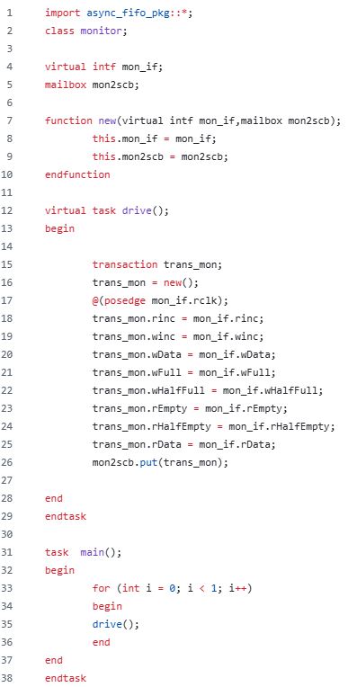
Class based Verification
Monitor
Scoreboard

Slide 15
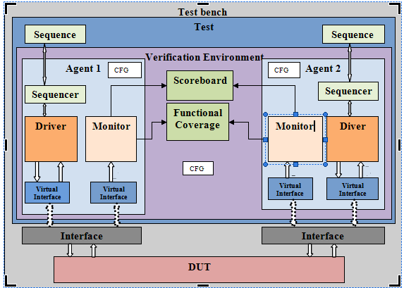
UVM based Verification

Slide 16
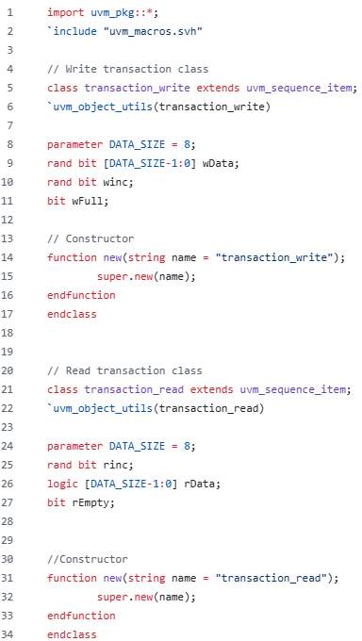
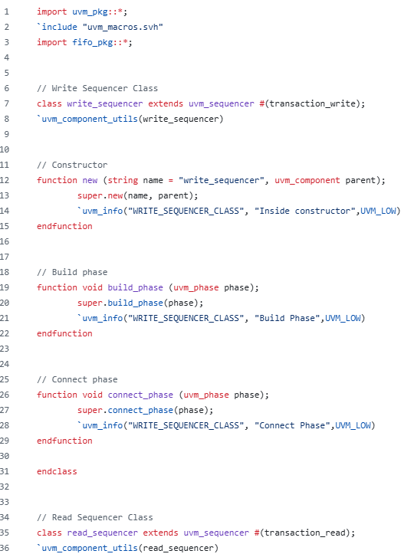
UVM based Verification
Sequence item
Sequencer

Slide 17
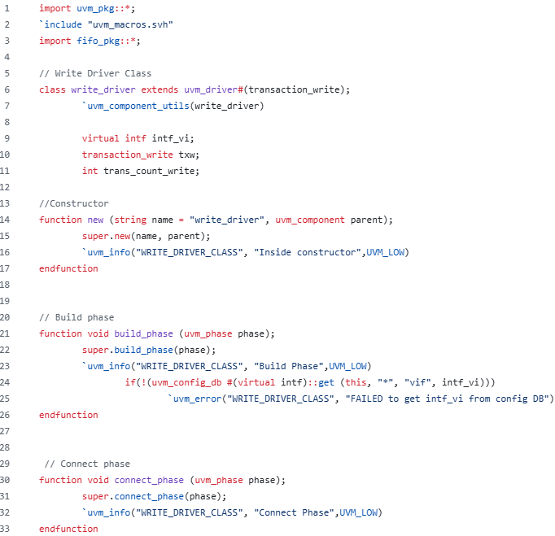
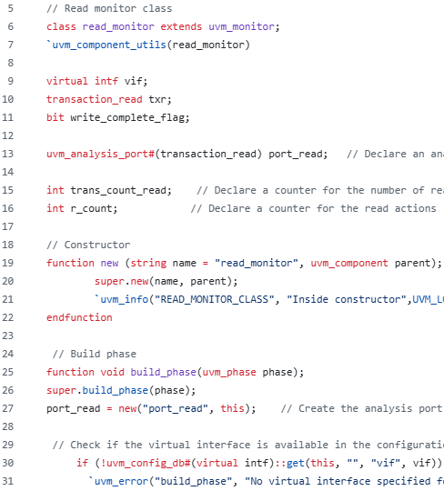
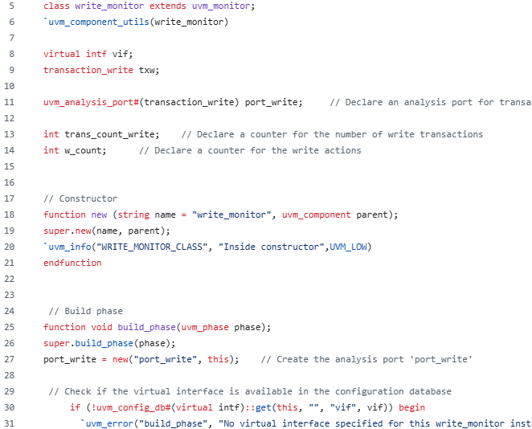
UVM based Verification
Driver
Monitor

Slide 18
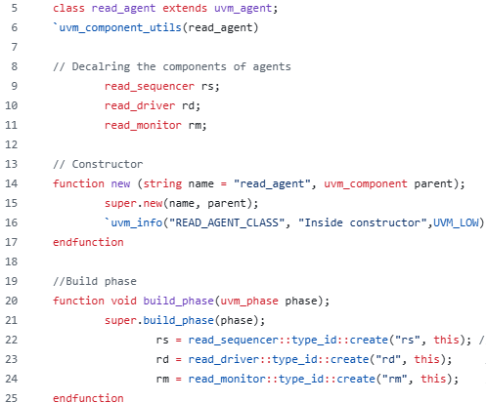
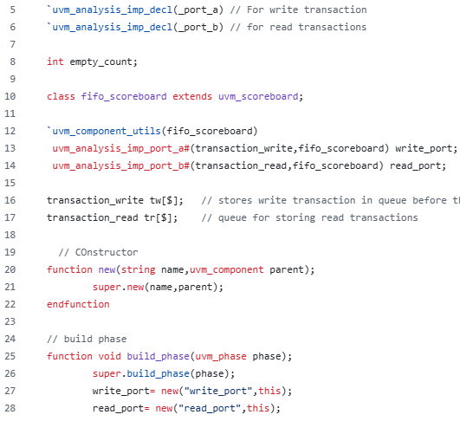
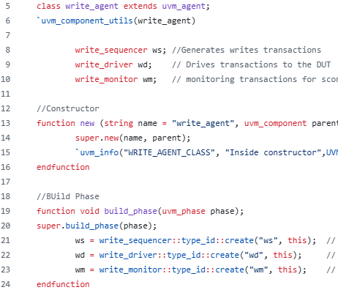
UVM based Verification
Agent
Scoreboard

Slide 19
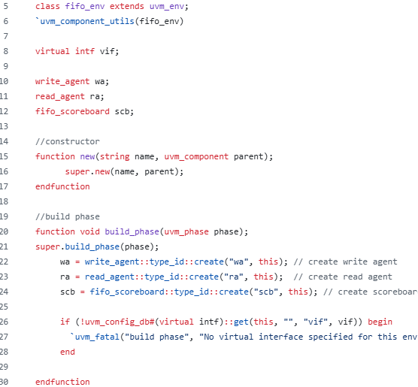
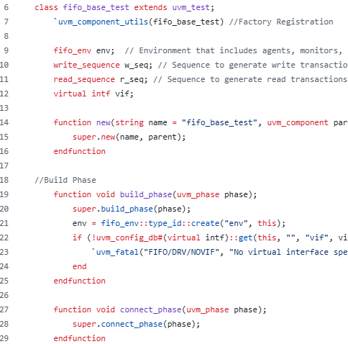
UVM based Verification
Environment
Test

Slide 20
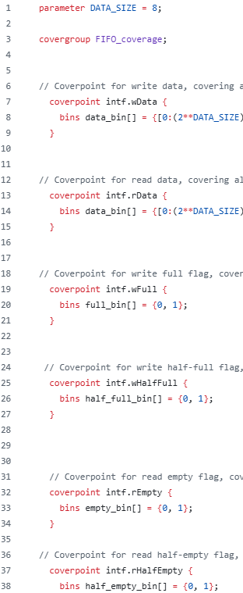
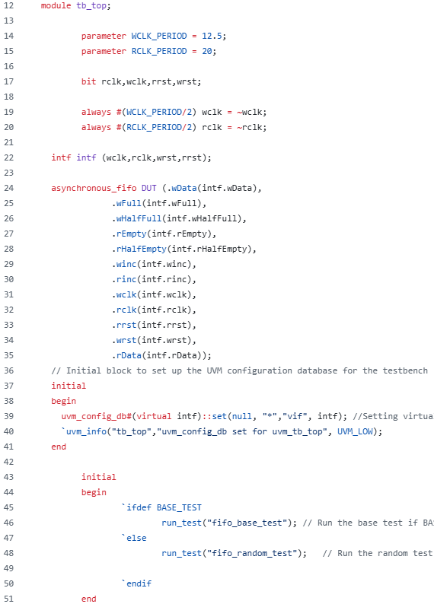
UVM based Verification
Coverage
Top

Slide 21
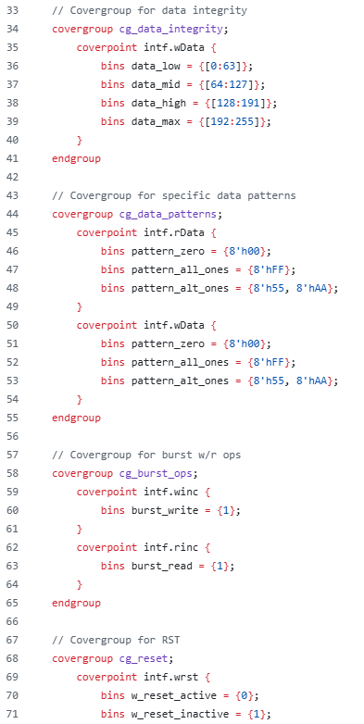
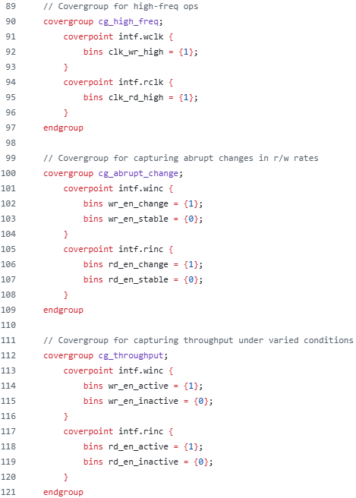
Coverage
Cover Groups : FIFO, half_full_empty, data_integrity(addr_range), data_patterns, reset, clks, etc

Slide 22
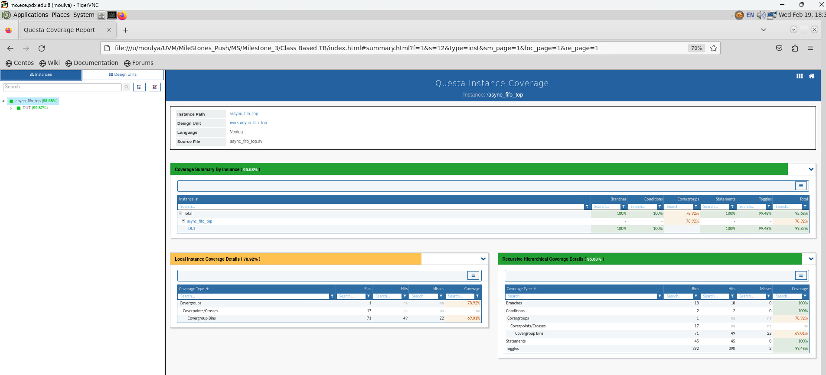
Coverage

Slide 23
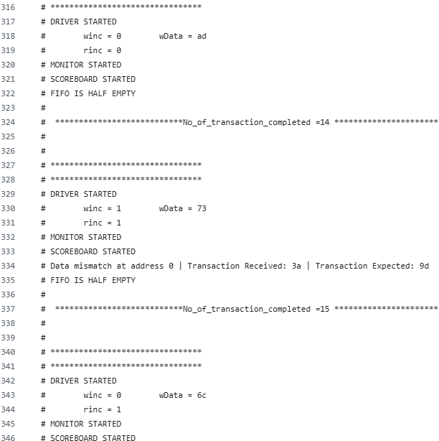
SV Simulation Results
SV Class based Results

Slide 24
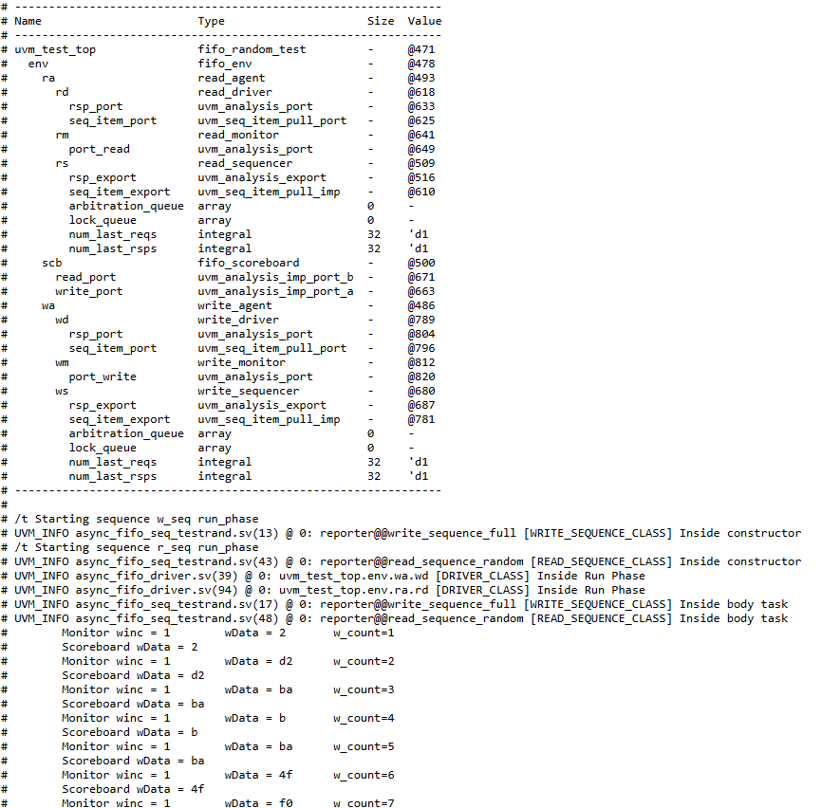
UVM Simulation Results

Slide 25
Challenges faced
During our initial test run, we quickly identified an issue. The `data_out` value was incorrectly received as 'x' due to a faulty connection during setup, leading to unexpected behavior. It was frustrating to see the read address increment values completely misaligned.
After completing the read and write transfers, we anticipated the correct assertion of full and empty signals, but they failed to appear. Each read transfer was supposed to extract the latest data from the monitor and driver, yet the system remained unresponsive, seemingly stuck without updating properly.
A significant problem was the lack of an error detection and correction mechanism, making it impossible to verify the asynchronous FIFO accurately. Additionally, race conditions between the write and read pointers caused instability and confusion. The most frustrating part was the system's failure to revert to a previously functional state, leaving us with a broken setup and no immediate resolution.

Slide 26
Conclusion
The design and verification of an asynchronous FIFO using SystemVerilog (SV) and Universal Verification Methodology (UVM) ensure accuracy and reliability.
Key techniques include functional coverage analysis, assertions, and a well-structured design approach.
SV and UVM enhance verification by providing modularity, reusability, and scalability.
Directed testing focuses on critical scenarios, while random testing helps identify edge cases.
By integrating these methodologies, the design meets its requirements and functions reliably.
This project achieved approximately 95% coverage, including both code and functional coverage.

Slide 27
References and Citations
1. S. Cummings, "FIFOs: Fast, predictable, and deep," in Proceedings of SNUG, 2002. [Online]. Available:http://www.sunburst-design.com/papers/CummingsSNUG2002SJ_FIFO1.pdf
2. S. Cummings, "FIFOs: Fast, predictable, and deep (Part II)," in Proceedings of SNUG, 2002. [Online]. Available: http://www.sunburst-design.com/papers/CummingsSNUG2002SJ_FIFO2.pdf
3. Putta Satish, "FIFO Depth Calculation Made Easy," [Online]. Available: https://hardwaregeeksblog.files.wordpress.com/2016/12/fifodepthcalculationmadeeasy2.pdf
4. A. Author et al., "Title of the Paper," in Proceedings of the Conference, 2015, pp. 123-456. [Online]. Available: https://ieeexplore.ieee.org/abstract/document/7237325.

Slide 28
References and Citations
5. M. Last Name et al., "Designing Asynchronous FIFO," [Online]. Available: https://d1wqtxts1xzle7.cloudfront.net/56108360/EC109-libre.pdf.
6. A. Author et al., "Title of the Paper," in Proceedings of the Conference, 2011, pp. 789-012. [Online]. Available: https://ieeexplore.ieee.org/stamp/stamp.jsp?arnumber=6041338
7. Aldec website https://www.aldec.com/en/company/blog/168--verification-effectiveness-with-riviera-pro-systemverilog-randomized-layered-testbench
8. [1] Chip Verify. [Online]. Available: https://www.chipverify.com

