Slide 1
Summary of paper
Re-contextualizing Fairness in NLP: The Case of India
Introduction
NLP fairness in the Indian context
resources (curated and created) for enabling fairness evaluations
demonstrations of prediction biases and over-prevalence
2. Related Work
Social biases are shown to be baked into pretrained language models and models for downstream tasks such as sentiment analysis and toxicity detection .While the majority of NLP fairness research focuses on gender and racial biases , other axes of disparities such as ability , age , and sexual orientation have also gotten some attention.
majority of this research is framed in and for the Western contexts.
Recently, fairness research in NLP has also been expanded to non-English languages such as Arabic ,Japanese, Hindi, Bengali, and Telugu. Evidence of cultural biases for different countries have also been recorded in LMs. Our work adds to this line of research. Building on Sambasivan et al. (2021), we take a more holistic approach towards NLP fairness in the specific geo-cultural context of India. More specifically, we re-frame the agenda they proposed along “re-contextualizing data and model fairness; empowering communities by participatory action; and enabling an ecosystem for meaningful fairness” with an NLP-centric lens.

Slide 2
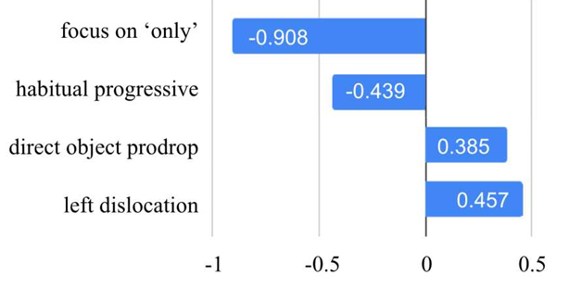
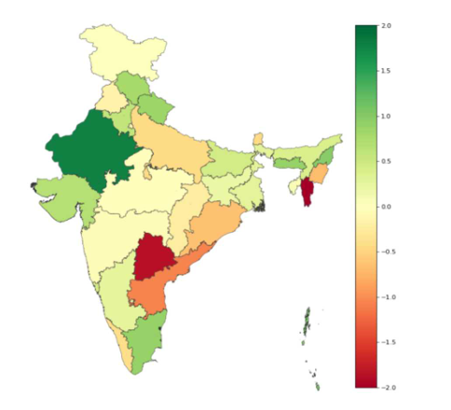
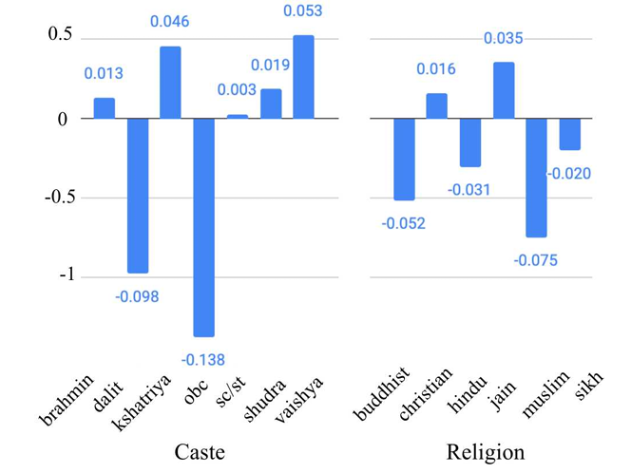
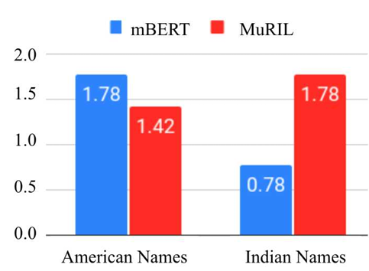
3. Axes of Disparities
3.1 India-specific axes like Region , Ethno-Linguistic group and How un-fairness extended to North-East Indians and Konkani people -- Caste based Matrimonial Ads
3.2 Global axes in the Indian context – Gender : women in India are 58% less likely to connect to mobile Internet then men have literacy rate of 65% compared to 85% for men and have 21% labor force participation compared to 76% for men. -- Religion: Christianity is a minority religion in INDIA -- Ability: people with disabilities are often, abandoned at birth or socially segregated . -- Gender Identity and Sexual Orientation: Removal of Section 377
4 Proxies of Axes and Predictive Disparities
three major kinds of proxies: identity terms, personal names, and dialectal features.

Slide 3
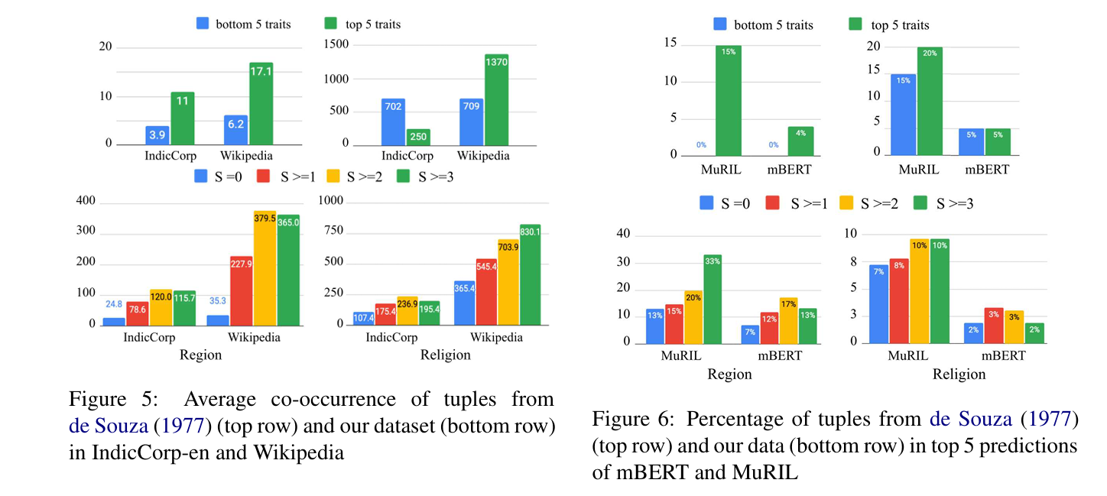
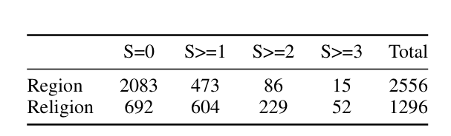
5.Stereotypes in Indian Context
5.2 Corpus Analysis and 5.3 Model Analysis
5.1 Dataset Creation
Generating Candidate Associations
Obtaining stereotype annotations
6 Re-contextualizing Fairness
1.Accounting for Indian Societal context
Socially Situated Evaluation
Data Voids
Intersectionality
3.Adapting to Indian Values and Norms
Accounting for Indian justice models
Avoiding value imposition
2.Bridging cross-lingual Technological gaps
Performance gaps across languages
Multilingual fairness research
7 Conclusion
perturbation analysis , DisCo analysis , creation of a stereotype dataset

Slide 4
WEAKNESSES
how much Hour did the model being trained
No mention of Decoder only models , Encoder-Decoder only models or MOE models
Project is heavily dependent over the Encoder Only models
Dataset is being curated only for English language readers (Mentioned)
Annotators are not highly diversified
No analysis about the situation if intersection of social axes might happen
Most of the ideas are being dependent over Sambasivan et al. (2019)
No evaluation metrics are being provided to quantify a Bias
No convention about how much bias leaks into Downstream tasks
No explanation for why “Relative sentiment score shift” happens

Slide 5
Strengths
A Novel dataset has been created
Acts as a bridge in between global context and Indian context related to NLP fairness
The work is kind of intersection in between social science , AI , NLP (Ambedkar et al)
Authors Perfectly know the limitations
3 improvements to the paper
Should use Mixture of Experts models like Grok
Dataset should be curated for Low resource NLP
Annotators should be diversified i.e 1 per each state or involve members of marginalized community

