Slide 1
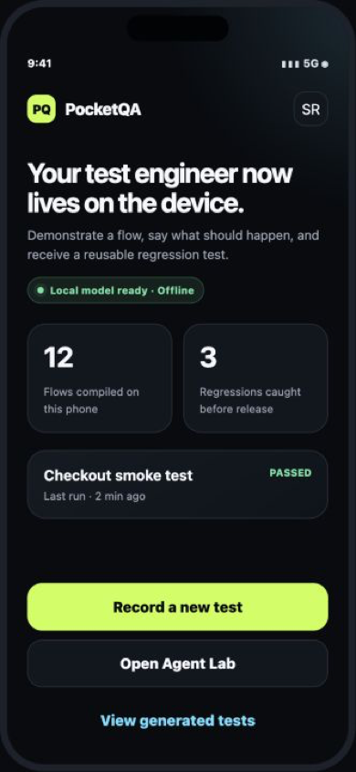
DEVELOPER TOOLS · iQOO HACKATHON 2026
PocketQA
Show a flow once.
Ship the regression test.
A private, on-device AI test author—and safe QA agent—for mobile teams.
ON-DEVICE AI · MOBILE QA
Bengaluru City Battle · 29–30 Aug 2026
Notes:
Open on the core promise: PocketQA converts a real demonstration into a reusable test, with the phone as both the authoring and inference surface.
[Sources]
- https://iqoo.reskilll.com/guide

Slide 2
THE PROBLEM
Mobile teams know what to test. Authoring it is the bottleneck.
“Make checkout work” is clear to a human—but not executable by CI.
01
Test intent stays trapped
Expected behaviour lives in tickets, voice notes and the developer’s head.
02
Automation takes specialist time
Small teams repeatedly choose between manual QA, brittle scripts, or cloud tools that do not understand the developer’s specific intent.
Selectors, waits and assertions must be authored and maintained manually.
03
Failures arrive without context
A red CI run rarely contains the human intent and exact evidence together.
02
Notes:
Frame the pain from our own mobile delivery experience. Avoid market-size claims; the strength is founder–problem fit and a crisp workflow gap.

Slide 3
THE PRODUCT
PocketQA turns intent into a deterministic test in five moves.
1
2
3
4
5
Speak
Show
Compile
Approve
Export
State what
should happen
Demonstrate
the flow once
Local AI creates
assertions
Human reviews
every step
YAML + evidence
to the laptop
THE RESULT
One human walkthrough becomes a reviewable regression test, reproducible bug report and portable CI asset.
03
Notes:
Walk left to right. Emphasise that the model proposes; the human approves; replay stays deterministic. This avoids unsafe autonomous control.

Slide 4
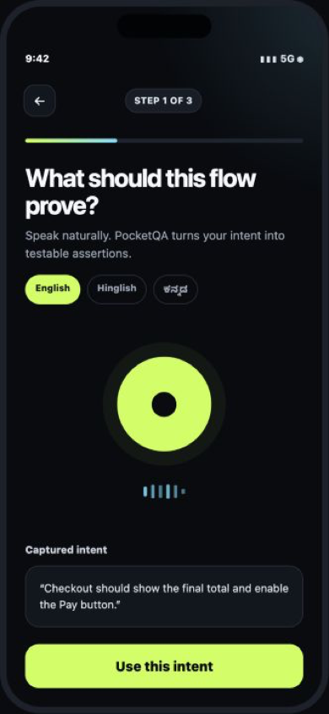
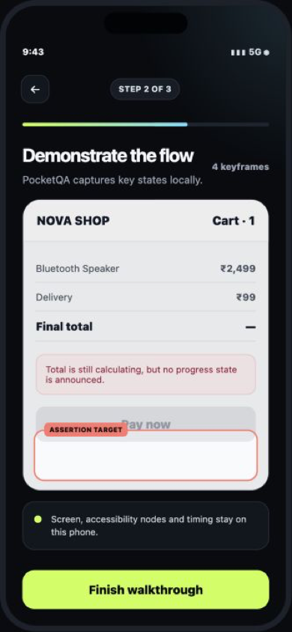
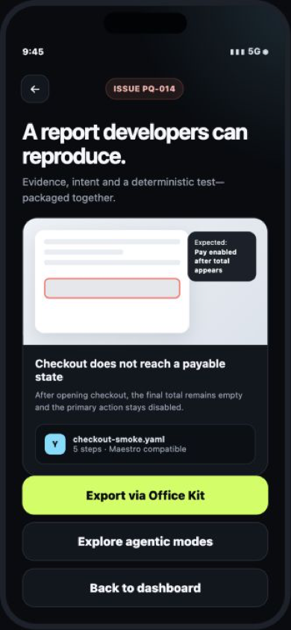
PROTOTYPE EXPERIENCE
The core demo remains simple enough to trust.
SAY
SHOW
SHIP
→
→
04
Notes:
This is the Phase 1 clickable prototype. The video can follow the same three-beat arc: speak the expected result, demonstrate the bug, export the test.

Slide 5
CLEAR DIFFERENTIATION
PocketQA authors the test; existing tools can still run it.
MAESTRO
FIREBASE ROBO
POCKETQA
Test execution framework
Automated cloud exploration
On-device semantic authoring
INPUT
Developer-authored flow
APK + generic crawl
Human demo + spoken intent
UNDERSTANDING
Commands and selectors
UI hierarchy exploration
Expected outcome + screen state
PROCESSING
Runner on device/emulator
Cloud test infrastructure
Local model on target phone
OUTPUT
Pass/fail + artifacts
Crawl graph + logs/video
Approved test + bug evidence
RELATIONSHIP
PocketQA can export to it
Different coverage mode
The authoring layer
05
Notes:
Do not claim that no AI testing tools exist. The defensible wedge is human-demonstrated intent, local semantic compilation and portable deterministic output.
[Sources]
- https://docs.maestro.dev/maestro-studio/run-tests-with-maestro-studio
- https://firebase.google.com/docs/test-lab/android/robo-ux-test

Slide 6
HOW THE AI WORKS
A local agent can observe, plan, act and learn—inside explicit rails.
01
02
03
04
OBSERVE
PLAN
ACT
LEARN
Fuse screenshots, UI tree, OCR, timing and voice intent.
Compile goals into a state graph, assertions and bounded branches.
Call approved UI actions; replay the saved test deterministically.
Store app vocabulary, approved fixes and test history locally.
SYSTEM MODEL · IF SUPPORTED
CUSTOM MODEL PATH
CONNECTED BOOST · OPTIONAL
Gemini Nano / ML Kit Prompt
Gemma / LiteRT
Sarvam + OpenAI
Text + image prompting and speech through AICore on compatible devices.
Portable local models, tuned prompts and strict test schemas.
Indic voice plus complex-screen review, tools and JSON schemas.
POLICY: the model proposes · the executor validates · guarded actions stop · every result leaves evidence
06
Notes:
This is the real AI depth: multimodal perception, planning, local memory and tool selection. Reliability comes from the policy gate and deterministic executor, not from pretending the model is always correct.
[Sources]
- https://developer.android.com/ai/overview
- https://developers.google.com/ml-kit/genai
- https://developer.android.com/reference/android/accessibilityservice/AccessibilityService
- https://docs.sarvam.ai/api/api-guides-tutorials/speech-to-text/streaming-api
- https://developers.openai.com/api/reference/cli/resources/beta/subresources/responses

Slide 7
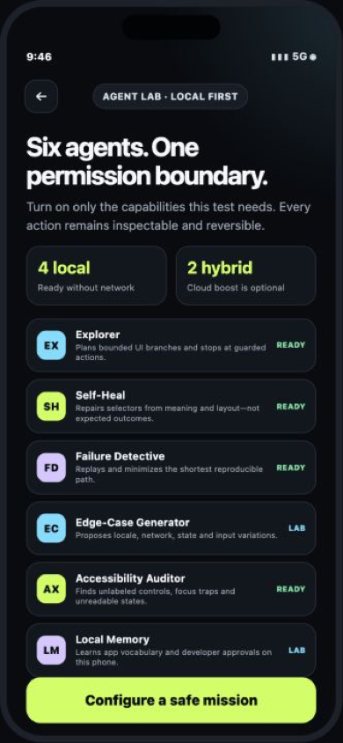
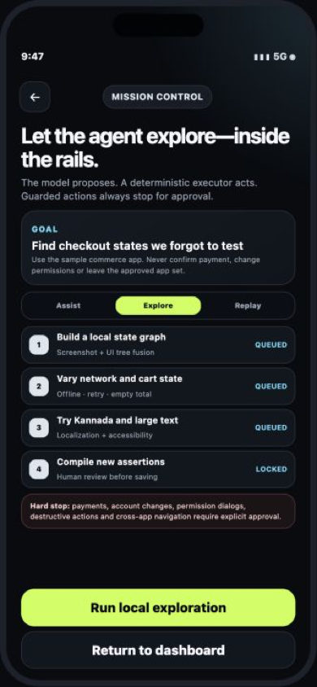
AGENTIC EXPANSION
One trusted loop can support six specialist agents.
BUILD NEXT
AGENT LAB
MISSION CONTROL
Explorer — bounded state graph + branch search
Self-Heal — semantic selectors, never assertions
Failure Detective — replay, minimize and explain
SECOND WAVE
Edge-Case Generator — locale, network, state and input variants
Accessibility Auditor — labels, focus, large text and contrast
Local Memory — app vocabulary, approvals and test history
PLATFORM BETS
Android AppFunctions as local tools · OEM Computer Control · multi-device cooperative test agents
Each agent is opt-in. High-risk actions remain outside the autonomous tool set.
07
Notes:
Present this as a roadmap, not a claim that every agent will be complete on day one. AppFunctions is experimental and Android Computer Control is currently limited to OEM-preloaded assistants, making both credible platform bets rather than MVP dependencies.
[Sources]
- https://developer.android.com/ai/appfunctions
- https://developer.android.com/ai/computer-control
- https://developer.android.com/guide/topics/ui/accessibility/service

Slide 8
30-HOUR EXECUTION PLAN
Finish the trusted loop before adding autonomy.
GATE 1 · MUST WORK
GATE 2 · WINNING WOW
GATE 3 · ONLY IF STABLE
Authoring loop
One safe Explorer
Specialist agents
React Native shell
Screen + UI-tree capture
Intent → strict JSON
Human approval + YAML
Build a local state graph
Try one bounded branch
Stop before guarded action
Show novel-state evidence
Selector self-heal
Failure minimizer
Accessibility audit
Indic connected voice
DEMO RULE
Agent mode stays an opt-in tab until the five-step authoring flow passes end to end.
08
Notes:
This keeps the ambition without gambling the submission. Finish the authoring path, then add the Explorer as the memorable agentic extension; every other agent is a stretch goal.
[Sources]
- https://iqoo.reskilll.com/
- https://iqoo.reskilll.com/guide

Slide 9
PRODUCT VISION
Start with test authoring.
Grow into a private QA agent.
01
Human intent in
Voice, demonstration and product context.
02
Bounded local agents explore
Visible plan, approved tools and hard stops.
03
Deterministic evidence out
Reviewable assertions, replay and portable tests.
AIRPLANE MODE · ONE BUG · ONE TEST · ONE SAFE EXPLORATION
09
Notes:
Close on the product progression rather than the team biography. The live proof is still concrete: compile one test offline, then show one bounded exploration mission.
[Sources]
- https://developer.android.com/ai/overview
- https://developer.android.com/ai/appfunctions
- https://iqoo.reskilll.com/guide

