Slide 1


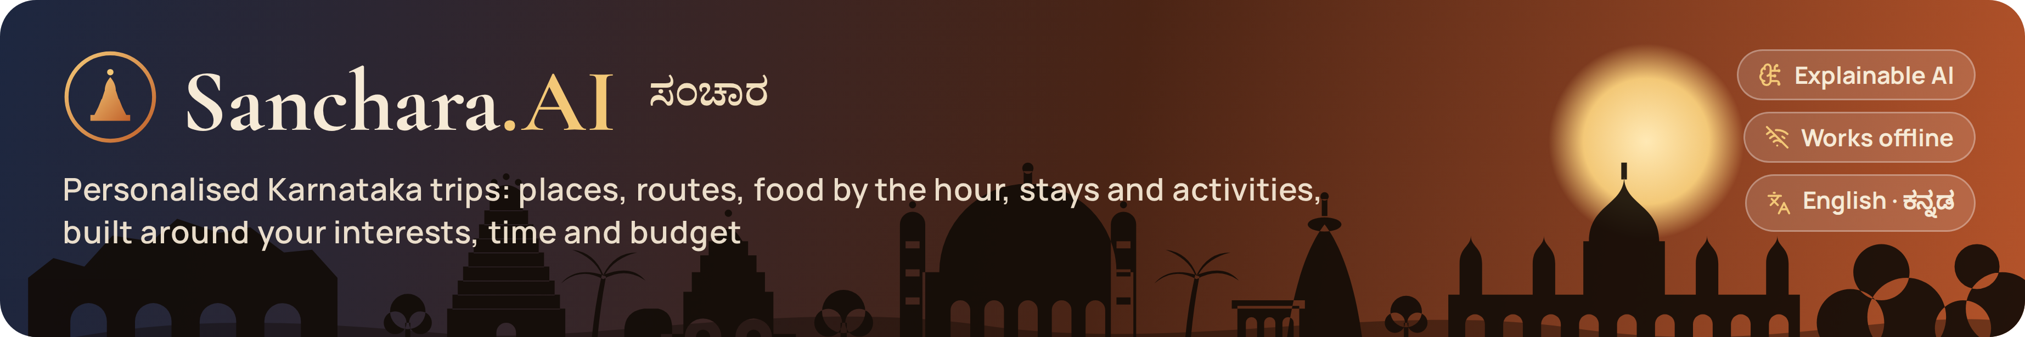
AI TO REDESIGN TOURISM
Project Competition • 25 September 2026
Sanchara.AI — ಸಂಚಾರ
Personalized Tourism Recommendation System · Smart Technology · Problem #3
Team Name: ______________________
Institution: ______________________
Team Members: ______________________
AI to Redesign Tourism • Bagalkot • 25 September 2026
Notes:
Good morning. We are team ____ from ____. Our project is Sanchara.AI — 'sanchara' means travel in Kannada. It is a personalised tourism recommendation system for Karnataka: tell it where you are, what you love, how many days and your budget, and it plans the places, the route, the food at the right time and the stay for the night — in seconds, in English or Kannada, even offline.

Slide 2
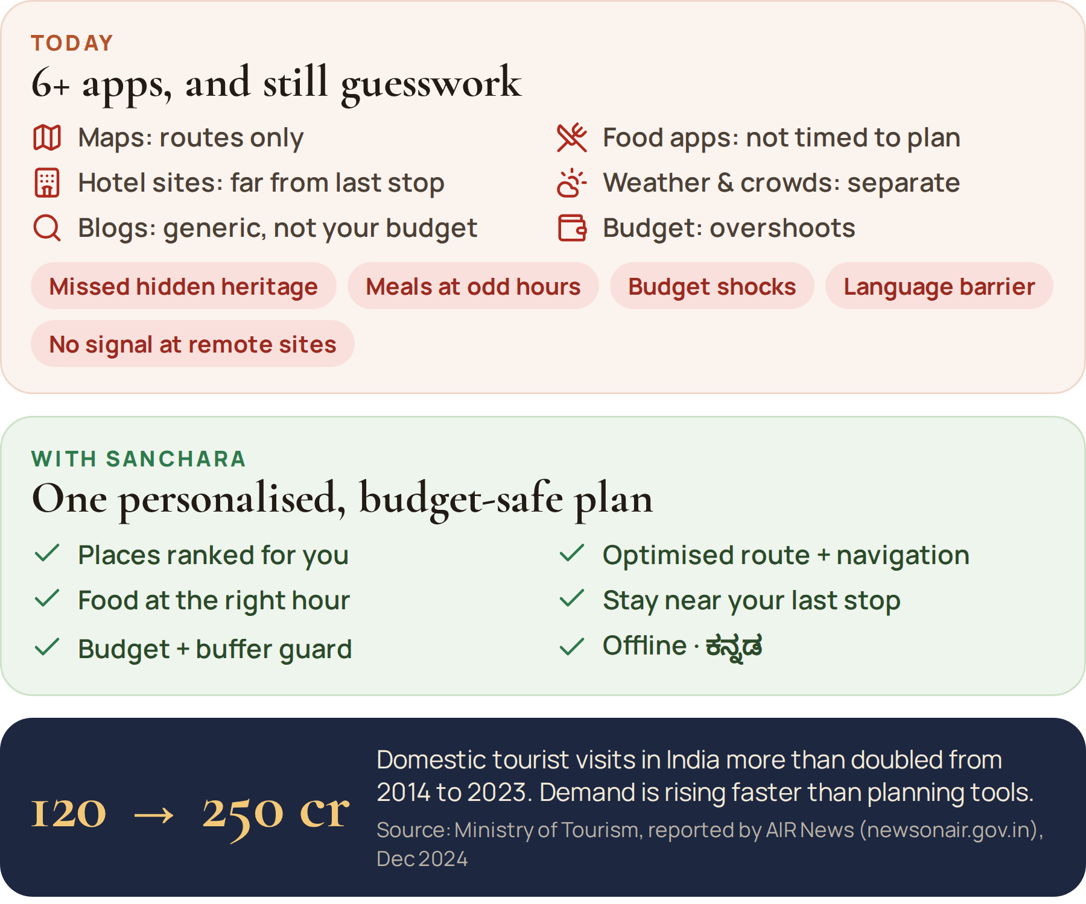
1. Tourism Problem
Problem: Planning a Karnataka trip means juggling maps, food apps, hotel sites, weather and blogs. Tourists still miss nearby heritage, eat at odd hours, overshoot budgets and get stuck without signal or Kannada signage.
Target users: Domestic & foreign tourists, families, students, senior citizens and groups on North Karnataka circuits (Badami–Aihole–Pattadakal, Hampi, Vijayapura, Belagavi, Hubballi–Dharwad), plus on-the-spot travellers asking “what now?”
Why is this important? Tourist visits in India more than doubled (120 cr in 2014 → 250 cr in 2023). Personalised, timed, budget-safe plans spread visitors to lesser-known sites and put money into local eateries, stays and artisans.
Tourism location / context: Bagalkot district alone has three world-class Chalukyan sites within 40 km (Pattadakal is UNESCO), yet most visitors see just one. Remote sites have weak mobile data, so the AI must work offline.
AI to Redesign Tourism • Bagalkot • 25 September 2026
Notes:
Today a tourist uses six or more apps and still guesses: maps give routes but not what to see, food apps don't know your plan, hotels are far from your last stop, and budgets overshoot. Here in Bagalkot, Badami, Aihole and Pattadakal are within 40 km, yet most visitors see only one. Demand is rising — domestic tourist visits more than doubled between 2014 and 2023 (Ministry of Tourism, AIR News). Our target users are tourists, families, students and seniors on North Karnataka circuits.

Slide 3
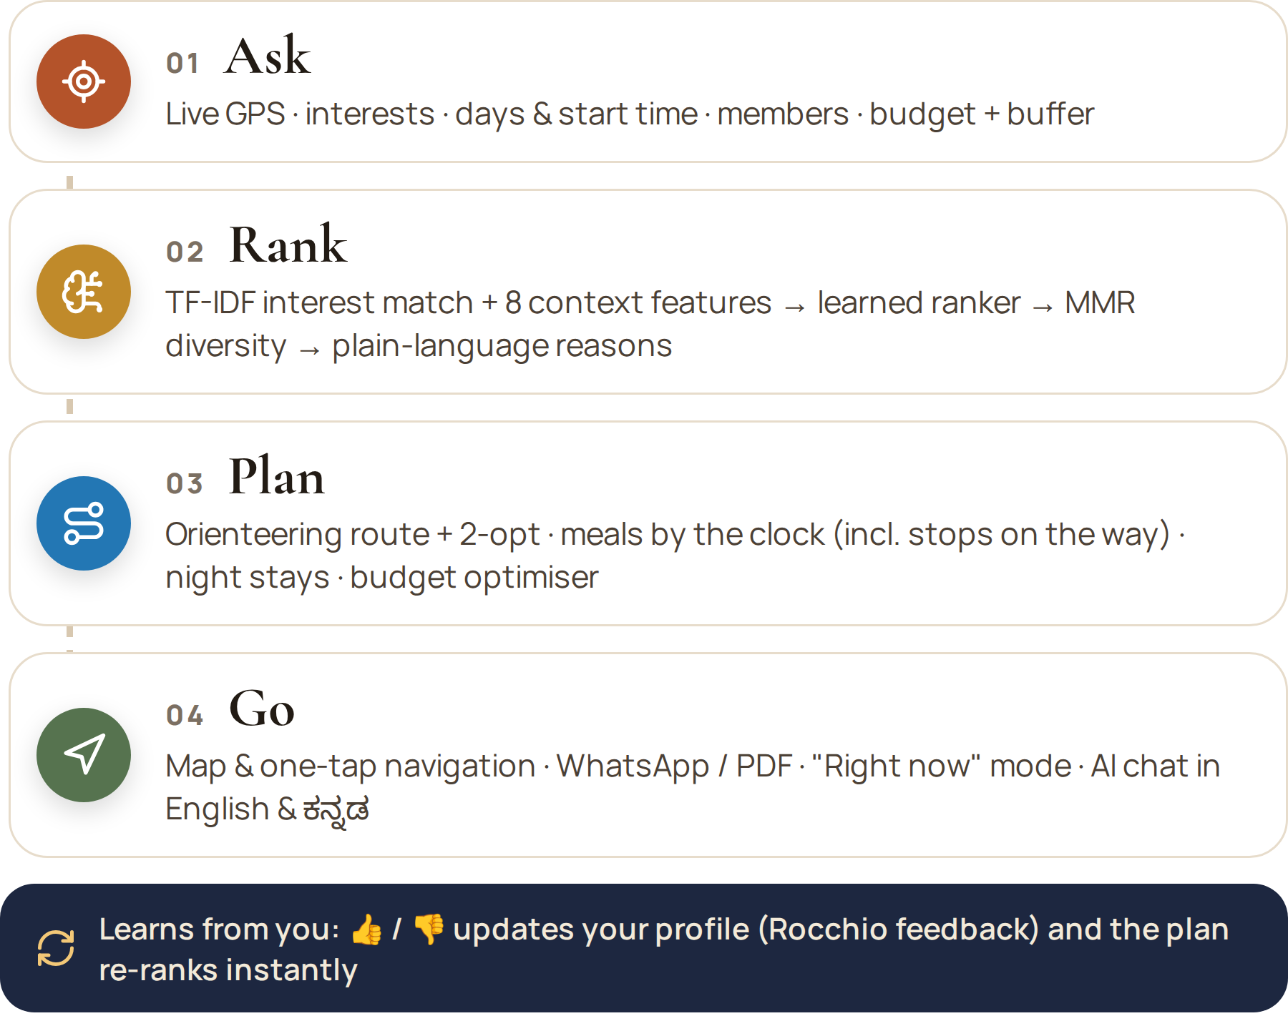
2. Proposed AI Solution
Solution in 2–3 points:
  1. Ask four things: live GPS location, interests, days & start time, members + budget + buffer. The AI ranks 175 curated places across all 31 districts and explains every pick.
  2. Build a day-by-day plan: optimised route & navigation, breakfast / lunch / snacks / dinner at the right hour (with meal stops on the way), a stay each night and activities, all within budget + buffer.
  3. “Explore right now” mode and an AI chat assistant (Gemini + offline) in English and ಕನ್ನಡ.
AI used: TF-IDF content-based recommender + logistic-regression learning-to-rank (8 context features) + MMR diversity + Rocchio feedback learning · orienteering route optimisation with 2-opt · crowd & sunset models · Gemini LLM grounded on the computed plan.
Innovation: Explainable picks (“why this place”), meal-time-aware food on the route, a budget + buffer optimiser that trims plans automatically, government stays (KSTDC / JLR) first, and on-device AI that works offline in ~40 ms.
AI to Redesign Tourism • Bagalkot • 25 September 2026
Notes:
Our solution works in four steps: Ask, Rank, Plan, Go. The tourist answers four questions. The AI ranks places with a hybrid recommender and shows the reason for every pick. Then it builds the itinerary — an optimised route, meals timed to the clock including stops on long drives, a stay for each night, and a budget meter with a buffer. If you dislike a suggestion, the model learns instantly and re-plans.

Slide 4
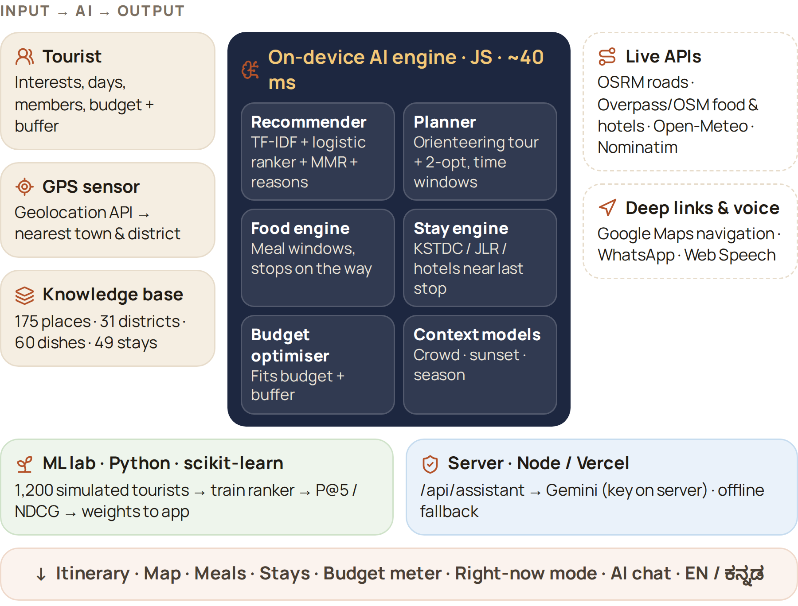
3. Technology & Architecture
AI/ML model: Logistic-regression ranker over TF-IDF interest match + proximity, popularity, season, predicted crowd, group, budget and opening-hours features — trained in Python (scikit-learn), runs in the browser. Planner: orienteering heuristic + 2-opt + time-window scheduling.
Dataset / data source: Curated Karnataka knowledge base (175 places, 31 districts, 60 dishes, 29 eateries, 49 stays incl. KSTDC/JLR) · OpenStreetMap (Overpass) · OSRM · Open-Meteo · Wikimedia Commons · 1,200 simulated tourists for training.
Software: HTML/CSS/JavaScript PWA, Leaflet maps, zero-dependency Node.js server, Vercel serverless function, Python (pandas, scikit-learn, matplotlib), VS Code.
IoT / APIs / hardware: Phone GPS (Geolocation API), OSRM routing, Overpass POIs, Open-Meteo weather, Nominatim, Google Maps navigation links, Gemini API (key kept server-side), Web Speech. Runs on any phone or laptop — no GPU.
Workflow: Input (GPS + interests + time + group + budget) → AI (rank → route → schedule meals & stays → fit budget) → Output (itinerary, map, costs, chat).
AI to Redesign Tourism • Bagalkot • 25 September 2026
Notes:
Technically, all the AI runs on the device in JavaScript — a plan takes about 40 milliseconds, so it works at remote sites without internet. The ranker is a logistic-regression learning-to-rank model trained in Python on simulated tourists; the weights are exported into the app. When online we add live road routes from OSRM, live restaurants and hotels from OpenStreetMap, weather from Open-Meteo, and Gemini for chat — the API key never leaves the server.

Slide 5
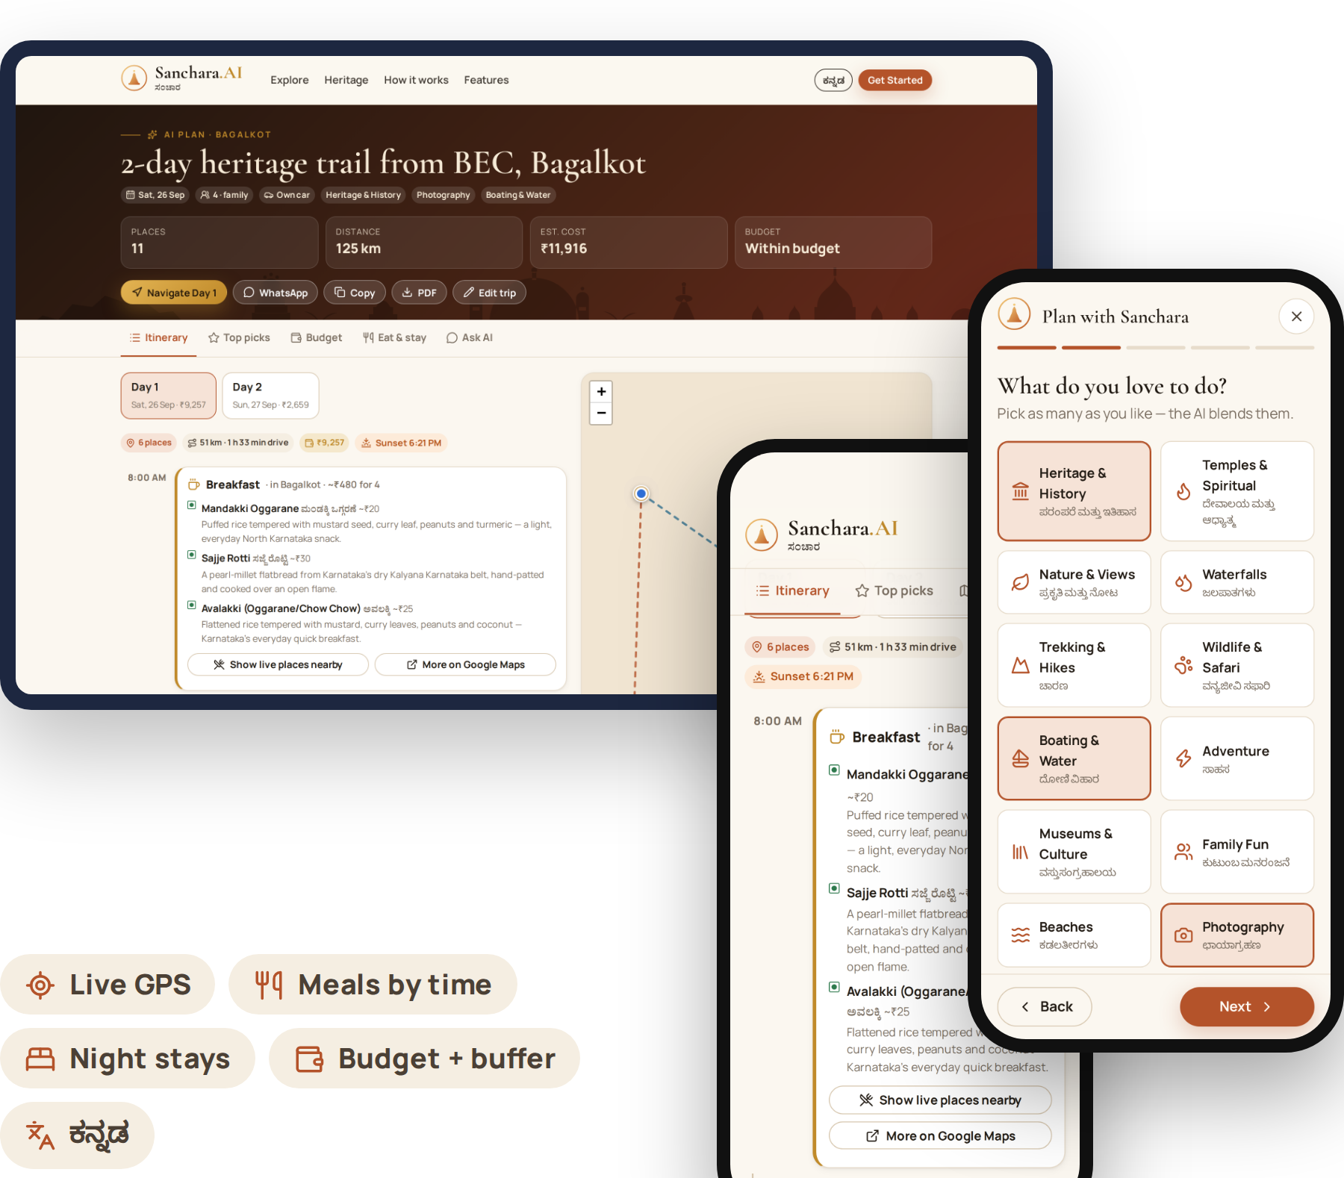
4. Working Prototype
Prototype status: Fully working web app on laptop and phone — installable (PWA), works offline, deployable free on Vercel. Complete source code with a VS Code run guide.
Key features: Live-GPS start · 15 interests · 1–7 day plans or “right now” mode · food by the hour + meal stops on the way · night stays · budget + buffer meter · 👍/👎 learning · map + one-tap navigation · WhatsApp / PDF · Kannada UI.
How the tourist uses it: Get Started → share location → pick interests → days & start time → members, budget & buffer → Generate → follow the plan with “Navigate” or ask the AI.
Demonstration steps: 1) Live location at BEC Bagalkot 2) Heritage + boating, 2 days, family of 4, ₹15,000 + ₹3,000 buffer 3) Itinerary with reasons, meals & KSTDC stay 4) Budget meter 5) 👎 re-ranks instantly 6) Ask AI “what should I eat now?”
AI to Redesign Tourism • Bagalkot • 25 September 2026
Notes:
Live demo: I share my location — it detects Bagalkot. I choose heritage and boating, two days, a family of four, fifteen thousand rupees with a three-thousand buffer. In seconds we get the itinerary: each place with its match score and reasons, breakfast, lunch, snacks and dinner at the right times with local dishes, and a KSTDC stay for the night. The budget tab shows we are within budget. I dislike one temple — it re-ranks instantly. Finally I ask the assistant what to eat now.

Slide 6
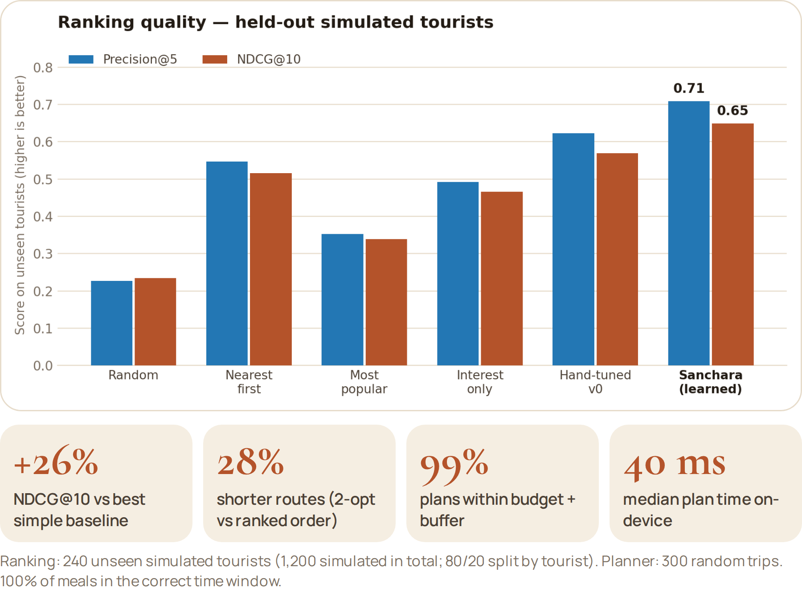
5. Results & Tourism Impact
Key result / performance: On 240 unseen simulated tourists: NDCG@10 0.65 vs 0.52 for the best simple baseline (+26%), P@5 0.71, AUC 0.81. Across 300 trips: 28% shorter routes, 99% of plans within budget + buffer, 100% of meals on time, ~40 ms per plan.
Tourist benefit: One plan instead of 6+ apps — fewer missed sites, local food at the right hour, a stay near the last stop, no budget shocks, Kannada support and one-tap helplines (112 · 1091 · 1363).
Impact on tourism: Spreads visitors from Hampi to Aihole, Lakkundi and Itagi; promotes KSTDC/JLR stays, khanavalis and crafts (Ilkal sarees, Bidriware); nudges off-peak visits and lower-CO₂ KSRTC travel.
Cost / feasibility: ₹0 to run — free APIs and free hosting, zero-dependency code, works offline on low-end phones; ready to plug in Karnataka Tourism's official data.
Future scope: Real footfall + feedback-trained models, AR monument recognition, Kannada/Hindi voice guide, KSTDC booking integration, festival crowd forecasting (Hampi Utsav, Dasara).
AI to Redesign Tourism • Bagalkot • 25 September 2026
Notes:
Results: on 240 tourists the model had never seen, our learned ranker reaches NDCG@10 of 0.65 against 0.52 for the best simple baseline — a 26 percent lift — with precision@5 of 0.71. Across 300 random trips the route optimiser cuts driving by 28 percent, 99 percent of plans stay within budget plus buffer, and every meal lands in the right time window. It costs nothing to run and spreads tourists to lesser-known heritage sites and local businesses. To be transparent: training data is simulated because we have no real users yet; the same script retrains on real feedback.

Slide 7
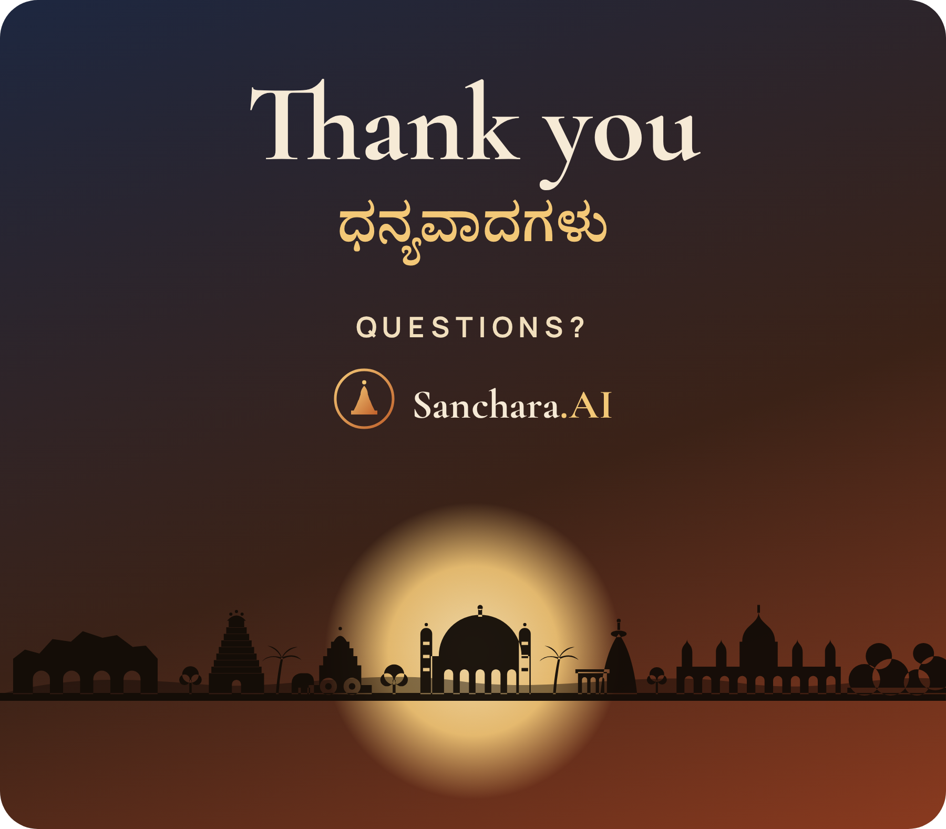
6. Conclusion & Q&A
One-line project conclusion:
“Sanchara.AI turns four simple answers into a complete, budget-safe Karnataka trip — places, routes, food, stays and activities — planned by explainable AI in seconds.”
Key innovation: A hybrid explainable recommender + orienteering route planner with meal-time food and a budget + buffer optimiser, running on-device, offline, in English and ಕನ್ನಡ.
Expected tourism impact: More travellers discovering North Karnataka beyond one famous site, longer stays and more spend with local businesses — at ₹0 cost to deploy.
THANK YOU
AI to Redesign Tourism • Bagalkot • 25 September 2026
Notes:
To conclude: Sanchara.AI turns four simple answers into a complete, budget-safe trip — places, routes, food, stays and activities — planned by explainable AI in seconds, offline and in Kannada. We believe it can bring more travellers to North Karnataka's heritage beyond a single famous site, at zero cost. Thank you — ಧನ್ಯವಾದಗಳು. We're happy to take questions.

