Slide 1
GraphQL – Technology to build agile API system
Enterprise Operational Informatics (Radiology Solutions)
12-SEP-2019

Slide 2
Agenda
Overview of GraphQL (20 mins)
Hands-on Part 1: GraphQL Query, Mutations and Subscriptions (25 mins)
Hands-on Part 2: Building an application using GraphQL (35 mins)
Hands-on Part 3: Migration to GraphQL from Legacy API with introduction to GraphQL resolvers (25 mins)

Slide 3
ASK : Strategic enabler for enterprise value creation
Discover product api’s and inter-op among the products to provide unified CX regardless and business unit or sales channel.
Unified customer experience - CX
Enable faster, and easier new idea generation, creation and deployment.
Time to Market & Product Market Fit
Enable faster, and easier application development on platforms for third party dev’s &, customers.
Expansion - DX

Slide 4
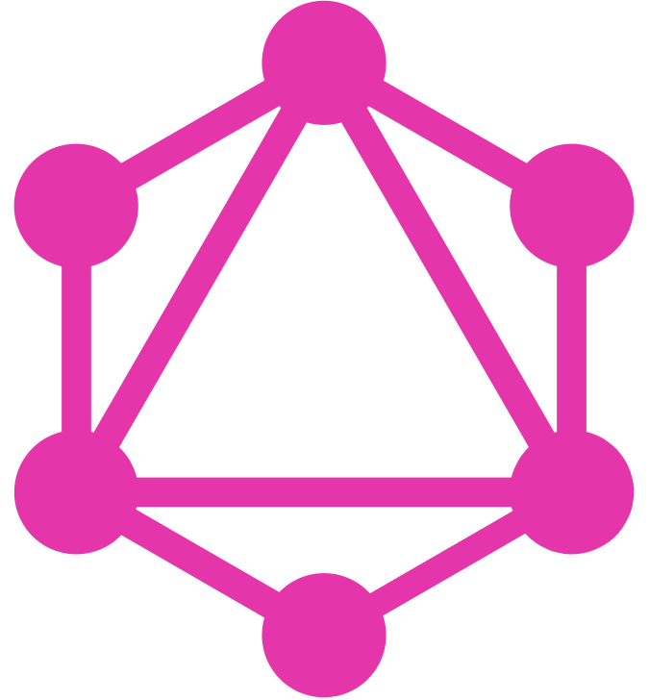





GraphQL Evolution
A data query language for building API
Developed to cope with the need for more flexibility and efficiency in client-server communication.
GraphQL was developed internally by Facebook in 2012 before being publicly released in 2015.
GraphQL project was moved from Facebook to the newly-established GraphQL Foundation, hosted by the non-profit Linux Foundation.
Open Source version published in July 2015
Specification : https://facebook.github.io/graphql

Slide 5

GraphQL – Faster Time to Market
Features
Unified Query Language
Schema Definition Language(SDL)
Query/Mutation/Subscriptions (server to client : websockets)
Multiple data sources (database/REST/SOAP/…)
Unified Data exchange format – JSON
Type safe on IDE/CLI (developers delight)
Efficient v/s traditional REST
Accessing multiple endpoints with single query
No more Over/Under Fetching
Rapid Product Iterations on the Front End
Good Analytics insight on backend(data model)

Slide 6
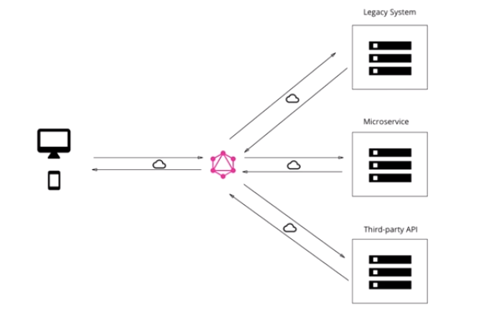
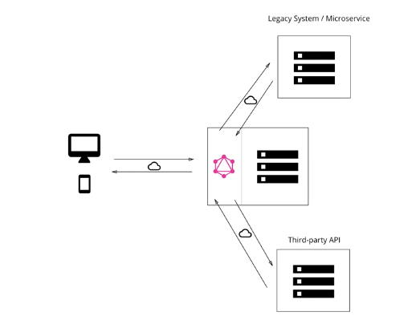
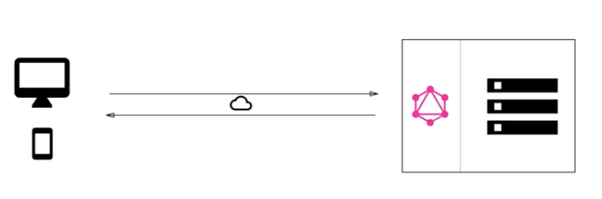
GraphQL – Architecture
GraphQL is only specification
Declarative Data Fetching (data model driven architecture/design)
Architectural use cases
GraphQL server with a connected database
GraphQL server to integrate existing system
A hybrid approach with a connected database and integration of existing system
Front end developers friend since data fetching complex can be pushed to the server side and client doesn’t care where data is coming from. Front end can ask for exactly what is required.

Slide 7
Unified Customer Experience
Customer ( Internal Business Units & Hospital )
Enables iterating through ideas without cross-BIU inertia
Achieves the corporate mission of inter-operability
Builds synergies across different business units
Does not need BIG BANG corporate initiative like data virtualization, Unified data model, does need consistent semantic model
Radiology
Product
Clinical
Product
Cardiology
Product
Business Unit
Business Unit
Business Unit
PACS
EMR
Cardiology
Hospital System Data

Slide 8
Our Experience – GraphQL on Performance Bridge
Drop-in replacement of GraphQL platform on existing PostgreSQL db
Expansion – with seamless transition
Very minimal impact to existing install base
Low footprint - no additional resources
Self discovery of data model
IDE integration – improved productivity
Quick learning curve
Apps
Apps
New Apps
New Apps
New Apps
Legacy SDK
Modern SDK
Legacy Platform
GraphQL Platform
PostgreSQL DB

Slide 9
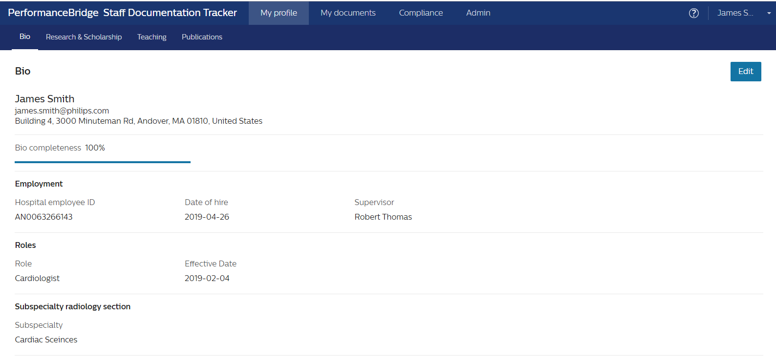
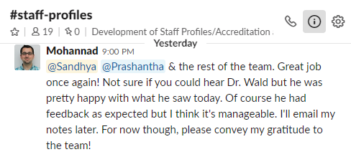

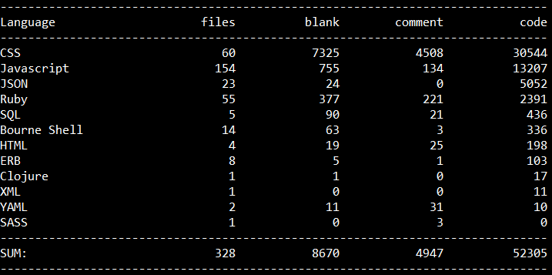
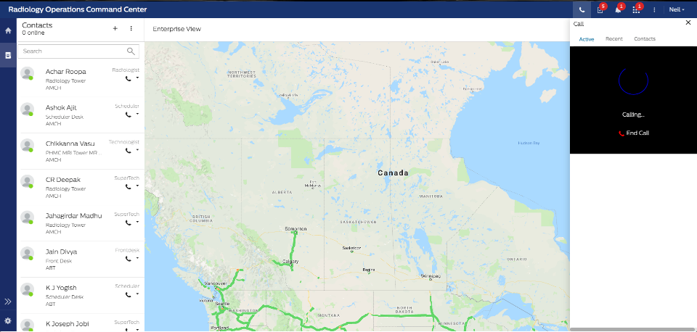

Our Experience – GraphQL on Performance Bridge
Enable across BU’s
3 dev @
5 weeks
Save
Cost

Slide 10
Hands-on Part 1: GraphQL Query, Mutations and Subscriptions
GraphQL Query
GraphQL Mutation
GraphQL Subscription

Slide 11
books
id(integer) | person_id(integer) | title(text) | price(integer) | genre_id(integer) | publication_date(date)
Primary Key
id- books_pkey
Foreign Keys
genre_id → genres . id - books_genre_id_fkey
person_id → persons . id - books_person_id_fkey
persons
id(integer) | name(text) | age(integer) | city(text) | phone(text)
Primary Key
id - persons_pkey
Primary key
id - genres_pkey
genres
id(integer) | type(text)

Slide 12
Hands-on Part 2: Building an application using GraphQL
React Application
Plot a graph : No. Of Books by Genre
Plot a graph : No. Of Books by Person
Run Query : Mutation
Subscription

Slide 13
Hands-on Part 3: Migration to GraphQL from Legacy API with introduction to GraphQL resolvers
GraphQL queries/mutations consists of number of fields.
GraphQL server consists of resolver functions for every field.
Each resolver function is to retrieve the data for its corresponding field.

