Slide 1
Toxicity Analysis Using NLP
Subrat Kumar Samal

Slide 2
Dataset(s)
The data set used is “train.csv” as in Toxicity Project Assessment

Slide 3
Motivation
This project is an Exploratory Data analysis on the toxic comments using NLP and Machine learning Techniques.
The unstructured data was clea.ned using NLP techniques so as to be made available for analysis using Machine learning algorithms

Slide 4
Findings
The Toxic: Non-toxic comments as in the input file is approximately 1:10
Upon tokenization and finding top 5 contextual words as
['please', 'talk', 'wikipedia', 'page', 'article’]
The values for Recall and Precision for class 1 are always 0 on using SVC.The result is same when model is used for Train data as well. This implies that the model seems to focus on the 0s only. So we need to tune the hyperparameters
Upon using GridSearch and StratifiedKFold we see improvement in Recall values along with optimized accuracy of 91% for the optimized SVM model

Slide 5
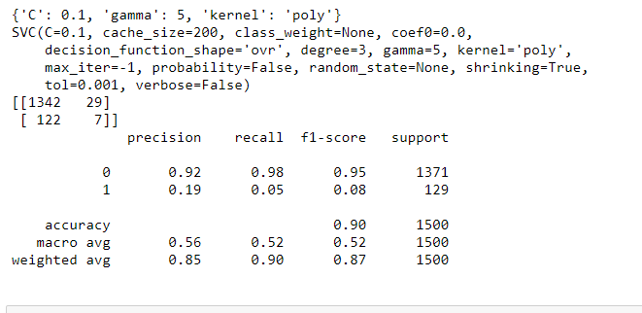
Test

Slide 6
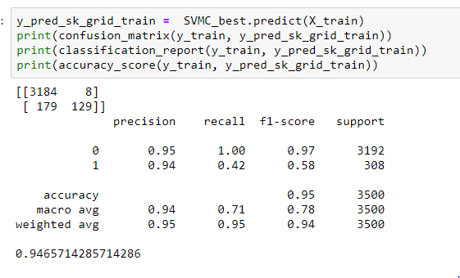
Train

Slide 7
