Slide 1
The Normal Forms
3NF and BCNF
BY
Jasbir Jassu

Slide 2
Preview
Normalization
Solution: Normal Forms
Introducing 3NF and BCNF
3NF
Examples
BCNF

Slide 3
Normalization
Normalization is the process of efficiently organizing data in a database with two goals in mind
First goal: eliminate redundant data
  for example, storing the same data in more than one table
Second Goal: ensure data dependencies make sense
  for example, only storing related data in a table

Slide 4
Benefits of Normalization
Less storage space
Quicker updates
Less data inconsistency
Clearer data relationships
Easier to add data
Flexible Structure

Slide 5
The Solution: Normal Forms
Bad database designs results in:
  redundancy: inefficient storage.
  anomalies: data inconsistency, difficulties in maintenance
1NF, 2NF, 3NF, BCNF are some of the early forms in the list that address this problem

Slide 6
Third Normal Form (3NF)
Meet all the requirements of the 1NF
Meet all the requirements of the 2NF
Remove columns that are not dependent upon the primary key.

Slide 7
1) First normal form -1NF
1NF : if all attribute values are atomic: no repeating group, no composite attributes.
The following table is not in 1NF
DPT_NO | MG_NO | EMP_NO | EMP_NM
D101 | 12345 | 20000 20001 20002 | Carl Sagan Mag James Larry Bird
D102 | 13456 | 30000 30001 | Jim Carter Paul Simon

Slide 8
Table in 1NF
DPT_NO | MG_NO | EMP_NO | EMP_NM
D101 | 12345 | 20000 | Carl Sagan
D101 | 12345 | 20001 | Mag James
D101 | 12345 | 20002 | Larry Bird
D102 | 13456 | 30000 | Jim Carter
D102 | 13456 | 30001 | Paul Simon
all attribute values are atomic because there are no repeating group and no composite attributes.

Slide 9
2) Second Normal Form
  Second normal form (2NF) further addresses the concept of removing duplicative data:
    A relation R is in 2NF if
      (a) R is 1NF , and
      (b) all non-prime attributes are fully dependent on the candidate keys. Which is creating relationships between these new tables and their predecessors through the use of foreign keys.
    A prime attribute appears in a candidate key.
    There is no partial dependency in 2NF.
    Example is next…

Slide 10
No dependencies on non-key attributes
Inventory
Description | Supplier | Cost | Supplier Address
There are two non-key fields. So, here are the questions:
If I know just Description, can I find out Cost? No, because we have more than one supplier for the same product.
If I know just Supplier, and I find out Cost? No, because I need to know what the Item is as well.
Therefore, Cost is fully, functionally dependent upon the ENTIRE PK (Description-Supplier) for its existence.
Inventory
Description | Supplier | Cost

Slide 11
CONTINUED…
Inventory
Description | Supplier | Cost | Supplier Address
If I know just Description, can I find out Supplier Address? No,
because we have more than one supplier for the same product.
If I know just Supplier, and I find out Supplier Address? Yes.
The Address does not depend upon the description of the item.
Therefore, Supplier Address is NOT functionally dependent upon the ENTIRE PK (Description-Supplier)
for its existence.
Supplier
Name | Supplier Address

Slide 12
So putting things together
Inventory
Description | Supplier | Cost | Supplier Address
Inventory
Description | Supplier | Cost
Supplier
Name | Supplier Address
The above relation is now in 2NF since the relation has no non-key attributes.

Slide 13
3) Remove columns that are not dependent upon the primary key.
So for every nontrivial functional dependency X --> A,
(1) X is a superkey, or
(2) A is a prime (key) attribute.

Slide 14
Example of 3NF
Books
Name | Author's Name | Author's Non-de Plume | # of Pages
If I know # of Pages, can I find out Author's Name? No. Can I find out Author's Non-de Plume? No.
If I know Author's Name, can I find out # of Pages? No. Can I find out Author's Non-de Plume? YES.
Therefore, Author's Non-de Plume is functionally dependent upon Author's Name, not the PK for its existence. It has to go.
Books
Name | Author's Name | # of Pages
Author
Name | Non-de Plume

Slide 15
Another example: Suppose we have relation S
S(SUPP#, PART#, SNAME, QUANTITY) with the following assumptions:
(1) SUPP# is unique for every supplier.
(2) SNAME is unique for every supplier.
(3) QUANTITY is the accumulated quantities of a part supplied by a supplier.
(4) A supplier can supply more than one part.
(5) A part can be supplied by more than one supplier.
We can find the following nontrivial functional dependencies:
(1) SUPP# --> SNAME
(2) SNAME --> SUPP#
(3) SUPP# PART# --> QUANTITY
(4) SNAME PART# --> QUANTITY
The candidate keys are:
(1) SUPP# PART#
(2) SNAME PART#
The relation is in 3NF.

Slide 16
The table in 3NF
SUPP# | SNAME | PART# | QTY
S1 | Yues | P1 | 100
S1 | Yues | P2 | 200
S2 | Yues | P3 | 250
S2 | Jones | P1 | 300

Slide 17
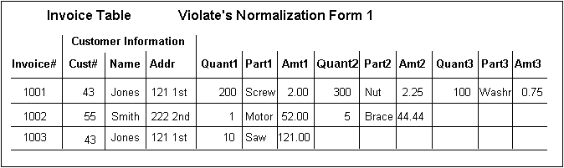
Example with first three forms
Suppose we have this Invoice Table
First Normal Form: No repeating groups.
The above table violates 1NF because it has columns for the first, second, and third line item.
Solution: you make a separate line item table, with it's own key, in this case the combination of invoice number and line number

Slide 18
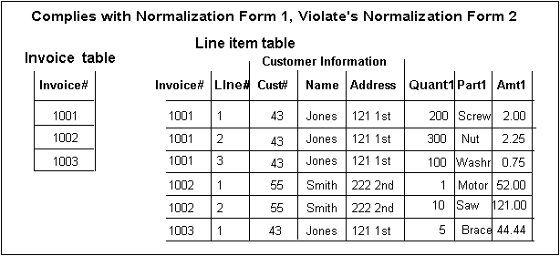
Table now in 1NF

Slide 19
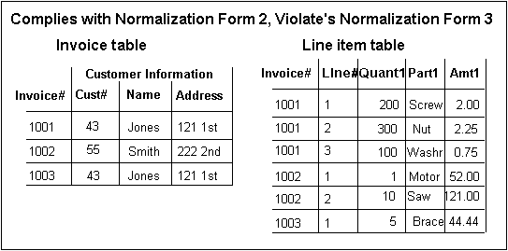
Second Normal Form:
Each column must depend on the *entire* primary key.

Slide 20
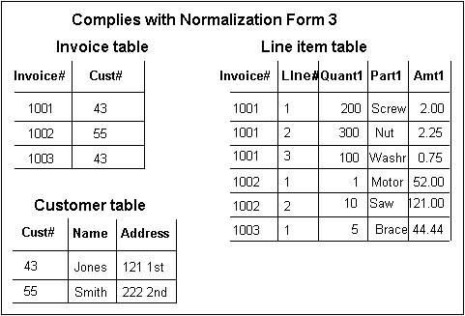
Third Normal Form:
Each column must depend on *directly* on the primary key.

Slide 21
Boyce-Codd Normal Form (BCNF)
Boyce-Codd normal form (BCNF)
A relation is in BCNF, if and only if, every determinant is a
candidate key.
The difference between 3NF and BCNF is that for a functional
dependency A → B, 3NF allows this dependency in a relation
if B is a primary-key attribute and A is not a candidate key,
whereas BCNF insists that for this dependency to remain in a
relation, A must be a candidate key.

Slide 22
ClientInterview
ClientNo | interviewDate | interviewTime | staffNo | roomNo
CR76 | 13-May-02 | 10.30 | SG5 | G101
CR76 | 13-May-02 | 12.00 | SG5 | G101
CR74 | 13-May-02 | 12.00 | SG37 | G102
CR56 | 1-Jul-02 | 10.30 | SG5 | G102
FD1 clientNo, interviewDate → interviewTime, staffNo, roomNo (Primary Key)
FD2 staffNo, interviewDate, interviewTime→ clientNo (Candidate key)
FD3 roomNo, interviewDate, interviewTime → clientNo, staffNo (Candidate key)
FD4 staffNo, interviewDate → roomNo (not a candidate key)
As a consequece the ClientInterview relation may suffer from update anmalies.
For example, two tuples have to be updated if the roomNo need be changed for staffNo SG5 on the 13-May-02.

Slide 23
Example of BCNF(2)
To transform the ClientInterview relation to BCNF, we must remove the violating functional dependency by creating two new relations called Interview and StaffRoom as shown below,
Interview (clientNo, interviewDate, interviewTime, staffNo)
StaffRoom(staffNo, interviewDate, roomNo)
Interview
ClientNo | interviewDate | interviewTime | staffNo
CR76 | 13-May-02 | 10.30 | SG5
CR76 | 13-May-02 | 12.00 | SG5
CR74 | 13-May-02 | 12.00 | SG37
CR56 | 1-Jul-02 | 10.30 | SG5
StaffRoom
staffNo | interviewDate | roomNo
SG5 | 13-May-02 | G101
SG37 | 13-May-02 | G102
SG5 | 1-Jul-02 | G102
BCNF Interview and StaffRoom relations

Slide 24
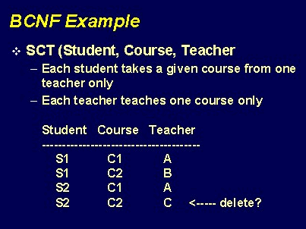
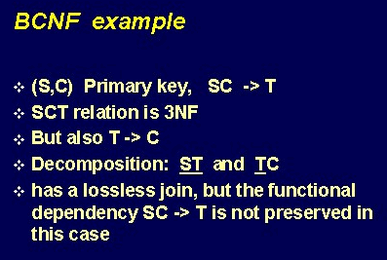
Another BCNF Example
Example taken from Dr. Lee’s 2004 lecture notes

Slide 25
Sources:
http://www.troubleshooters.com/littstip/ltnorm.html
http://www.cs.jcu.edu.au/Subjects/cp1500/1998/Lecture_Notes/normalisation/3nf.html
Dr. Lee’s Fall 2004 lecture notes

