Slide 1

Human Computer Interaction Based On Eye Gaze Estimation
By
T MOHAMMED AAZAM
(15001A0501)
SUBRATA DAS
(15001A0563)
Under the guidance of
Dr. A. ANANDA RAO B.Sc.,B.Tech.,M.Tech., Ph.D(IITM).
Professor & Director (Research and Development)
Department of Computer Science & Engineering
JNTUA College of Engineering, Ananthapuramu.
(Autonomous)
2018-2019

Slide 2
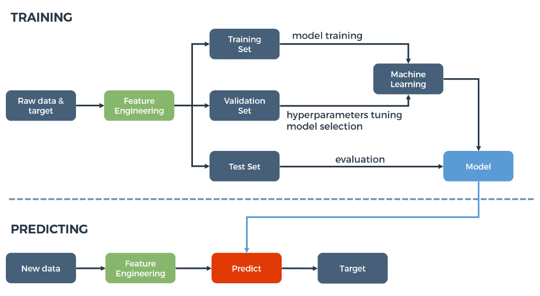
INTRODUCTION
MACHINE LEARNING:
Machine learning (ML) is a method of…
data analysis that automates analytics model building
identifies new cases
In this method we can get
Two major parts…
Training
Prediction

Slide 3
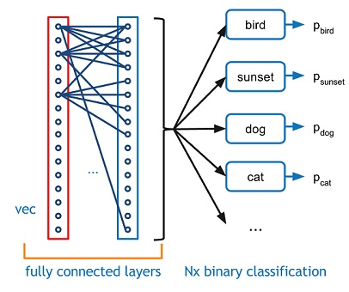
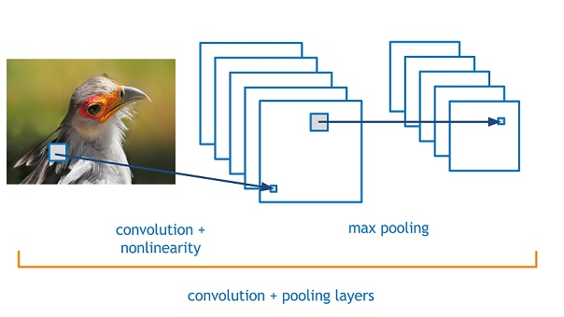
INTRODUCTION(Contd.)
Convolution Neural Network:
A Convolutional Neural Network (CNN) is comprised of one or more convolutional layers and then followed by one or more fully connected layers as in a standard multilayer neural network.
There are four layered concepts we should understand in Convolutional Neural Networks:
Convolution
ReLU
Pooling
Full Connectedness

Slide 4
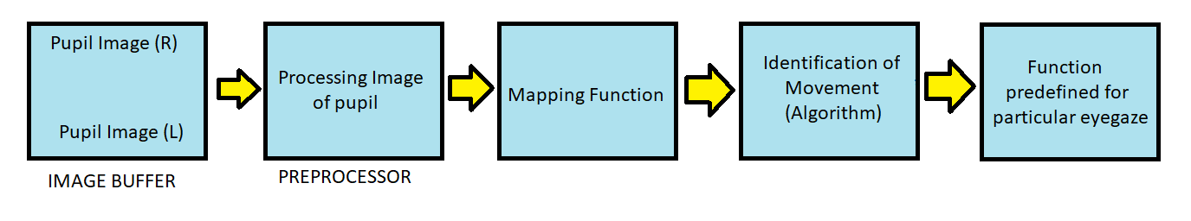
EXISTING SYSTEM
Eye Gaze Detection System for Impaired User GUI Control was implemented by using in
determining the point in space at which a person is focusing visual attention.
This system is developed for………..
Empowering impaired users with the ability to control the pointing and selection of components in a User Interface (UI) typically done by mouse and keyboard, with eye movement.
In the existing system …..
Eye Motion
Non-intrusive Camera-based Systems
Image Difference Method with Glint Detection
Algorithm to detect pupil and pupil movement
Gaze Selection

Slide 5
Proposed System:
OBJECTIVE:
The Objective Of Our Project Is To Construct An Eye Gaze Direction Controlled Robotic Car With Help Of
Convolutional Neural Network.
EYE DETECTION:
Appearance-based Method And Pattern based Methods
Cozzi Et Al. And In Huang Et Al. Used Machine Learning Algorithm SVM On Extracted Features.
Some Researchers Tried To Detect Eye Region Using Convolutional Neural Network
Eye Gaze Estimation:
Three Approaches : Appearance-based ,Shape-based And Component Separation Zhang Et Al. Combine
The Data From Face Pose Estimator And Eye Region Using A CNN
Model And Trained A Regression Model In The Output Layer

Slide 6
PROPOSED SYSTEM
The system functionality flow is described below……….
GETTING
IMAGE BY
CAMERA
Start
Processing
by machine
Processing Of Image Using Deep Learning Based Gaze Estimation Algorithm In Python
Environment
Predefined
functions done by machine
Transmitting of information by Bluetooth
transmitter
Decode detected
gaze
in the image

Slide 7
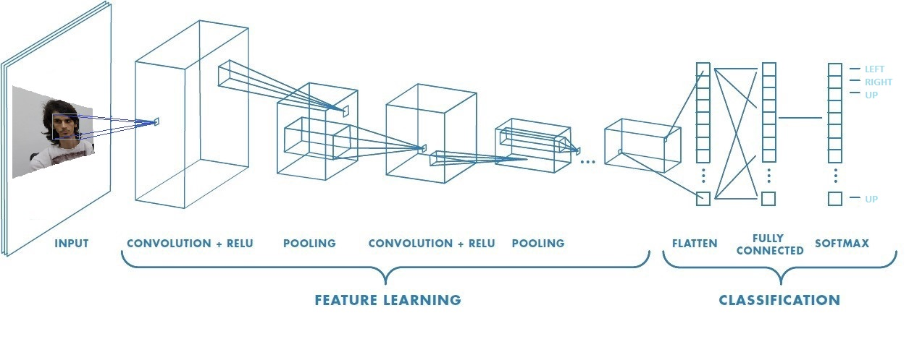
Convolution Neural Network:
A Convolutional Neural Network (CNN) is comprised of one or more convolutional layers and then followed by one or more fully connected layers as in a standard multilayer neural network.
In CNN there are …
Feature Learning
Classification
Feature Learning :
Convolution
ReLU
Pooling
Classification :
Flatten
Fully Connected
Softmax

Slide 8
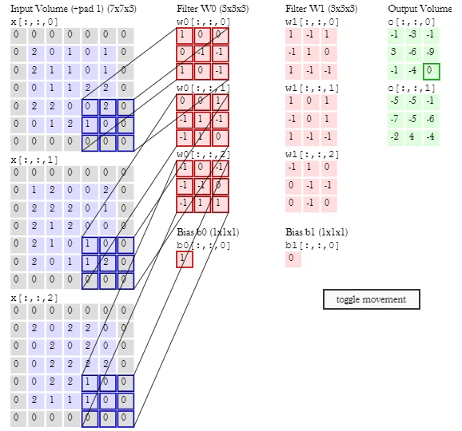
Convolution Layer :
A ConvNet is able to successfully capture the Spatial
and Temporal dependencies in an image through the
application and transfer it into a tensor data matrix
Here, Model will make filter and the filter is the dot product of the input matrix.
Filter will provide a bias matrix that is the output of the other neuron .
After that the output volume is created in the form of matrix.
Here ,
The objective of the Convolution Operation is to extract the
high-level features such as edges, from the input image.
In the built in Kernel of Convolution layer there are filters
That will convolute the image pixel value to the feature
matrix.

Slide 9
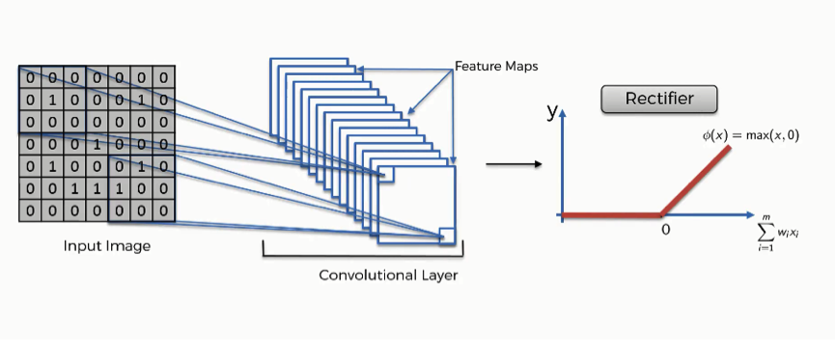
Rectified Linear Unit (ReLU):
The Rectified Linear Unit, or ReLU, is not a separate component of the convolutional neural networks' process.
At the time of convolution there may be some missing of data or noisy data are found .
If it is kept like that we can not perform feature extraction from the data .
This problem is solved by rectified the image passing through the code
Exposer change, flatten the image is done by the layer for easily understandable by the
machine.

Slide 10
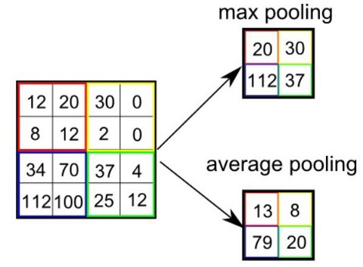
Pooling :
The Pooling layer is also responsible for reducing the spatial size of the Convolved Feature.
There are two types of Pooling: Max Pooling and Average Pooling.
Max Pooling returns the maximum value from the portion of the image covered by the Kernel. Max
Pooling also performs as a Noise Suppressant.
Average Pooling returns the average of all the values from
the portion of the image covered by the Kernel. Depending
on the complexities in the images, the number of such
layers may be increased for capturing low-levels details even
further, but at the cost of more computational power.
After that this neuron output is given to the next classification
Layer for detection .

Slide 11
Classification — Fully Connected Layer:
The fully connected (FC) layer in the CNN represents the feature vector for the input.
This feature vector/tensor/layer holds information that is vital to the input.
When the network gets trained,
this feature vector is then further use for classification, regression, or input into other
network like RNN for translating into other type of output, etc.
During training, this feature vector is being used to determine the loss, and help the
network to get train.
The convolution layers before the FC layer(s) hold information regarding local features in the input image such as edges, blobs, shapes, etc. Each conv layer hold several
filters that represent one of the local features.
The FC layer holds composite and aggregated information from all the conv
layers that matters the most.

Slide 12
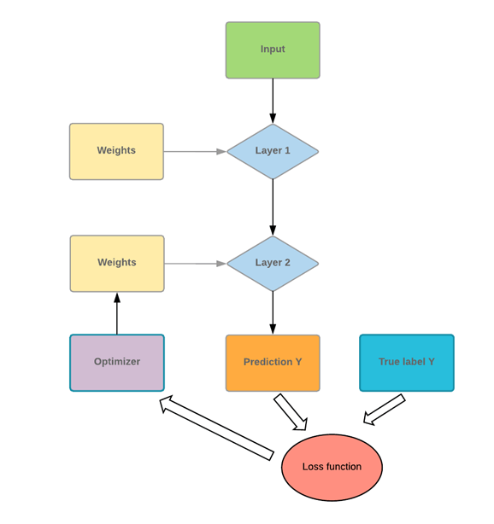
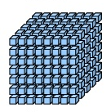
TensorFlow Library :
For fast numerical computation created and released by
GOOGLE
It will create deep learning model.
Determine data flow form one node to another.
Node, edges, operation are calculated by the image or data set
Compute probability of the layer for predicting object.
To make the image into a binary array.
Tensor is an multi-dimensional array that can store different weights at
a time in the array.
Here in the tensor the weight “w” and
The input “x” are added to the neural network.

Slide 13
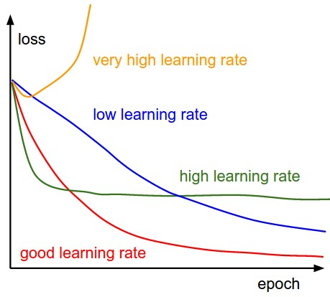
Loss, Accuracy, Learning rate :
Data set is divided into training, validation and testing .
At the time of validate the model what is used to get the validation loss that will update the weight for the model
Validation accuracy is a parameter that will identify the accuracy at the time of feeding the model.
Learning Rate…
How fast optimize the weight.
Too high model might skip the optimum solution.
Small learning rate too many iteration .
Epoch is a hypo parameter which is defined before training a model.
One epoch is when an entire dataset is passed both forward and
Backward though Neural Network only once.
So, divide it small batches
A batch is the total number of training examples present in a single both
and an iteration is the number of batches needed to complete one epoch.
2000 training 500 batches 4 Iteration for Feeding in one Epoch.

Slide 14
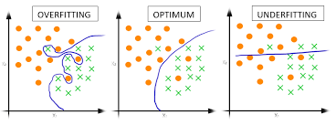
Confusion matrices:
Summary of prediction result on a classification problem
Correct and incorrect prediction are summarized with count values and broken down by
each class.
When is the confusion and when is the prediction.
Error of classifier and the types of error are being mode.
By drawing confusion matrices we
get an idea about the curve of overfitting
Optimum and underfitting fitting graph
Thus prediction will be more easy.

Slide 15
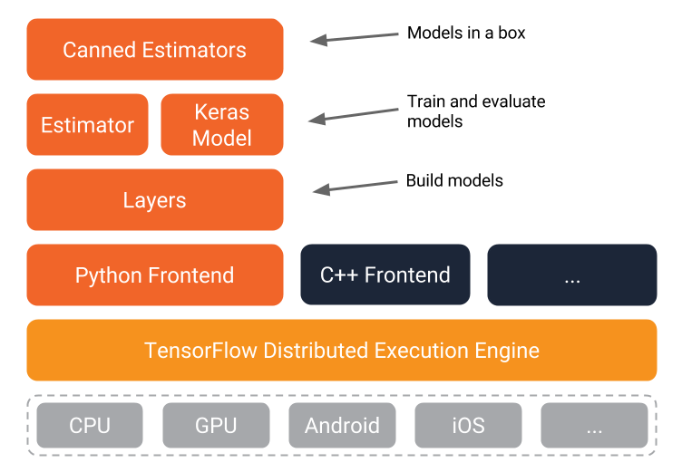
KERAS:
High level neural network API (PYTHON language written)
To RUN TensorFlow , CNTK or Theano
Reduce the cognitive load.
Reduce the number of use cases for API
Turns model into product.
Keras model is the training and the
Evaluation model that works above the
TensorFlow GPU .
Python used as a connector of TensorFlow
And Keras model data.

Slide 16
Conv1D convolution layer(e.g. temporal convolution):
By using the library of KERAS we can implement the layers :
CODE USED IN PROGRAM :
from keras.layers.convolutional import Conv1D, MaxPooling1D, Conv2D, MaxPooling2D,ZeroPadding2D,AveragePooling2D
Conv1D convolution layer(e.g. temporal convolution):
This layer creates a convolution kernel that is convolved with the layer input over a single spatial (or temporal) dimension to produce a tensor of outputs.
Input shape : 3D shape(batch, steps, channels)
Output shape: 3D shape(batch, steps, channels)

Slide 17
KERAS:
Conv2D:
This layer creates a convolution kernel that is convolved with the layer input to produce a tensor of outputs. If (use_bias) is True, a bias vector is created and added to the outputs. Finally, if activation is not None, it is applied to the outputs as well.
Input shape:
4D tensor with shape: (batch, channels, rows, cols) if data_format is "channels_first" or 4D tensor with shape: (batch, rows, cols, channels) if data_format is "channels_last".
Output Shape :
4D tensor with shape: (batch, filters, new_rows, new_cols) if data_format is "channels_first" or 4D tensor with shape: (batch, new_rows, new_cols, filters) if data_format is "channels_last". rowsand cols values might have changed due to padding.

Slide 18
KERAS:
MaxPooling1D:
Max pooling operation for temporal data.
CODE USED IN PROGRAM :
keras.layers.MaxPooling1D(pool_size=2, strides=None, padding='valid', data_format='channels_last’)
Input shape:
If data_format='channels_last': 3D tensor with shape: (batch_size, steps, features)
If data_format='channels_first': 3D tensor with shape: (batch_size, features, steps)
Output shape:
If data_format='channels_last': 3D tensor with shape: (batch_size, downsampled_steps, features)
If data_format='channels_first': 3D tensor with shape: (batch_size, features, downsampled_steps)
MaxPooling2D:
Max pooling operation for spatial data.
Input shape
If data_format='channels_last': 4D tensor with shape: (batch_size, rows, cols, channels)
If data_format='channels_first': 4D tensor with shape: (batch_size, channels, rows, cols)
Output shape
If data_format='channels_last': 4D tensor with shape: (batch_size, pooled_rows, pooled_cols, channels)
If data_format='channels_first': 4D tensor with shape: (batch_size, channels, pooled_rows, pooled_cols)

Slide 19
KERAS:
AveragePooling2D:
keras.layers.AveragePooling2D(pool_size=(2, 2), strides=None, padding='valid', data_format=None)
Average pooling operation for spatial data.
Input shape
If data_format='channels_last': 4D tensor with shape: (batch_size, rows, cols, channels)
If data_format='channels_first': 4D tensor with shape: (batch_size, channels, rows, cols)
Output shape
If data_format='channels_last': 4D tensor with shape: (batch_size, pooled_rows, pooled_cols, channels)
If data_format='channels_first': 4D tensor with shape: (batch_size, channels, pooled_rows, pooled_cols)
ZeroPadding2D
keras.layers.ZeroPadding2D(padding=(1, 1), data_format=None)
Zero-padding layer for 2D input (e.g. picture).
This layer can add rows and columns of zeros at the top, bottom, left and right side of an image tensor.

Slide 20
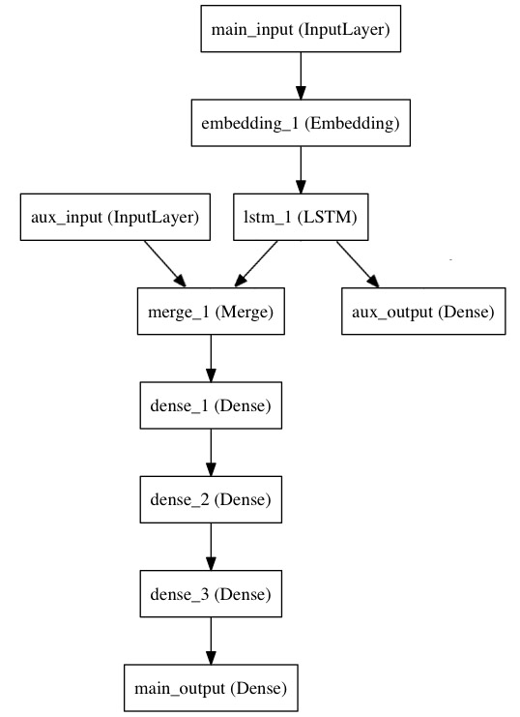
Multi-input and multi-output models:
The functional API: models with multiple inputs and
outputs. The functional API makes it easy to
manipulate a large number of intertwined data streams.
Let's consider the following model. To predict how
many right left operation. The main input to the model will be the headline itself, as a sequence of words, but to spice things up, our model will also have an
auxiliary input, receiving extra data such as the time of day when the headline was posted, etc. The model will also be supervised via two loss functions. Using the main loss function
earlier in a model is a good regularization mechanism for deep models.

Slide 21
How The program works :
Deep Learning :
Need to import all the libraries that will support all the function.
The path should be defined data_dir_list = os.listdir(data_path)
The images are transferred to the BGR to HSV colour-space.
After transferring the images should be resized and until all the images are being converted the process is iterative.
Both the eye will get the same data that are fed to the network.
After that from keras.layers.core import Dense, Dropout, Activation, Flatten and from keras.laye
s.convolutional import Convolution2D functions will turn the output to the model and feeding is started to the
layer .
7. Here 9 classes are initially defined and according to the analysis of the images, the prediction of gazes are detected.
Split the data set into training , validation and testing are done and the weight is being calculated .
Once weight is calculated then the data is put in activation layer , ReLU layer , Maxpooling layer and the next
forward weight for calculation is noted .
Then the epoch is defined and the batch size is put manually to do the iteration process for several time to get the
appropriate weight .

Slide 22
How The program works (CONTD.):
Activate tensorflow-gpu2 for getting the value in a 3D tensor
TensorFlow gpu will accelerate the computation of the code.
After calculating all the data , how well our code is performing , to manipulate that we plotted
The graph. Training_loss vs Validation_loss , true_label , training_accuracy vs validation _accuracy .
Normalization_confusion matrix, average loss and the accuracy of the data set is increased in every
Epoch.
Those data are saved in hdf5 file
The graph is visualized by the import matplotlib.pyplot as plt in the output window
Here one hot encoding is used .

Slide 23
One Hot Encoding:
Why to use One Hot Encoding :
Machine learning algorithm cannot work with categorical data at a time directly.
Categorical data must be converted into numbers .
This is required for both input and output variables that are categorical .
If there are different categories then the data are divided to sub categories.
The value should be decoded into binary vector.
Running the code of block will prints the sequence labels.
Then finally one hot encoding is done more efficiently by the deep learning keras library
For building the tensor it is needed to convert the data to binary encoded function for eye gazed detection.

Slide 24
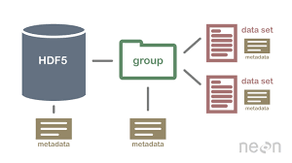
HDF5:
HDF5 is a unique technology suite that makes possible the management of extremely
large and complex data collections.
The HDF5 technology suite includes:
A versatile data model that can represent very complex data objects and a wide variety of
metadata.
A completely portable file format with no limit
on the number or size of data objects in the
collection.
A rich set of integrated performance features
that allow for access time and storage space
optimizations.
Tools and applications for managing,
manipulating, viewing, and analyzing the data in
the collection.

Slide 25
HDF5(CONTD.):
Why to use……..
For high volume and complex data manipulation
For flexible, efficient storage
Enable application to evolve in new model
To support long term data calculation
It has two parts…………
Container that holds the HDF5 file.
Array for holding the calculated weight .
NUMPY array is used to implement the array.
Later this file is used to classified the data in the new data set.

Slide 26
Testing:
For testing the calculated weights and bias that are saved in .hdf5 file are given as an input :
loaded_merged_model=load_model('my_model_our_dataset2_revised.hdf5’)
Then the facial 68 points of the face that is saved in the shape_predictor_68_face_landmarks.dat file is used to find the face and the eye locations .
The convoluted layer, maxpooling and the ReLU layer are calculated with the weights in the .hdf5 file .
Most higher prediction value is the output of the direction.

Slide 27
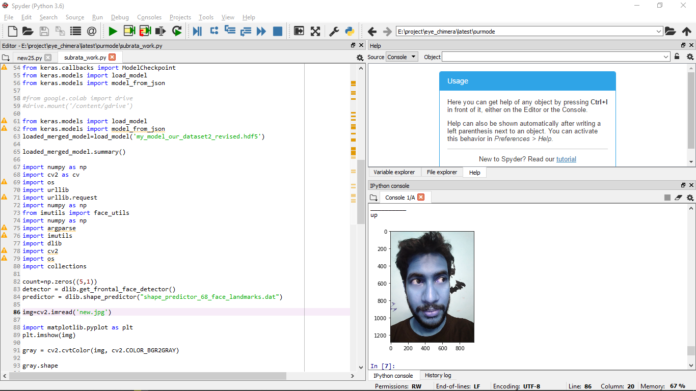
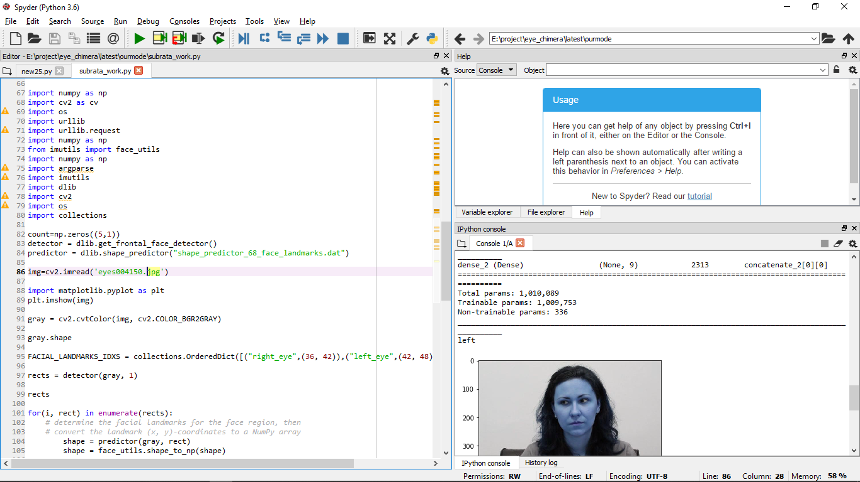
Testing result :

Slide 28
Programs working by basic ML:
Our algo
Analysis
eye_chimera DataSet
.hdf5 file
Our algo
Model building
Our image
Algo with
shape predictor
Up left right
down centre

Slide 29
CONCLUSION:
Previous eye gaze detection techniques are intrusive and it is too hard to determine the
Eye movement accurately .Here simple camera is used to detect the eye from the whole
environment .
Here the deep learning algorithm that depends on the Convolutional Neural Network has
out performed all state of the out results.
If a deeper network is used for detection the accuracy might be increased but the system will become much slower . So a limited neuron based system is developed here.
The whole system has taken less cost because we have used the mobile camera to take
Input.
If at the place of robotic car, the arm and the computer interaction module can be used
that can give the game controller and the support to the handicaped people .

Slide 30
References
1.Paralysis Facts & Figures-Spinal Cord Injury-Paralysis Research Center. Christopherreeve.org.Retrieved 2013 02-19. 2. cureresearch.com, Statistics by Country for Paralysis,[Online].2005. Available: www: cureresearch: com =p = paralysis=stats-country printer:html: 3. M. Eizenman, T. Jares, and A. Smiley, A new methodology for the analysis of eye movementsand visual scanning in drivers, in Proc. 31st An. Conf. Erg. & Safety, Hall, Quebec, Canada,1999. 4. J. L. Harbluk, I. Y. Noy, and M. Eizenman, The impact of cognitive distraction on driver visualand vehicle control, in Proc. Transp. Res. Board 81st An. Meet., Washington, DC, USA, Jan.2002. 5. D. Cleveland, Unobtrusive eyelid closure and visual point of regard measurement system, inProc. Tech. Conf. on Ocular Measures of Driver Alertness, sponsored by The Federal Highay Administration Office of Motor Carrier and Highway Safety and The National Highway Traffic Safety Administration Office of Vehicle Safety Research, Herndon, VA, USA, 1999, pp. 57- 74.

Slide 31
References
6. P. A. Wetzel, G. Krueger-Anderson, C. Poprik, and P. Bascom, An eye tracking system for analysis of pilots scan paths, United States Air Force Armstrong Laboratory, Tech. Rep. AL/HR-TR-1996-0145, Apr. 1997. 7. J. H. Goldberg and X. P. Kotval, Computer interface evaluation using eye movements: methods and constructs, Int. J. Ind. Erg., vol. 24, no. 6, pp. 631-645, Oct. 1999. Parana, Entre Rios, Argentina, in 2000. 8. Wedel, M.; Pieters, R. (2000). ”Eye fixations on advertisements and memory for brands: a model and findings”. Marketing Science. 9. M. Eizenman, L. H. Yu, L. Grupp, E. Eizenman, M. Ellenbogen, M. Gemar, and R. D. Levitan, A naturalistic visual scanning approach to assess selective attention in major depressive disorder, Psychiat. Res., vol. 118, no. 2, pp. 117-128, May 2003. 10. D. W. Hansen and Q. Ji. In the eye of the beholder: A survey of models for eyes and gaze.PAMI, 2010. 11. E. D. Guestrin and M. Eizenman, ”General theory of remote gaze estimation using the
pupil center and corneal reflections,” in IEEE Transactions on Biomedical Engineering, vol. 53, no.6, pp. 1124-1133, June 2006.

Slide 32
Thank you ALL

