Slide 1

Introduction to OpenGL and GLUT
GLUT

Slide 2
Outline
OpenGL & GLUT basics
  Grpahics Pipeline
  2-D drawing
  User interaction

Slide 3
What is OpenGL?
An application programming interface (API)
A (low-level) Graphics rendering API
Generate high-quality color images composed of geometric and image primitives

Slide 4
Maximal Portability
Display device independent
Window system independent
Operating system independent
Without a standard API (such as OpenGL) - impossible to port
(100, 50)
Line(100,50,150,80) - device/lib 1
Moveto(100,50) - device/lib 2
Lineto(150,100)
(150, 100)

Slide 5
OpenGL Basics
OpenGL’s primary function – Rendering
Rendering? – converting geometric/mathematical object descriptions into frame buffer values
OpenGL can render:
  Geometric primitives
  Bitmaps and Images (Raster primitives)

Slide 6
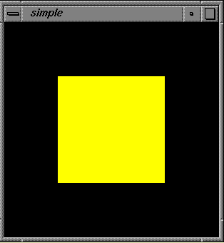
Code Example
void Display()
{
glClear(GL_COLOR_BUFFER_BIT);
glColor4f(1,1,0,1);
glBegin(GL_POLYGON);
glVertex2f(-0.5, -0.5);
glVertex2f(-0.5, 0.5);
glVertex2f(0.5, 0.5);
glVertex2f(0.5, -0.5);
glEnd();
glFlush();
}
….

Slide 7
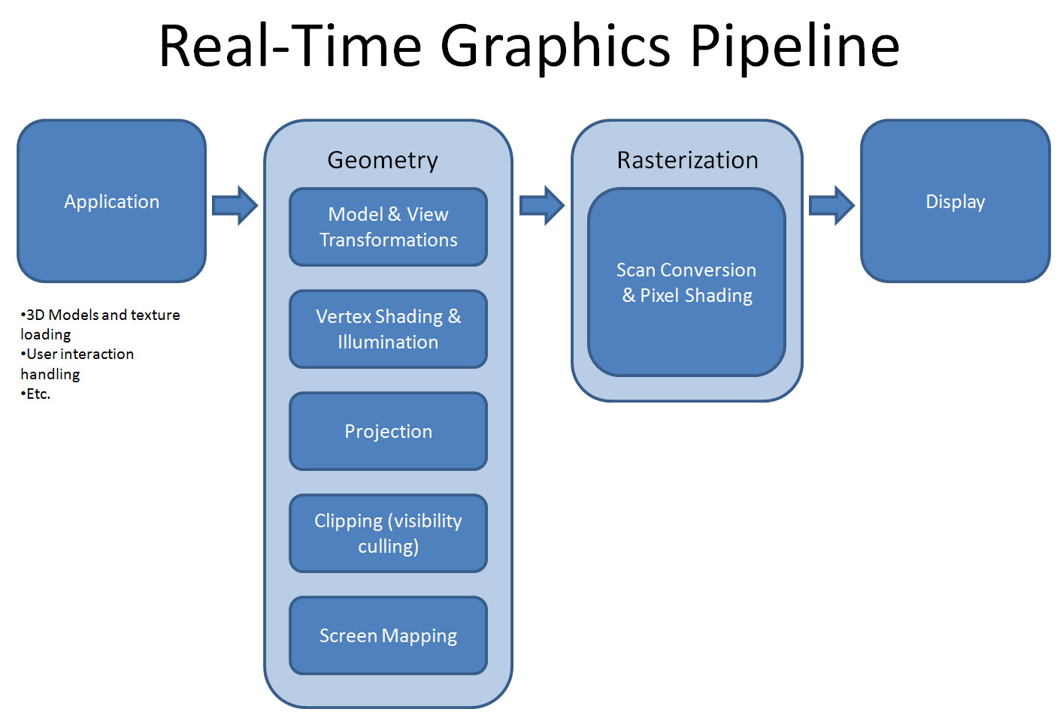
Graphics Pipeline

Slide 8
OpenGL – What is It?
GL (Graphics Library): Library of 2-D, 3-D drawing primitives and operations
  API for 3-D hardware acceleration
GLU (GL Utilities): Miscellaneous functions dealing with camera set-up and higher-level shape descriptions
GLUT (GL Utility Toolkit): Window-system independent toolkit with numerous utility functions, mostly dealing with user interface

Slide 9
Event-driven GLUT program structure
1. Configure and open window
2. Initialize OpenGL state, program variables
3. Register callback functions
• Display (where rendering occurs)
• Resize
• User input: keyboard, mouse clicks, motion, etc.
4. Enter event processing loop

Slide 10
Call Back Function
A callback function is a function passed into another function as an argument, which is then invoked inside the outer function to complete some kind of routine or action.
In C, a callback function is a function that is called through a function pointer

Slide 11
Simple OpenGL program
#include <stdio.h>
#include <GL/glut.h>
void main(int argc, char** argv)
{
  glutInit(&argc, argv); // configure and open window
  glutInitDisplayMode(GLUT_RGB | GLUT_DOUBLE);
  glutInitWindowSize(100, 100);
  glutCreateWindow(“hello”);
  init(); // set OpenGL states, variables
  glutDisplayFunc(display); // register callback routines
  glutKeyboardFunc(keyboard);
  glutMainLoop(); // enter event-driven loop
}

Slide 12
Configure and open window
• glutInit: Pass command-line flags on to GLUT
• glutInitDisplayMode: OR together bit masks to set modes on pixel type
• glutInitWindowSize, glutCreateWindow: Set drawing window attributes, then make it

Slide 13
Initialize OpenGL state
• init(): Set OpenGL state, program variables
– Use GL types/typedefs GLfloat, GLint, GL_TRUE, GL_FALSE, etc. for
cross-platform compatibility
void init() {
  glClearColor(0.0, 0.0, 0.0, 0.0);
  glMatrixMode(GL_PROJECTION);
  glLoadIdentity();
  gluOrtho2D(0, right, 0, top);
}
sets “units” of subsequent draw commands

Slide 14
OpenGL screen coordinates
• Bottom left corner is origin
• gluOrtho2D() sets the units of the screen
coordinate system
•gluOrtho2D(0, w, 0, h) means the
coordinates are in units of pixels
•gluOrtho2D(0, 1, 0, 1) means the
coordinates are in units of “fractions of window
size” (regardless of actual window size)
glOrtho2D(L,R,B,T);

Slide 15
glutInitWindowSize sets the size of the window.
Use glViewport to specify the window region in window coordinates to be drawn to.
gluOrtho2D specifies the coordinates to be used with the viewport which defaults to the window size.

Slide 16
So, if you want create a 400 x 400 window and only want to draw to the rectangle(50, 50, 350, 350) within the window, then use glViewport(50, 50, 350, 350). You would then use gluOrtho2D to set your GL coordinates wthin the viewport. So, if you used gluOrtho2D(-1.0, 1.0, -1.0, 1.0) then visible GL coordinates would range from -1.0 to 1.0 in the x direction, from -1.0 to 1.0 in the y direction.

Slide 17
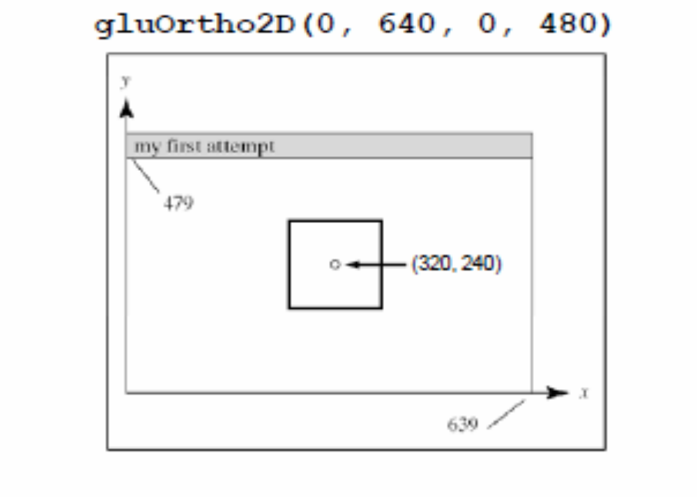
Example: Specifying the center of a square

Slide 18
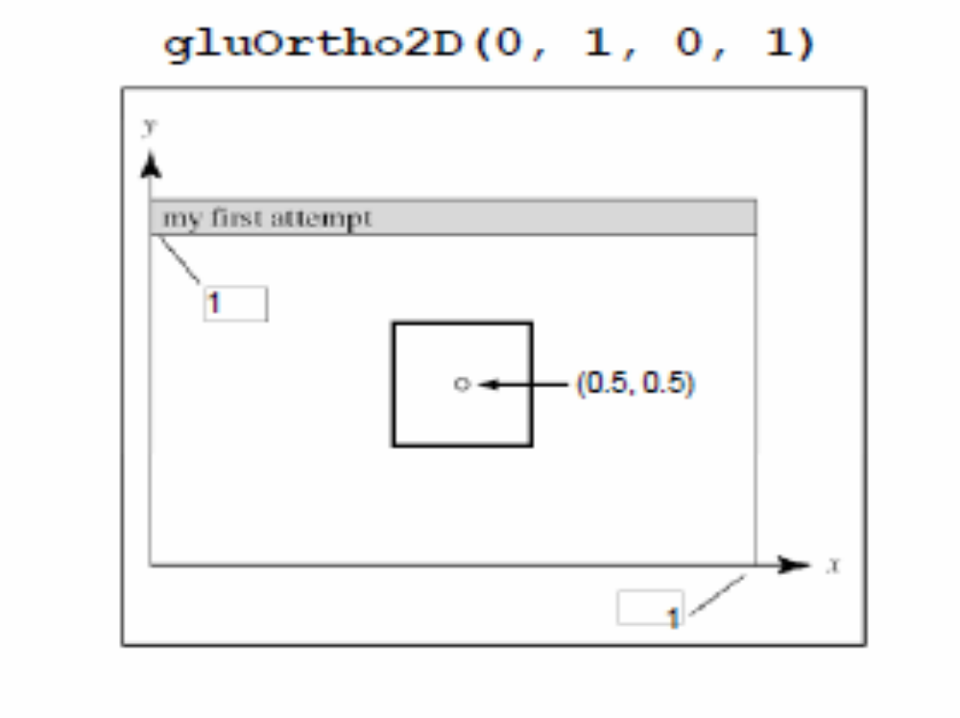
Example: Specifying the center of a square

Slide 19
A complete OpenGL program
#include <stdio.h>
#include <GL/glut.h>
void main(int argc, char** argv)
{
  glutInit(&argc, argv);
  glutInitDisplayMode (GLUT_SINGLE | GLUT_RGB);
  glutInitWindowSize (640, 480);
  glutInitWindowPosition (100, 150);
  glutCreateWindow ("my first attempt");
  glutDisplayFunc(myDisplay);
  myInit ();
  glutMainLoop();
}

Slide 20
A complete OpenGL program (cont.)
void myDisplay(void)
{
  glClear (GL_COLOR_BUFFER_BIT);
  glColor3f (0.0, 0.0, 0.0);
  glPointSize(4.0);
  glBegin(GL_POINTS);
  glVertex2i(100, 50);
  glVertex2i(100, 130);
  glVertex2i(150, 130);
  glEnd();
  glFlush ();
}

Slide 21
A complete OpenGL program (cont.)
void myInit (void)
{
  glClearColor(1.0, 1.0, 1.0, 0.0);
  glColor3f(0.0f, 0.0f, 0.0f);
  glPointSize(4.0);
  glMatrixMode(GL_PROJECTION);
  glLoadIdentity();
  gluOrtho2D(0.0, 640.0, 0.0, 480.0);
}

Slide 22
Rendering Steps
In function registered with glutDisplayFunc():
1. Clear window
• glClear(GL_COLOR_BUFFER_BIT);
2. Draw shapes
• Set colors, patterns, point/line sizes
• Specify type of geometric primitive(s) and list vertices
3. Swap buffers if display mode is GLUT_DOUBLE
4. Force all operations to complete with glFlush()

Slide 23
Single- vs. double-buffering
• Single-buffering: Draw directly to screen buffer
• Double-buffering: Draw to offscreen
buffer, then make that the screen buffer when done
• For animation, double-buffering is better because it eliminates flickering

Slide 24
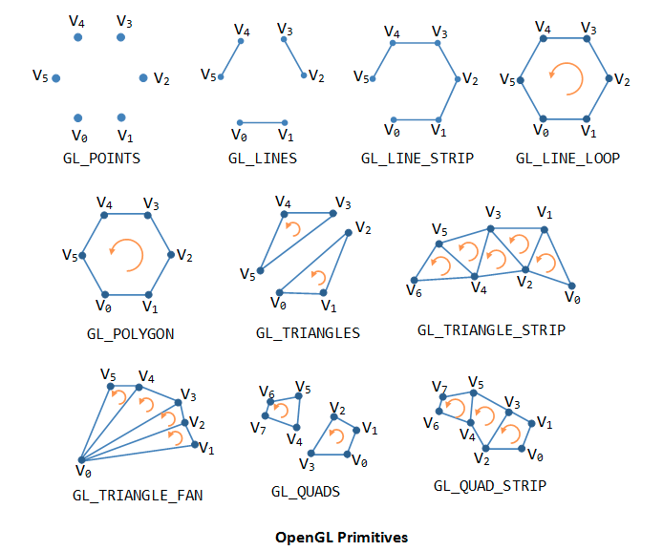
OpenGL Geometric Primitives

Slide 25
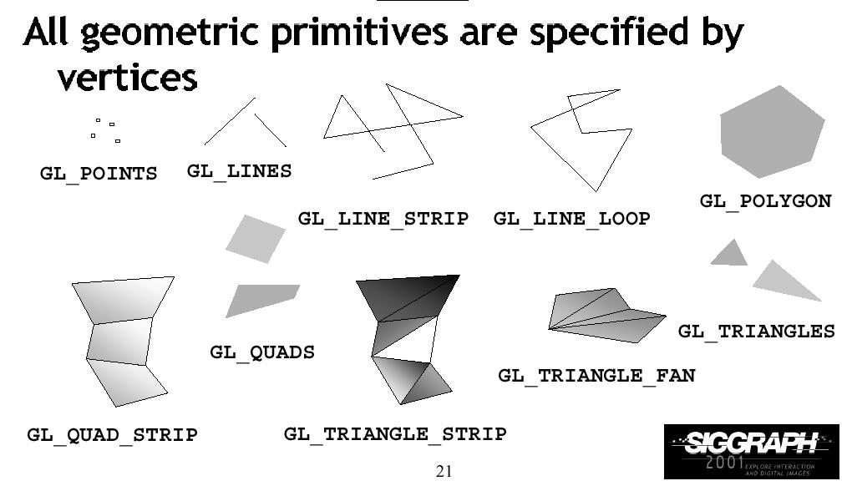
Primitive Types

Slide 26
Sample Example
Void DrawQuad(GLfloat color[])
{
glColor3f(0,0,1);
glBegin(GL_QUADS);
glVertex2f(0,0);
glVertex2f(1.0, 0,0);
glVertex2f(1.0, 1.0);
glVertex2f(0.0, 1.0);
glEnd();
}

Slide 27
OpenGL Command Formats
glVertex2f(x, y)
Add ‘v’ for vector
form
glVertex2fv(v)
number of
Components/
Dimensions
2 – (x,y)
3 – (x,y,z)
4 – (x,y,z,w) or
(r,g,b,a)
B – byte
ub – unsigned byte
s – short
us – unsigned short
i – int
ui – unsigned int
f – float
d – double

Slide 28
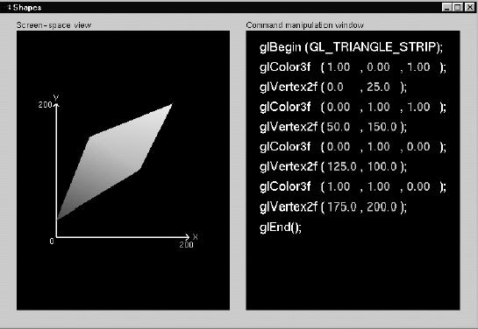
Shape Example

Slide 29
Use GLUT (OpenGL Utility Toolkit)
For fast prototyping, we can use GLUT to interface with different window systems
GLUT is a window independent API – programs written using OpenGL and GLUT can be ported to X windows, MS windows, and Macintosh with no effort

Slide 30
GLUT Basics
GLUT
Program Structure
Configure and open window (GLUT)
Initialize OpenGL (Optional)
Register input callback functions (GLUT)
  Render
  Resize
  Input: keyboard, mouse, etc
Enter event processing loop (GLUT)

Slide 31
Sample Program
GLUT
#include <GL/glut.h>
#include <GL/gl.h>
Void main(int argc, char** argv)
{
int mode = GLUT_RGB|GLUT_SINGLE;
glutInitDisplayMode(mode);
glutInitWindowSize(500,500);
glutCreateWindow(argv[0]);
init();
glutDisplayFunc(display);
glutKeyboardFunc(key);
glutMainLoop();
}

Slide 32
Sample Program
GLUT
#include <GL/glut.h>
#include <GL/gl.h>
Void main(int argc, char** argv)
{
int mode = GLUT_RGB|GLUT_SINGLE;
glutInitDisplayMode(mode);
glutInitWindowSize(500,500);
glutCreateWindow(“Simple”);
init();
glutDisplayFunc(display);
glutKeyboardFunc(key);
glutMainLoop();
}
Specify the display
Mode – RGB or color
Index, single or double
Buffer

Slide 33
Sample Program
GLUT
#include <GL/glut.h>
#include <GL/gl.h>
Void main(int argc, char** argv)
{
int mode = GLUT_RGB|GLUT_SINGLE;
glutInitDisplayMode(mode);
glutInitWindowSize(500,500);
glutCreateWindow(“Simple”);
init();
glutDisplayFunc(display);
glutKeyboardFunc(key);
glutMainLoop();
}
Create a window
Named “simple”
with resolution
500 x 500

Slide 34
Sample Program
GLUT
#include <GL/glut.h>
#include <GL/gl.h>
Void main(int argc, char** argv)
{
int mode = GLUT_RGB|GLUT_SINGLE;
glutInitDisplayMode(mode);
glutInitWindowSize(500,500);
glutCreateWindow(“Simple”);
init();
glutDisplayFunc(display);
glutKeyboardFunc(key);
glutMainLoop();
}
Your OpenGL initialization
code (Optional)

Slide 35
Sample Program
GLUT
#include <GL/glut.h>
#include <GL/gl.h>
Void main(int argc, char** argv)
{
int mode = GLUT_RGB|GLUT_SINGLE;
glutInitDisplayMode(mode);
glutInitWindowSize(500,500);
glutCreateWindow(“Simple”);
init();
glutDisplayFunc(display);
glutKeyboardFunc(key);
glutMainLoop();
}
Register your call back
functions

Slide 36
Callback functions?
GLUT
Most of window-based programs are event-driven
– which means do nothing until an event happens, and then execute some pre-defined functions
Events – key press, mouse button press and release, window resize, etc.

Slide 37
GLUT
glutDisplayFunc(void (*func)(void) )
Void main(int argc, char** argv)
{
…
glutDisplayFunc(display);
…
}
void display() – the function
you provide. It contains all
the OpenGL drawing function
calls and will be called
when pixels in the window
need to be refreshed.

Slide 38
Event Queue
GLUT
Keyboard
Event queue
….
MainLoop()
Mouse
Window
Mouse_callback()
{
….
{
Keypress_callback()
{
….
{
window_callback()
{
….
{

Slide 39
And many more …
GLUT
glutKeyboardFunc() – register the callback that will be called when a key is pressed
glutMouseFunc() – register the callback that will be called when a mouse button is pressed
glutMotionFunc() – register the callback that will be called when the mouse is in motion while a buton is pressed
glutIdleFunc() – register the callback that will be called when nothing is going on (no event)

Slide 40
glutMainLoop()
GLUT
#include <GL/glut.h>
#include <GL/gl.h>
Void main(int argc, char** argv)
{
int mode = GLUT_RGB|GLUT_SINGLE;
glutInitDisplayMode(mode);
glutInitWindowSize(500,500);
glutCreateWindow(“Simple”);
init();
glutDisplayFunc(display);
glutReshapeFunc(resize);
glutKeyboardFunc(key);
glutMainLoop();
}
The program goes into a infinite
loop waiting for events

Slide 41
Windows Config: glut
Unzip glut-3.7.6-bin.zip and you will get
1. glut.h
2. glut32.dll
3. glut32.lib

