Slide 1


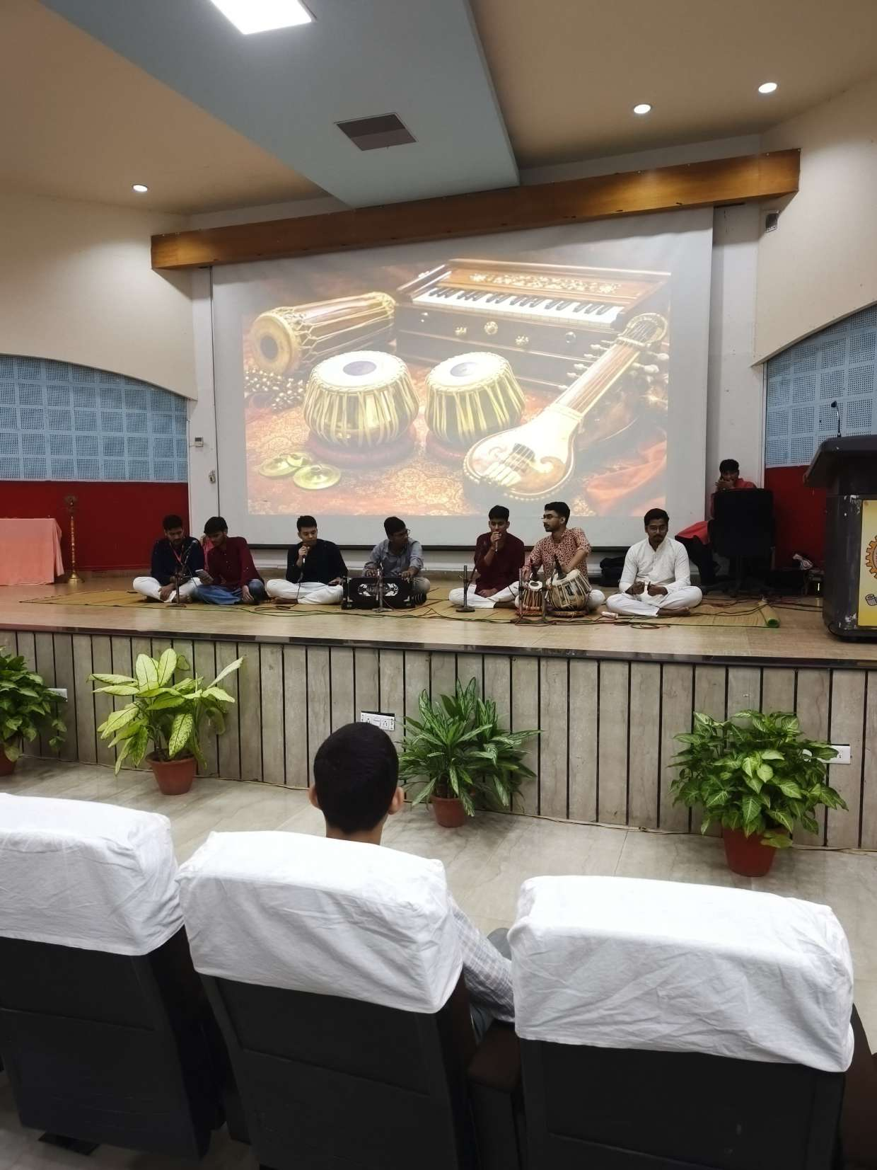
OFFICIAL DIGITAL IDENTITY & PLATFORM
ANAHAD BAND
अनहद मंडली • MNNIT ALLAHABAD
"Where Every Talent Finds Its Rhythm"
Music • Devotion • Culture • Creativity
A student-driven musical, spiritual, and cultural community at Motilal Nehru National Institute of Technology (MNNIT) Allahabad, uniting youth through bhajans, kirtans, theatre, and sacred Vedic traditions.
Live Stage Performance – Anahad Classical Ensemble
Seminar Hall, MNNIT Allahabad Campus

Slide 2
COMMUNITY OVERVIEW
About Anahad Band & Philosophical Ethos
Where Engineering Rigor Meets Sacred Cultural Heritage
Music (संगीत)
Classical ragas, light devotional vocals, harmonium, tabla, mridanga, acoustic guitars, and flute.
Devotion (भक्ति)
Congregational Harinam Sankirtan, Sri Ram Navami, Janmashtami, and Deepotsav celebrations.
Culture (संस्कृति)
Sanatana theatrical drama, Ramayana enactments, sacred rangoli arts, and Vedic rituals.
Creativity (सृजन)
Scriptwriting, bulletin art boards, acoustic jam sessions, and inclusive student collaboration.
The Philosophy of "Anāhata Nāda" (अनहद नाद):
In Indian sacred literature, "Anāhad" refers to the unstruck, self-existing cosmic sound of creation. At MNNIT Allahabad—an premier institution celebrated for research and engineering—Anahad Band provides students a welcoming, ego-free sanctuary to connect with their spiritual roots, experience pure musical joy, and build lifelong bonds across all departments (CSE, ECE, Mechanical, Civil, EE, Biotech, MCA, M.Tech, and PhD).
"नाहं वसामि वैकुण्ठे योगिनां हृदये न च। मद्भक्ता यत्र गायन्ति तत्र तिष्ठामि नारद॥" — Where My devotees sing, there I dwell.

Slide 3
DESIGN & AESTHETICS
UI/UX Architecture & Indian Cultural Aesthetics
Inspired by Hack36.in, SAC MNNIT & Modern Professional Platforms
Visual System & Design Rules
🎨 Color Palette
Deep Navy (#080D1A), Charcoal, Saffron (#FF6F1E), Divine Gold (#F59E0B), and Warm Chandan Cream (#FFFBEB).
🔤 Typography
Cinzel Decorative (Headings), Cinzel (Serif), Plus Jakarta Sans (UI body), Rozha One & Tiro Devanagari (Hindi).
🪔 Sacred Motifs
Rotating mandala geometries, glowing clay diyas, bansuri soundwaves, and Dhanush-Baan emblems.
🎵 Ambient Tanpura
Built-in pure Web Audio API synthesizer playing meditative Sa-Pa drone harmonies on-demand without audio files.
📱 Responsiveness
Tailwind CSS fluid layouts optimized for Android mobile, tablets, and high-DPI desktop displays.
Website Blueprint (8 Core Sections)
• A. Hero Section: Branding, MNNIT crest, tagline, CTAs, interactive audio player.
• B. About Us: History, purpose, vision, 4 spiritual-musical pillars, shlokas.
• C. What We Do: 6 interactive discipline cards with photos and highlight tags.
• D. Events & Performances: Filterable calendar (Upcoming & Celebrated), register modal.
• E. Photo Gallery: All 20 authentic photos, masonry grid, categories, lightbox.
• F. Show Your Talent (Join): Interactive student membership form + WhatsApp group integration.
• G. Coordinators & Contact: 4 student leads, direct phone, WhatsApp chat, campus map.
• H. Admin Control Center: Secure portal for event CRUD, photo uploads, and CSV exports.

Slide 4
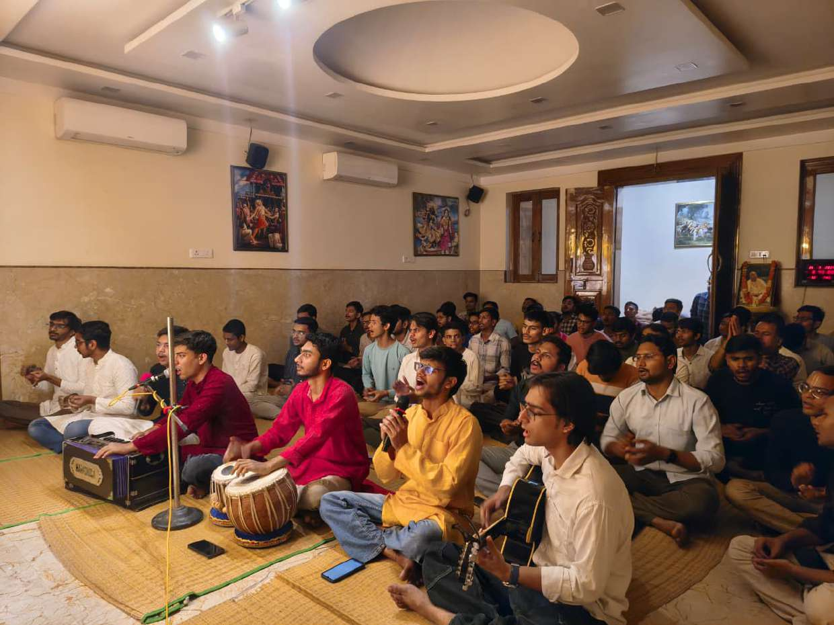
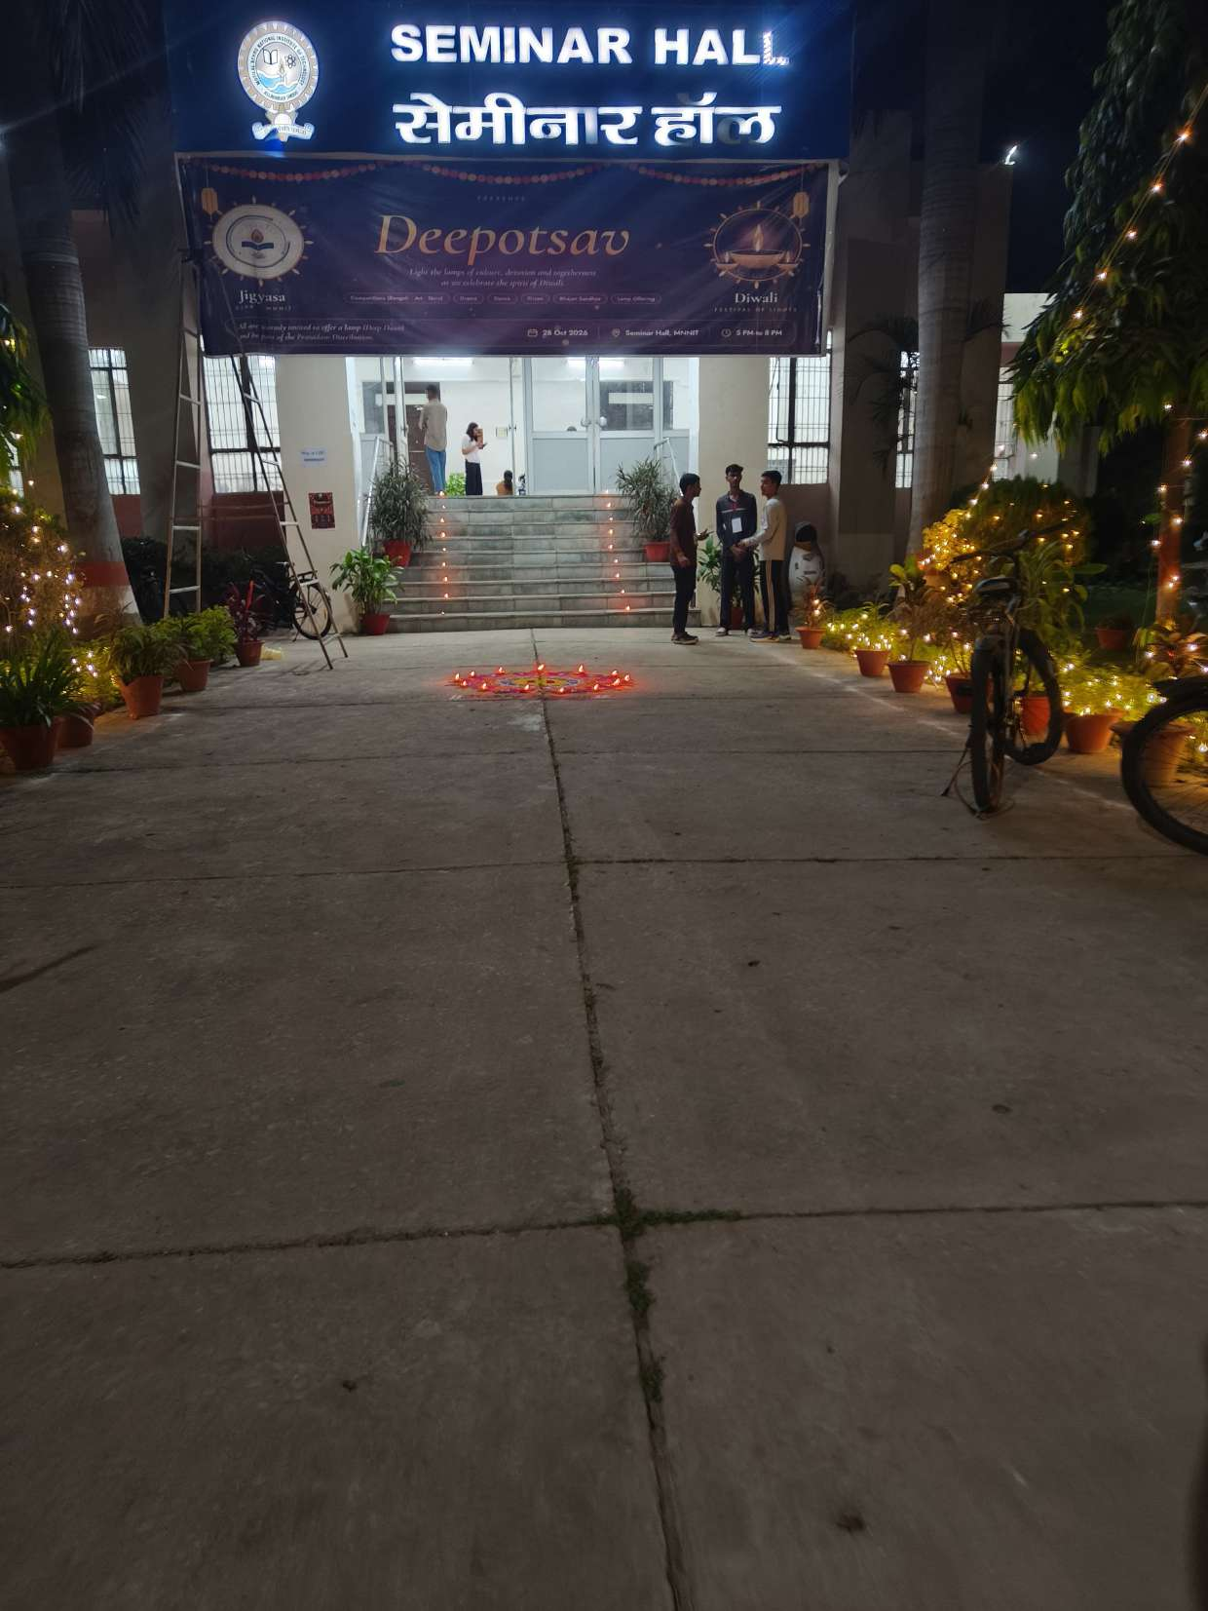
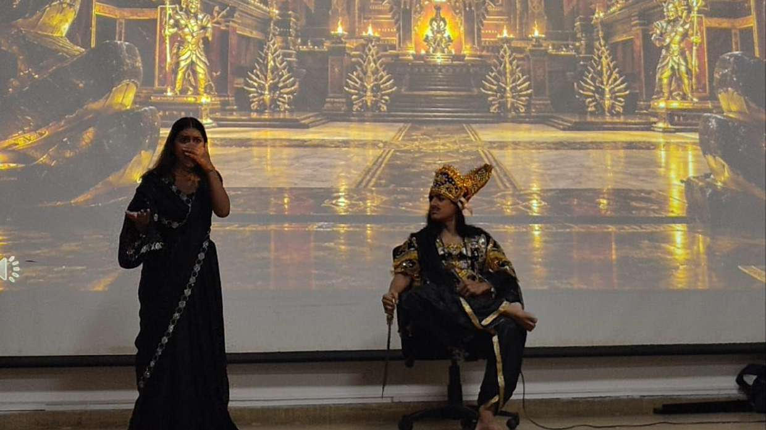
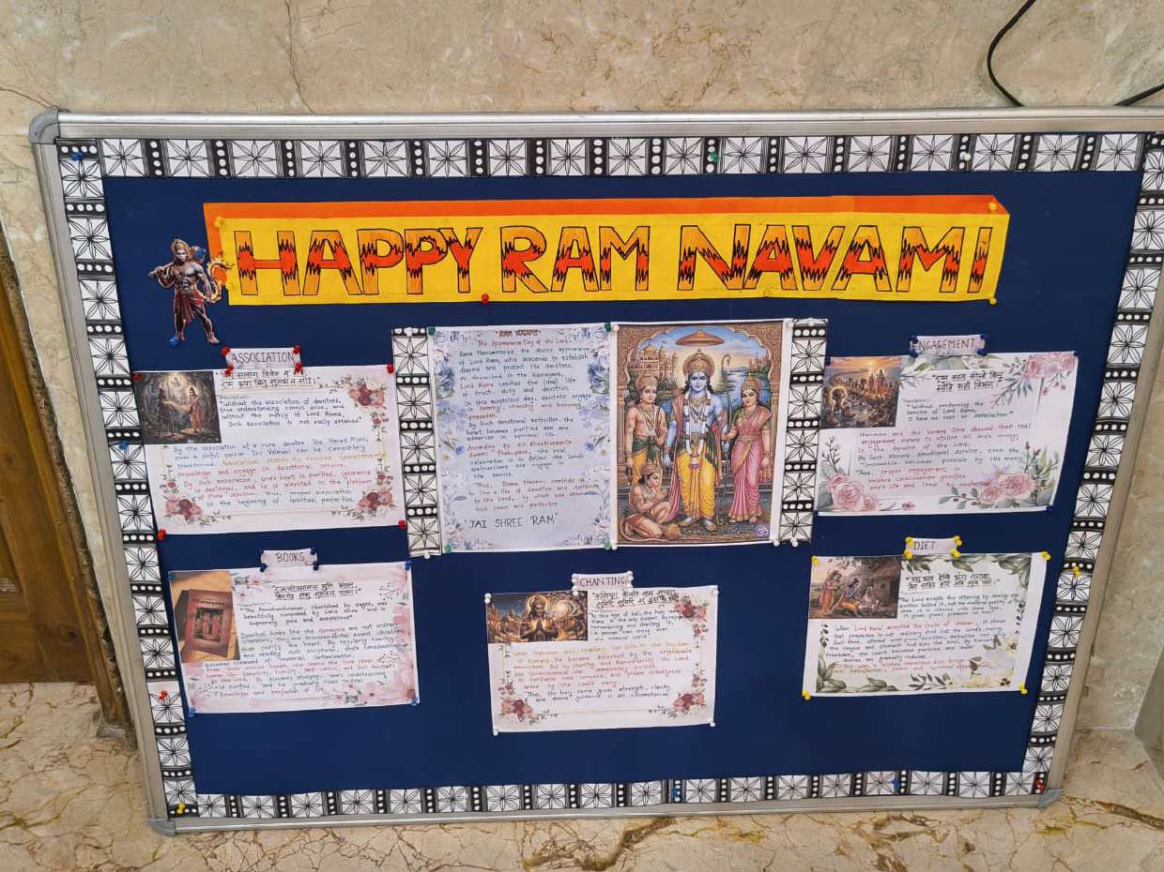
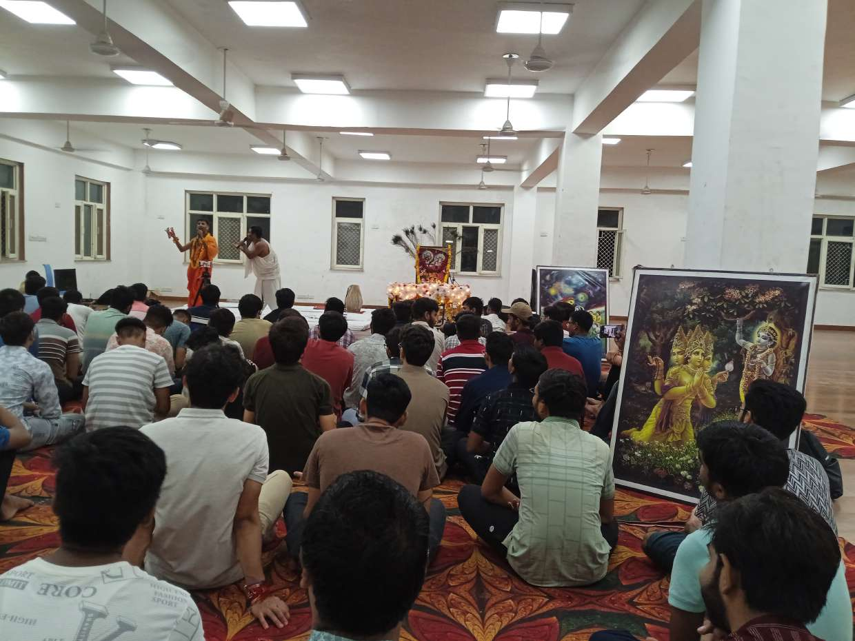
DISCIPLINES & OFFERINGS
What We Do: Creative & Devotional Arts
Diverse Expressions of Talent Under One Harmonious Banner
1. Singing & Music
Classical ragas, semi-classical bhajans, and vocal harmonizing training.
2. Bhajans & Kirtans
Congregational Harinam Sankirtan with harmonium, mridanga, and kartals.
3. Devotional Celebrations
Deepotsav with 1000+ diyas, Ram Navami, and Janmashtami Abhishekam.
4. Drama & Theatre
Stage plays of Ramayana and cultural epics with traditional costumes.
5. Rangoli & Visual Art
Intricate sacred floor mandalas, floral art, and hand-lettered notice boards.
6. College Fests
High-energy musical acts at SAC cultural nights and student inductions.

Slide 5
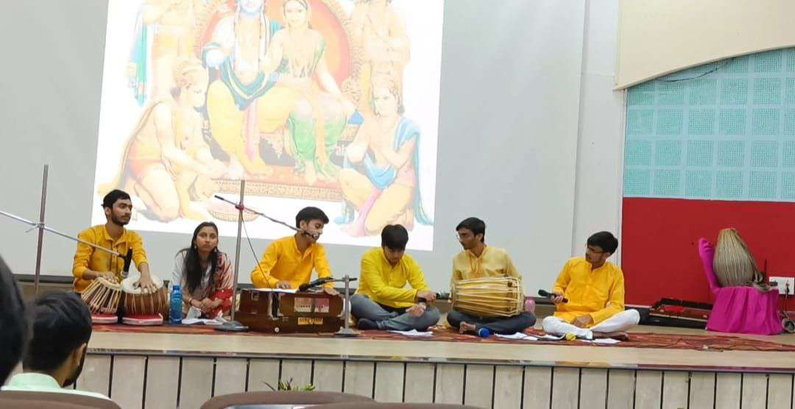
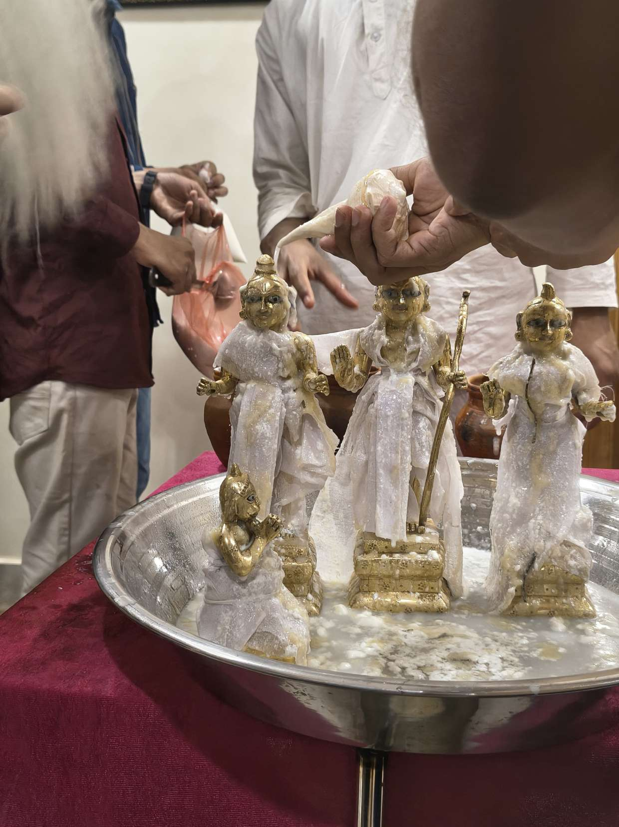
EVENTS & GATHERINGS
Major Campus Celebrations & Performances
Uniting MNNIT Allahabad in Devotion, Unity, and Joy
● COMPLETED
Deepotsav Mahotsav
📍 Seminar Hall Forecourt
1000+ clay diyas, traditional rangoli, divine Aarti, and soulful Bhajan Sandhya by Anahad Band.
● COMPLETED
Sri Ram Navami Utsav
📍 Seminar Hall
Honoring Bhagwan Shri Ram with devotional bhajans, Ramcharitmanas stutis, and art exhibitions.
● COMPLETED
Janmashtami & Abhishekam
📍 Student Activity Center
Sacred Vedic snana ceremony with conch shell (Shankha), midnight Harinam kirtan, and Mayur dance.
● UPCOMING
Acoustic Bhajan Sandhya
📍 Hostel Assembly Hall
Unplugged evening of devotional acoustic guitar, tabla, harmonium, and soulful group chanting.

Slide 6
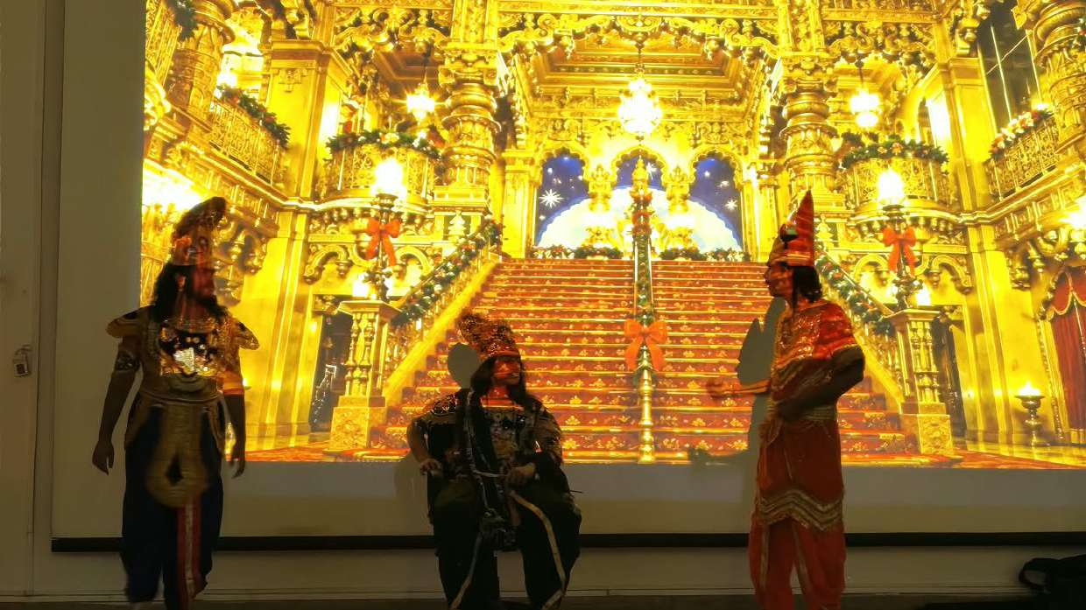
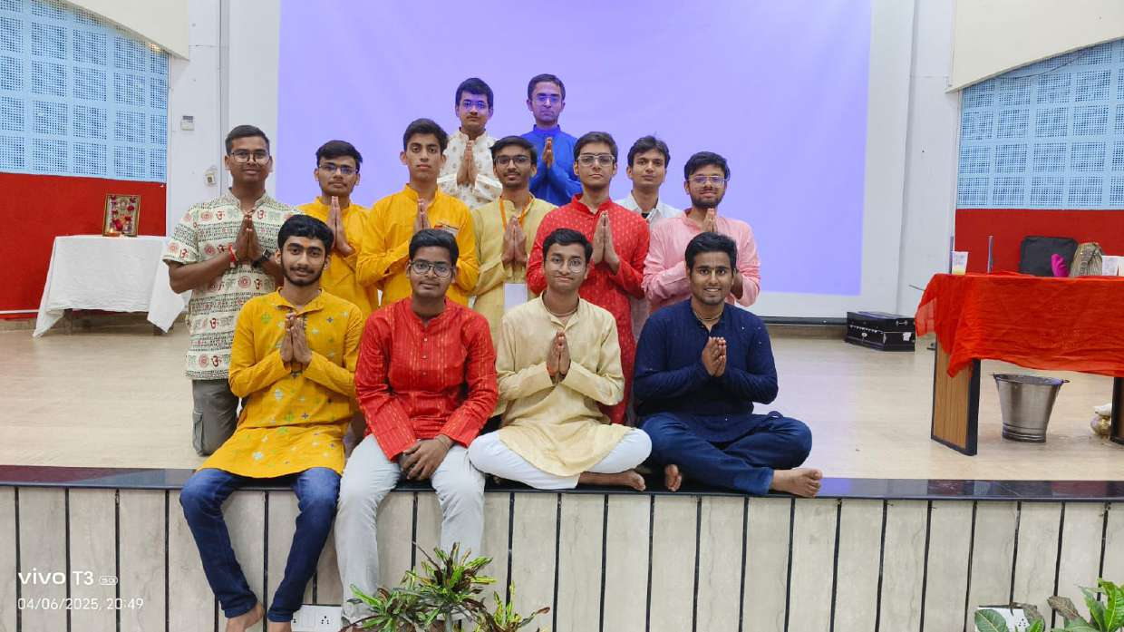
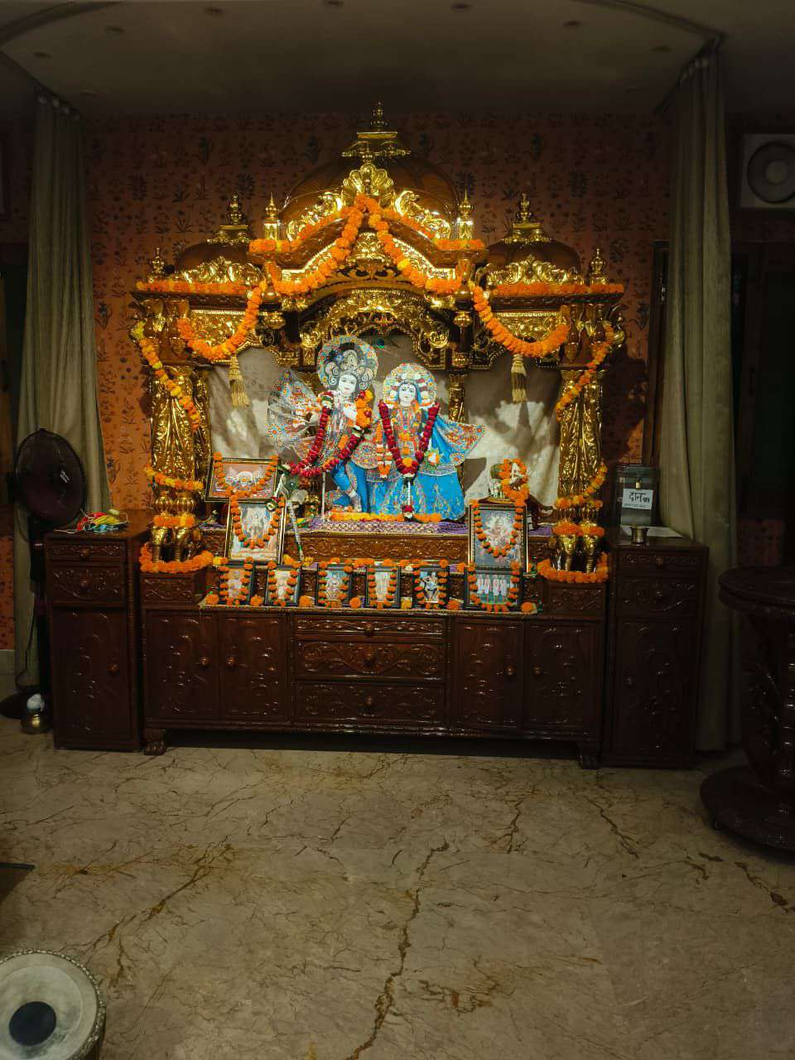
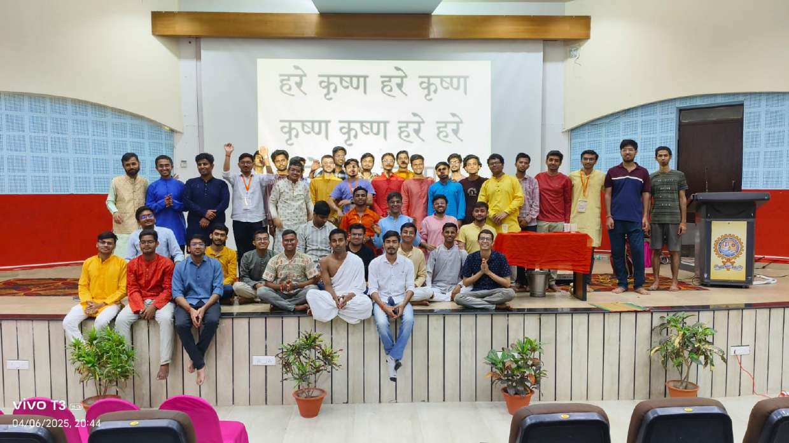
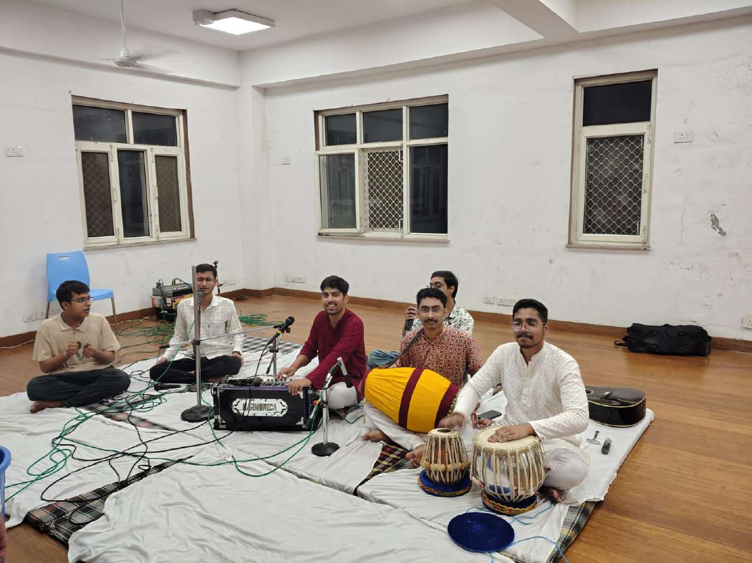
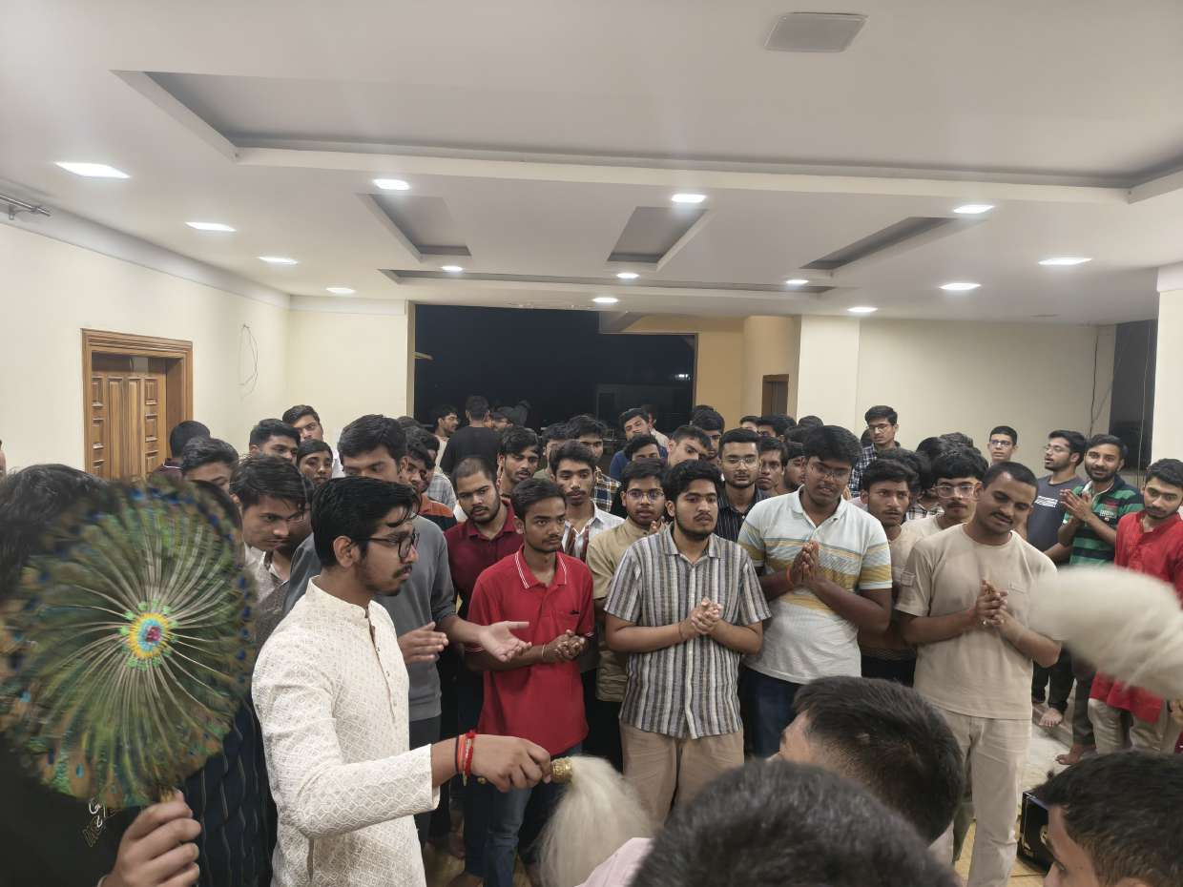
SACRED VISUAL ARCHIVE
20 Authentic Photographs Integrated
Real Glimpses from Anahad Band Performances & Campus Festivities
Deepotsav Entrance
Anahad Stage Ensemble
Royal Court Drama
Members in Pranām
Divine Sanctum Altar
Maha Mantra Chorus
Rehearsal Jam Session
Ecstatic Chanting

Slide 7
STUDENT INDUCTION
"Show Your Talent" – Join Anahad Community
Welcoming Singers, Instrumentalists, Actors, Artists & Devotional Enthusiasts
Membership Application Form Fields
✔ Full Name & Email:
Personal/College email for official correspondence.
✔ Year of Study & Branch:
1st Year Freshers to PhD scholars (all branches welcome).
✔ WhatsApp & Phone Number:
Direct mobile contact for rehearsal & event coordination.
✔ Skills & Talents:
Multi-select: Vocals, Harmonium, Tabla/Mridanga, Guitar, Flute, Drama/Acting, Rangoli, Sound/Media.
✔ Why to Join Anahad?:
Expression of student's passion for music, culture, and spirituality.
✔ Previous Experience:
Past background in musical, theatrical, or spiritual gatherings.
Direct Community Engagement
💬 Official WhatsApp Group
Direct invitation link: https://chat.whatsapp.com/HTotuzjgWJOLb6m8bmMyif
⚡ Real-Time Notifications
Weekly kirtan timings, rehearsal schedules, and fest participation alerts.
🎉 Interactive Experience
Instant celebratory confetti animation upon submitting application.
💾 Dual-Layer Storage
Immediate offline persistence via localStorage + Supabase cloud database sync.
📊 Coordinator Instant Review
Submissions can be exported directly to CSV for Google Sheets integration.

Slide 8
LEADERSHIP & CONTACT
Student Coordinators & Campus Outreach
Motilal Nehru National Institute of Technology Allahabad
MUSIC & COORDINATION
Arpit Srivastava
Lead Student Coordinator
MNNIT Allahabad
📞 +91 9311694460
💬 WhatsApp Enabled
EVENTS & CULTURAL OUTREACH
Subrata Ghosh
Student Coordinator
MNNIT Allahabad
📞 +91 8391842765
💬 WhatsApp Enabled
SPIRITUAL ACTIVITIES & LOGISTICS
Neeraj Sharma
Student Coordinator
MNNIT Allahabad
📞 +91 7852076730
💬 WhatsApp Enabled
MEDIA & PUBLIC RELATIONS
Varun Kumar
Student Coordinator
MNNIT Allahabad
📞 +91 9142352216
💬 WhatsApp Enabled
Official Campus Correspondence & Location
📍 Address: Motilal Nehru National Institute of Technology (MNNIT) Allahabad, Teliarganj, Prayagraj, Uttar Pradesh - 211004, India
✉️ Email: anahad.mnnit@gmail.com | 📸 Instagram: @anahad_mnnit | 🔗 WhatsApp Community: https://chat.whatsapp.com/HTotuzjgWJOLb6m8bmMyif

Slide 9
GOVERNANCE & OPERATIONS
Admin Control Center & Content Management
Empowering Student Leads to Manage Content Seamlessly Without Code
🔐 Authentication & Security
Password-protected admin session (PIN: anahad108). Public site remains strictly read-only for security.
📅 Event Management
Add new events, set categories (Festival, Celebration, Kirtan, Drama, Art), update timings, venues, and delete past listings.
📸 Gallery Photo Uploads
Upload fresh event photos directly via file picker or image URL, assign categories, and publish to gallery instantly.
📋 Membership Submissions
Review incoming student applications submitted through the website with 1-click Export to CSV for Excel / Google Sheets.
⚙️ Site Links & Settings
Update official WhatsApp group URL, coordinator phone numbers, official email, and Google Forms on the fly.

Slide 10
TECHNOLOGY & DEVOPS
Full-Stack Architecture & Deployment Pipeline
High-Performance Modern Web Engineering
Frontend Stack
• React.js 18 (Component Architecture)
• Vite 6 (Sub-second HMR & Rollup)
• Tailwind CSS (Vedic Custom Theme)
• Lucide React (Sacred & UI Icons)
• Canvas Confetti (Celebration FX)
Hosting & DevOps
• Render Static Site Hosting
• Auto-deployment on Git push
• render.yaml Blueprint included
• SPA Redirects (/index.html)
• High-speed CDN & free SSL
Backend & Data
• Supabase PostgreSQL (Optional)
• Row Level Security (RLS) policies
• localStorage Dual-Layer sync
• Zero breaking dependencies
• CSV Application Export engine
Code Repository
• GitHub Repository configured
• Subrataghosh3281/Mnnit-Spiritual-Community
• Complete source code pushed
• 55 committed files & assets
• Clean branch tracking

