Slide 1



Age of Information Aware Trajectory Planning of UAVs in Intelligent Transportation Systems: A Deep Learning Approach
1st Thesis Progress Presentation
Fall 2023
Supervised By:
Prof. Dr. Md. Abdur Razzaque
Advisor, Green University Of Bangladesh

Slide 2
PRESENTED BY:
Nigga 1
Nigga 2
Nigga 3

Slide 3
OUTLINE
Introduction
Problem Statement
Objective
Related Works
Motivation
System Model
Budget
Gantt Chart
Q & A Session

Slide 4
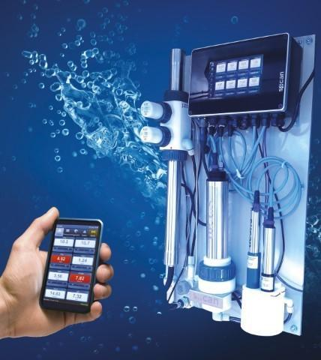

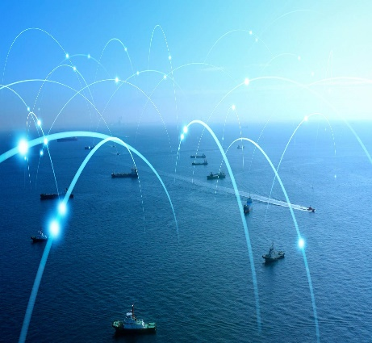

Why use UAV?
Acquire Realtime Information
Maintain information freshness for Intelligent transportation systems: Collecting timely information is critical for safety and driving assistance.
Better Connectivity: UAVs are expected to play a vital role in networks for enabling more connectivity.

Slide 5
Why do AOI Trajectory Planning?
Quantify the freshness of collected information: Qos supported applications gets a better performance evaluation.
Better UAV Network Design: Existing UAV network designs are insufficient to maintain fresh information. Connection loss occurs.

Slide 6
Problem Statement
How can we find a better tradeoff between transmission latency & energy consumption?
Through which mechanism we can ensure better QoE?
How can we design an algorithm to select the optimal edge server for offloading the computing tasks from vessel IoT users?

Slide 7
Paper Objectives
To design a maritime network framework which can adopt Mobile Edge Computing (MEC) server to offload the compute-intensive task of M-IoT users.
To bring a trade-off between maximizing user Quality-of-Experience (QoE) and minimizing energy consumption.

Slide 8
Related Works (2/4)
Focuses-
hierarchical network architecture for maritime communications
restricted infrastructure of maritime radio networks.
Motivation-
The different distribution and density of MUEs
The necessity of hierarchical networks.
The consideration of heterogeneous channels
Kim, Yongjae, Yujae Song, and Sung Hoon Lim. "Hierarchical maritime radio networks for internet of maritime things." IEEE Access 7 (2019):

Slide 9
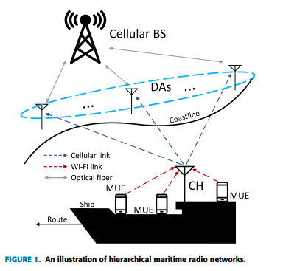
Related Works (1/3)
Contribution & Approach
Ship clusters the Maritime User Equipment's
Distribution on the ship by Thomas cluster process
Network performances given in terms of the average data rate and outage probability of a ship were numerically evaluated
A simple antenna selection algorithm was proposed for guarantee their QoS requirements

Slide 10
Related Works (1/3)
Limitation
The impact of movement of ship which results in the channel uncertainty
Distribute Antennas have no certain direction to their routes.
Haven’t consider the offloading scenario of the tasks.

Slide 11
Wang, Zhen, Bin Lin, Lu Sun, and Ying Wang. "Intelligent Task Offloading for 6G-Enabled Maritime IoT Based on Reinforcement Learning." In 2021 International Conference on Security, Pattern Analysis, and Cybernetics (SPAC), pp. 566-570. IEEE, 2021.
Related Works (2/3)
Focuses-
Edge computing network for M-IoT based on the space-air-ground sea integrated by 6G
Energy efficiency of maritime terminals and reduce the processing delay of different tasks
Motivation-
Connecting network of space-air-ground-sea integration
Seamless global coverage

Slide 12
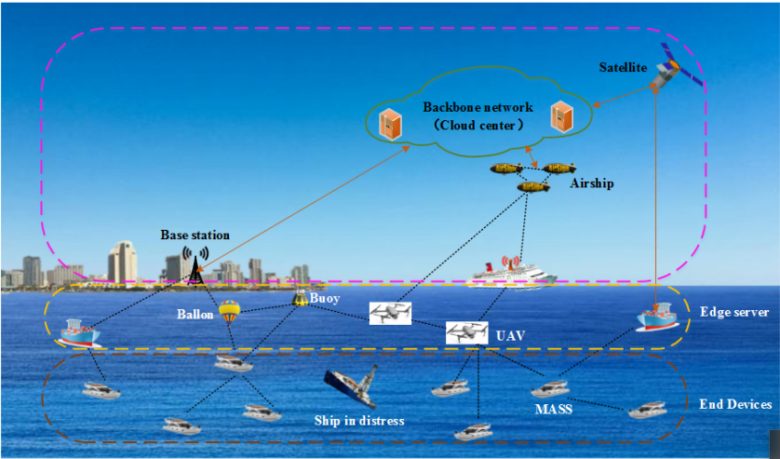
Contribution & Approach
Related Works (2/3)
Communication model
Computing model
→Local model
→Edge model
→Cloud model
Optimize energy using Reinforcement learning

Slide 13
Related Works (2/3)
Limitation
Massive marine data with low cost
The task offloading scenario has not been considered.

Slide 14
Yang, Tingting, Hailong Feng, Shan Gao, Zhi Jiang, Meng Qin, Nan Cheng, and Lin Bai. "Two-stage offloading optimization for energy–latency tradeoff with mobile edge computing in maritime Internet of Things." IEEE Internet of Things Journal 7, no. 7 (2019)
Related Works (3/3)
Focuses-
to investigate the dynamic offloading problem
proposing a two-stage joint optimal offloading algorithm
Motivation-
Popularity & importance of data-driven maritime services
To tackle the data traffic in the M-IoT.
15

Slide 15
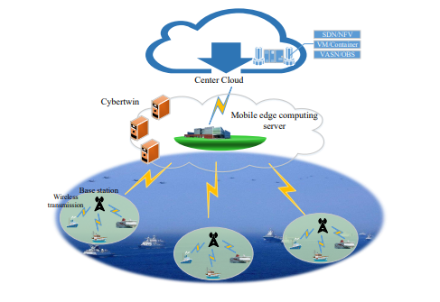
Contribution & Approach
Related Works (3/3)
A novel maritime communication network framework & two-stage optimal offloading algorithm is proposed
The channel allocation and power allocation problem were proposed

Slide 16
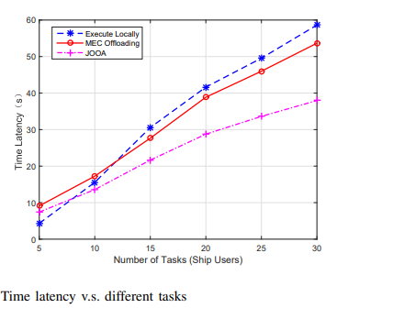
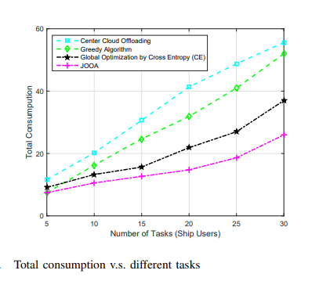
Related Works (3/3)
Limitation
Has almost the same consumption of energy & more latency in case of fewer ship users.
All ship users need to report information to the center cloud, which may cause information blocking.

Slide 17
Our Motivation
Reducing complexity
To offload data from Vessel Traffic Server to ensure QoE.
Improving the overall user experience

Slide 18
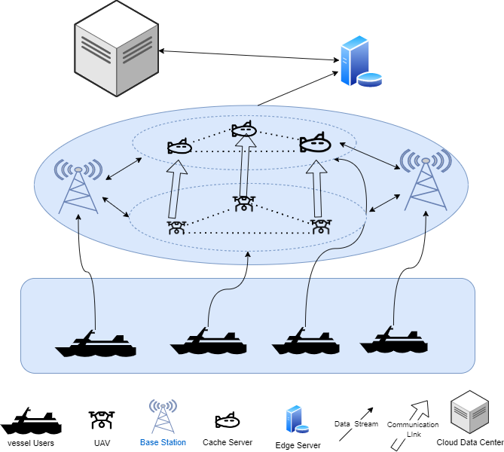
System Model
Blue = Water Area.

Slide 19

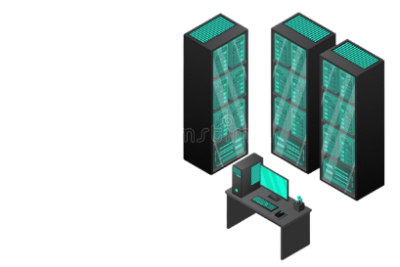





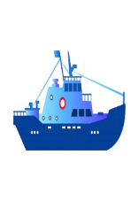




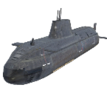
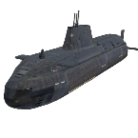
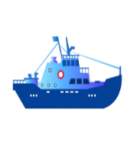
System Model
Cloud Data Center
MEC Server
Base Station 1
Base Station 2
UAVs
Data Stream
Communication Link
Cache Servers
Vessel terminals

Slide 20
Budget
Serial Number | Description of Item | Unit | No. of Units | Per unit cost BDT. | Duration (month) | Total BDT
1 | Researcher | Person | 3 | 20,000 | ----- | 60,000
2 | Data Collection | Survey Travel | 1 | 30,000 | ---- | 30,000
3 | Materials | Laptop | 1 | 50,000 | ---- | 50,000
4 | Research Grant policy | Publication | 2 | 10,000 | ---- | 20,000
5 | Miscellaneous | --- |  | 500 | 12 | 6000
6 |  |  |  |  | Total | 166,000

Slide 21
GANTT CHART
THESIS
PLAN
JANAUARY
FEBRUARY
MARCH
APRIL
MAY
JUNE
JULY
AUGUST
SEPTEMBER
OCTOBER
NOVEMBER
DECEMBER
PROBLEM IDENTIFICATION
1 MONTH
LITERATURE REVIEW
2 MONTHS
SYSTEM
DIAGRAM
15 DAYS
OPTIMIZATION FORMULATION
45 DAYS
HEURISTIC FORMULATION
45 DAYS
DATA
COLLECTION
1 MONTH
IMPLEMEN-
TATION
2 MONTHS
COMPARISON
1 MONTH
PAPER &
REPORT WRITTING
45 DAYS

Slide 22
References
Yang, Tingting, Hailong Feng, Shan Gao, Zhi Jiang, Meng Qin, Nan Cheng, and Lin Bai. "Two-stage offloading optimization for energy–latency tradeoff with mobile edge computing in maritime Internet of Things." IEEE Internet of Things Journal 7, no. 7 (2019)
Wang, Zhen, Bin Lin, Lu Sun, and Ying Wang. "Intelligent Task Offloading for 6G-Enabled Maritime IoT Based on Reinforcement Learning." In 2021 International Conference on Security, Pattern Analysis, and Cybernetics (SPAC), pp. 566-570. IEEE, 2021.
Yang, Tingting, Jiacheng Chen, and Ning Zhang. "AI-empowered maritime internet of things: a parallel-network-driven approach." IEEE Network 34, no. 5 (2020): 54-59.
Xia, Tingting, Michael Mao Wang, Jingjing Zhang, and Lei Wang. "Maritime internet of things: Challenges and solutions." IEEE Wireless Communications 27, no. 2 (2020): 188-196.
Song, Yujae, Huicheol Shin, Sungmin Koo, Seungjae Baek, Jungmin Seo, Hyoun Kang, and Yongjae Kim. "Internet of Maritime Things Platform for Remote Marine Water Quality Monitoring." IEEE Internet of Things Journal (2021).
Wang, Zhen, Bin Lin, Lu Sun, and Ying Wang. "Intelligent Task Offloading for 6G-Enabled Maritime IoT Based on Reinforcement Learning." In 2021 International Conference on Security, Pattern Analysis, and Cybernetics (SPAC), pp. 566-570. IEEE, 2021.

Slide 23

Q & A Session

