Slide 1
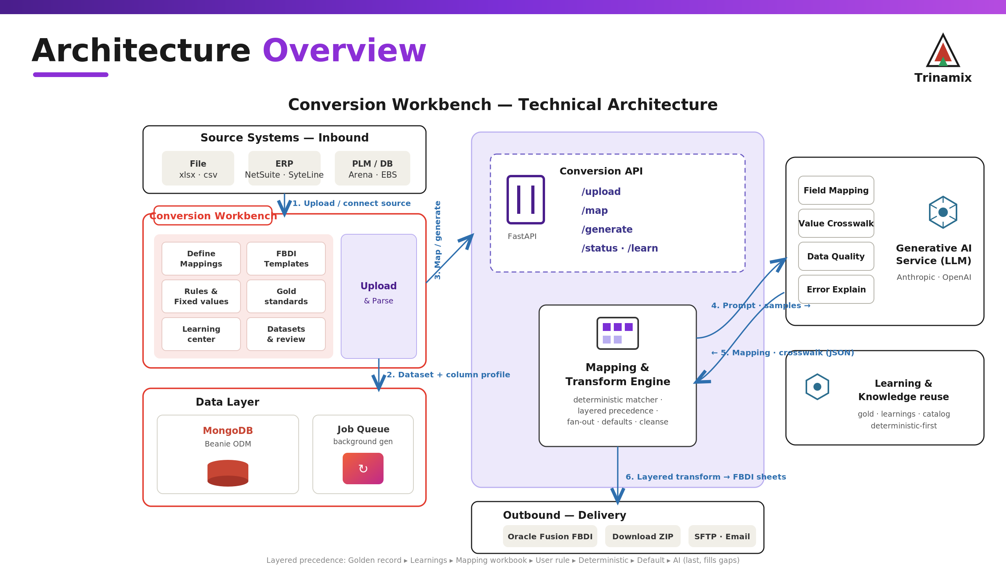
Notes:
Trinamix Conversion Workbench — technical architecture. React SPA, FastAPI on Render, mapping/transform engine, MongoDB + GridFS, external LLM, outbound into Oracle Fusion FBDI.

Slide 2
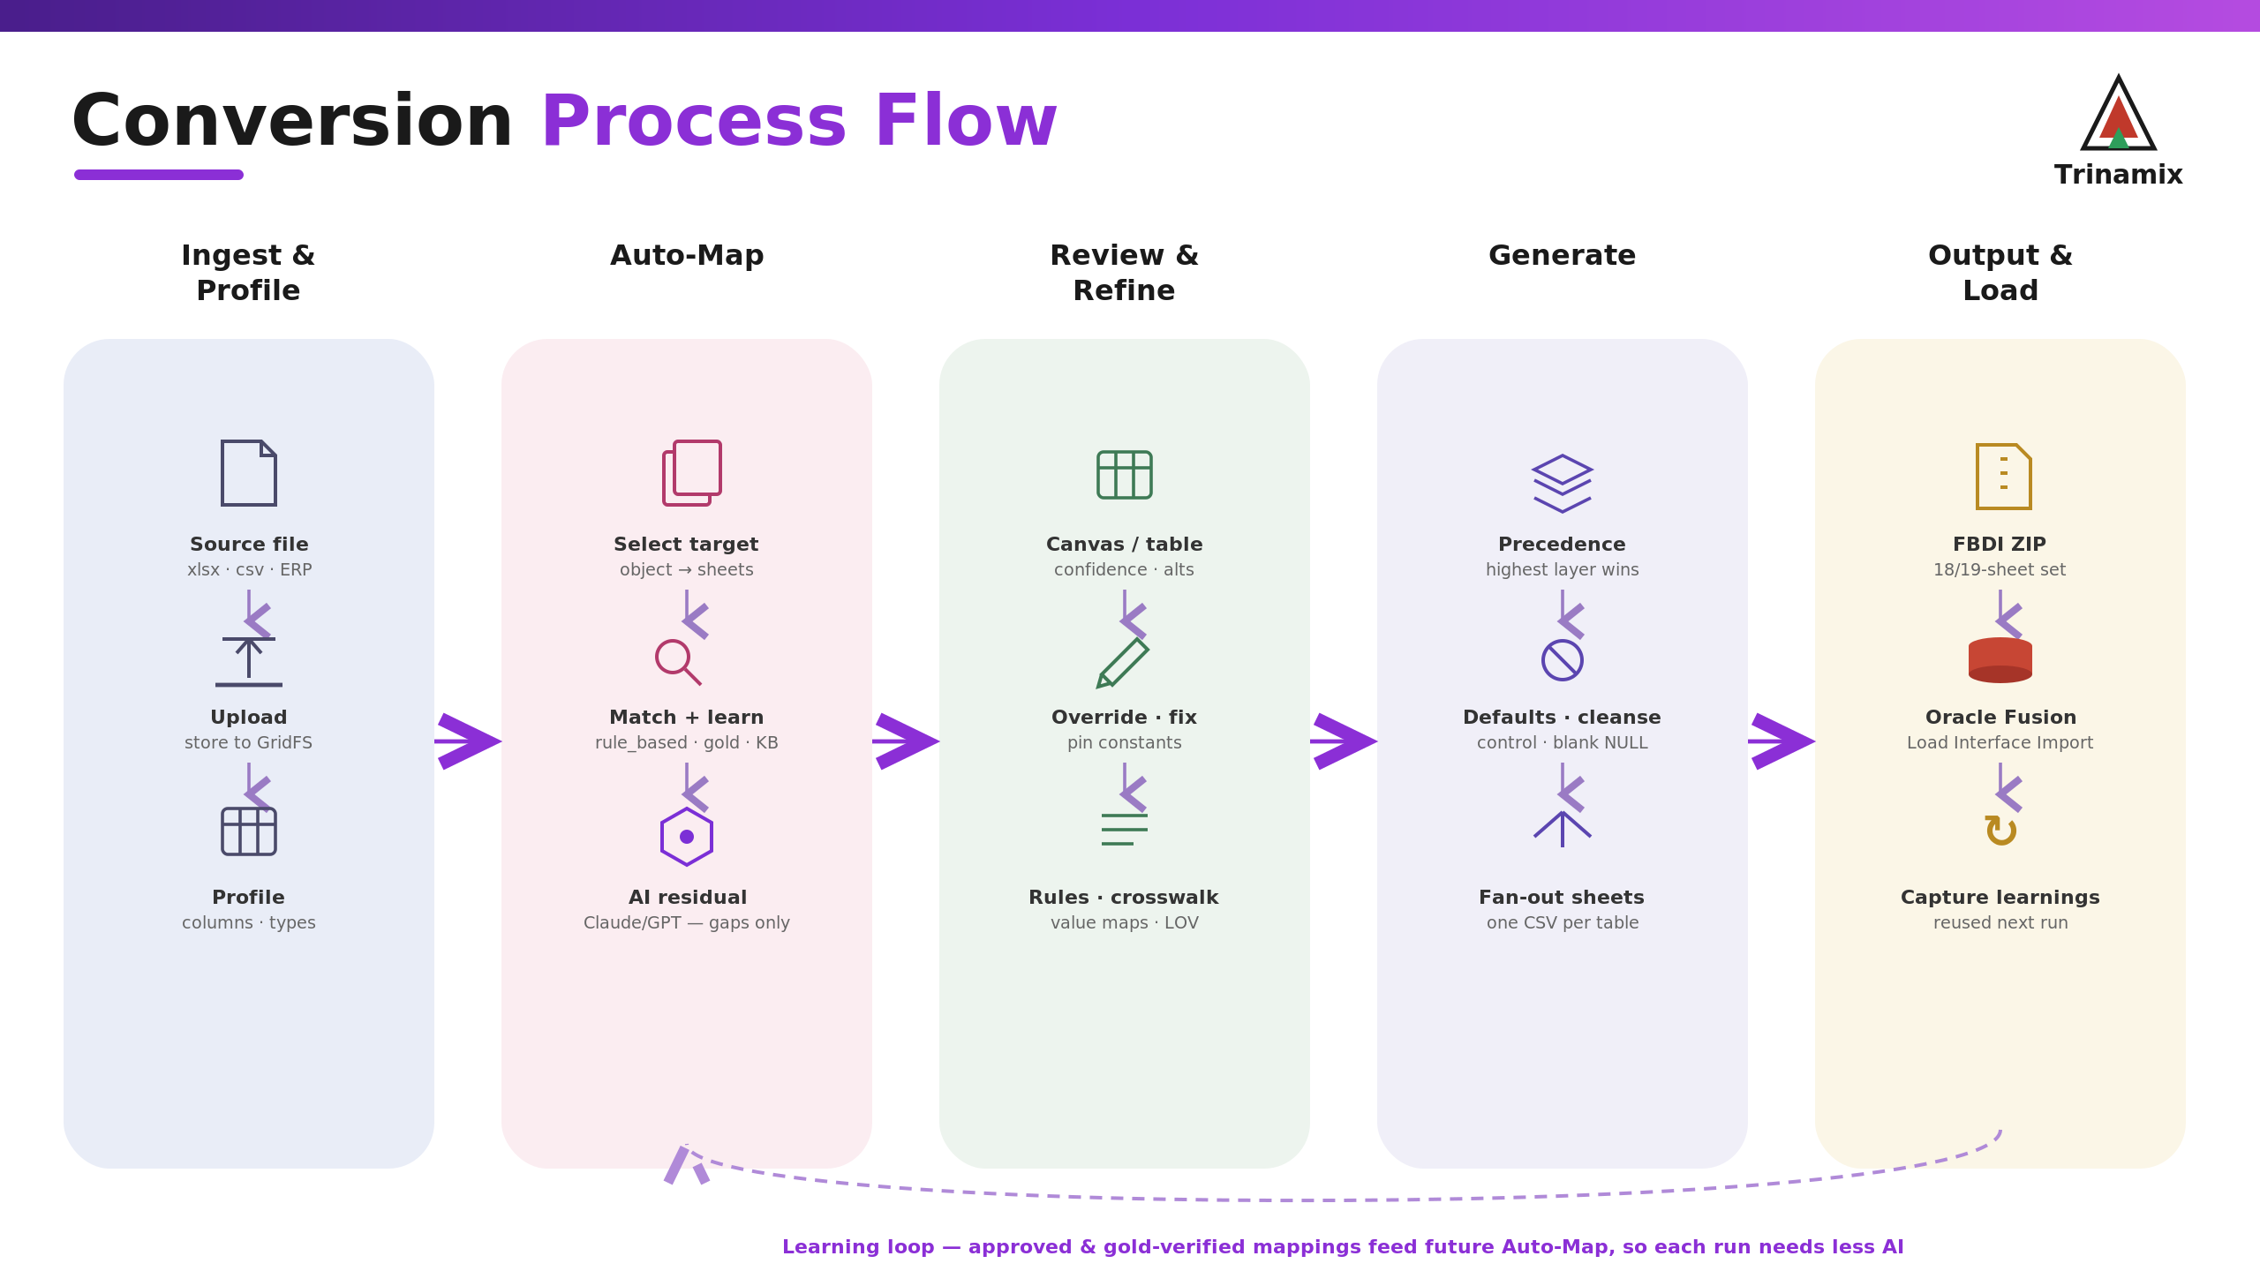
Notes:
Conversion process flow: Ingest & Profile -> Auto-Map -> Review & Refine -> Generate -> Output & Load, with the layered mapping precedence and the learning feedback loop.

