Slide 1
SDN BASED DDoS DETECTION USING ML & DL TECHNIQUES
Presentation by:
Subuhana.N
Intern ID: 2170619
M.Tech in Artificial Intelligence
TKMCE
Project Presentation
13-05-2022

Slide 2
TABLE OF CONTENTS
INTRODUCTION
METHODOLOGY
DATASET
FEATURES IN DATASET
INSDN DATASET
EXPERIMENTS USING SUPERVISED ML TECHNIQUES
EXPERIMENTS USING UNSUPERVISED ML TECHNIQUES
EXPERIMENTS USING DEEP LEARNING TECHNIQUES
RESULTS and DISCUSSION
CONCLUSION
REFERENCES

Slide 3
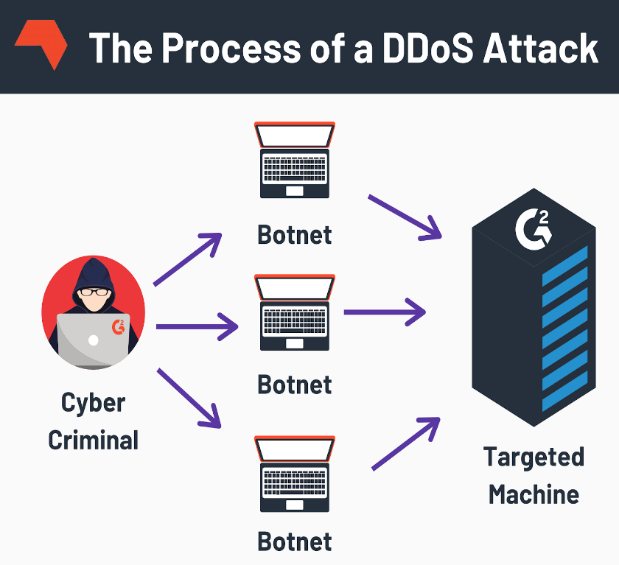
INTRODUCTION
The Software-Defined Network (SDN) is a new network paradigm that promises more dynamic and efficiently manageable network architecture for new-generation networks
Distributed Denial of Service (DDoS) attacks are the most effective attack vector to the SDN, targeting the varied and emerging computational network infrastructures across the globe
Attackers use botnets to concurrently launch DDoS attack that exhaust the target system
Many companies such as Amazon, Twitter, Facebook, GitHub suffered from DDoS attack
Accurate Detection and Prevention of DDoS Attack is necessary for protecting the network Systems

Slide 4
METHODOLOGY
Supervised Machine Learning Algorithms
Logistic regression
Gaussian Naïve Bayes
SVM
Decision Tree
Random Forest
Gradient Boosting
Unsupervised Machine Learning Algorithms
K Means Clustering
Deep Learning Techniques
DNN
Auto Encoder and XGBOOST
CNN
LSTM
BiLSTM
TabNet
TCN

Slide 5
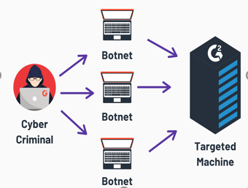
DATASET
DDoS Attack SDN Dataset
DDoS attack data set generated in SDN environment and made publicly accessible to researchers for use in machine learning and deep learning research
The dataset consisting of TCP, UDP, and ICMP traffic is shown using the normal and attack traffic class label
Total 23 features and 104345 network flows are available in the data set
Class label indicates whether the traffic type is benign or malicious
Benign traffic has label 0 and malicious traffic has label 1

Slide 6
FEATURES IN DATASET
Feature Name | Description
dt | Transmission moment of packets over the network device
switch | Switch ID
src | IP address of the sender of the packets
dst | IP address to which the packets was sent
pktcount | Number of packets
bytecount | Number of bytes
dur | Duration
dur_nsec | Duration in nano seconds
tot_dur | Total duration of network flow
flows | Number of flow packets
packetins | Total flow entries in the switch

Slide 7
FEATURES IN DATASET(Contd…)
Feature Name | Description
pktperflow | Packet count during a single flow
byteperflow | Byte count during a single flow
pktrate | Number of packets per sec
Pairflow | Number of flow packets per second
Protocol | Types of communications internet protocols
port_no | Port number of the sender of the packets
tx_bytes | Number of bytes transferred from the switch port
rx_bytes | Number of bytes received on the switch port
tx_kbps | Data transfer rate
rx_kbps | Data Receiving rate
tot_kbps | Sum of tx_kbps and rx_kbps

Slide 8
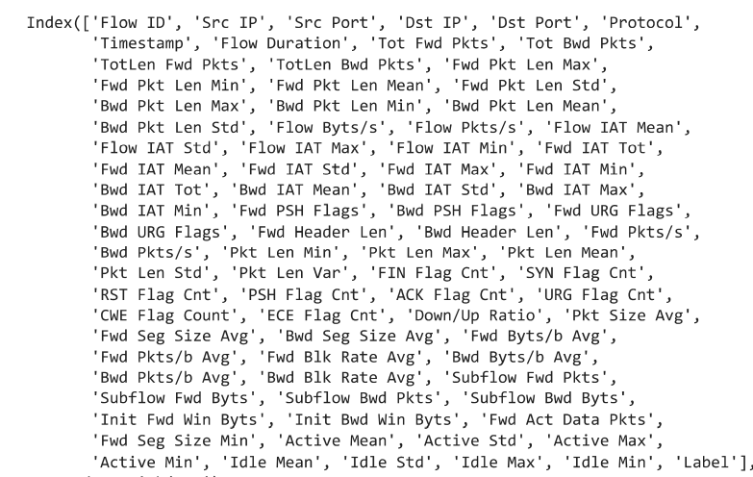
INSDN DATASET
Comprehensive SDN dataset to verify the performance of intrusion detection systems
Total 84 features and 136743 network flows are available in the data set
The InSDN dataset includes different attacks that can strike the data, control, and application layers
The source of attacks in the dataset is classified into two categories Internal and External

Slide 9
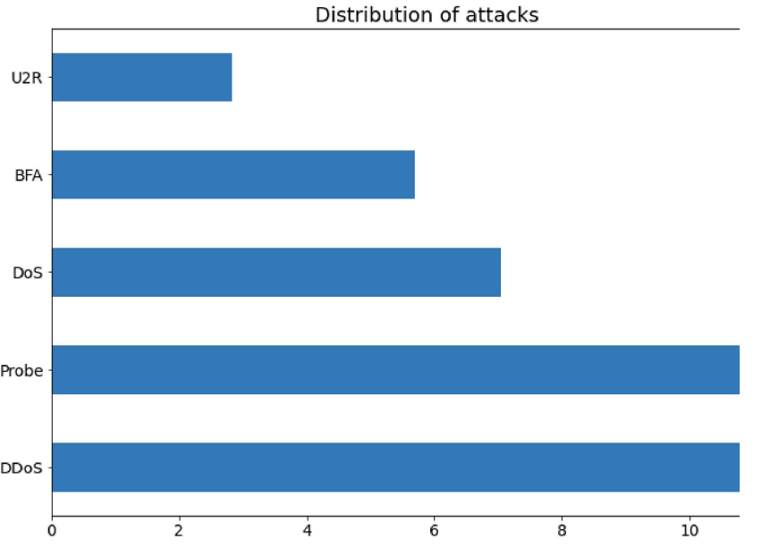
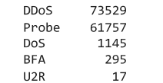
INSDN DATASET (Contd…)
Internal: These attacks come from internal users, who have full access to the SDN network
External: These attacks commonly are launched from the outside network
The attacker is mainly altering the SDN network using different malicious activities such as code exploits, DoS, malware, etc

Slide 10
EXPERIMENTS USING SUPERVISED MACHINE LEARNING ALGORITHMS
Machine Learning methods are used to detect unusual events that are not consistent with normal network behavior
Load the dataset
Splitting the dataset into features and label
Splitting the dataset in to training and testing
Create a Machine Learning models using supervised ML algorithms such as Logistic regression, Gaussian NB, SVM, Decision Tree, Random Forest and Gradient Boosting
Train the models on the dataset and test the model
Evaluate the performance of ML models for DDoS detection

Slide 11
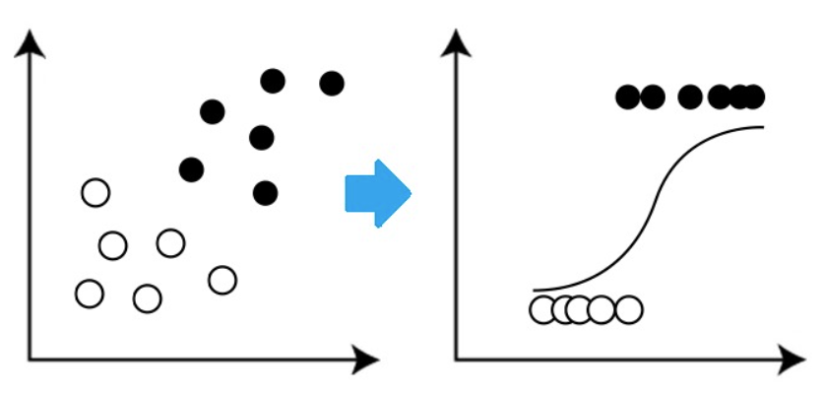

LOGISTIC REGRESSION
Logistic regression is a useful analysis method for classification problems
where trying to determine if a new sample fits best into a category as aspects of cyber security problems such as attack detection
Create a Machine Learning model using Logistic Regression algorithm
Train the model in the dataset and test the model
Evaluate the performance of model for DDoS detection

Slide 12
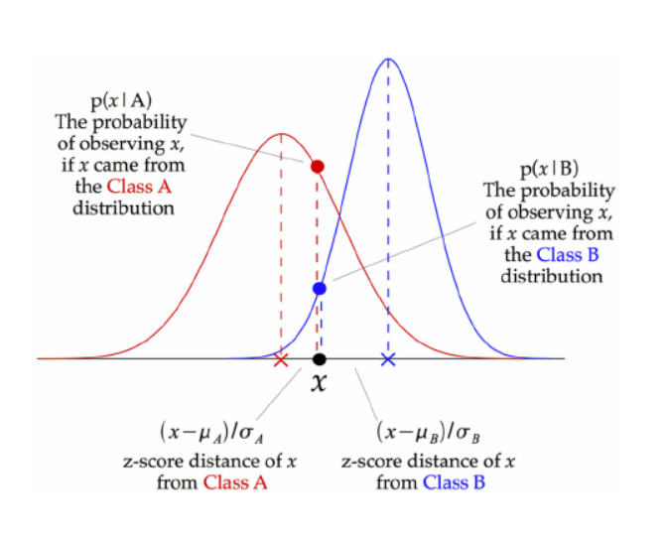

GAUSSIAN NAÏVE BAYES
Naive Bayes are a group of supervised machine learning classification algorithms based on the Bayes theorem
Gaussian Naive Bayes is a variant of Naive Bayes that follows Gaussian normal distribution and supports continuous data
At every data point Z score between the point and each class mean is calculated
Train, test and evaluated the Gaussian NB model for DDoS detection

Slide 13
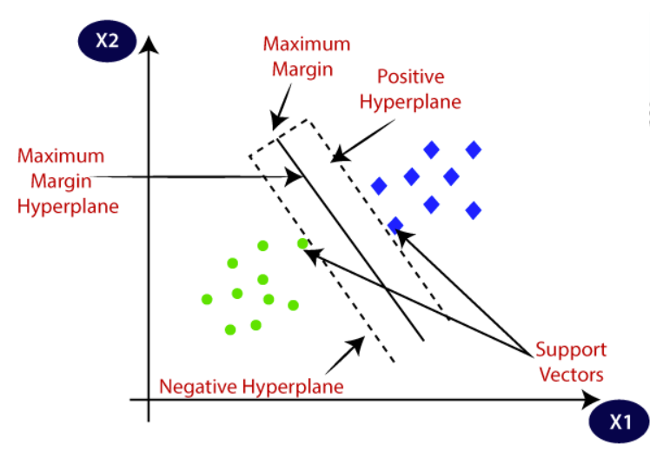

SUPPORT VECTOR MACHINE (SVM)
The goal of the SVM algorithm is to create the best line or decision boundary that can segregate n-dimensional space into classes so that we can easily put the new data point in the correct category in the future
This best decision boundary is called a hyperplane
SVM chooses the extreme points that help in creating the hyperplane, these are support vectors
Train the dataset using SVM model and make predictions using the model
Evaluated the performance of SVM for DDoS detection

Slide 14
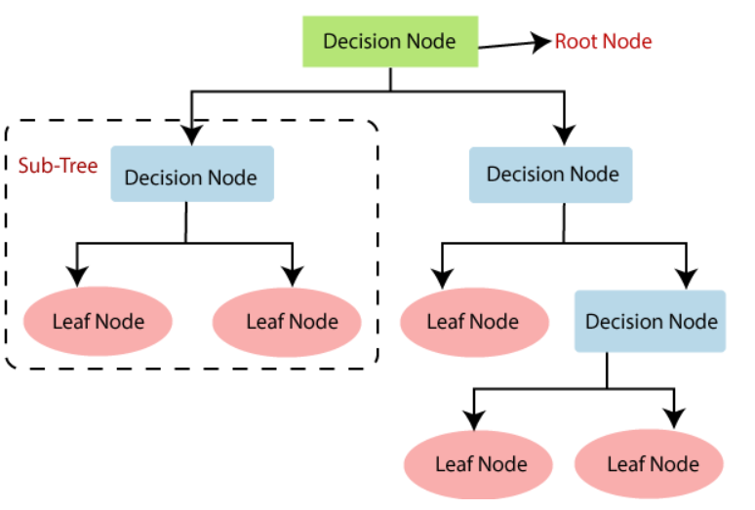

DECISION TREE
It is a tree structured classifier; a decision tree is drawn upside down with its root at the top
In a Decision tree, there are two nodes, which are the Decision Node and Leaf Node
Internal nodes represent the features of a dataset, branches represent the decision rules, and each leaf node represents the outcome
Decision nodes are used to make any decision and have multiple branches, whereas Leaf nodes are the output of those decisions and do not contain any further branches
This methodology is more commonly known as learning decision tree from data and the tree is called Classification tree as the target is to classify whether the traffic is Normal or DDoS

Slide 15
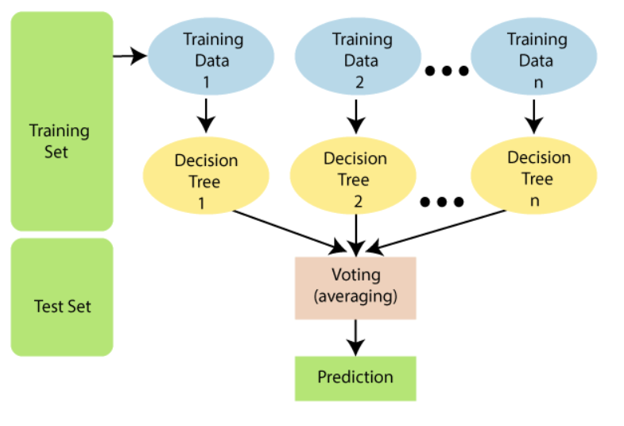
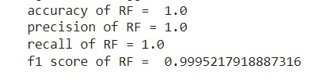
RANDOM FOREST
Random Forest is a classifier that contains a number of decision trees on various subsets of the given dataset and takes the average to improve the predictive accuracy of that dataset
Random forest takes the prediction from each tree and based on the majority votes of predictions it predicts the final output
The greater number of trees in the forest leads to higher accuracy and prevents the problem of overfitting

Slide 16
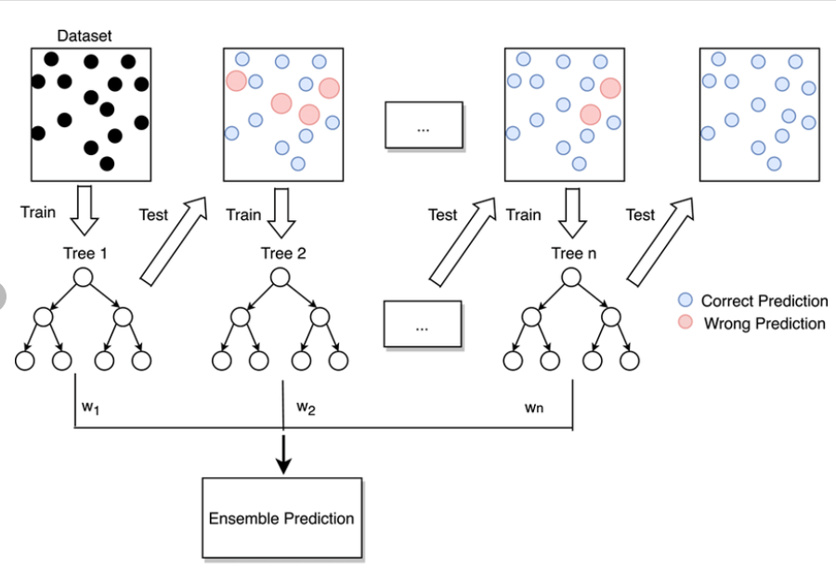
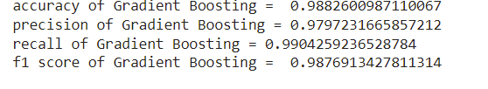
Gradient Boosting
Powerful ensemble machine learning algorithm that uses decision trees
Gradient boosting classifier consist of weak learner, additive component and loss function
The decision trees are the weak learners, and the loss function has to be differentiable
The objective is to minimize the loss
Works like gradient descent optimization algorithm

Slide 17
EXPERIMENTS USING UNSUPERVISED MACHINE LEARNING ALGORITHMS
The goal of this unsupervised machine learning technique is to find similarities in the data point and group similar data points together
“Clustering” is the process of grouping similar entities together
Automatically split the dataset into group based on similarities
This will give us insight into underlying patterns of different groups
Identify different groups of network traffic such as Normal and DDoS attack
Clustering is also used to reduces the dimensionality of the data when dealing with a copious number of variables
K means clustering is employed for DDoS detection

Slide 18
EXPERIMENTS USING K MEANS CLUSTERING
The goal of K Means is to identify similar data points and cluster them together while trying to distance each cluster as far as possible
Compare PCA and t-SNE data reduction techniques prior to running K-Means clustering algorithm
Principal component analysis or (PCA) is a classic method we can use to reduce high-dimensional data to a low-dimensional space
T-Distributed Stochastic Neighbor Embedding (t-SNE) is also a great dimensionality reduction technique. Unlike PCA, t-SNE can reduce dimensions with non-linear relationships
Silhouette Method: This technique measures the separability between clusters. If the silhouette score is close to one indicates the clusters are well separated

Slide 19
K MEANS –PCA-TSNE-STEPS
Load the dataset
Standardize the data
Applying K Means on the original dataset
Feature Reduction via PCA
Applying K Means to PCA principal components
Feature Reduction via t-SNE
Applying K Means to t-SNE clusters
Comparing PCA and t-SNE K Means derived clusters

Slide 20
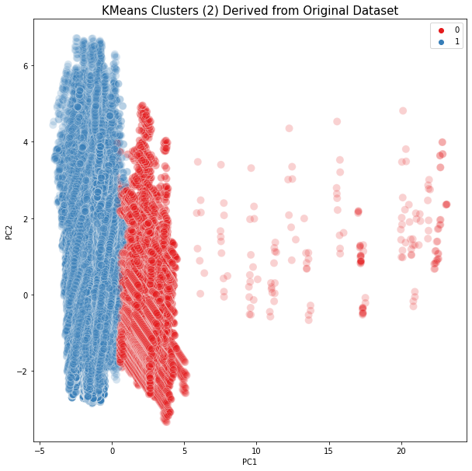
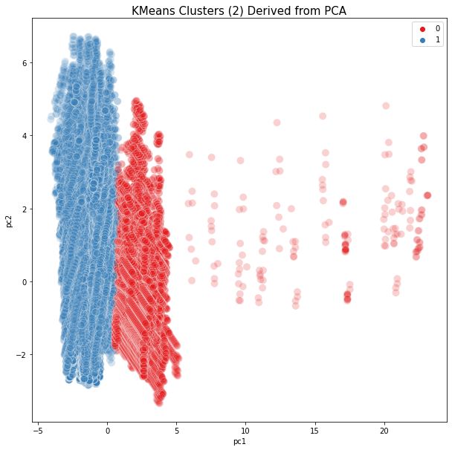
K MEANS CLUSTER VISUALIZATION

Slide 21
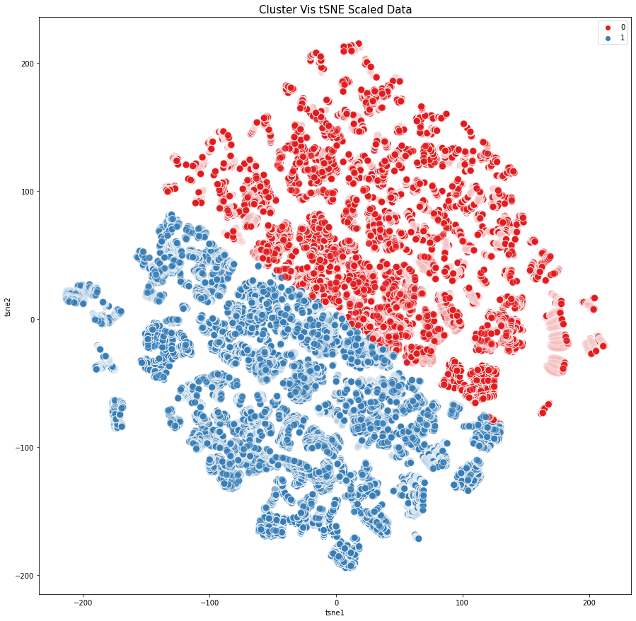
K MEANS WITH TSNE

Slide 22
Experiments using DEEP LEARNING TECHNIQUES
Deep Learning is capable of automatically finding correlations in raw data, and it has the advantage of supervised and unsupervised learning
Deep Learning techniques can significantly improve the performance of DDoS detection
The goal is to tackle the problem of binary classification in the DDoS Detection System
Classify the network traffic into normal and DDOS attack traffic
DNN, Auto Encoder and XGBOOST classifier, CNN, LSTM, BiLSTM, Tab Net and TCN are employed for DDOS detection

Slide 23
DEEP NEURAL NETWORK
Load the dataset
Splitting the dataset into features and label
Splitting the dataset in to training and testing (20% for testing and 80% for training)
Feature Scaling or Standardization using Standard Scaler
Create DNN with sequential model having input layer, 3 hidden layer and output layer
The input layer consist of 22 neurons corresponds to 22 features selected and relu activation function used
The hidden layers consist of equal number of 30 neurons and relu activation function is used
There are also two dropout layers with dropout ratio 0.2
The output layer consists of 2 neurons with softmax activation function because it is a binary classification problem
The output label ‘0’ indicates the network traffic is normal and ‘1’ indicates the traffic is DDoS attack

Slide 24
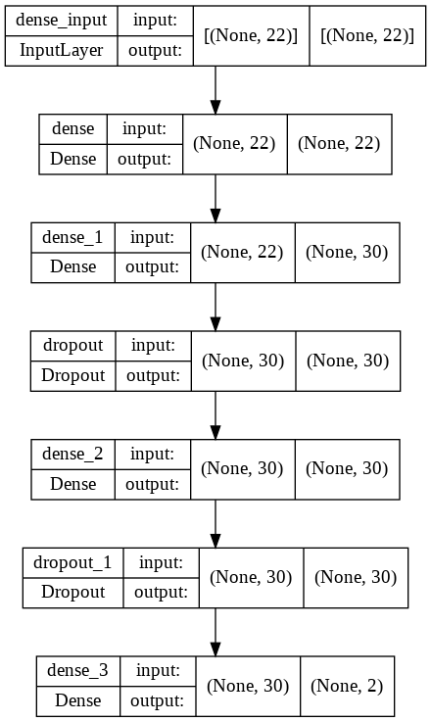
DEEP NEURAL NETWORK (Contd…)
Compile the model using ‘Sparse categorical cross entropy’ loss function, accuracy metrics and ‘ADAM’ optimizer
Fit the model with 20 epochs and batch size selected is 16
Plot the training and validation accuracy values
Plot the training and validation loss values
Make predictions on the test set
Evaluate the model and obtain the accuracy
The accuracy obtained is 98.93 %

Slide 25
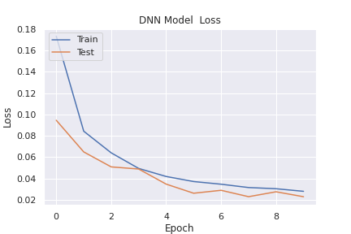
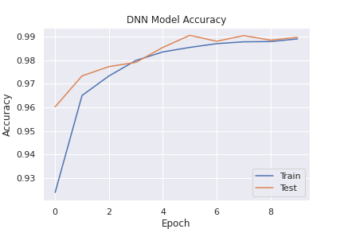
EXPERIMENTAL RESULTS of DNN

Slide 26
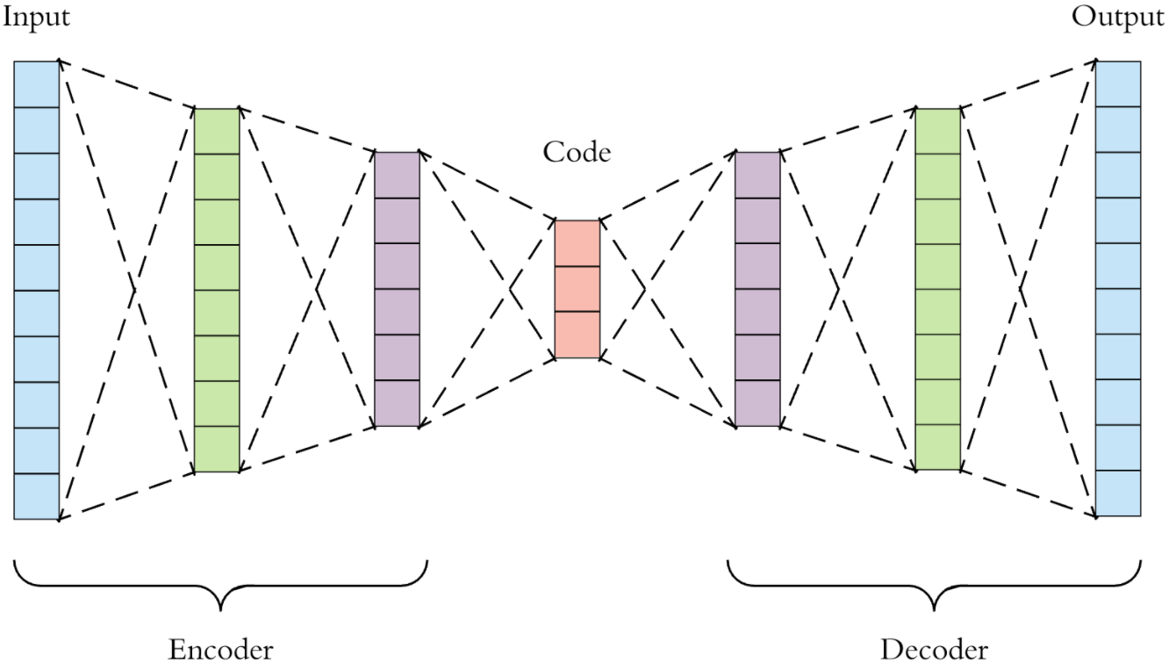
AUTO ENCODER & XGBOOST
Auto Encoder is a type of neural network that can be used to learn a compressed representation of raw data
The encoder compresses the input, and the decoder attempts to recreate the input from the compressed version provided by the encoder
After training, the encoder model is saved, and the decoder is discarded
The encoder can then be used as a data preparation technique to perform feature extraction on raw data that can be used to train the XGBOOST classifier
XGBoost, which stands for extreme Gradient Boosting, is a scalable, distributed gradient boosted decision tree
XGBoost is a decision-tree-based ensemble Machine Learning algorithm that uses a gradient boosting

Slide 27
EXPERIMENTAL RESULT OF AUTOENCODER& XGBOOST
Split the dataset in to train and test
Scale the dataset using Min Max scaler
Define the Auto Encoder model with encoder model, bottleneck, and decoder model
Fit the autoencoder model to reconstruct input
Define and save the encoder model without decoder
Compress the input data using encoder model
Import the XGBoost classifier
Encode the train data
Encode the test data
Fit the XGBoost classifier model on the training set
Make predictions on the test data
Evaluate the performance of the model
Evaluation Metric | Obtained Value
Accuracy | 97.58 %
Precision | 97.41 %
Recall | 96.25 %
F1 score | 97.43 %

Slide 28
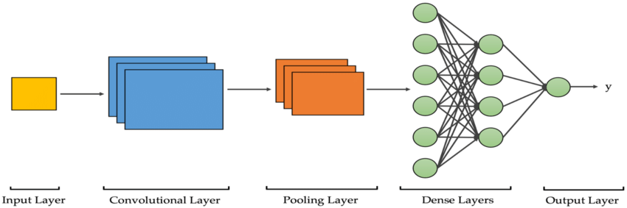
CONVOLUTIONAL NEURAL NETWORK
CNN has proven to be effective in many various studies and applications specifically in image classification field.
CNN consists of multiples layers: input layer, convolutional layers, pooling layers, fully connected layer and output layer
Deepness of the CNN dependence on the number of layers used
1D CNN is used for the DDoS detection in SDN environment

Slide 29
CONVOLUTIONAL NEURAL NETWORK (Contd…)
Load the dataset
Splitting the dataset into features and label
Splitting the dataset in to training and testing (20% for testing and 80% for training)
Feature Scaling or Standardization using Standard Scaler
Create CNN with sequential model having input layer, 2 convolution layer, batch normalization layer, max pooling layer, 2 dropout layer, flatten layer and 2 dense layer
The input layer consist of 22 neurons corresponds to 22 features selected and relu activation function used
The output layer consists of 2 neurons with softmax activation function because it is a binary classification problem
CNN model is compiled with Sparse categorical cross entropy and Adam optimizer
The model is fitted with 20 epochs and plot the training and validation loss and accuracy
The accuracy obtained is 99.50%

Slide 30
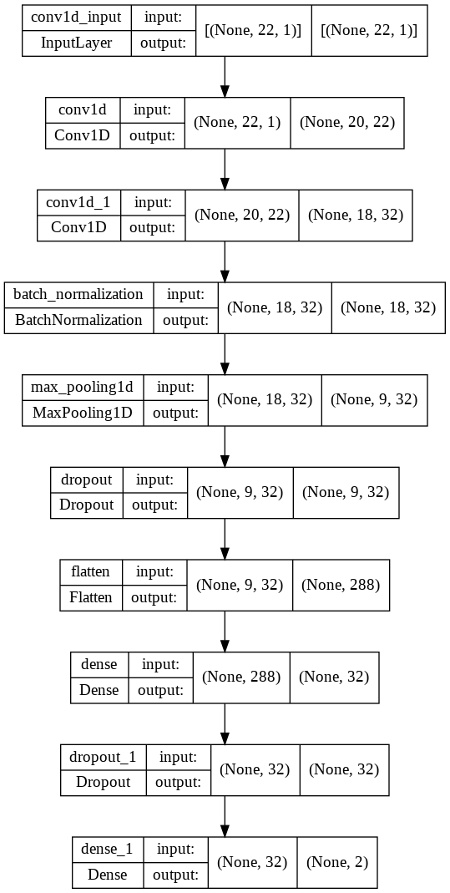
CONVOLUTIONAL NEURAL NETWORK (Contd…)

Slide 31
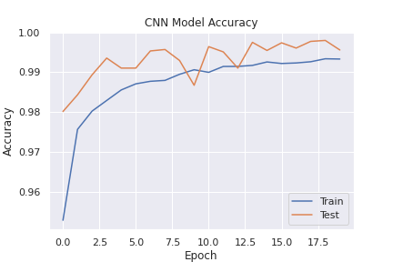
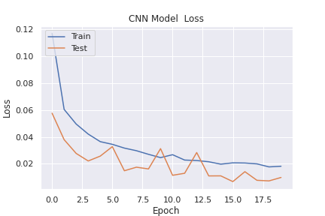
EXPERIMENTAL RESULTS of CNN

Slide 32
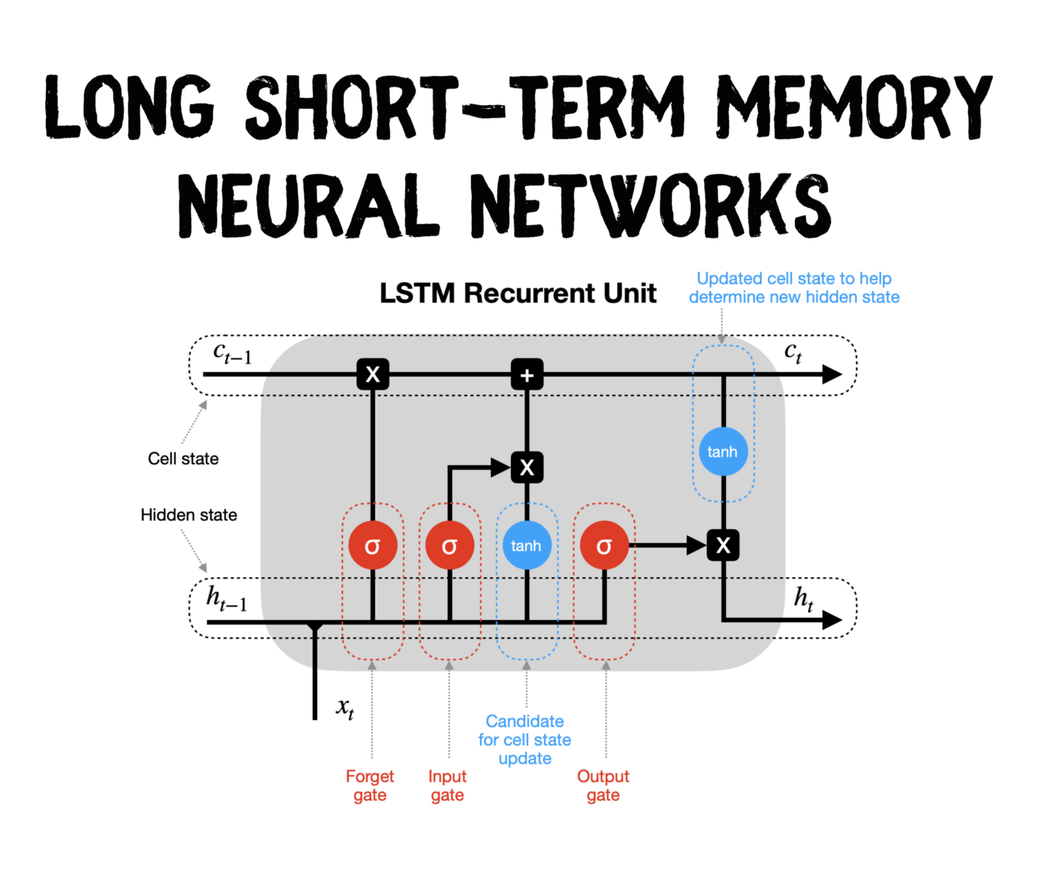
LONG SHORT TERM MEMORY
Long-term and short-term memory model
is a special RNN model, which is proposed to solve the problem of gradient dispersion of RNN model
Intention of LSTM design is to solve the problem of long-term dependence in RNN
LSTM model replaces RNN cells in the hidden layer with LSTM cells to make them have long-term memory ability

Slide 33
LONG SHORT TERM MEMORY (Contd…)
Load the dataset
Splitting the dataset into features and label
Splitting the dataset in to training and testing (20% for testing and 80% for training)
Feature Scaling or Standardization using Standard Scaler
Reshape the inputs for LSTM (samples, time steps, features)
Create the LSTM with sequential model
The LSTM architecture consist of one LSTM layer with 22 neurons and tanh activation function, the kernel regularizer is l2
The Dense layer having relu activation function and l2 regularizer
The output layer having softmax activation function
Compile the model with sparse categorical cross entropy loss function and Adam optimizer
The model is fitted with 10 epochs and plot the training and validation loss and accuracy
The accuracy obtained is 95.06%

Slide 34
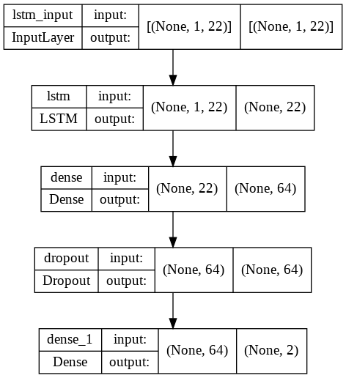
LONG SHORT TERM MEMORY (Contd…)

Slide 35
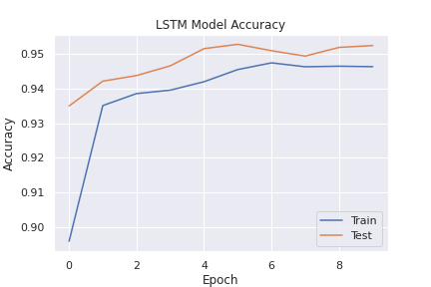
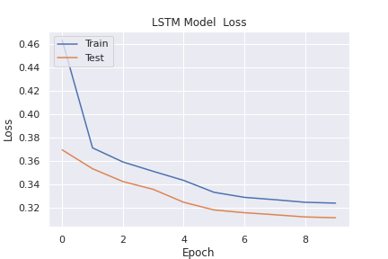
EXPERIMENTAL RESULTS of LONG SHORT TERM MEMORY

Slide 36
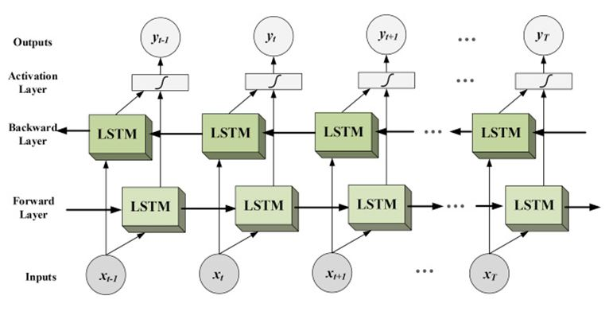
BIDIRECTIONAL LONG SHORT TERM MEMORY
Bidirectional LSTMs are an extension of traditional LSTMs that can improve model performance on sequence classification problems
In bi-directional, we can make the input flow in both directions to preserve the future and the past information
Bidirectional LSTMs train two instead of one LSTMs on the input sequence
The first on the input sequence as-is and the second on a reversed copy of the input sequence
This can provide additional context to the network and result in faster and even fuller learning on the problem

Slide 37
BIDIRECTIONAL LONG SHORT TERM MEMORY (Contd…)
Load the dataset
Splitting the dataset into features and label
Splitting the dataset in to training and testing (20% for testing and 80% for training)
Feature Scaling or Standardization using Standard Scaler
Reshape the inputs for BiLSTM (samples, time steps, features)
Create the BiLSTM with sequential model
The BiLSTM architecture consist of one BiLSTM layer with 22 neurons and tanh activation function, the kernel regularizer is l2
The Dense layer having relu activation function and l2 regularizer
The output layer having softmax activation function
Compile the model with sparse categorical cross entropy loss function and Adam optimizer
The model is fitted with 10 epochs and plot the training and validation loss and accuracy
The accuracy obtained is 95.09%

Slide 38
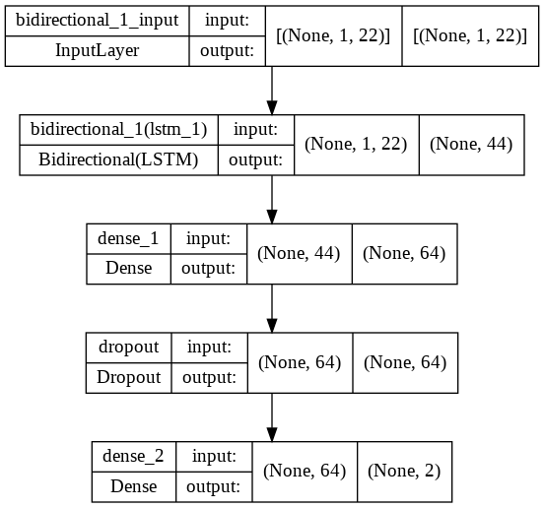
BIDIRECTIONAL LONG SHORT TERM MEMORY (Contd…)

Slide 39
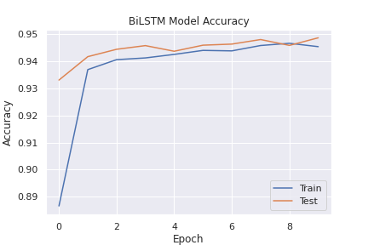
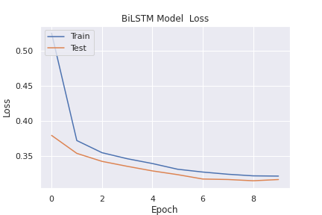
EXPERIMENTAL RESULTS of BIDIRECTIONAL LONG SHORT TERM MEMORY

Slide 40
TABNET
TabNet is a deep neural network specifically designed to learn from tabular data, developed by the research team at Google Cloud AI
TabNet inputs raw tabular data and is trained using gradient descent-based optimization, enabling flexible integration into end-to-end learning
Use sequential attention to choose which features to reason from at each decision step, enabling interpretability and better learning as the learning capacity is used for the most salient features.
TabNet employs a single deep learning architecture for feature selection and reasoning
TabNet enables two kinds of interpretability: local interpretability that visualizes the importance of features and how they are combined, and global interpretability which quantifies the contribution of each feature to the trained model

Slide 41
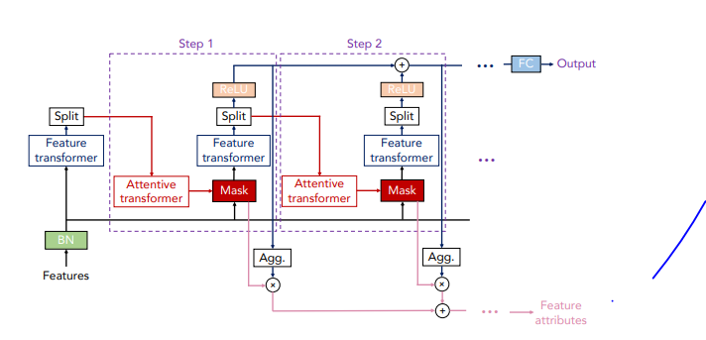
TABNET ENCODER
TabNet encoder, consists of sequential decision steps which encodes and selects features via a learnable mask.
TabNet trains on each row from a table, selects the relevant features in each step using a sparse learnable mask, and aggregates the predictions from each step to emulate an ensemble-like effect when making predictions
More steps in the encoder means that more ensembles are constructed

Slide 42
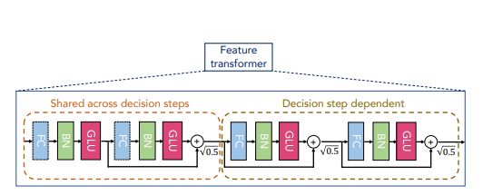
TABNET ENCODER (Contd…)
The two main components of the encoder :
Feature transformer: where the feature processing and engineering happens
There are two shared feature blocks to allow processed features to be shared between decision steps, and two decision step-dependent feature processors

Slide 43
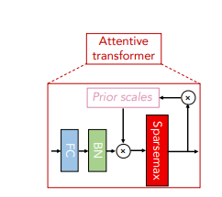
TABNET ENCODER (Contd…)
Attentive transformer: where the learning of the sparse mask takes place.
A sparsemax layer is used to promote sparsity in the learnable mask while it learns to attend to certain features
Feeding back information of prior scales allows TabNet to learn and control how much a feature has been used before in prior decision step
A hyper parameter can be specified to control the amount of feature reuse between decision steps

Slide 44
TABNET (Contd…)
Load the dataset
Splitting the dataset into features and label
Splitting the dataset in to training and testing (20% for testing and 80% for training)
Feature Scaling or Standardization using Standard Scaler
Import the TabNet classifier from pytorch.tabnet
Define the TabNet classifier model
Fit the model with 20 epochs
Visualize the feature importance of each decision step and plot the masks for the aggregated masks and mask for decision steps 1, 2 & 3
Make predictions on the test set
The accuracy Obtained is:98.95%

Slide 45
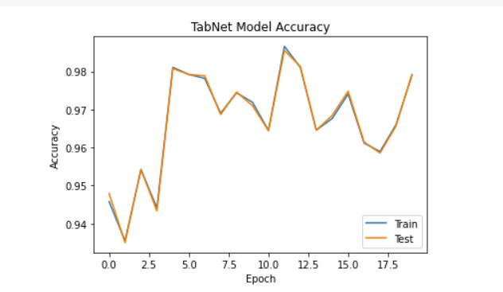
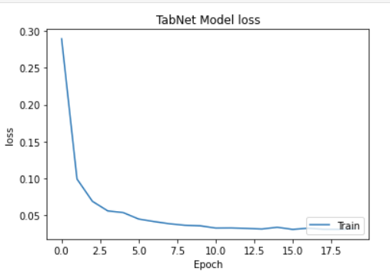
EXPERIMENTAL RESULTS of TABNET

Slide 46
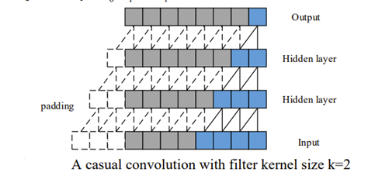
TEMPORAL CONVOLUTIONAL NETWORK (TCN)
TCN is a variation of Convolutional Neural Networks for sequence modelling tasks, by combining aspects of RNN and CNN architectures
TCN employs technique like multiple layers of dilated convolutions and padding of input sequences to handle different sequence lengths and detect dependencies between items that are not next to each other
The causal convolutions are used, where output at time t is convolved only with elements from time t and earlier in the previous layer,that is no information leakage from future to past
The TCN has two main constraints:
The output of the network should have the same length as its input
Network can only use the information from past time steps

Slide 47
TEMPORAL CONVOLUTIONAL NETWORK (TCN) (Contd…)
TCN uses a 1D fully-convolutional network (FCN) architecture, each hidden layer is the same length as the input layer, and zero padding of length (kernel size − 1) is added to keep subsequent layers the same length as previous ones
In causal convolution the receptive field sizes are limited unless stacking lots of layers, This makes problems when applying the casual convolution on sequence task for its heavy calculating cost
To overcome the problems, dilated convolutions are employed to enable an exponentially large receptive field with limit layers
TCNs possess very long effective history sizes using a combination of very deep networks and dilated convolutions
Dilation of a convolutional layer refers to the distance between the elements of the input sequence that are used to compute one entry of the output sequence

Slide 48
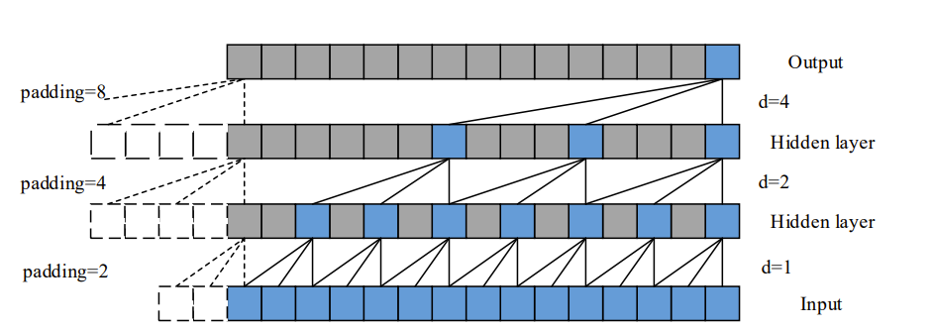
TEMPORAL CONVOLUTIONAL NETWORK (TCN) (Contd…)
A dilated convolution is a convolution where filter is applied over a region larger than its size by skipping input values with a given step.
When using dilated convolutions, it is common to increase the dilated factor d exponentially with the depth of the network.
This ensures the receptive field covering each input in the history, and enabled to get an extremely large receptive field as effective history by using deep networks.

Slide 49
TEMPORAL CONVOLUTIONAL NETWORK(TCN) (Contd…)
For the receptive field size of the TCN depends on the network depth n as well as filter size k and dilation factor d, making the TCN deeper and larger is important to obtain large enough receptive field
Making network deep and narrow, which means stacking a large amount layers and choosing a thin filter size, is an effective architecture
Residual connections have proven to be very effective in training deep networks
In a residual network, skip connections are used throughout the network, to speed up training process and avoid vanishing gradient problem in deep models

Slide 50
TEMPORAL CONVOLUTIONAL NETWORK (Contd…)
Load the dataset
Splitting the dataset into features and label
Splitting the dataset in to training and testing (20% for testing and 80% for training)
Feature Scaling or Standardization using Standard Scaler
Load the Keras TCN, import compiled TCN from keras TCN
Define the TCN model using compiled TCN
The model is fitted with 20 epochs and plot the training and validation loss and accuracy
The accuracy obtained is 99.67%

Slide 51
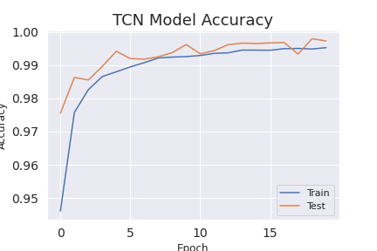
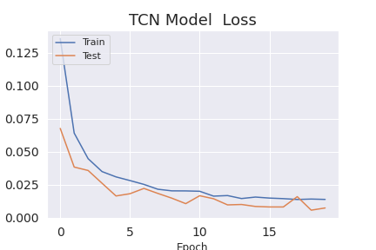
EXPERIMENTAL RESULTS of TCN

Slide 52
RESULTS AND DISCUSSION
Experimental Results of Supervised ML Algorithms
Evaluation Metrics | LR | GNB | SVM | DT | RF | GB
Accuracy (%) | 77.11 | 67.35 | 78.44 | 99.95 | 100 | 98.52
Precision (%) | 72.68 | 57.54 | 76.16 | 99.93 | 100 | 97.97
Recall (%) | 66.29 | 62.41 | 65.17 | 99.95 | 100 | 99.04
F1 score (%) | 75.54 | 66.17 | 76.67 | 99.95 | 99.95 | 98.46
Experimental Results of Unsupervised ML Techniques
Techniques | Sillhoutte Score
Kmeans on original dataset | 0.1961007339513506
Kmeans on PCA | 0.4613677492070967
Kmeans on TSNE | 0.34130406379699707

Slide 53
RESULTS AND DISCUSSION (Contd…)
Expeimental Results of DL Techniques
Techniques | Accuracy (%)
DNN | 98.39
Auto Encoder and XGBOOST | 97.66
CNN | 99.50
LSTM | 95.06
BiLSTM | 95.09
TabNet | 99.00
TCN | 99.67

Slide 54
VALIDATION IN INSDN DATASET
Expeimental Results of DL Techniques
Techniques | Accuracy (%)
DNN | 99.95
Auto Encoder and XGBOOST | 99.93
CNN | 99.96
LSTM | 99.61
BiLSTM | 99.62
TabNet | 99.98
TCN | 99.96

Slide 55
CONCLUSION

Slide 56
REFERENCES
[1] Tonkal, Ö., Polat, H., Başaran, E., Cömert, Z. and Kocaoğlu, R., 2021. Machine Learning Approach Equipped with Neighbourhood Component Analysis for DDoS Attack Detection in Software-Defined Networking. Electronics, 10(11), p.1227.
[2] Aamir, M. and Zaidi, S.M.A., 2021. Clustering based semi-supervised machine learning for DDoS attack classification. Journal of King Saud University-Computer and Information Sciences, 33(4), pp.436-446.
[3] Cil, A.E., Yildiz, K. and Buldu, A., 2021. Detection of DDoS attacks with feed forward based deep neural network model. Expert Systems with Applications, 169, p.114520.
[4] Haider, S., Akhunzada, A., Mustafa, I., Patel, T.B., Fernandez, A., Choo, K.K.R. and Iqbal, J., 2020. A deep CNN ensemble framework for efficient DDoS attack detection in software defined networks. Ieee Access, 8, pp.53972-53983.
[5] Novaes, M.P., Carvalho, L.F., Lloret, J. and Proença Jr, M.L., 2021. Adversarial Deep Learning approach detection and defense against DDoS attacks in SDN environments. Future Generation Computer Systems, 125, pp.156-167.

Slide 57
REFERENCES (Contd…)
[5] Elsayed, M.S., Le-Khac, N.A., Dev, S. and Jurcut, A.D., 2020, August. Ddosnet: A deep-learning model for detecting network attacks. In 2020 IEEE 21st International Symposium on" A World of Wireless, Mobile and Multimedia Networks"(WoWMoM) (pp. 391-396). IEEE.
[6] Cui, Y., Qian, Q., Guo, C., Shen, G., Tian, Y., Xing, H. and Yan, L., 2021. Towards DDoS detection mechanisms in software-defined networking. Journal of Network and Computer Applications, 190, p.103156.
[7] Devarajan, D. and Arora, K., 2021. Multiclass DDoS Detection using Machine Learning Ensemble. Available at SSRN 3884632.
[8] Sahoo, K.S., Panda, S.K., Sahoo, S., Sahoo, B. and Dash, R., 2019. Toward secure software-defined networks against distributed denial of service attack. The Journal of Supercomputing, 75(8), pp.4829-4874.

Slide 58
THANK YOU

